Slide 1
The Chess Puzzle Lock Screen
By Ryan Hayes and Dr. Joe Meehean
1

Slide 2
The Ubiquity of Cell Phones and Lock Screens
Smartphones have quickly become universal
Unlock our phones many times each day
How can we take advantage of this process?
2

Slide 3
The Self-Help Lock Screen
Alternative method of unlocking phone
Present the user with a problem or question pertaining to a certain subject
The correct response unlocks their phone
Over time the user increases their understanding of this field
3

Slide 4
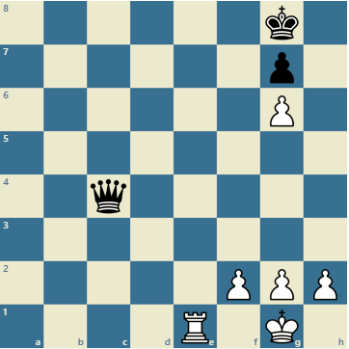
Chess Puzzles as a Lock Screen
Form of Self-Help Lock Screen
User is presented with a chess puzzle
The correct move unlocks their phone
User’s speed and board analysis skills will
increase in time
White to move
4

Slide 5
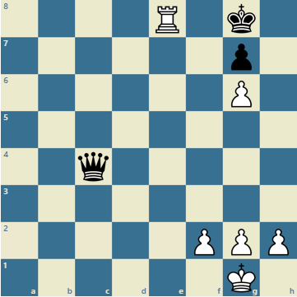
Chess Puzzles as a Lock Screen
Form of Self-Help Lock Screen
User is presented with a chess puzzle
The correct move unlocks their phone
User’s speed and board analysis skills will
increase in time
Unlocked!
4

Slide 6
Demo
5

Slide 7
Demo
6

Slide 8
Demo
7

Slide 9
Demo
8

Slide 10
Maintaining the Effectiveness of the Lock Screen
Self-Help Lock Screens require a replenishing supply of new problems/questions
In order to most effectively improve, the user consistently needs to be presented new puzzles
A larger variety of problems will prevent the lock screen from becoming stale
Updates through the Android Playstore or Apple iTunes are impractical
Too much overhead
9

Slide 11
RESTful Services
Send resources from server to client
Client = user’s Phone
Resource = chess puzzles
Uses same protocol that drives the World Wide Web
10

Slide 12
RESTful Services
Send resources from server to client
Client = user’s Phone
Resource = chess puzzles
Uses same protocol that drives the World Wide Web
10

Slide 13
RESTful Services
Send resources from server to client
Client = user’s Phone
Resource = chess puzzles
Uses same protocol that drives the World Wide Web
10

Slide 14
RESTful Services
Send resources from server to client
Client = user’s Phone
Resource = chess puzzles
Uses same protocol that drives the World Wide Web
10

Slide 15
RESTful Services
Send resources from server to client
Client = user’s Phone
Resource = chess puzzles
Uses same protocol that drives the World Wide Web
10

Slide 16
Benefits of RESTful Services
Compatible with many types of operating systems
Can be used on a variety of platforms besides phones
User can choose when to receive updates
Nightly basis
When they run out of problems
11

Slide 17
Current and Future State of The Chess Puzzle Lock Screen
Current
Lock screen reads problems from text file
Server which has RESTful service implemented
Future
Lock screen communicates with server to receive problems
Server posts a multitude of puzzles, rather than one at a time
Add policy where users choose when to receive updates
Add a feedback system
12

Slide 18
Questions?
13

