Slide 1

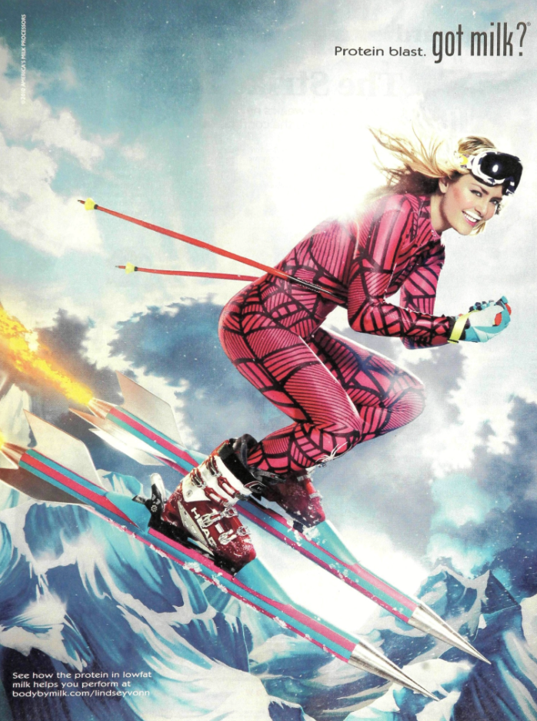
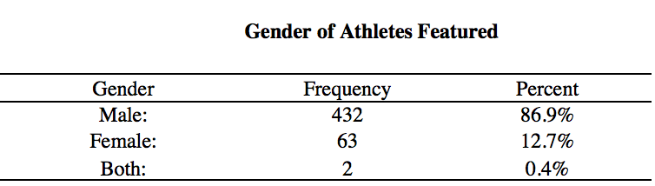
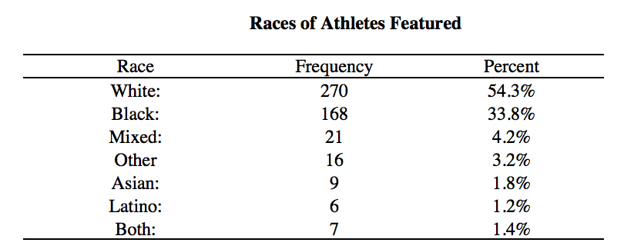
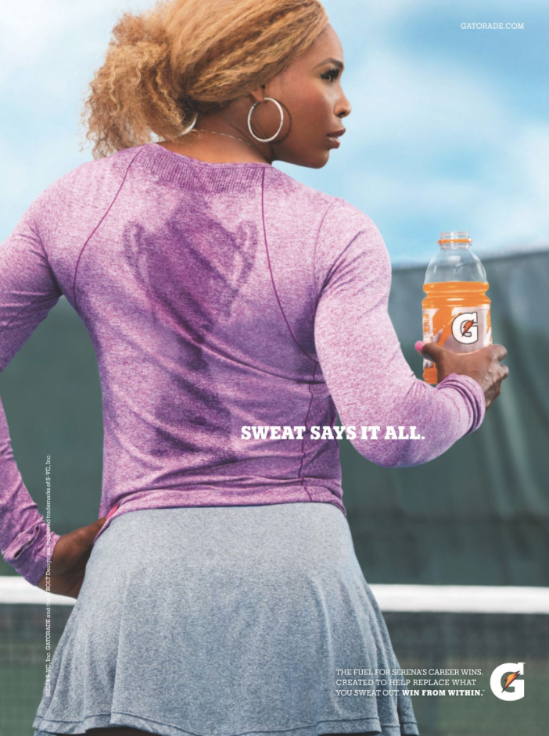

Gender Inequalities in Sports Illustrated
2010 - 2016
Elizabeth E. Kelly (kelly_e@lynchburg.edu)
Sport Management, Lynchburg College, Lynchburg, VA USA
Introduction
Results
This study analyzed 497 Sports Illustrated advertisements from 2010 – 2016.
Sports Illustrated was established in 1954
23 million people read the magazine each week
The inequality of both race and gender in the advertisements represents the Hegemonic Masculinity, and Hegemonic whiteness within sport.
Purpose:
To continue previous scholarly studies, and to determine the current gender divide in Sports Illustrated marketing advertisements using athletes.
The data shows the perceptible inequality with 432 (86.9%) of the advertisements representing male athletes, and 63 (12.7%) featuring female athletes.
Hegemonic Whiteness is also supported with 54.3% of the athletes featured being white. Specifically, 46.7% of the advertisements featured white males.
The positioning of athletes supports gender ideologies determined by the social world.
Females are often featured in sports that are “sex appropriate” such as tennis, surfing, golf, soccer etc.
The attire, accessories and positioning of female athletes are organized to show th athletes feminine qualities.
Advertisements using males often convey the masculinity within the positioning and the sport chosen.
Methods
497 advertisements analyzed from 2010 – 2016
Each advertisement was analyzed based on: name of the athlete, sport of the athlete, gender, race, and the company.
The advertisements were also coded under detailed analysis:
Setting of the Advertisement: Was the setting of the advertisement related or non-related to sport?
Apparel: Was the athlete dressed in athletic, or non-athletic apparel? If the athlete was female was she wearing jewelry?
Hair: (female athletes only) Describe the hairstyle in the advertisement. Was the style reflective of an athletic style or non-athletic style?
Positioning of Athlete: Was the positioning of the athlete in an actively engaging stance, or a posed stance.
Facial Expression: Did the athlete’s facial expression reflect one in action, or were they smiling?
Conclusions
Thesis:
. Regardless of the improvement to market female athletes, the inequality continues to create a social ideological gap within viewers, and supports the hegemonic masculinity within sport. The Sports Illustrated advertisements statistically reflect the gender roles made by society.
Important to note that sports Illustrated is a business with 23 million viewers, 78% being male.
Although the inequality of representation is drastically unequal, there is improvement from previous years and studies.

