Slide 1
Meta-analysis to assess the severity of off-label Botox usage in children
Erica Morris| Health Promotion | Lynchburg College

Slide 2
Botox Onabotulinumtoxin A
Clostridium Botulinum
Therapeutic Botulinum Toxin
Prescribing information
At Risk Populations
Is Botox a safe treatment to ease the symptoms of Cerebral Palsy in children?
Notes:
This is the question that your experiment answers

Slide 3
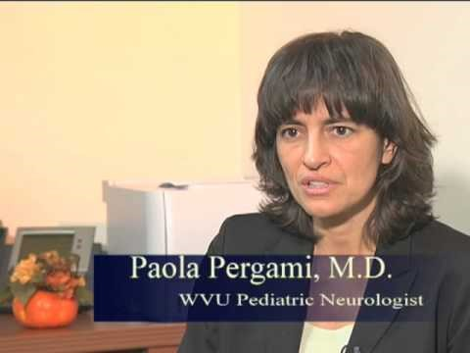
Botox for Pediatrics

Slide 4
Meta-Analysis of Off-Label Botox use in children
Methods:
    A PubMed, Google Scholar, and Cochrane Library search
Statistical Analysis:
    Sample population of 424 patients.
    Total adverse events was primary parameter for severity.
    Pearson’s correlations test in SPSS.
Results:
    75 percent of patients experienced an adverse event.
    No correlation between treatment time and adverse event.
Notes:
Summarize your research in three to five points.

Slide 5
Patient Demographics
Table 1. Patient Demographics, 2011-2016
Source: PubMed Medline, Google Scholar, Cochrane Library
Study | No. of Patients | Treated w. Botox | Average Age | Male : Female
Edwards et al.,2015 | 41 | 23 | 7 | 16:7
Fattal-Valevski, Sagi, Domenievitz,2011 | 30 | 30 | 9.9 | 16:14
Koman et al., 2013 | 71 | 28 | 9 | 24:63
Lin, Huang,Lin,Shieh,Chung,Chen,2015 | 12 | 12 | 7.6 | 4:8
Montgomery et al.,2016 | 274 | 76 | 7.3 | 176:98
Total | 424 | 165 | 8.16 yrs. | 47: 50

Slide 6
Study | Weight | Mean Injection | Mean Unit Dose
Edwards et al.,2015 | 51.5 | 10.5 | 400
Fattal-Valevski, Sagi, Domenievitz,2011 |  | 50 | 127
Koman et al., 2013 | 75 | 13.1 | 366
Lin, Huang,Lin,Shieh,Chung,Chen,2015 | 45.75 | 10 | 218
Montgomery et al.,2016
Total | 57.41 lbs.* | 20.9 units* | 277.75*
Source: PubMed Medline, Google Scholar, Cochrane Library *Averages influenced by unrepresented data.
Notes:
Establish hypothesis before you begin the experiment. This should be your best educated guess based on your research.

Slide 7
Severity Parameters
Study | Patient Retention | Treatment Duration | Adverse Event
Edwards et al.,2015 | 37 | 4 mons | 78
Fattal-Valevski, Sagi, Domenievitz,2011 | 26 | 3-4 mons
Koman et al., 2013 | 36 | 6.5 mons | 69
Lin, Huang,Lin,Shieh,Chung,Chen,2015 | 12 | 9 mons | 0
Montgomery et al.,2016 | 208 | 4 mons | 17
Total | 319 |  | 124
Notes:
List all of the steps used in completing your experiment.
Remember to number your steps.

Slide 8
Conclusion
None of the articles reported life-threatening complications.
Contractures can lead to bone deformation.
Botox can reduce or reverse the formation of contractures.
More research is needed.

Slide 9
References
W. (2010, July 26). Retrieved April 03, 2017, from https://www.youtube.com/watch?v=hS9zq7V9O4I
Edwards, P., Sakzewski, L., Copeland, L., Gascoigne-Pees, L., McLennan, K., Thorley, M., Boyd, R. N. (2015). Safety of Botulinum Toxin Type A for Children With Nonambulatory Cerebral Palsy. Retrieved April 02, 2017, from http://pediatrics.aappublications.org/content/early/2015/10/13/peds.2015-0749
Fattal-Valevski, A., Sagi, L., & Domenievitz, D. (2011). Botulinum toxin a injections to the upper limbs in children with cerebral palsy: duration of effect. Retrieved April 02, 2017, from https://www.ncbi.nlm.nih.gov/pubmed/20929909
Koman, L. A., Smith, B. P., Williams, R., Richardson, R., Naughton, M., Griffin, L., & Evans, P. (2013). Upper extremity spasticity in children with cerebral palsy: a randomized, double-blind, placebo-controlled study of the short-term outcomes of treatment with botulinum A toxin. Retrieved April 02, 2017, from https://www.ncbi.nlm.nih.gov/pubmed/23428186
Lin, Y. C., Huang, C. Y., Lin, I. L., Shieh, J. Y., Chung, Y. T., & Chen, K. L. (2015). Evaluating Functional Outcomes of Botulinum Toxin Type A Injection Combined with Occupational Therapy in the Upper Limbs of Children with Cerebral Palsy: A 9-Month Follow-Up from the Perspectives of Both Child and Caregiver. Retrieved April 02, 2017, from https://www.ncbi.nlm.nih.gov/pubmed/26599003
Montgomery, J., McCusker, S., Lang, K., Grosse, S., Mace, A., Lumley, R., & Kubba, H. (2016). Managing children with sialorrhoea (drooling): Experience from the first 301 children in our saliva control clinic. Retrieved April 02, 2017, from https://www.ncbi.nlm.nih.gov/pubmed/27240493

