Slide 1
Lynchburg College Mathematics 451
Project Presentation
Hunter Reynolds

Slide 2
Presentation of Problem
Game begins on a 20x20 checkerboard
100 pennies, 100 nickels, 100 dimes, and 100 quarters fill the board
59 random coins are removed
Coins can only be removed as follows:

Slide 3
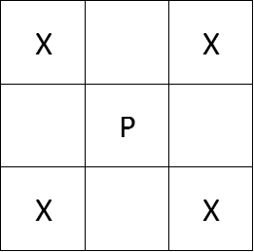
Penny
May be removed if all 4 adjacent squares are empty

Slide 4
Nickel
May be removed if at least three adjacent squares are empty

Slide 5
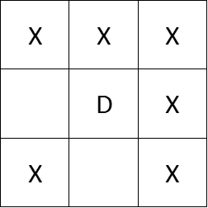
Dime
May be removed if at least 2 adjacent squares are empty

Slide 6
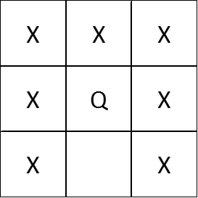
Quarter
May be removed if there is at least one adjacent square

Slide 7
Statement of the Problem
Show the game cannot be won
  I.E. all coins are removed

Slide 8
Analyzing problem
Trial and Error
  2.241854791x10⁹⁶ ways to distribute the pennies alone
Analyze the dimensions of the open squares

Slide 9
Defining the Dimensions of the Board
Each square has a side length of 1
Only counted in dimensions if vacant
Open edge is counted in perimeter if
  Bordering the edge of board
  Bordering an occupied square
  Perimeter of a square is at most 4

Slide 10
Analyzing Perimeter
Final perimeter is 80
Change is not constant for each coin

Slide 11
Definitions
Monovariant
  A value that changes in one direction (either increases or decreases)
  Important as perimeter changes in one direction for Penny, Nickel and Dime
Invariant
  A value that no longer changes
  Perimeter will become invariant when no coins can be removed

Slide 12
Proof:
Contradiction
Show that the perimeter cannot, with given rules, equal 80
  Analyze how the perimeter changes when coins are removed

Slide 13
Defining P₀
Initial Perimeter is highest when no empty spaces touch
Initial Perimeter is at most 4*59= 236

Slide 14
Defining K
K=initial coins removed= p+n+d+q
p,n,d,q are the pennies, nickels, dimes and quarters initially removed

Slide 15
How does the perimeter change when each coin is removed?

Slide 16
Penny
Perimeter decreases by 4
Perimeter goes from 16 to 12

Slide 17
Nickel
Perimeter decreases by at least 2
Can decrease by 4 if all squares adjacent are empty
Perimeter goes from 12 to 10

Slide 18
Dime
Decreases by at least 0
Can also decrease by 2 or 4
Perimeter remains 8

Slide 19
Quarter
Perimeter increases by at most 2
May decrease by 4, 2 or 0
Perimeter increases from 4 to 6

Slide 20
Inequality for the Perimeter
P₀≤4k
Recall p,n,d,q are initial pennies, nickels, dimes, quarters removed
P_{f}≤ 4k -4(100 -p) -2(100 -n) -0(100 -d) +2(100 -q)
= 4k -4(100 -p) -2(100 -n) +2(100 -q)
P_{f}≤ 4k -400 +4p +2n -2q

Slide 21
Assume the Game can be won
P_{f}=80
80≤ 4k -400 +4p +2n -2q
Recall k= p+n+d+q
4k= 4p+4n+4d+4q ≥4p +2n -2q

Slide 22
Continued
80≤ 4k -400 +4p +2n -2q≤ 4k -400 +4k
80≤ 8k -400
k=59
80≤ 8(59) -400=72, thus we have a contradiction.

Slide 23
Questions

