Slide 1
Crime, Attractiveness, and Race: A Dangerous Combination? By: Abby Bunting

Slide 2
Outline
Background Research
Present Research
Results/Discussion
Future Implications

Slide 3
Race and Attractiveness
African Americans are five times more likely to be incarcerated than Caucasians and Hispanics (Sakala, 2014).
Formation of a racial bias (Stewart, 1980).
Effects of attractiveness on punishment levels (DeSantts & Kayson, 1997).
Notes:
Of the two million adult citizens who are incarcerated across the country, African Americans are five times more likely to be incarcerated than Caucasians and Hispanics (Sakala, 2014).
Possessing previous knowledge of demographical statistics on prevalence rates of incarcerated citizens across races can potentially result in the formation of a racial bias, and can have an influence on future sentencing of similar individuals (Stewart, 1980). Another factor that can influence a person’s punishment level, other than race, is attractiveness (DeSantts & Kayson, 1997).

Slide 4
First Impressions
First impressions→ Crucial for success
Powerful influence over potential outcomes
Social evaluations used within the judicial system (Wilson & Rule, 2016; Abel & Watters, 2005)
Notes:
First impressions can exert a powerful influence in potential outcomes, such as job interviews, first dates and special occasions, in which social evaluations of a person’s character are determined strictly on external factors. What happens, however, when this method of social evaluation is generalized to the judicial system, and becomes a factor in determining the severity of sentencing and punishment that a guilty defendant receives? The judicial system then becomes an unreliable source in making just decisions, and can potentially result in inconsistent sentences given to individuals who are guilty of the same crime

Slide 5
Background Research
DeSantis and Kayson (1997)
Hypothesized: Significant main effect
Fictitious burglary case
-Racial disparities in sentencing
Harsher punishment, same crime
Findings—significant main effect
Notes:
Hypothesized that race would have a significant main effect on sentencing when the defendant is an African-American, and therefore it was predicted that these individuals would receive harsher sentencing than Euro-American defendants for the same crime.
The study found a significant main effect for attractiveness, race, and sex of the defendant in relation to the leniency of the sentence given to the defendant

Slide 6
Background Research
Dion (1972)
Found research on differential treatment of unattractive and attractive children
Attractive child vs. Unattractive child
Teacher’s Daily Journal Reports
Findings?
Notes:
The main components of this bias, involving reduced punishments and inconsistent treatment, have been studied and generalized to a younger population consisting of children. Dion (1972) study explored the relationship between the physical attractiveness stereotype and how it may be present at an early childhood developmental level
(1) An attractive child who has committed a harmful act will be considered less likely to possess chronic antisocial behavior than an unattractive child, especially in cases where the offense is severe. Adults will evaluate attractive children as less likely to have previously committed a similar, harmful transgression, and will be considered as less likely to commit a similar offense in the future than an unattractive child. (2) A transgression committed by an attractive child will be evaluated as less socially undesirable than an identical transgression/act committed by an unattractive child, particularly for mild offenses (Dion, 1972).

Slide 7
Leniency Bias
Attractiveness as an indication of socially desirable traits
Believed that attractive people display socially desirable traits which may lead others to certain expectations about the defendants’ habits, values, and their reaction to committing crime.
Notes:
Believed that attractive people display socially desirable traits which may lead others to certain expectations about the defendants’ habits, values, and their reaction to committing crime.

Slide 8
Present Research
My Study
Vignettes
Why?
Hopes to increase support for previous findings
Notes:
Previous findings: leniency bias afforded to children who are more attractive/unequal treatment

Slide 9
Variables
IV: Attractiveness, Race, and Severity of Crime
DV: Punishment Ratings

Slide 10
Hypotheses/Predictions
Strongest (greater punishment) = Unattractive + African American+ Severe Crime
Weakest (lesser punishment) = Attractive + Caucasian + Non-Severe Crime
Interaction Effect
Notes:
Attractive, Causation children would be judged less harshly and receive a lesser punishment outcome than their unattractive counterpart, regardless of severity of crime committed.
Interaction effect between race and level of attractiveness on punishment outcome in both severe and petty crimes.

Slide 11
Method/Procedure (cont’d)
Materials
Facial Stimuli: The Child Affective Facial Expression (CAFE)—cited from LoBue and Thrasher (2015)
Vignette manipulation
Survey Monkey

Slide 12
Method/Procedure
To manipulate:
Attractiveness (attractive v. unattractive)—16 facial stimuli rated on 5-point Likert scale
Race (African American vs. Caucasian)—facial stimuli presented of 8-year-old children
Severity of Crime (severe v. non-severe)—vignettes

Slide 13
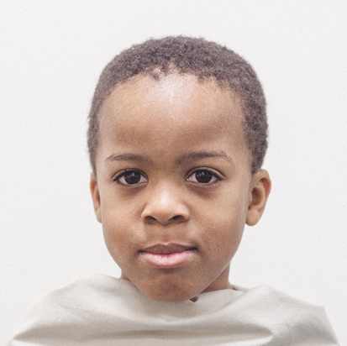
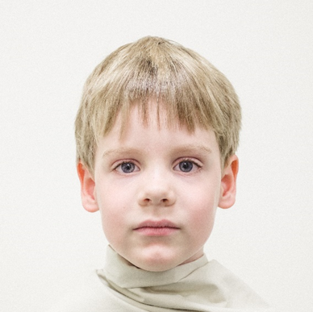
The Child Affective Facial Expression (CAFE)
Sample
African American Male Child
Caucasian Male Child

Slide 14
Vignettes
Sample:
Non-Severe Crime (Caucasian Male)
Matthew is an 8-year-old, Caucasian male who was arrested for shoplifting at a local mall in his community. Matthew was found to have taken $100 worth of merchandise from the store and seen running out of the mall carrying these items in a book bag when he was chased down by security and turned over to the police. He was immediately taken to the police station.

Slide 15
Vignettes
Sample:
Non-Severe Crime (African American Male)
Andre is an 8-year-old, African American male who was caught on camera trying to sneak items out of a local electronics store by stuffing them into a book bag. Andre hadn’t gotten very far before local police caught him running on foot and identified 100 dollars-worth of missing items that had been taken from the store. Andre was immediately taken to the police station.

Slide 16
Vignettes
Sample:
Severe Crime (Caucasian)
Max is an 8-year-old, Caucasian male who was arrested for suffocating his baby brother when he wouldn’t stop crying in his crib. Max’s parents found their baby lying motionless in the crib, and Max sitting on the ground holding a pillow. Max’s parents immediately called the police and indicated what had happened. Max was arrested for murder and taken to the police station.

Slide 17
Vignettes
Sample:
Severe Crime (African American)
Tyrone is an 8-year-old, African American male who was arrested for pinning down his younger sister and holding his hands to her throat until she turned blue. He did this because she would not stop repeating everything Tyrone said to her. Tyrone’s father found his daughter lying in the grass motionless, when he realized what had happened. His father immediately called the police and Tyrone was arrested for murder and taken to the police station.

Slide 18
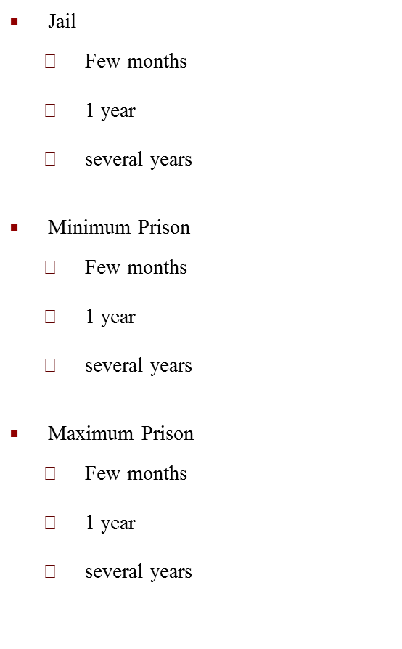
Punishment Outcomes
Community Service
Few weeks
Few months
1 year
Rehabilitation
Few months
1 year
a few years
Juvenile Detention
Few months
1 year
a few years

Slide 19
Sample Demographics
52 Participants
78% Female (39)
20% Male (10)
2% Other (1)
Undisclosed (2)
Ethnicity
84% Caucasian
16% Non-Caucasian
Class Standing
52% First Years
24% Second Years
16%Third Years
8% Fourth Years
Age
Mean age: 19.37 (SD= 1.30)

Slide 20
Results
The main hypotheses of the study were not supported.
Exploratory analysis
Significant main effect for participant’s race
Non-Caucasian participant
WNS: F (3, 44) = 2.920, p = 0.044
Notes:
Sig. difference between non-Caucasian participants and Caucasian participants on their punishment ratings of white child offenders in the non-severe crime category

Slide 21
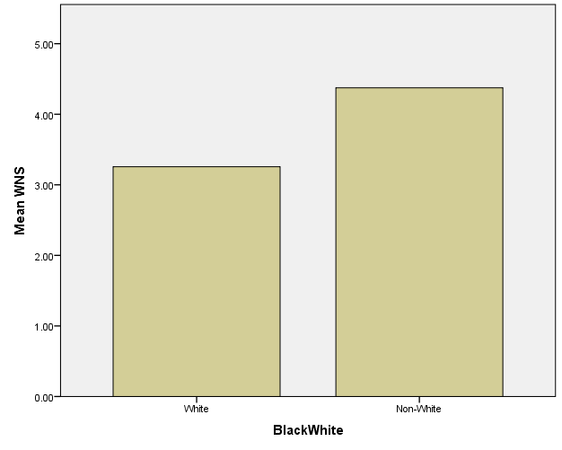
Non-Severe Crime and Race
Participant’s Race
Figure 1. Punishment ratings of Non-Severe Crime White offenders by participants’ race.

Slide 22
Discussion
Leniency Bias
Adults hold a physical attractiveness stereotype of children similar to that held for other adults (Dion, 1972).
Results: Hypotheses unsupported
Sentencing Children vs. Adults
Race component

Slide 23
Limitations
Sample diversity
Attractiveness manipulation of facial stimuli
Notes:
May not have been enough variability in attractiveness levels

Slide 24
Further Implications
Further research: inconsistent treatment of children based on external factors
School setting
Research should include measures with higher validity

Slide 25
References
Leventhal, G., & Krate, R. (1977). Physical Attractiveness and Severity Of Sentencing. Psychological Reports, 40(1), 315-318. doi:10.2466/pr0.1977.40.1.315
DeSantts, A., & Kayson, W. A. (1997). Defendants' Characteristics of Attractiveness, Race, And Sex And Sentencing Decisions. Psychological Reports, 81(2), 679-683. doi:10.2466/pr0.1997.81.2.679

Slide 26
Questions???

Slide 27
Crime, Attractiveness, and Race: A Dangerous Combination? By: Abby Bunting

