Slide 1
Evaluating the Effects of
Gene Mutation on
Arabidopsis thaliana
CarolAnne Bekus, Dr. Erin Friedman

Slide 2
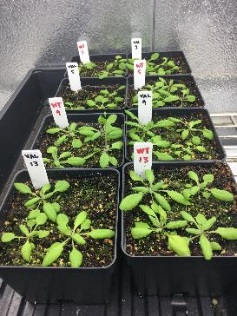
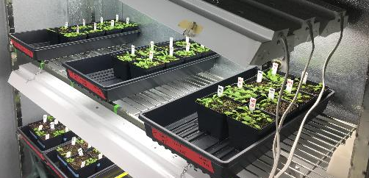
Arabidopsis thaliana: Model Organism
Simple genome
Easy maintenance and space-efficient
Short life-cycle (~6 weeks)
Applicable similarities with other plants
Notes:
Any Questions?

Slide 3
Importance of Seed Oil Production
Oil seed crops for biodiesel production
Soy beans
Rapeseed and Canola
Biodiesel over Petroleum
Increase fuel efficiency
Environmental factors
Easier production/renewable energy
Notes:
http://articles.extension.org/pages/28006/oilseed-crops-for-biodiesel-production#Oilseed%20Crops%20for%20Biodiesel%20Production

Slide 4
val1 and bZIP Gene
Both genes:
Transcription regulators
bZIP67 and VPI/AB13-like 1
Similar in main food source plants
Soybean, Rapeseed, Sunflower, Maize, etc.
Mutant:
Increased seed storage proteins
Reduced oil production in seeds
Notes:
Function: increase seed oil production but what other does it do to harm the development
Mutation:
Two different genes, two different pathways
Study in parallel to see other developmental processes they control
Don’t want to alter one outcome to then get other negative outcomes with it
Transcriptional regulators:
Alter the amount of proportions of seed storage proteins or oils when developing seeds
When mutate one or the other you get excess
Even though it makes more

Slide 5
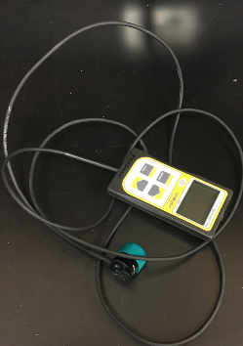
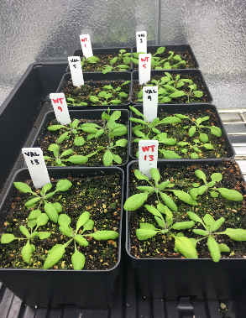
Growth Conditions
Light intensity measured in PPF = $\left[\frac{µmol}{m^{2}s}\right]$
Growth Chamber
23°C temp
16 hours light; 8 hours dark
Bottom-watered
Notes:
Any Questions?

Slide 6
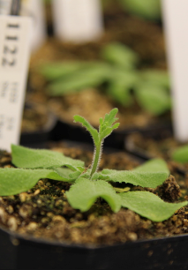
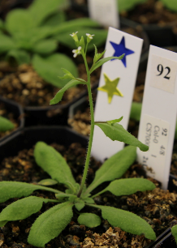
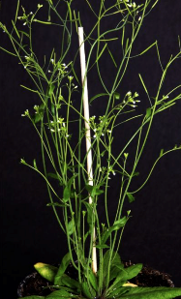
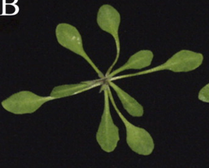
Stages of the Life Cycle: Bolting
Why look at the time the plants bolt?
Stage 1.08
Bolt
Stage 6.0
Stage 8.0
Notes:
1.08→ 8 leaf-rosettes
Bolt
6.0 → flower emergence
8.0 → silique ripening
Eve

Slide 7
val1
Figure 1: Stages of growth between mutant and wild type. This graph looks at stages when there are 8-leaf rosettes (1.08), emergence of bolt, flower emergence (6.0), and silique ripening.
Notes:
Change origin to day 15

Slide 8
val1
Figure 2: Comparison of the average number of days to bolt for both WT and val1. Data was taken from 72 samples per genotype over 2 trials of the same experiment.
Notes:
Any Questions?

Slide 9
Week 5
Week 6
val1
val1
Figure 3a. The average number of reproductive parts (flowers and siliques) under light of 73 PPF after 5 weeks for 20 specimens of val1 and WT. Error bars represent standard error.
Figure 3b. The average number of reproductive parts (flowers and siliques) under light of 73 PPF after 6 weeks for 20 specimens of val1 and WT. Error bars represent standard error.
Notes:
Note 5 weeks and 6 weeks on the graph

Slide 10
bZIP
Figure 4: Stages of growth for mutant and wild type plants. This graph looks at stages when there are 8-leaf rosettes (1.08), emergence of bolt, anthesis (6.0), and silique ripening (8.0) for 20 specimen of each phenotype.
Notes:
Any Questions?

Slide 11
bZIP
Figure 5: Comparison of the average number of days to bolt for both WT and BZIP. Data was taken from 20 samples per treatment. Error bars signify standard error.
Notes:
Any Questions?

Slide 12
Week 5
Week 6
bZIP
bZIP
Figure 6a. The average number of reproductive parts (flowers and siliques) under light of 73 PPF after 5 weeks for 20 specimens of bZIP and WT. Error bars represent standard error.
Figure 6b. The average number of reproductive parts (flowers and siliques) under light of 73 PPF after 6 weeks for 20 specimens of bZIP and WT. Error bars represent standard error.
Notes:
Any Questions?

Slide 13
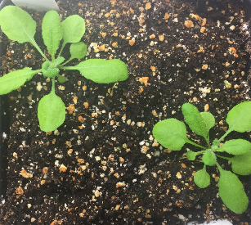
Results
Mutants longer to bolt and reach each developmental stage
Significantly lower reproductive parts at week 5
Gap closes at between WT and mutant at week 6
val1 and bZIP have similar phenotypes
Notes:
Any Questions?

Slide 14
Conclusion
Fewer number of structures that make the oil are emerging later.
Less reproductive parts ≠ necessarily mean less seeds
How do we optimize the plant?
Pathways may react differently to other stresses
Light intensities, drought conditions, etc
Notes:
Any Questions?

Slide 15
References
Boyes, D., Zayed, A., Ascenzi, R., McCaskill, A.J., Hoffman, N., Davis, K., and Gorlach, J. (2001). Growth stage-based phenotypic analysis of Arabidopsis: a model for high throughput functional genomics in plants. The Plant Cell. 13, 1499- 1500.
Jakoby, M., Weisshaar, B., Dröge-Laser, W., Vicente-Carbajosa, J., Tiedemann, J., Kroj, T., & Parcy, F. (2002). bZIP transcription factors in Arabidopsis. Trends in plant science. 7(3), 106-111.
Sharma, N., Bender, Y., Boyle, K., and Robert, P. R. (2013). High-level expression of sugar inducible gene2 (HSI2) is a negative regulator of drought stress tolerance in Arabidopsis. BMC plant biology. 13, 170.
Shewry, P.R., Napier, J.A., Tatham, A.S., (1995) Seed storage proteins: structures and biosynthesis. The Plant Cell. 7, 945-956
Suzuki, M., Wang, H.H., and McCarty, D.R. (2007) Repression of the LEAFY COTYLEDON 1/B3 regulatory network in plant embryo development by VP1/ABSCISIC ACID INTENSITIVE 3-LIKE B3 genes. Plant physiology. 143, 902-911.
The Arabidopsis Information Resource. 2016. About Arabidopsis. Phoenix Bioinformatics. Available from: https://www.arabidopsis.org/portals/education/aboutarabidopsis.jsp#sum
Collakova, E. High-level sugar inducible 2 (HSI2) or VPI/ABI3-like (VAL 1) (AT2G30470). n.d. VA: Virginia Tech.
Notes:
Any Questions?

Slide 16
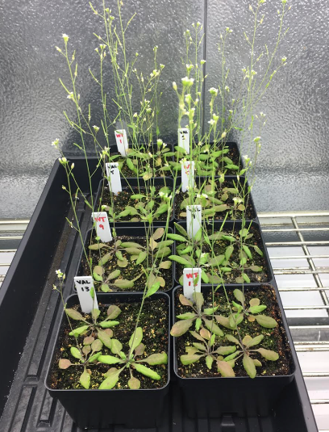
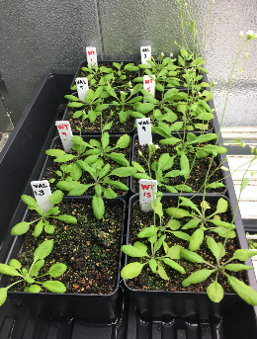
Questions?
Notes:
Any Questions?

