Slide 1
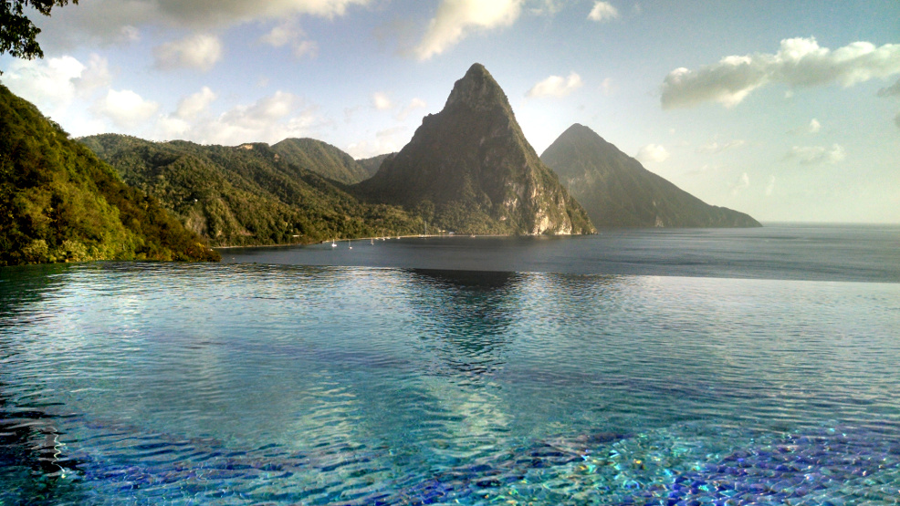
Lynchburg College Doctor of Physical Therapy Program
Service Trip to St. Lucia 2O18:
Following the progress of a 7 year old boy over 3 years from non-ambulatory to running with peers
Presented by: Ainsley Reed and Brooke Panfil
Notes:
Ainsley
Intro me and Brooke
We are physical therapy students and we had the opportunity to be apart of a service learning trip to St. Lucia this past January.
Brooke and I were partners for this trip, I am a second year student and Brooke is a first year student
On our very first day we met a little boy names mark and we wanted to share his story with you today

Slide 2
Abstract:
In January of 2016, the Lynchburg College Doctor of Physical Therapy program formed the first group of 10 students and 2 professors that traveled to the island of St. Lucia to provide much needed physical therapy services to the children in special education schools. During the initial visit, several students had the opportunity to work with a 5 year old boy named Mark who had just learned to stand and presented with behavioral issues and lacked fine-motor skills.
After spending only a couple hours with Mark, the students came up with a plan and some recommendations for Mark’s teachers with hopes to improve Mark’s overall function. Since then, Mark has been visited twice more and the improvements Mark has made physically and behaviorally have been remarkable. Mark’s incredible story displays the impact physical therapy has on our children and the value service trips have on countries in need. His story has touched the lives of the students and faculty members involved and he is a reminder to us that we have the power to make a difference in people’s lives and can help to improve their quality of life.

Slide 3
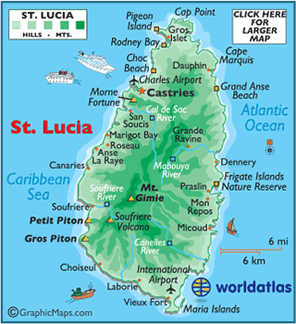

LC DPT Service Trip to St. Lucia
Mission:
  Provide physical therapy services to children in 5 special education schools
  Educate teachers/caregivers
  Create a plan of care
3 visits beginning January 2016
Progress has been seen in the functional abilities of several children since the first trip
Notes:
Brooke
In our LC DPT program, we have the opportunity to travel to St. Lucia once a year to provide much needed physical therapy services to children in the special education schools all over the island
Limited access to PT in the school systems - 1 PT who visits 1-2x a year??
Teachers who receive basic training are assigned to work in special education schools and have no experience working with children at a lower functional level - basically have to serve as PTs for these children to improve participation in the classroom
That is why when we visit, our goals are to evaluate the kids, create a plan of care that the teachers can work with the child on all year round to improve the childs overall function, and also educate the teachers to give them a better understanding for who they are working with
The first time St Lucia was visited was in January of 2016 when 10 students and 2 faculty members traveled there
Seeing a combination of new students as well as the same students from year to year
Specifically more progress seen this year in 2018 - third trip
Images from: https://www.worldatlas.com/webimage/countrys/namerica/caribb/lc.htm
http://www.healingmotionomaha.com/blog/2017/10/happy-physical-therapy-month/

Slide 4
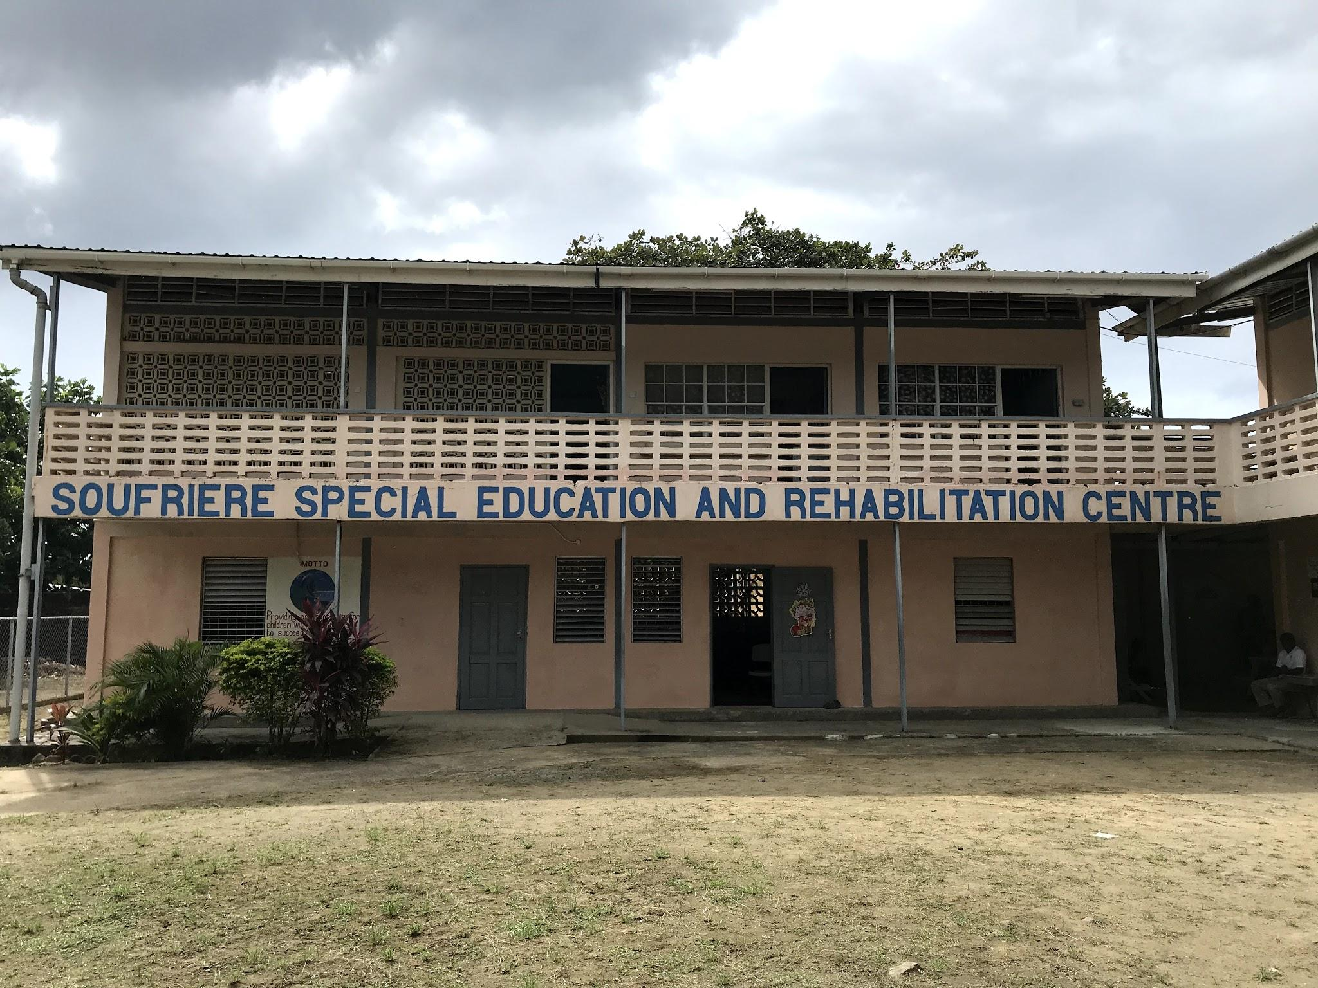
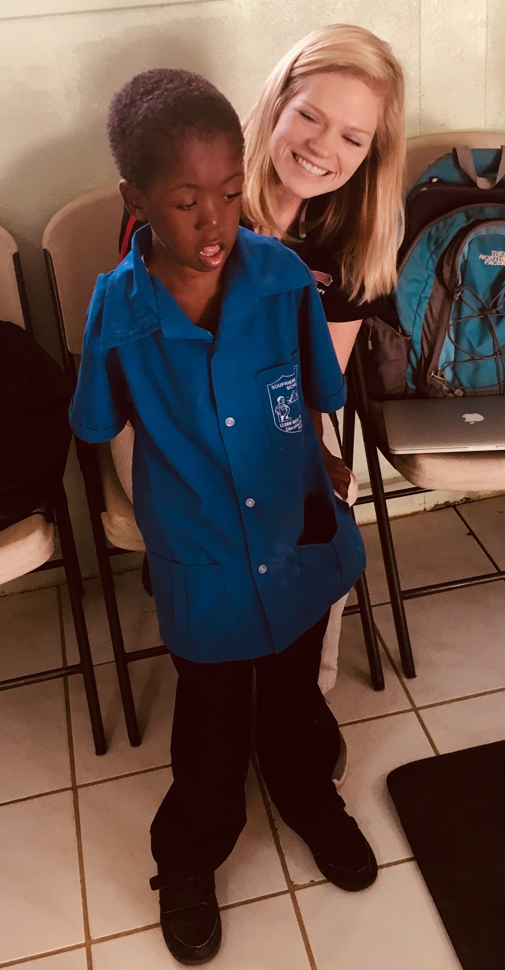
Mark:
7 y/o boy
No known medical conditions
Delay in physical development
  Learned to stand in September 2015
Findings:
  Walking, running, jumping, stairs, LOVES soccer
  Avoids fine motor skills
  Speech: “yes” and “no” responses
Teacher concerns: behavioral issues, lack of attention in the classroom, toileting issues
Previously visited in 2016 and 2017
Notes:
Brooke: story, findings
Ainsley: physical development, teacher concerns, prior visits
I was able to talk with his teacher and get more information about Mark.
Identified as their “miracle child.” Mark didn’t learn to stand until he was about 5 years old in 2015. He wasn’t able to play and interact with other kids his age due to lacking the physical skills. No medical conditions were identified by his teacher that may contribute to this delay in development. However, his teacher believed the delay may have been due to Mark’s small home environment with lack of space to walk/run as well as lack of proper teaching when we was younger.
The child we saw was running outside with classmates and playing soccer.
His teacher’s main concerns were Mark’s behavioral issues and lack of attention in the classroom. (limiting factors of his participation in school) thats what we decided to focus our interventions towards and make recommendations for his teachers to carry-out the next year
We noticed that Mark was also visited by DPT students in 2016 and 2017 - with documentation and recommendations from those visits indicating Mark’s progress over time. We were unaware of how physically limited Mark had previously been. Learning that he couldn’t ambulate just 3 years earlier was shocking to us and that is why we took such an interest in his case.
Normal pediatric development (milestones): pull to stand 7 months, independent stance 10 months, independent walking 12 months, up/down stairs with reciprocal steps 3 years, run 2-3 yrs, kick ball 2-3 yrs, jump 2.5 years
Now having to teach a 5 y/o child how to walk/run at school - more challenging for the teachers to manage, lack of experience in this area, teachers appreciated any information provided to assist with Mark’s progression to walk/run.
Mark demonstrates overall delay in all motor milestones, however, he has progressed quickly, acquiring functional skills including walking, running, jumping, stairs

Slide 5
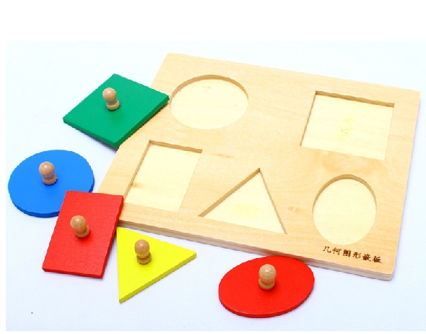
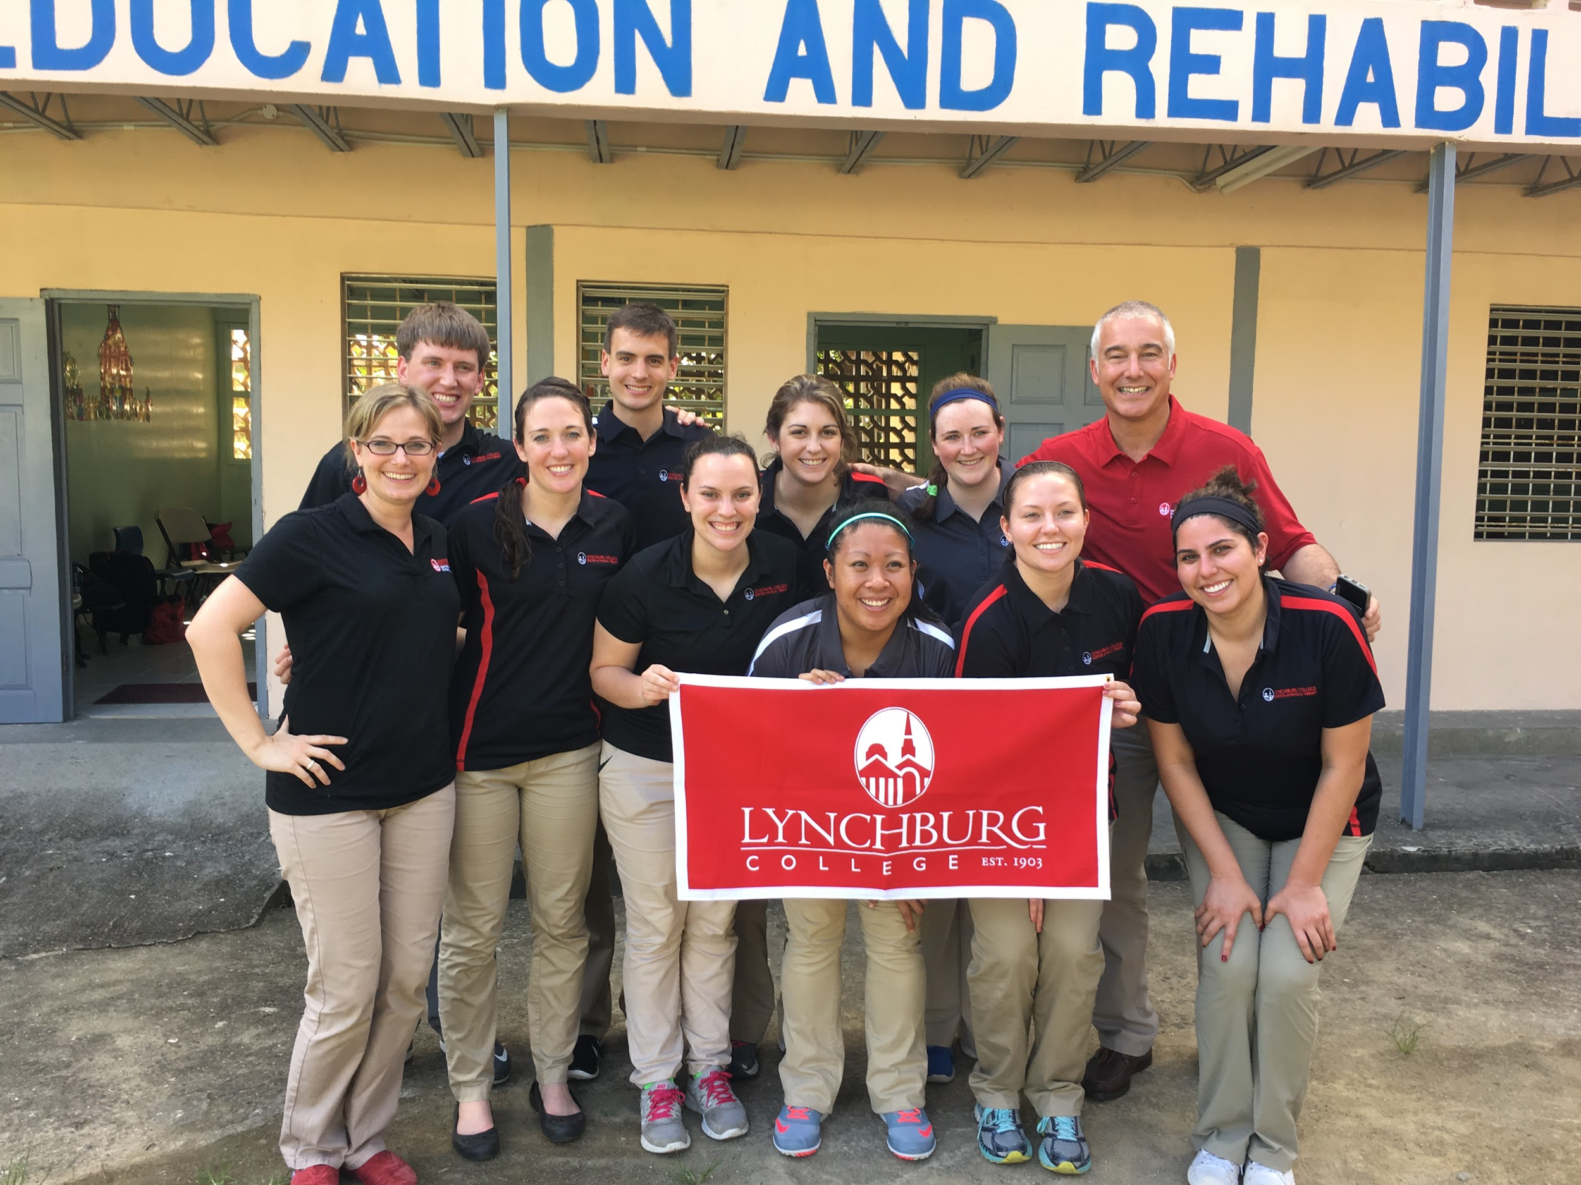
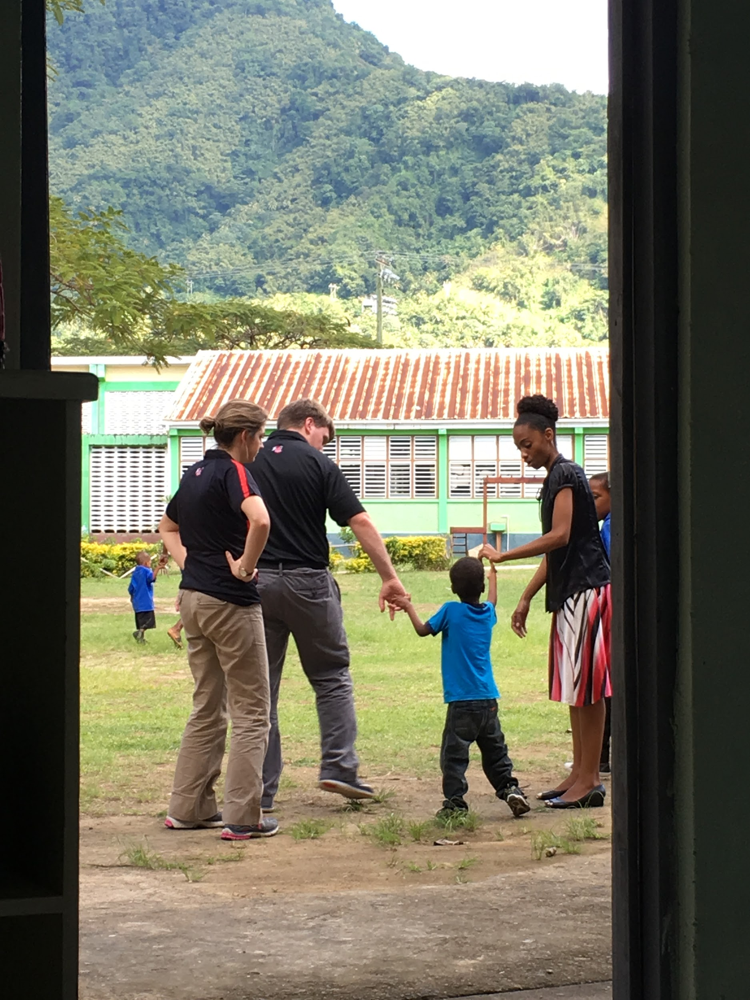
January 2016
Findings:
  Able to stand independently for 1 min
  Unsafe with walking
  Nonverbal and stubborn
Recommendations:
  Limit distractions when given a task
  Fine motor games
  Balance activities in standing and sitting
WALKING - as much as possible, as normal as possible
Notes:
Image: https://www.doctortechindia.com/Multipurpose-execisers/Physio-ball
https://www.pinterest.com/pin/55872851604679751/
Ainsley
megan dullae, dustin ferrel, laura rhodes worked with Mark in Jan 2016
Comment on picture - needing assistance to stance and walk, wide BOS
Overall work on fine motor tasks, balance tasks in standing to prepare for ambulation, and as much walking as possible while maintaining safety
Recommendations:
They noted that Mark gets distracted easily, so putting him in a quiet room to eliminate distractions would help him stay focused on the task he was given
Mark loves to play games, so turning his therapy into a game will make it easier for him to comply. For example, a fine motor game could be trying to find objects in a bowl of rice
Balance activities are important s he can progress from standing to walking and running. Things like sitting on physioballs and having him march, bounce, or catch something will improve his balance
He can also lay on his stomach on the physioball and alternate lifting his arms and legs to work on his core stability and balance
And also simple activities like catching a ball while standning on one leg will help him gain balance control
Walking was the main goal in January 2016, so getting him up and walking with as little assistance necessary was very important because walking takes a lot of practice

Slide 6
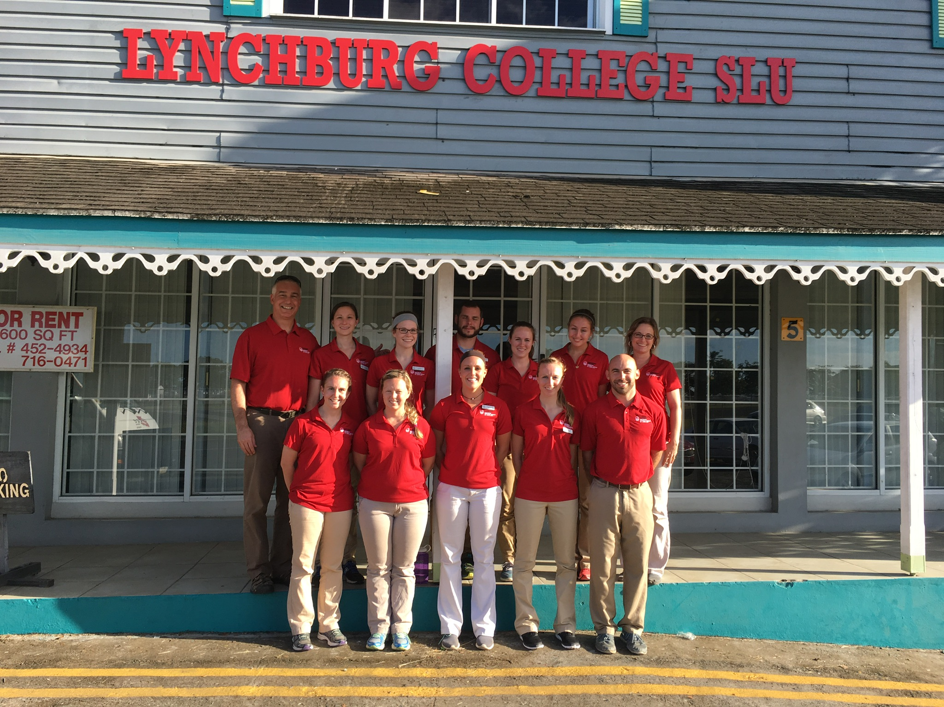
January 2017
Findings:
  Able to stand and walk safely
  Unsafe and slow with running
  Unable to jump, kick a ball
  Stairs using handrail
  Insufficient strength
  Nonverbal
Recommendations:
  Improve lower extremity strength/power -- stairs
  Core stability
  Dynamic gait and balance activities: obstacle course
  Run and jump as Mark feels comfortable
Notes:
BROOKE
Briefly
Take note of the bolded words under findings and the green dictates that Mark made improvements in that area from the previous year
No use of AD
Not able to jump on the ground, but could jump on trampoline with hands held

Slide 7
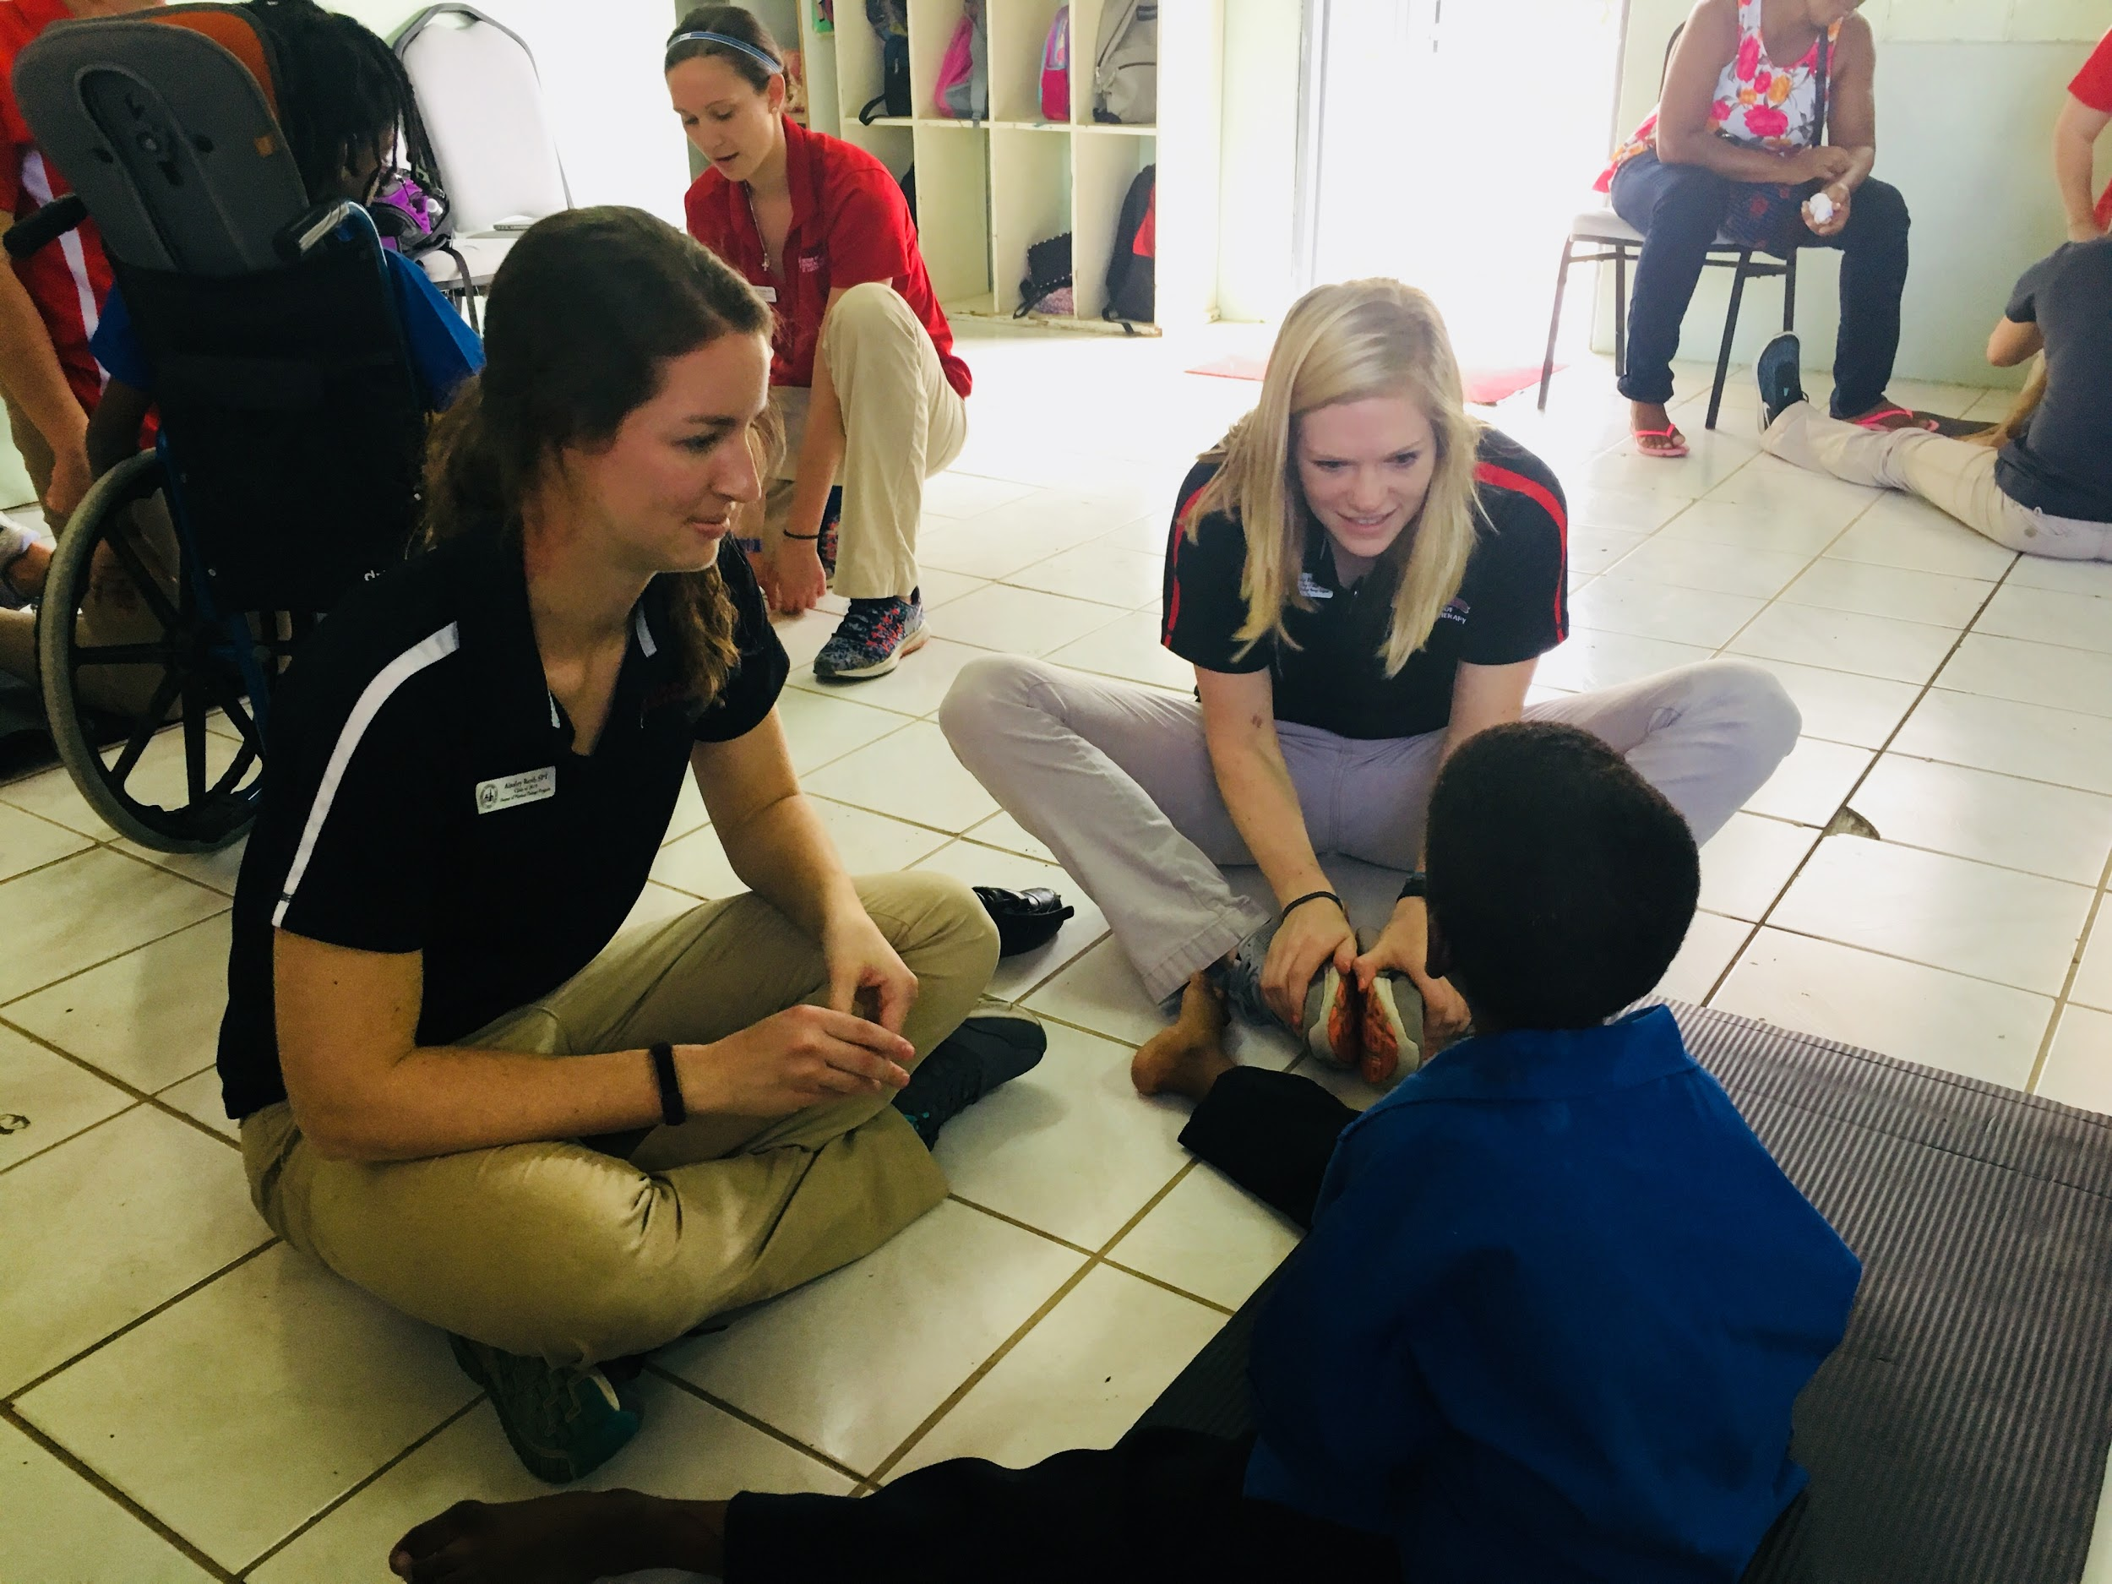
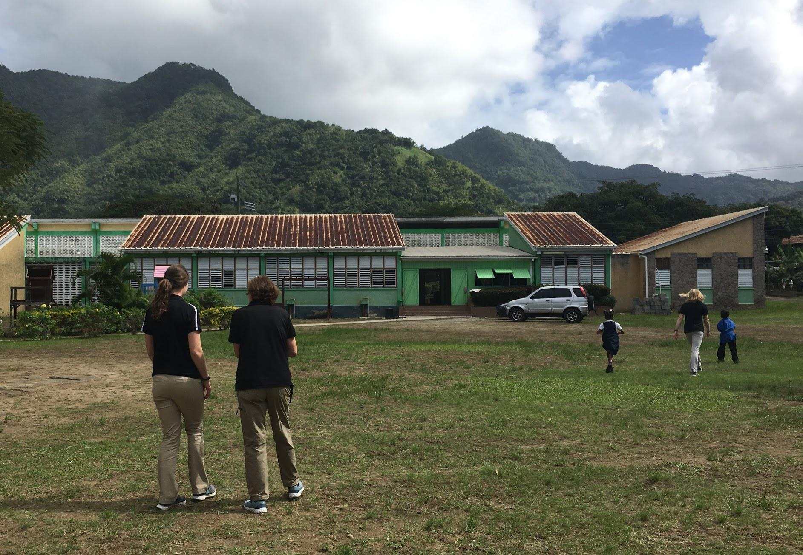
January 2018
Findings:
Able to walk, run, jump, kick soccer ball
Step-to gait pattern with stairs using handrail
Verbalize “yes” and “no” only 25% of the time
Improved postural control and balance
Trouble with fine motor tasks and staying focused
Notes:
Ainsley
Comment on sitting position in picture - need for wide BOS
Comment on running picture - no need for assistance

Slide 8
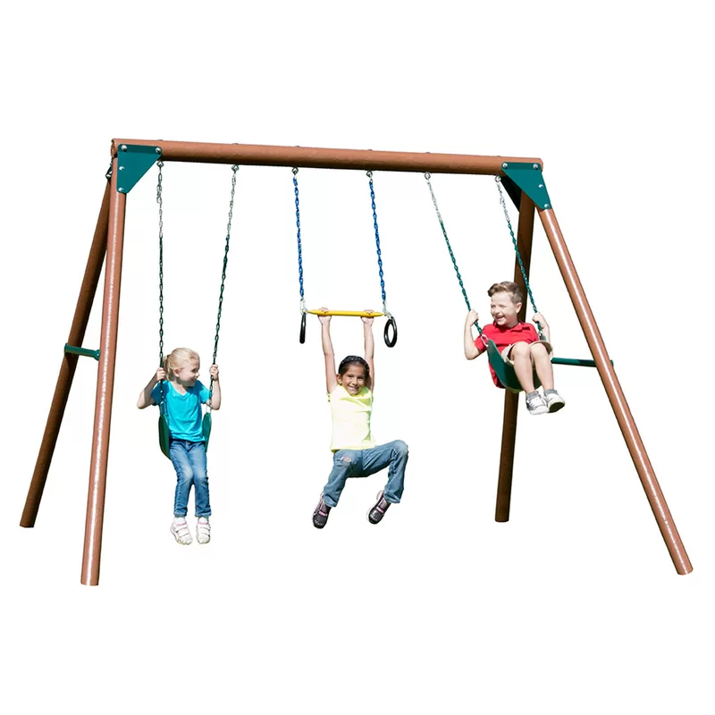
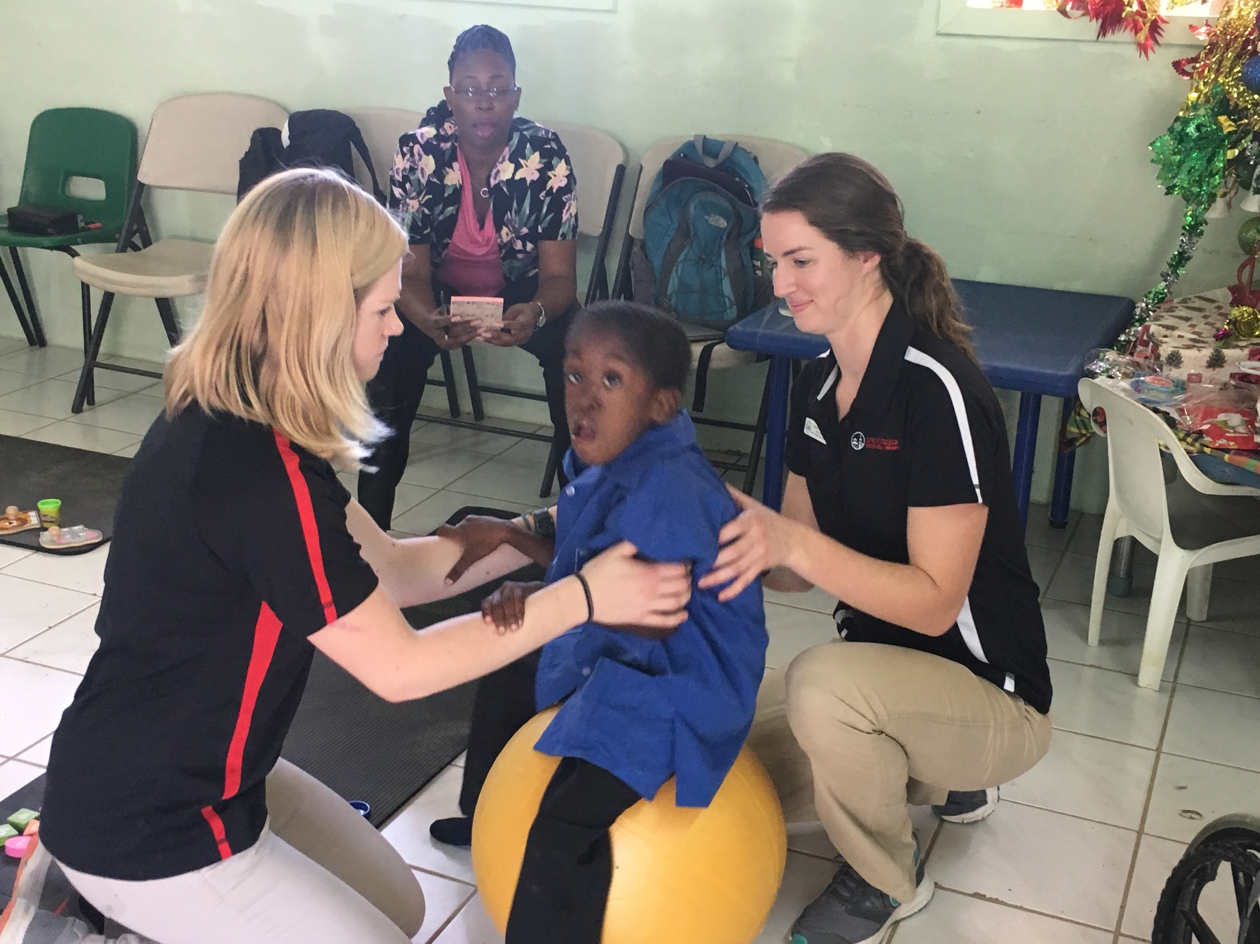
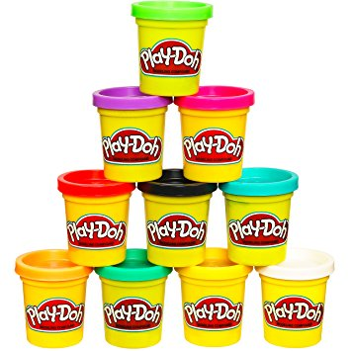
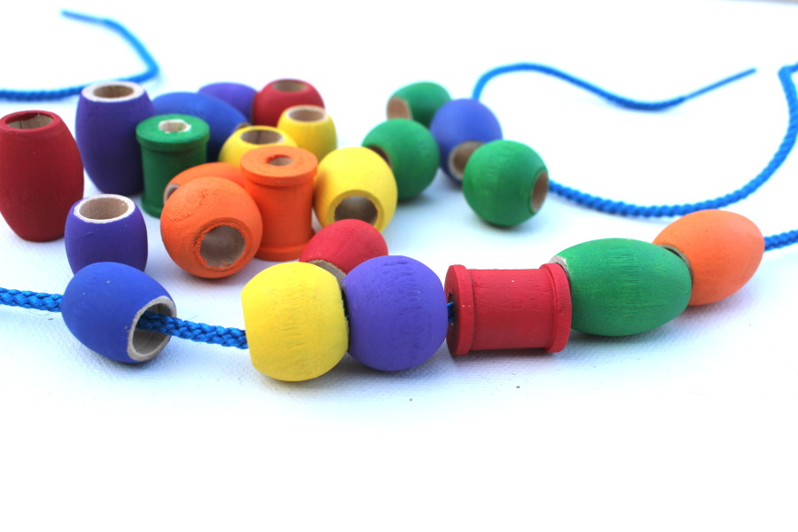
January 2018
Recommendations:
  Meet sensory needs
    Sit and bounce on physioball
    Swing on the playground
  Fine motor skills
    Puzzles, string beads, Play-doh
  Increase attention span: Task → reward
  Continue to encourage the child to run, play with peers, kick a ball, climb stairs
Notes:
BROOKE
Images: http://elemenopkids.com/product/stringing-beads-set/
https://www.wayfair.com/baby-kids/pdp/swing-n-slide-orbiter-swing-set-sns1303.html
https://www.amazon.com/Play-Doh-Modeling-Compound-Exclusive-Non-Toxic/dp/B00JM5GW10
Not targeted so much at physical components - more behavioral issues being addressed
Continue to increase the length of time attending to a specific task and follow with a reward: for example, he lved to go outside and play soccer so we told Mark to complete a puzzle and once that was completed, we would go outside and play for 5 minutes
Brush over our findings, talk more about what this means for us

Slide 9
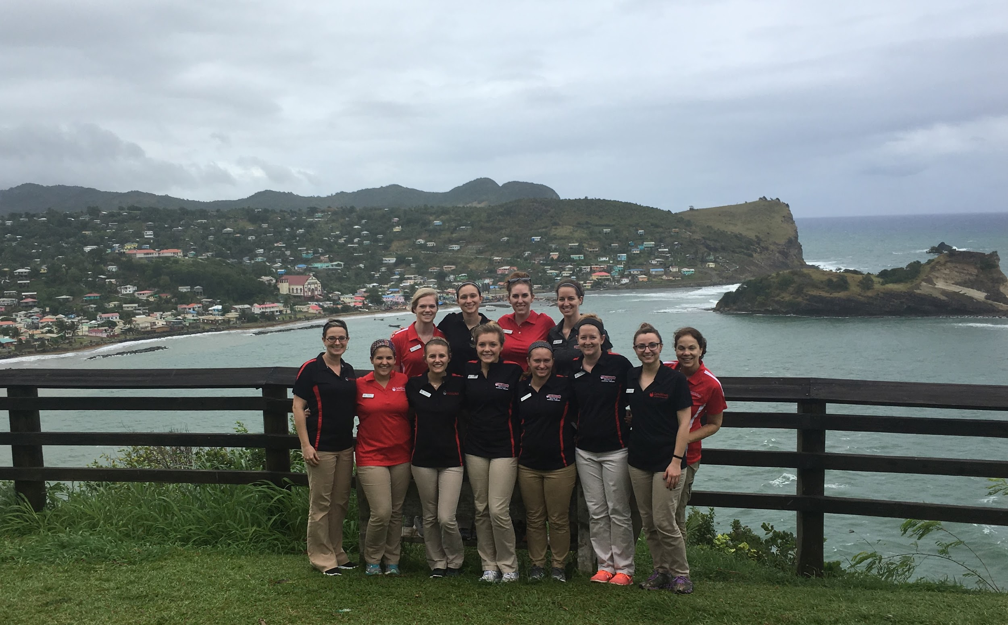
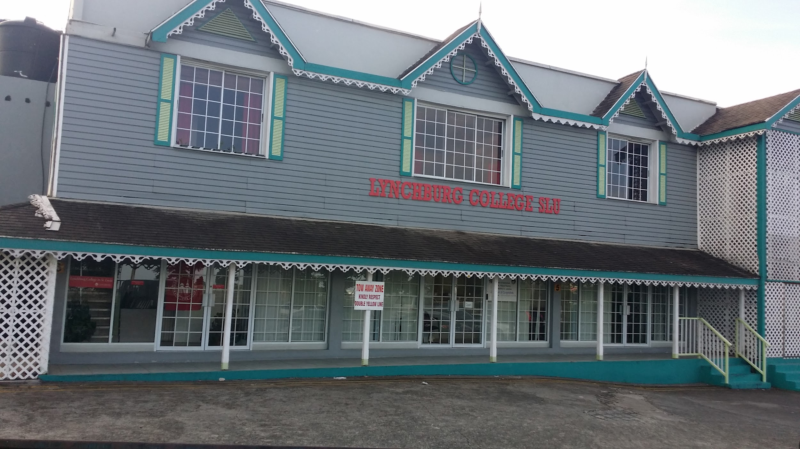
Conclusion
Impact of physical therapy in St. Lucia special education schools
  Children
  Teachers/caregivers
Impact of this trip on LC DPT students and our education
  Hands-on experience
The future of service trips to St. Lucia
  Need for continued medical services provided to countries in need
Notes:
BROOKE - first statement
Mark’s incredible story displays the impact physical therapy has on our children and the value service trips have on countries in need. His story has touched the lives of the students and faculty members involved and he is a reminder to us that we have the power to make a difference in people’s lives and can help to improve their quality of life.
Large part of the interaction was providing education to teachers so that they can continue to help the child throughout the year
Take a break from the textbooks and apply the skills we’ve learned in the classroom to real life situations. Gain hands-on experience
See how peds, neuro, ortho, cardiopulm come into play
Challenged me to think like a clinician and was a very rewarding experience
There is a need for continued medical services in St. Lucia and other countries in need, not just PT but all health professions. This trip has shown us that after 3 visits, we are starting to make a difference. We need to continue to make a difference in the lives of these children.
Providing education to teachers and caregivers to improve the quality of life of these children
Lack of regular PT in the school systems - 1 PT that visits once a year
Making a difference in the school systems after 3 visits

Slide 10
Photo Release Statement
All photos were given permission to be used for educational purposes.

Slide 11
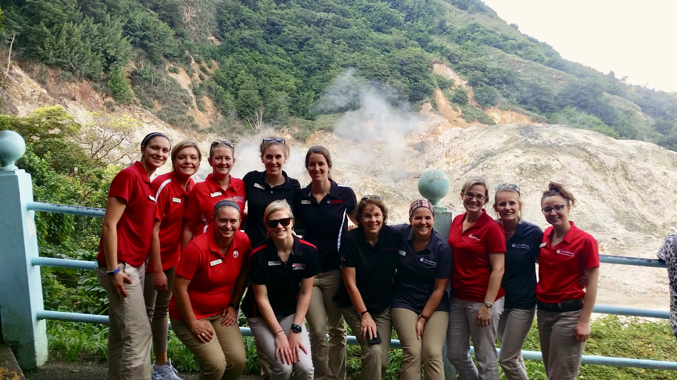
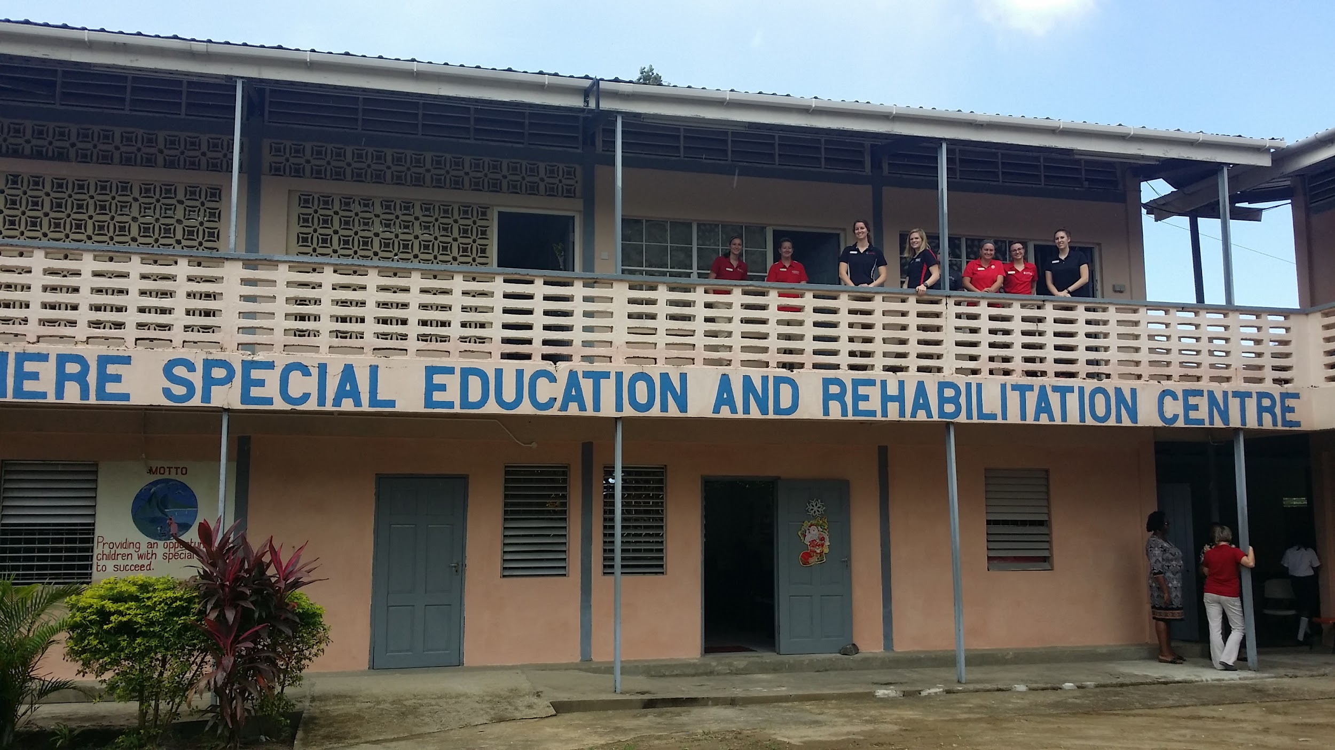
Questions?

