Slide 1
Girl Power: Recovering the Female Stage Voice in Ben Jonson’s The Masque of Queens
By: Sara Severens

Slide 2
Background
Ben Jonson (1572 – 1637)
Masques and antimasques
Stuart Court
Queen Anne

Slide 3
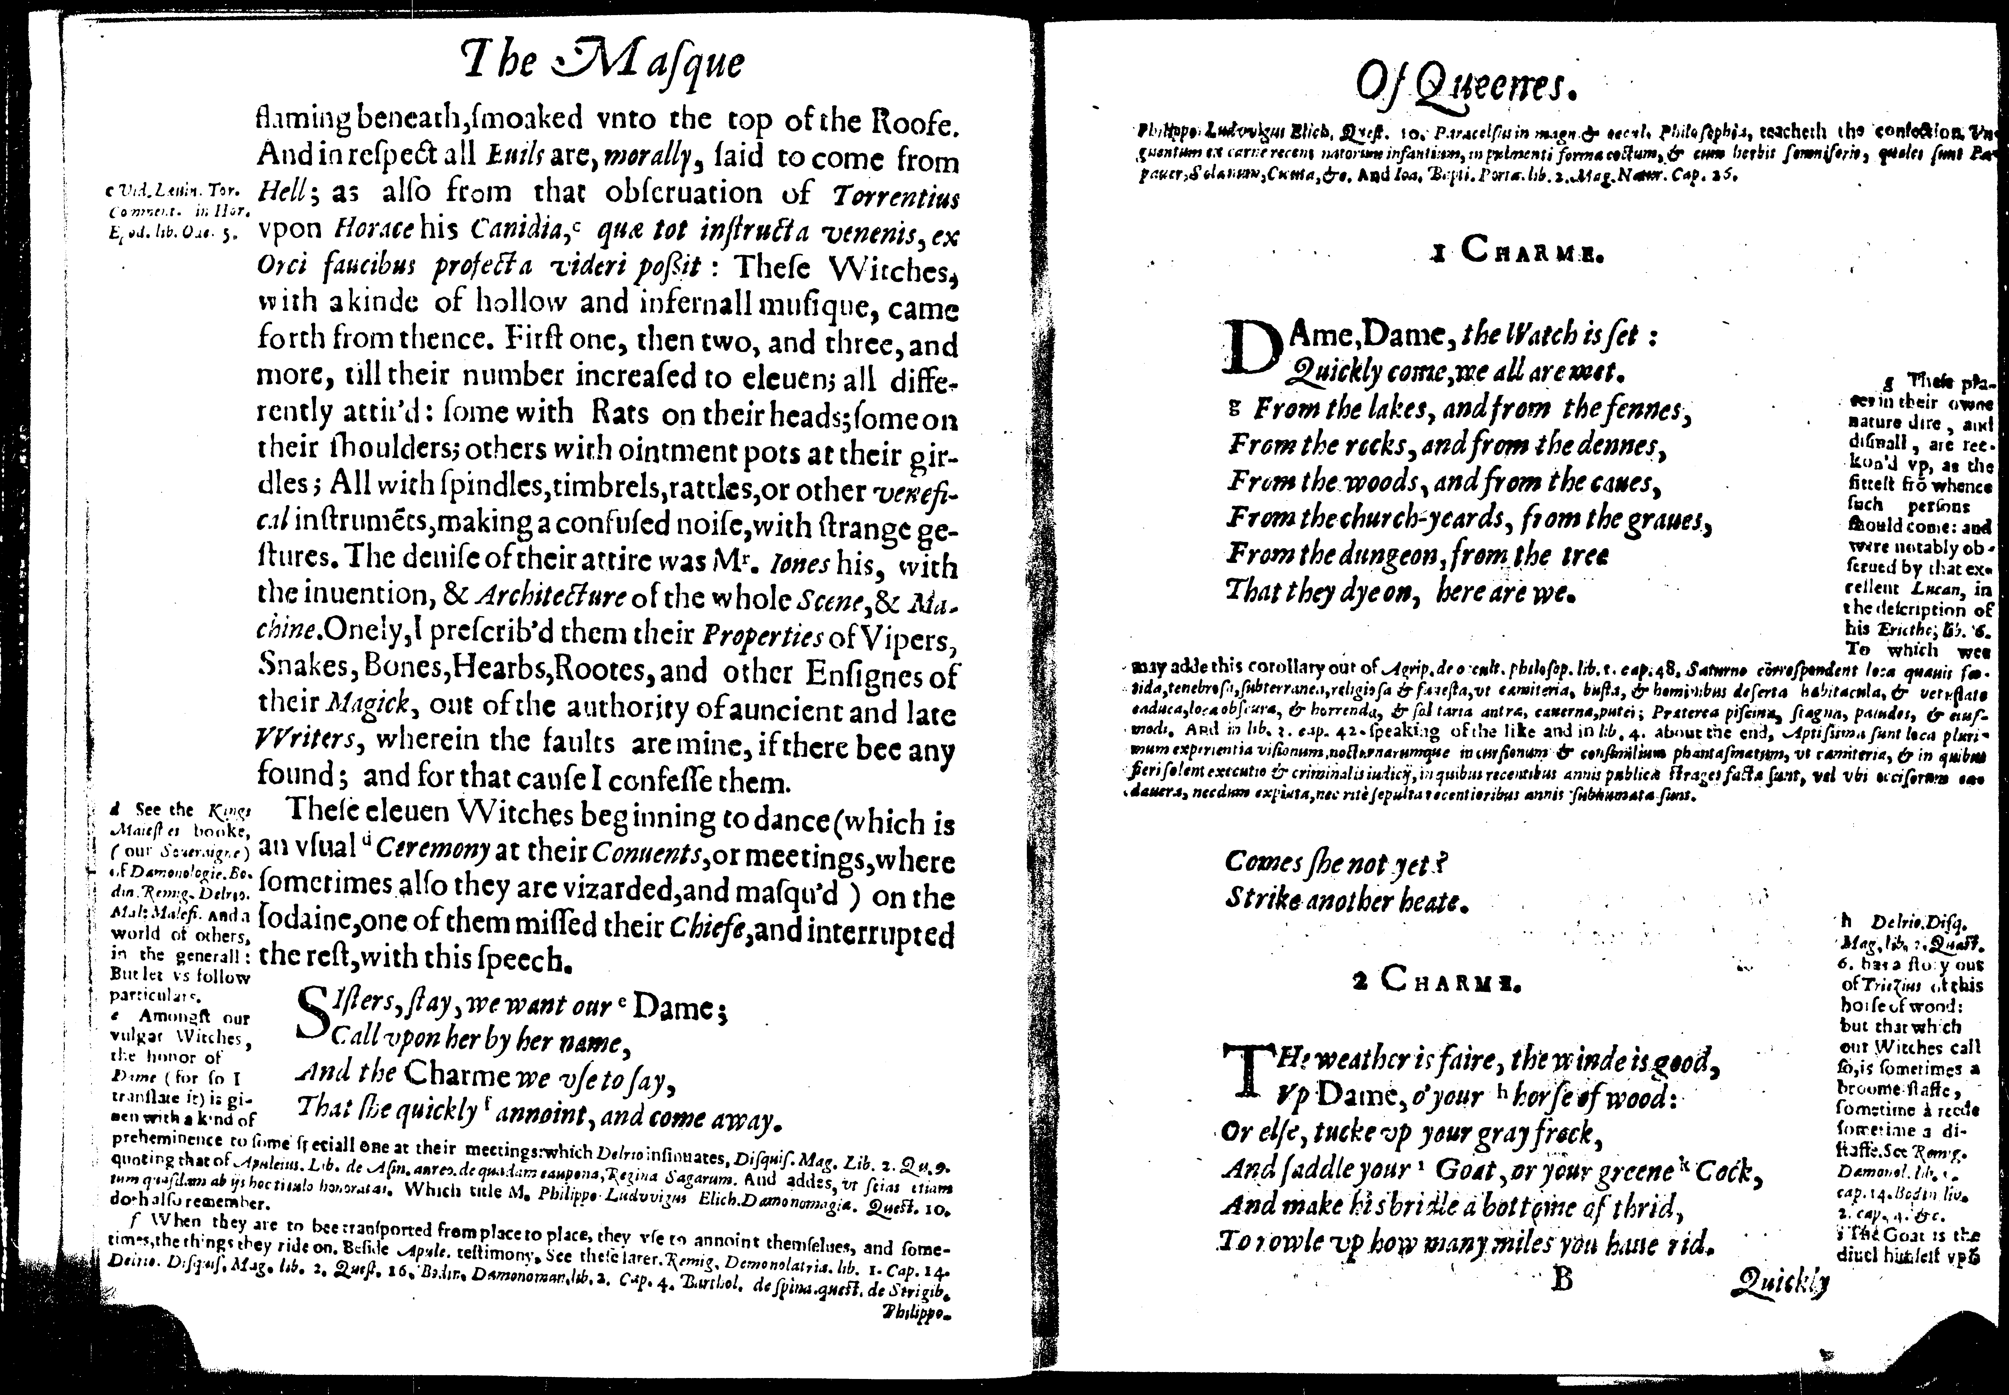
What I did…

Slide 5
Why it Matters
Unexplored area of literary scholarship
Intimate look into a royal court
New take on an area of literature we study frequently

Slide 6
Areas for Further Study
I would like to produce this masque
I would like to know what the music sounds like
I would like to look at the antimasque through an Eco Poetics lens

Slide 7
Works Cited
Berry, Philippa, and Jayne Elisabeth Archer. "Reinventing the Matter of Britain: Undermining the State in Jacobean Masques." British Identities and English Renaissance Literature. Eds. David J. Baker and Willy Maley. Cambridge, United Kingdom: University of Cambridge 119 -133. Print.
Donaldson, Ian. Ben Jonson: A Life. Oxford, England: OUP Oxford, 2011. Web.
Fisher, Shelia, and Janet E. Halley. "The Lady Vanishes: The Problem of Women's Absence in Late Medieval and Renaissance Texts." Seeking the Woman in Late Medieval and Renaissance Writings Essays in Feminist Contextual Criticism. Eds. Shelia Fisher and Janet E. Halley. 1st ed. United States of America: University of Tennessee Press, 1989. 1 – 14. Print.
Halberstam, Judith. "Female Masculinity." Literary Theory: An Anthology. Eds. Julie Rivkin and Michael Ryan. 2nd ed. Malden, MA: Blackwell Publishing, 2004. 935 - 954. Print.
Jonson, Ben. The Masque of Queens. London: N. Ores, 1609. Print.
Lewalski, Barbara K. "Enacting Opposition: Queen Anne and the Subversions of Masquing." Writing Women in Jacobean England. USA: President and Fellows of Harvard College, 1993. 15 – 43. Print.
Loomba, Ania. "The Colour of Patriarchy: Critical Difference, Cultural Difference and Renaissance Drama." Shakespeare, Feminism and Gender. Ed. Kate Chedgzoy. New York, NY: Palgrave, 2001. 235 - 250. Print.
Marcus, Leah S. "Pastimes and the Purging of Theater: Ben Jonson's Love Restored and Bartholomew Fair." The Politics of Mirth Jonson, Herrick, Milton, Maravell, and the Defense of Old Holiday Pastimes. USA: The University of Chicago Press, 1989. 24 - 63. Print.
Maurer, Margaret. "Reading Ben Jonson's Queens." Seeking the Woman in Late Medieval and Renaissance Writings Essays in Feminist Contextual Criticism. Eds. Shelia Fisher and Janet E. Halley. 1st ed. United States of America: University of Tennessee Press, 1989. 233 - 260. Print.
McDermott, Kristen. "Jonson's Gossips and the Stuart Family Drama." Early Theatre (2006): 61. Web.
Montrose, Louis. "Professing the Renaissance: The Poetics and Politics of Culture." Literary Theory: An Anthology. 2nd ed. Malden, MA: Blackwell Publishing, 2004. 584 - 588. Print
Pilhuj, Katja. "Mapping Queenship: Anna of Denmark's Politics of Representation in Stuart Cartography and the Masque of Queens." Early Modern Women: An Interdisciplinary Journal 9.2 (2015): 3 - 38. Web.
Ravelhofer, Barbara. "Theatre Dances." The Early Stuart Masque: Dance, Costume, and Music. Oxford: OUP Oxford, 2006. 67 - 96. Web.
---. "Two Jonsonian Court Masques." The Early Stuart Masque: Dance, Costume, and Music. Oxford: OUP Oxford, 2006. 187 - 199. Web.
Walls, Peter. "Masque Song." Music in the English Courtly Masque. Walton Street, Oxford: Oxford University Press, 1996. 43 – 103. Print.

Slide 8
Questions?

