Slide 1
The Importance of Home Style to Congress Today
Stephen Ruppel

Slide 2
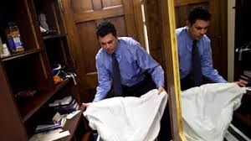
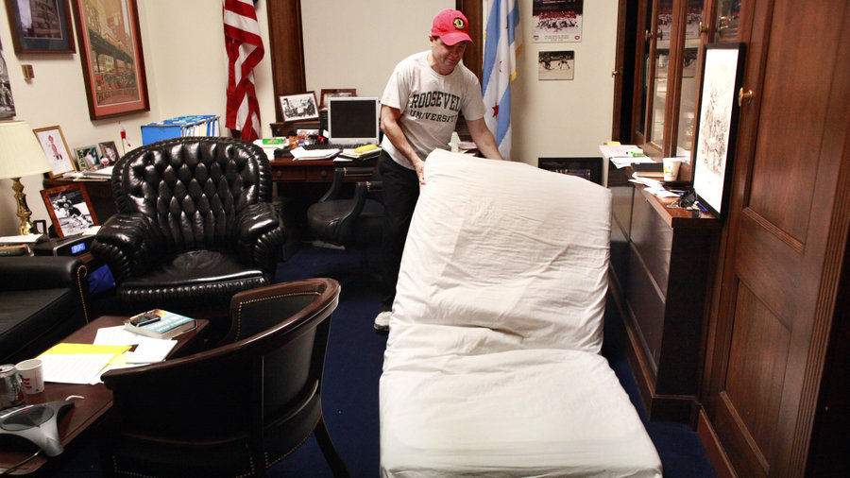
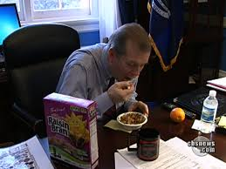
Office or Bedroom?
Notes:
Jason Chaffetz, Tim Walberg, and Mike Quigley

Slide 3
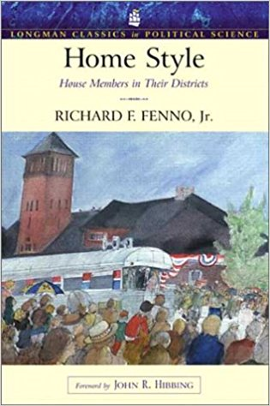
Richard Fenno’s Home Style
https://www.amazon.com/Home-Style-Members-Districts-Classics/dp/032112183X

Slide 5
Bibliography
https://www.cbsnews.com/news/one-fifth-of-house-freshmen-sleep-in-offices/
https://www.thedailybeast.com/shutdown-hardships-for-members-of-congress-who-sleep-in-capitol-offices
https://www.npr.org/2015/12/26/458207661/meet-the-lawmakers-who-sleep-shower-work-all-on-capitol-hill

