Slide 1
Lynchburg’s Connectivity: A Discussion on Lynchburg’s Sidewalk Systems
Lauren Fishbein
Student Scholar Showcase Presentation

Slide 2
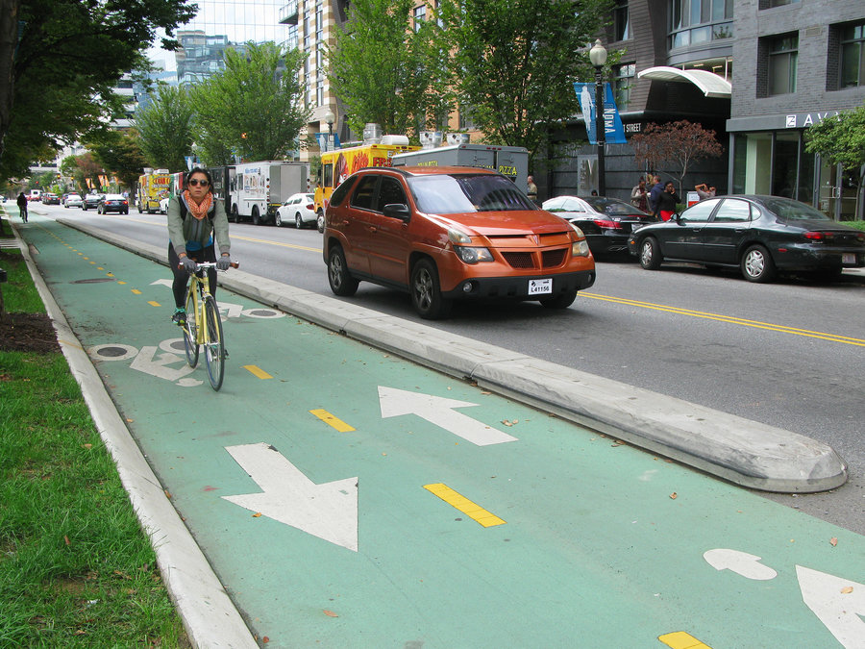
Advantages of Sidewalk Development
Advantages
Social Benefits of Walkability
Pedestrian Safety
Increased Property Value
Increased Tourism
Lessens Harmful Emissions

Slide 3
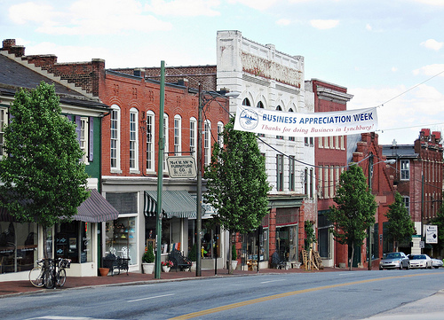
Lynchburg’s Goals and Original Ordinance
enhance the general walkability and connectivity of all Lynchburg neighborhoods by strengthening the zoning ordinances so that every development and addition to existing development requires the construction of sidewalk on road frontages
Exemptions: existing cross-slopes in excess of twenty-five (25) percent measured across the width of the right-of-way, storm water conveyances or other physical constraints render required sidewalk improvements unfeasible.”

Slide 4
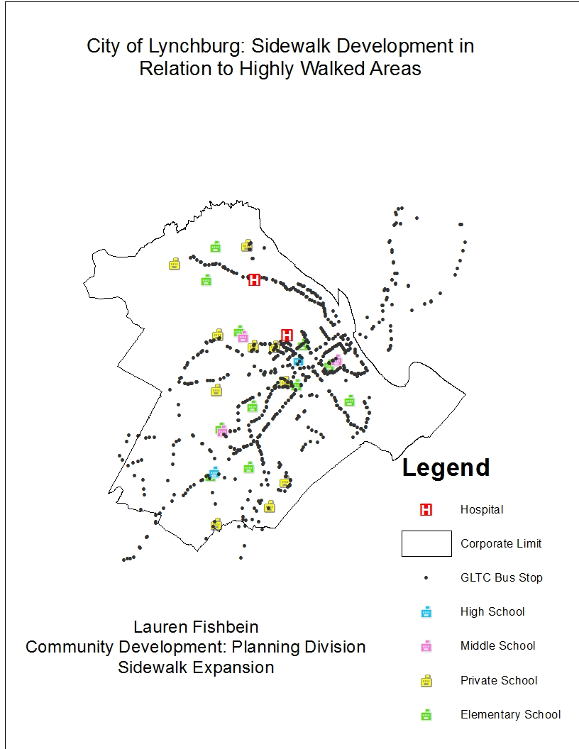
A Glance at Lynchburg

Slide 5
Deterrents of Sidewalk Development
Deterrents
Expensive to Build
Concerns of Relativity to more Rural Communities/ Less Traveled Areas
“Sidewalks Going Nowhere”

Slide 6
The Edited Sidewalk Zoning Ordinance
35.2-67.3 Sidewalk Exemptions
“a. The Zoning Administrator may lessen or eliminate the requirements for sidewalks when existing cross‐slopes in excess of twenty‐five (25) percent, stormwater conveyances or other physical constraints render required sidewalk improvements unfeasible. (b) The Zoning Administrator may eliminate the requirement for sidewalk on streets with fewer than one hundred (100) vehicle trips per day and if the area served by the street will not generate an excess of one hundred (100) vehicle trips per day based upon the existing zoning patterns and the Comprehensive Plan’s Future Land Use Map.”
updated: 11-14-17

Slide 7
Works Consulted
City of Lynchburg Zoning Ordinances-February 23,2016
City of Lynchburg Zoning Ordinance – Adopted February 23, 2016 (revised November 1, 2017)
Sidewalks in the Suburbs. (n.d.). Retrieved April 03, 2018, from https://www.planning.org/pas/reports/report95.org
Thank you, City of Lynchburg Planning Division, for your efforts and time throughout the past year!

