Slide 1
Making Music with Maria Montessori
A Pedagogical Analysis of Montessori’s Methodology
Renee Banks, Leray Wingo, Sarah Young
Notes:
Sarah

Slide 2
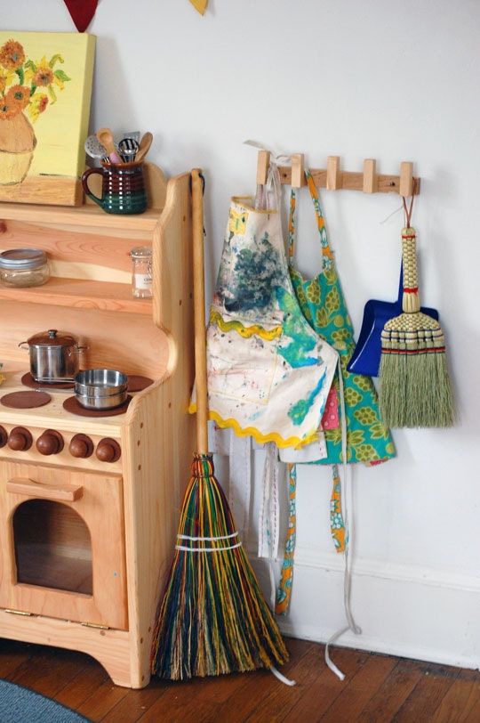
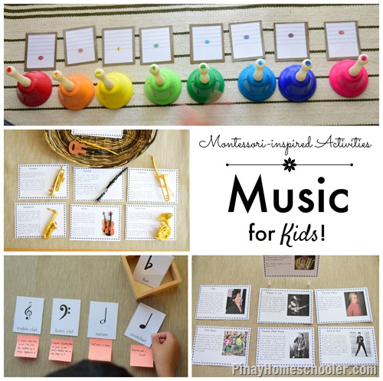
Introduction of Topic
Who was Maria Montessori (1870-1952)?
Renowned Italian physician and educator best known for her philosophy of education
Important points to consider:
Montessori’s ideology can be applied to any classroom environment.
However, Montessori’s methods may not be universally accepted in common school systems.

Slide 3
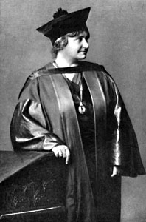
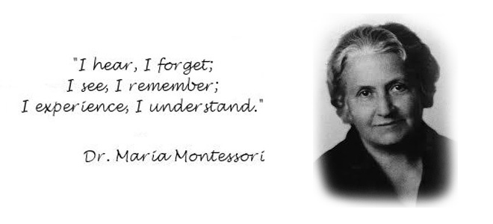
Research Purpose, Problems, and Resources

Slide 4
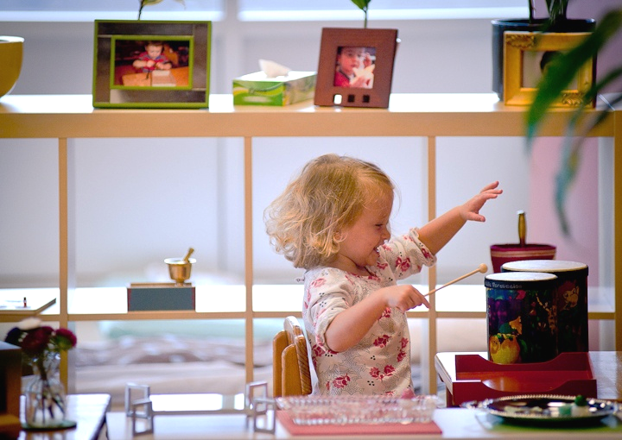
Purpose
Problems
With the intent of improving music pedagogy and classroom environments, the purpose of this research is to examine and implement the teaching methods of Maria Montessori.
to analyze the life of Maria Montessori;
to examine Montessori’s educational theory and methodologies; and
to create a series of three lesson plans utilizing Montessori’s techniques adapted for the music classroom.

Slide 5
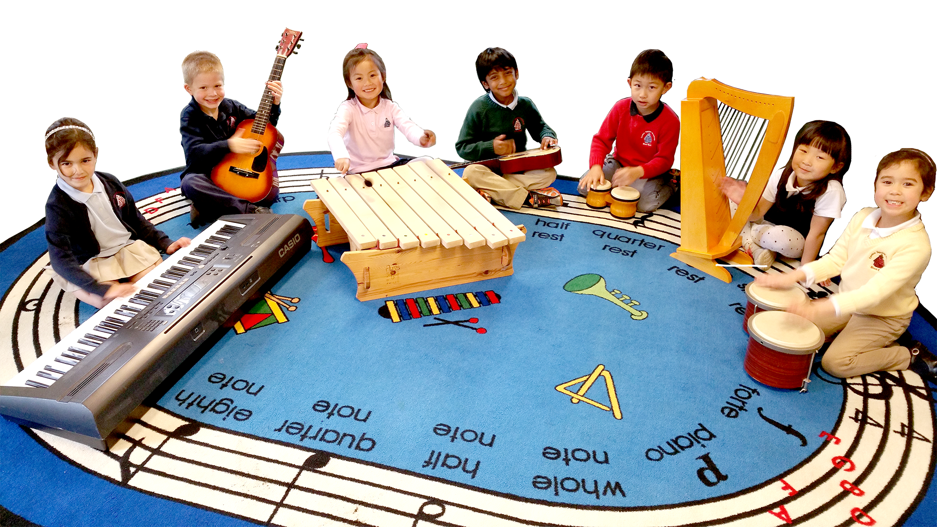
Literature Review
The following primary and secondary sources were used to analyze Montessori’s ideologies and teaching methods and formed the basis of class discussion.
Pittas P. & Gray K., (2004). Maria Montessori. Addressing education: Purposes, plans, and politics (Vol. 1 ed. 3 pp. 304-330). US: Xlibris Corporation.
Montessori, M. (1949). The absorbent mind. (Vol. 1, pp. v-421). India: The Theosophical Publishing House.
Montessori, M., Hunt, J., & Valsiner, J. (2013). The Montessori method. (pp. xi-318). New Brunswick, NJ: Transaction Publishers.

Slide 6
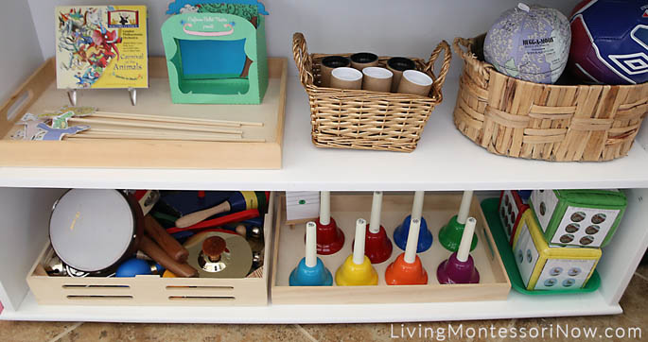
Methodology
Design
An investigation of Montessori’s method led to this study
The researcher consulted primary sources, course texts, and websites to analyze Montessori’s teaching methods and the implications for music education
Analysis
To identify Montessori’s teaching methods
To examined how they were used in a Montessori classroom
To explore how to implement them in music classrooms
To create lesson plans based on Montessori’s methods
Public Presentation
The researchers presented the findings in a display on (April 4, 2018) at the Student Scholar Showcase at Lynchburg College in Lynchburg, Virginia.

Slide 7
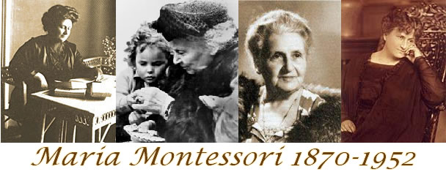
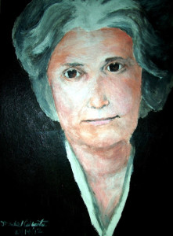
Problem One
To analyze the life of
Maria Montessori
Notes:
Leray

Slide 8
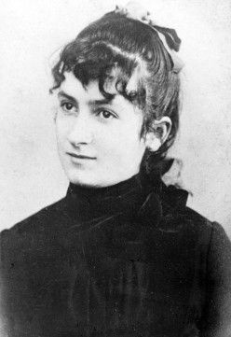
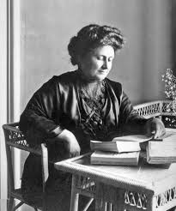
Montessori’s Life
Born in Chiaravalle, Italy (1870) (Pittas & Gray, 2004)
Upper middle-class status = educational opportunities
Enter medical field despite encouragement to enter teaching
Overcame gender obstacles: First woman to enter medical school in Italy – became doctor in 1896
Known for her high level of patient competency and respect
Involved in social reform (gender equality and children advocacy) (Burns, 2017)
In 1901 began study of educational philosophy and anthropology (Campbell & Scott-Kassner, 2014)
In 1907, opened “Casa dei Bambini” (Children’s House) for underprivileged children, aged 3-7 (Rome)

Slide 9
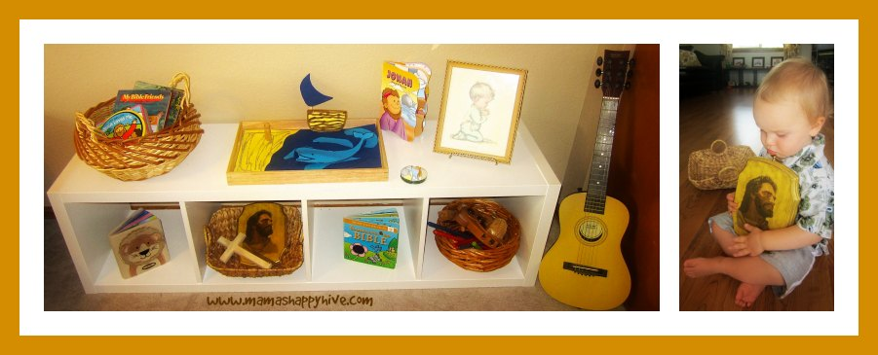
Problem Two
To examine Montessori’s theory and methodology
Notes:
Renee

Slide 10
Montessori Theory and Methodologies
Influenced by Jean-Jacques Rousseau (1712-1778), Johann Pestalozzi (1746-1847), and Jean Itard (1774-1838)
Incorporated natural laws
Encourages independent actions and thoughts
“first the education of the senses, then the education of the intellect” (Peggy & Gray, p. 306)
Methodologies
independence grants freedom
proper versus improper adult intervention
teachers hold the power to both assist in the development intellectually and restrict development of exploration and innovative thinking
observe before acting
concepts of discipline
Concept of discipline
Eliminated the concept of prizes and external forms of punishment in the classroom.
“discipline must come through liberty” (Montessori, as cited in Pittas and Gray, 2004, p. 311).
Notes:
Montessori applied natural laws by providing the use of learning tools made to be tactile in order use the touch to establish an understanding of new concepts, tables and chairs were made to accommodate for the size of the children, and children are encouraged to share and work at their own paces.

Slide 11
Problem Three
To create lesson plan integrating Montessori’s method into the music classroom
Notes:
Renee

Slide 12
QR to Receive Lesson Plans
Notes:
explain how we integrate being free with structure

Slide 13
Making Fun! Short Music Activities
Ages: 2-5 years old
Objective: Students will be able to, with limited guidance, understand musical concepts in order to strengthen their aural skills, rhythmic and kinesthetic abilities.
Goal: Students will be introduced to various musical experiences in order to enhance and provide examples to develop their aural skills, kinesthetic, and knowledge of instruments.
Instructional Strategies: Encourage students to actively engage in the musical activities
Lesson Plan created by Renee Banks

Slide 14
Around the World
Ages: 5-10 years old
Objective: Students will be able to explore various nations in order to learn about the continents through music.
Goal: Students will learn about the geography of the Earth and the continents using musical activities.
Instructional Strategies: To teach geography through singing and movement.
Lesson Plan created by Sarah Young

Slide 15
Instrumental Petting Zoo
Ages: 5-10 years old
Objective: The objective of this lesson is for the child to gain hands on experience and learn about the instruments that they find most interesting.
Goal: The goal of this lesson is to foster exploration of the various musical instrument families through teacher guided play.
Instructional Strategies: Think-Pair-Share
Lesson Plan created by Leray Wingo
Notes:
By sharing their experiences with their classmates, the students engage in observational learning, and the collaboration of ideas. The students can implement the knowledge acquired previously by playing the instruments if they so choose.
Since this lesson is child-centered, their activities will be left up to the student’s own imagination. The teacher should observe, mediate, and provided additional information as needed. Guided practice is helpful, but independent trial and error is encouraged.

Slide 16
Instrumental Petting Zoo
Demonstration Group
Touch, play, and listen to the different instruments at the edge of the stage.
Notes:
Post Lesson Discussion
what instrument did you like the most?
which instrument did you like the least?
which instruments are similar?
PROS & CONS

Slide 17
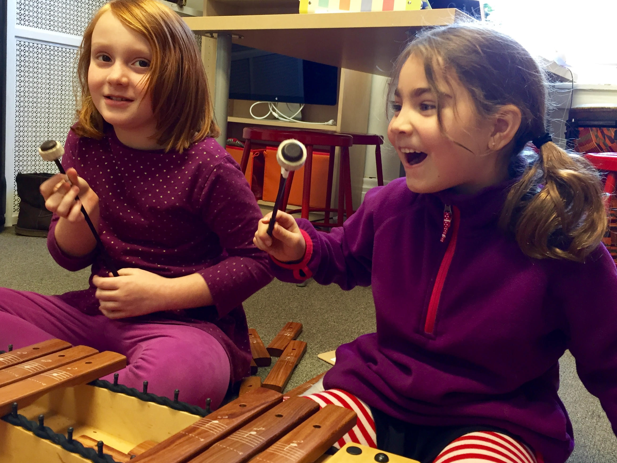
Conclusions
Montessori’s methods benefit young children throughout their development.
The Montessori techniques give children the opportunity to test their ideas, themselves, their relationships, and materials.
Her methods can be integrated into the music classroom based on personal experiences and lesson plan guidelines.

Slide 18
Implications
We implemented these lesson plans at R. S. Payne Elementary, Leesville Road Elementary, and Montessori Children’s House.
These lesson plans can be used in middle school band to introduce instruments.
Montessori’s methods taught respect, care, and responsibility for others and their environment.

Slide 19
Bibliography
Giacomini, A. & Costanzi, G. (2017). The Montessori school in the world. (pp. 10-17). Sovera Edizioni.
Kramer, R. (2017). Maria Montessori: A biography. (pp. 1-100). New York, NY: Diversion Books
Lillard, P. (2011). Montessori today: a comprehensive approach to education from birth to adulthood (pp. 1-240) Knopf Doubleday Publishing Group.
Pittas, P. & Gray, K. (2004). Maria Montessori. Addressing education: Purposes, plans, and politics. (Vol. 1 Ed. 3 pp. 304-330). US: Xlibris Corporation
Montessori, M. (1949). The Absorbent Mind. (Vol. 1, pp. v-421). India: The Theosophical Publishing House.
Montessori, M., Hunt, J., & Valsiner, J. (2013). The Montessori Method. (pp. xi-318). New Brunswick, NJ: Transaction Publishers.
Ryniker, D. H., & Shoho, A. R. (2001). Student perceptions of their elementary classrooms: Montessori vs. traditional environments. Montessori life. (Vol. 13 No. 1, pp. 45-48). New York, NY: American Montessori Society.
Torrence, M. (2001). Montessori and play: theory vs. practice. Montessori life. (Vol. 13 No. 3, pp. 8-11). New York, NY: American Montessori Society.

Slide 20
Thank you!
Dr. Cynthia B. Ramsey
Dr. Kara E. Dean
Montessori Children’s House of Lynchburg, Virginia

Slide 22
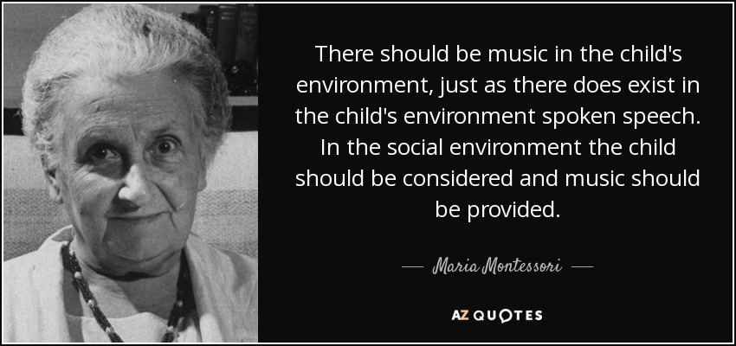

Slide 23
Making Music with Maria Montessori
Questions?
A Pedagogical Analysis of Montessori’s Methodology
Renee Banks, Leray Wingo, Sarah Young
Notes:
Sarah

