Slide 1
Effects of the Environment on Recovery and Neuroplasticity in Brain Injury Patients
Rebekkah McLellan
https://www.army.mil/article/142825/traumatic_brain_injury_awareness_month_highlights_resources
Notes:
need to be a clear understanding of what I was looking at
significance- objective of research

Slide 2
Significance
The “why”- I have a personal stake in learning about this because I have had a head injury that changed my life.
Each year an estimated 1.7 million people in the United States sustain a Traumatic Brain Injury (Center for Disease Control). These people can live with deficits from this invisible disability without anyone ever knowing.
What was looked at?
Differences in types of environment and whether this benefitted or made no difference in a person’s self relationship, personal relationships, and recovery.

Slide 3
Objective
The objective of this research was to complete a literature review in the MPH program. I wanted to gain an understanding of how the environment plays a role in the recovery from a brain injury and how the neuroplasticity is affected.
Methods:
Key words used were: brain injury, traumatic brain injury, acquired brain injury, environment, recovery, rehabilitation, enriched environment, and plasticity
Databases used were: LC OneSearch, Medline, EBSCOhost, and Google Scholar

Slide 4
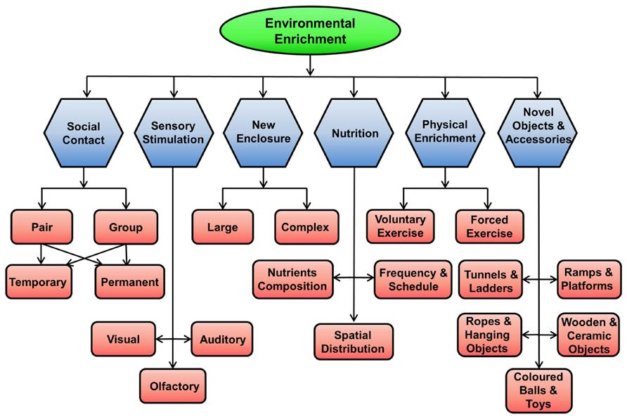
What is Environmental Enrichment?
Environment is referred to as the biological, social, and psychological aspects affecting a brain injury or post BI patient (Richardson, McKay, and Ponsford. 2014).
Environmental Enrichment is treatment, socialization, or change in a patients environment that may have the ability to assist in the recovery process or plasticity post brain injury.
Image: https://www.frontiersin.org/articles/10.3389/fncel.2014.00097/full

Slide 5
Post-Injury or Post Acute Decline
What is it?
A time after the initial brain injury in which the patient has deterioration in one or more aspects of their life, lifestyle, or environment
Causes a disparity in mental flexibility and cognitive processing speed (Kelly, Amerson, and Barth. 2012)
Difficulties faced:
Relationship
Poorer education outcomes
Difficulty living independently (Richardson et al. 2014)

Slide 6
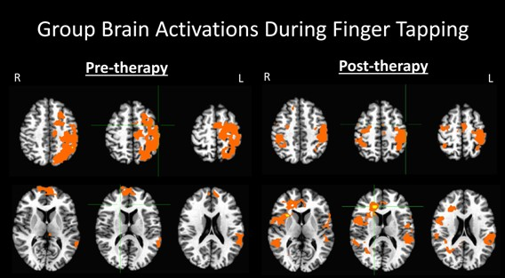
Neurogenesis
Image: http://slideplayer.com/slide/9784949/31/images/12/Stroke+patients+rewired.jpg

Slide 7
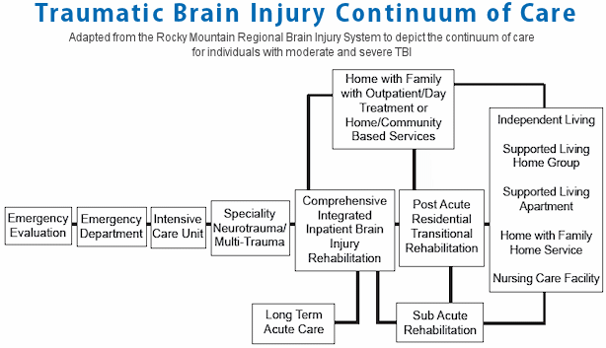
Treatment
Image:http://www.biausa.org/brain-injury-treatment.htm

Slide 8
Community Involvement and Self Participation
Participation post injury within personal tasks and community involvement decreases (Wong et al. 2017)
Post BI patients found disparities in the Information and Technology Access, social attitudes toward them and their support systems and their physical environment (Wong et al. 2017)
This causes reduced participation and poorer affect toward the community and self

Slide 9
Physical Activity
Pairing EE with physical activity causes greater recovery and neurogenesis
Environmental Enrichment enhances the level of physical activity which then in turn has beneficial brain structure effects
Supported by AJ Hannan (2014)
Study on rodents in standard and enriched housing conditions
Showed that physical activity increased in the enriched environment and increased hippocampal neurogenesis
Supported by Frasca et al (2013)
Use it or lose it theory
Social leisure activity is associated with less cognitive decline
Physical activity proposed as a buffer against post-acute decline

Slide 10
Combined versus Monotherapy
Combined Therapy
Monotherapy
EE and stem cell therapy(Dunkerson et al. 2014)
Music evoked and memory training(Gurr and Foxhall. 2014)
EE with task specific training (Mala and Rasmussen. 2017)
EE with growth treatment factor (Mala and Rasmussen. 2017)
Task specific training and growth treatment factor (Mala and Rasmussen. 2017)
Environmental Enrichment
Neuropsychology
Rehabilitation
Physical therapy
Notes:
citations

Slide 11
Limitations
Small study pools
Animal models
Limited research on prior conditions
Only 24 sources used
Minimal research breaking down age, sex, race

Slide 12
Recommendations and Discussion
More research dividing the kinds of EE
Discontinue repetitive studies
Transition to human subjects
More research on post-acute decline and pre- injury conditions
Information more available to patients, families, and caretakers

Slide 13
Conclusion
Environmental Enrichment is a successful method to promote brain repair
Neuroplasticity and positive recovery effects sustain long term
Focus should be refined to separate demographics and different areas of EE

Slide 14
Questions?

Slide 15
References
Frasca, D., Tomaszczyk, J., Mcfadyen, B. J., & Green, R. E. (17 April 2013). Traumatic brain injury and post-acute decline: what role does environmental enrichment play? A scoping review. Frontiers in Human Neuroscience,7(31), 1-25. doi:10.3389/fnhum.2013.00031
Hannan, A. J. (2014). Review: Environmental enrichment and brain repair: harnessing the therapeutic effects of cognitive stimulation and physical activity to enhance experience-dependent plasticity. Neuropathology and Applied Neurobiology,40(1), 13-25. doi:10.1111/nan.12102
Kelly, J. C., Amerson, E. H., & Barth, J. T. (2012). Mild Traumatic Brain Injury: Lessons Learned from Clinical, Sports, and Combat Concussions. Rehabilitation Research and Practice,2012, 1-5. doi:10.1155/2012/371970
Malá, H., & Rasmussen, C. P. (2017). The effect of combined therapies on recovery after acquired brain injury: Systematic review of preclinical studies combining enriched environment, exercise, or task-specific training with other therapies. Restorative Neurology and Neuroscience,35(1), 25-64. doi:10.3233/rnn-160682
Richardson, C., McKay, J., & Ponsford, J.L. (2014) The trajectory of awareness across the first year after traumatic brain injury: The role of biopsychosocial factors, Brain Injury, 28:13-14, 1711-1720, DOI: 10.3109/02699052.2014.954270
Traumatic Brain Injury & Concussion. (2017, July 06). Retrieved September 20, 2017, from https://www.cdc.gov/traumaticbraininjury/index.html

Slide 16
References
Traumatic Brain Injury Information Page. (n.d.). Retrieved November 21, 2017, from https://www.ninds.nih.gov/Disorders/All-Disorders/Traumatic-Brain-Injury-Information-Page
Treatment. (n.d.). Retrieved October 18, 2017, from http://www.biausa.org/brain-injury-treatment.htm
Wong, A. W., Ng, S., Dashner, J., Baum, M. C., Hammel, J., Magasi, S., . . . Heinemann, A. W. (2017). Relationships between environmental factors and participation in adults with traumatic brain injury, stroke, and spinal cord injury: a cross-sectional multi-center study. Quality of Life Research,26(10), 2633-2645. doi:10.1007/s11136-017-1586-5

