Slide 1
“You’re Sexist!” “No, I’m a Sports Reporter”: A Study of Female and Male Athletes' Perceptions in Sports
By: Lauryn Beam

Slide 2
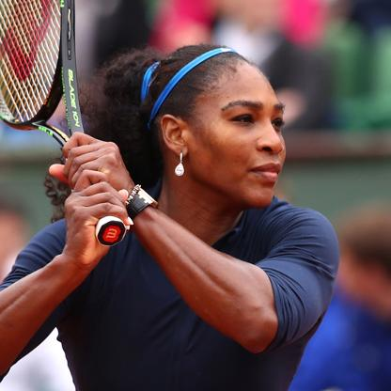
Serena Williams v. John McEnroe
Brandi Chastain v. Nicolas Anelka

Slide 3
Research Question
Are female athletes portrayed more negatively than male athletes in print media during scandals?

Slide 4
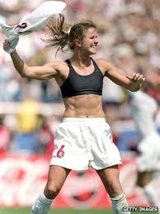
Methodology
Two articles for each athlete
Basic Information
Further analysis
Compare who was portrayed more negative

Slide 5
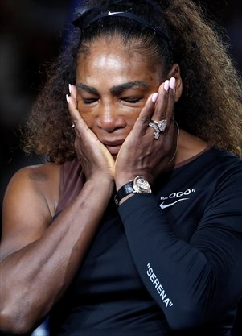

Slide 6
Serena Williams v. John Mcenroe
Williams:
“US Open Umpire on Serena William’s controversy: Do Not Worry about me”
Little Concern for Williams
Focus on the umpire
Described Williams with aggressive actions
“Serena Williams Accuses Official of sexism in US Open Loss to Naomi Osaka”
Williams is the enemy, Osaka the victim
Williams anger escalated
Accused her of ruining win for Osaka
McEnroe:
“British Umpire view Verbal abuse with Quiet Frustration”
Explains history
Past player quotes
“Brat behavior”
Stereotyped American athletes
“McEnroe is fined $2,100”
Temper hurts the game of tennis
Used past players quotes

Slide 7
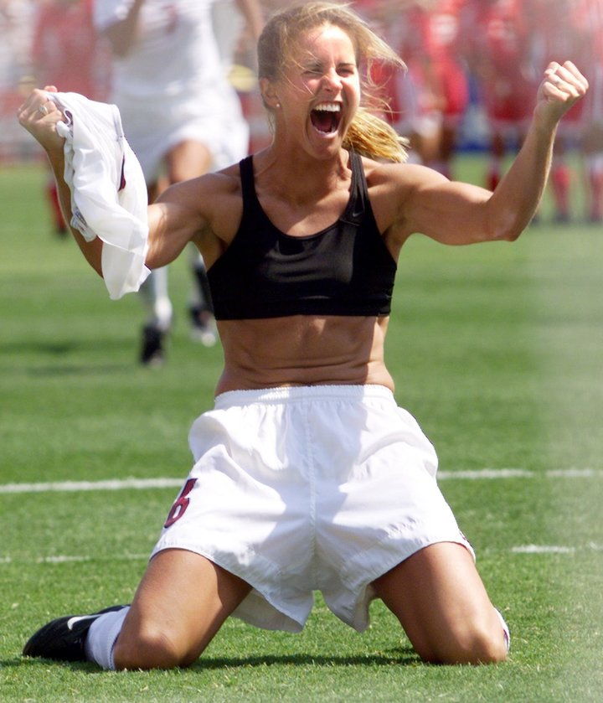

Slide 8
Brandi Chastain v. Nicolas anelka
Chastain
“Sports Business: Was Sports Bra Celebration Spontaneous?”
Nike told her to do it
Publicity stunt
Took credit away
“Why Women’s World Cup Champion exposed Bra”
Describe the game itself
Revolutionize women sports
Focus was on Chastain and game play
Anelka
“Nicolas Anelka Gesture: striker said to be ‘gobsmacked’ by international row over his ‘quenelle’ celebration amid calls for him to be banned”
Support for French Comedian
Used Anelka’s quotes
Anelka did not see religion involved
“Nicolas Anelka’s quenelle gesture in support of friend Diedonne causes outrage in France”
History
Explained symbol origin
Involved more of the association

Slide 9
Results
Male athletes were portrayed more negatively than females in both instances. However, women were seen to be removed from their articles.

Slide 10
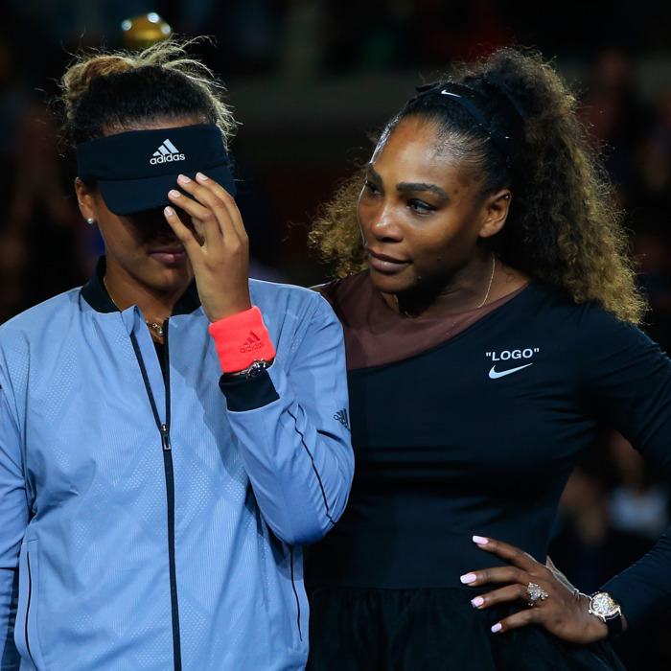
Conclusions
Explanation of Differences
Promotion of Female Sports
Effect on Sports World
Change?
Further Research

Slide 11
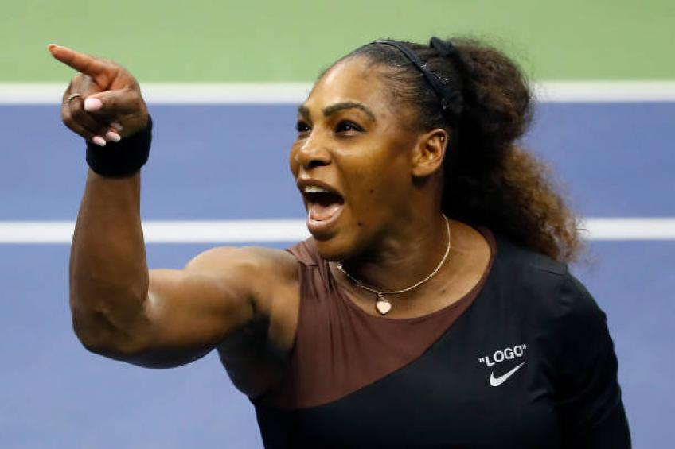
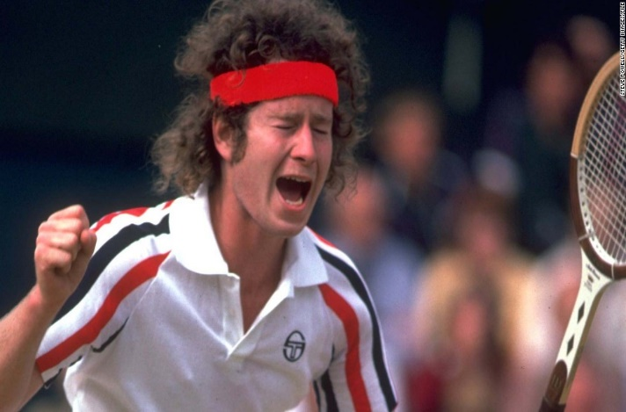
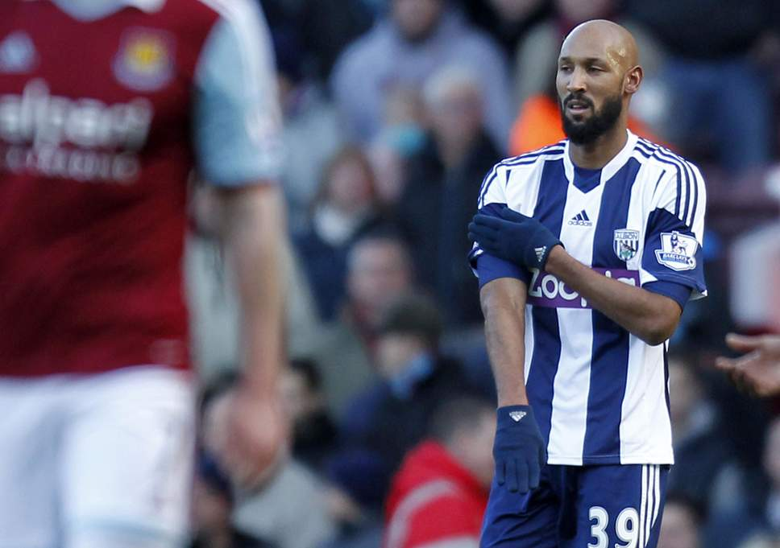
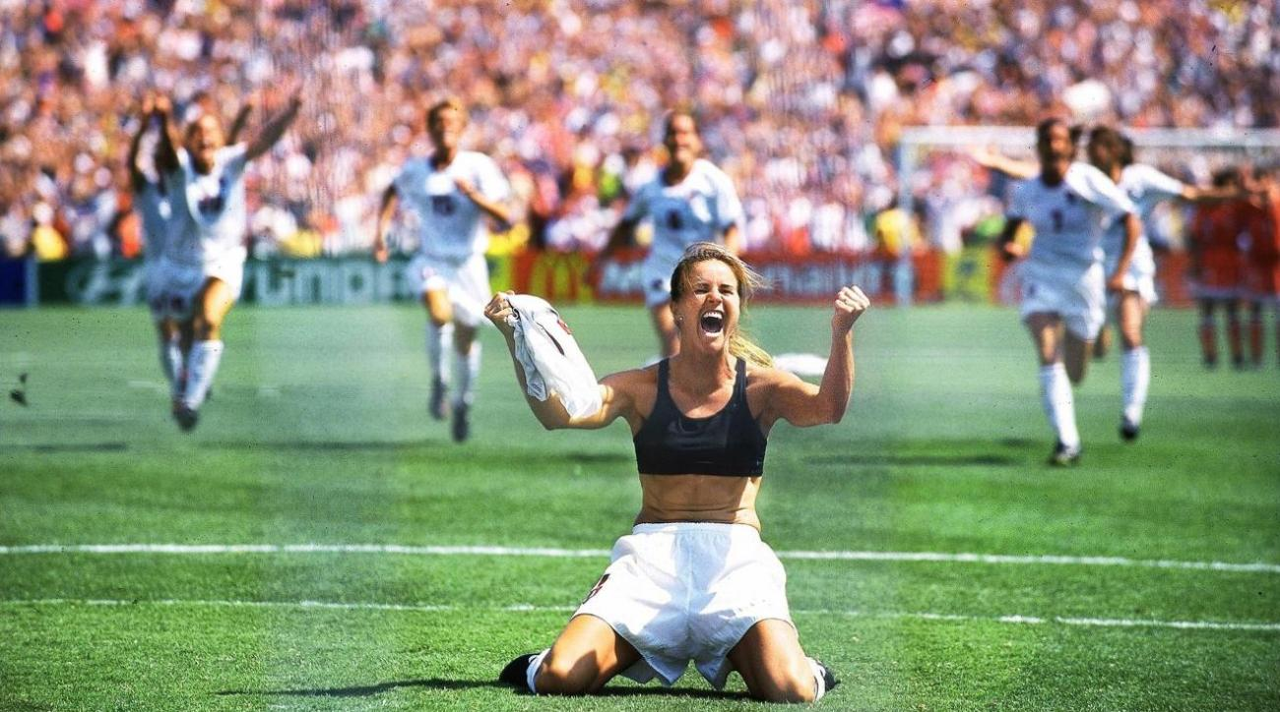
Questions?

