Slide 1
The Effects of Cognitive Stimulation of Instagram on Anxiety, Memory, Fear of Missing Out, and Self-Esteem
Anna Destino

Slide 2
Outline
Introduction
Background Research
Research Question and Hypotheses
Method
Results
Discussion and Conclusion
Future Research
References
Acknowledgments
Questions

Slide 3
Background Research
Jarrett (2016)
Executive functioning among emerging adults
Emerging Adults- developmental stage 18-25
Findings
Those with decreased executive functioning exhibited heightened anxiety and inattention
Executive functioning and working memory
Notes:
-studied the deficit in executive functioning among emerging adults, specifically those with ADHD and anxiety
-college students completed scales that assessed anxiety, ADHD, and general psychological distress
-working memory is someone’s ability to pull information from their long-term memory to their attention by recalling the information

Slide 4
Background Research
Lillard and Peterson (2011)
Studied exposure to stimulating television shows in children
Effect on executive functioning
Findings
Fast-pace resulted in lower memory recall
Notes:
Executive function- various skills that allow all ages to execute various tasks through memory, attention, self-regulation, and alertness
Results: exposure to fast-paced television shows affected children’s short-term memory
Current research- shifting attention and the fast-pace of viewing may be similarly cognitively stimulating for emerging adults when viewing Instagram

Slide 5
Background Research
Kross et al. (2013)
Satisfaction with life- anxiety and self-esteem
Findings
Heightened Facebook use, heightened anxiety and lower self-esteem
Notes:
Looked at effects of social media (Facebook) use on immediate emotional well-being and satisfaction with life
Satisfaction with life was measured using anxiety and self-esteem scales

Slide 6
Background Research
Przybylski et al. (2013)
Fear of Missing Out (FoMo)- seeing others engage in behaviors you wish to be a part of
Findings
Young adults have highest FoMo
Higher FoMo, more social media use
Deficit in psychological well-being, turn to social media
Notes:
Definition- FoMo can be defined as a sense of anxiety or loneliness because of seeing other friends or followers on social media engaging in behaviors or activities that they wish they were a part of

Slide 7
Research Questions
Does Instagram stimulation affect...
Memory recall?
FoMo?
Anxiety level?
Self-esteem?

Slide 8
Variables
Independent Variables:
Cognitive Stimulation
Level 1: Instagram (experimental group)
Level 2: Coloring (control group)
Time (pre- and post-test)
Dependent Variables:
Memory Recall
Fear of Missing Out (FoMo)
Anxiety
Self-Esteem
Notes:
Chose coloring on an ipad to be consistent so that using technology was not an extraneous variable

Slide 9
Hypotheses
Participants in the experimental group (Instagram) are expected to have higher levels of FoMo and lower memory recall than the control group (coloring).
Participants in the experimental group (Instagram) will have increased anxiety and decreased self-esteem from the pre- to post-test condition.
Participants in the post-test experimental group (Instagram) will have the highest anxiety and lowest self-esteem.

Slide 10
Participants
90 University of Lynchburg students (89% female)
Age
Mean= 19.24
Standard Deviation= 1.12
74% White, 11% Black/African-American
53% Single
16% had visited Italy
Notes:
Explain recruitment

Slide 11
Participants
Instagram Use (hours per week)
Mean= 6.67
Standard Deviation= 4.87
Opens/Checks Instagram (times per day)
Mean= 9.87
Standard Deviation= 9.06

Slide 12
Materials
Demographics
Memory- Memory Scale
FoMo- Fear of Missing Out Scale (Przybylski et al., 2013)(α= .82)
Anxiety- Hospital Anxiety and Depression Scale (HADS) (Bjelland et al., 2002)(α= Pre-HADS .79 & α= Post-HADS .83)
Self-Esteem- State Self-Esteem Scale (SSES) (Heatherton & Polivy, 1991)(α= Pre-SSES .83 & α= Post-SSES .84)
Social Self-Esteem (α= .85 Pre-Social SESS & α= .88 Post-Social SSES)
Appearance Self-Esteem (α= .86 Pre-Appearance SESS & α= .84 Post-Appearance SESS)
Perception of Instagram Use
Notes:
Memory- 10 questions
FoMo- 10 questions
Anxiety- 7 questions
SSES- 13 questions (half & half social and appearance) (with the exclusion of question four for both Pre and Post-SESS totals because it did not prove to be internally consistent)
Perception of Instagram Use- 4 questions

Slide 13
Procedure
Pre-Test
Demographics Questionnaire
Self-Esteem
Anxiety
Study Abroad Presentation (5 min.)
Notes:
Pre-test- demographics, anxiety, and self-esteem scales
Then I gave a 5-minute presentation about my study abroad experience
Framed as promoting study abroad
Talked about the class I took, excursions, and take away message

Slide 14
Procedure
10 minutes of Cognitive Stimulation
Coloring on iPads
Instagram
Post-Test
Perception of Instagram Use Questionnaire
Memory Scale
FoMo Scale
Anxiety Scale
Self-Esteem Scale
Notes:
10-minutes of cognitive stimulation- randomly assigned to coloring on an iPad or scroll through Instagram
Post-test- the perception of Instagram use only for the Instagram condition, same anxiety and self-esteem scales, FoMo, and memory scales

Slide 15
Data Analyses
Independent Samples T-test
FoMo
Memory Recall
2 (Time) x 2 (Condition) mixed model ANOVA
Time- pre- and post-test (within)
Condition- Instagram vs. Coloring Groups (between)
Notes:
Independent Samples T-Test- significance between the Instagram and coloring groups
Mixed Model ANOVA (time)- pre- and post-test evaluation for anxiety, self-esteem, social self-esteem, & appearance self-esteem (within)
Mixed Model ANOVA (condition)- Instagram versus coloring condition for anxiety and self-esteem (between)

Slide 16
Results: T-Test
Memory Recall
Not significant, t (88) = 1.39, p = .17
FoMo
Significant, t (88) = -2.40, p = .018
Notes:
Memory recall saw no significant difference between the Instagram and coloring condition
FoMo saw a significant difference between the Instagram and coloring condition as the Instagram group had higher levels of FoMo than the coloring group

Slide 17
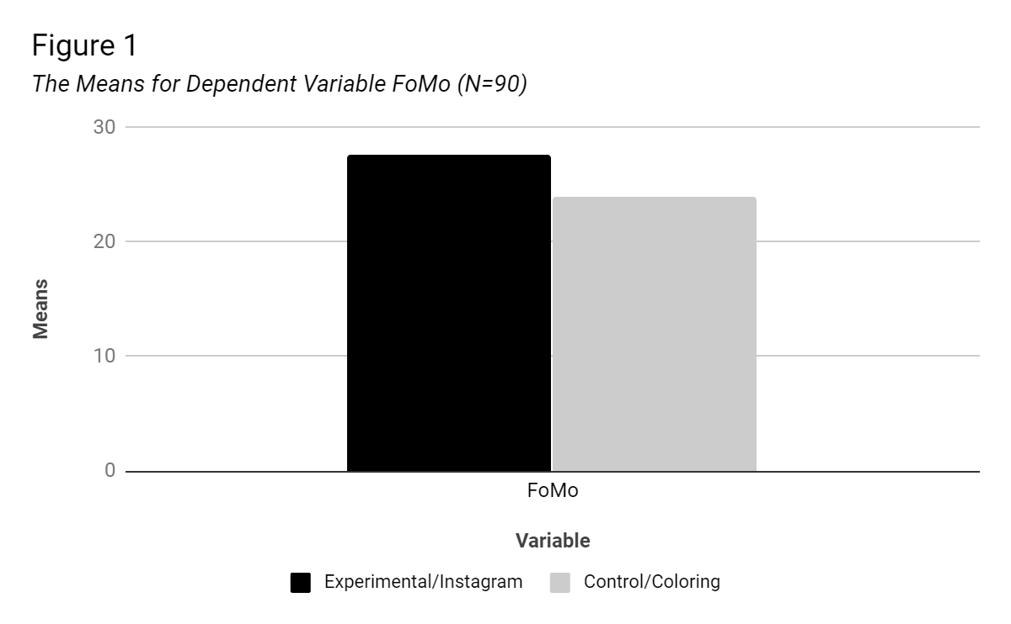
FoMo Figure
Notes:
Here you can see the means for the Instagram versus the coloring group with the instagram group mean of 27 and coloring group mean of 24

Slide 18
Results: Time
Anxiety
Not significant, F (1,88) = 1.38, p = .24, η² = .02
Self-Esteem
Overall Self-Esteem
Significant, F (1,88) = 14.04, p = .001, η² = .14
Social Self-Esteem
Significant, F (1,88) = 18.31, p = .001, η² = .172
Appearance Self-Esteem
Not significant, F (1,88) = 1.60, p = .21, η² = .02
Notes:
Looking at the factor of time which was comparing pre to post test, within subjects results:
-anxiety was not significant overall for any participants regardless of condition
-overall self-esteem and the subscale of social self-esteem were significant => means that viewing social media demonstrated a slight increase in overall and social self-esteem from the pre to post-test
-appearance self-esteem did not significantly change from the pre to post-test condition

Slide 19
Self-Esteem Descriptive Statistics
Means and Standard Deviations for {Social} Self-Esteem (N= 90)
Variable | Factor |  | M | SD
Self-Esteem | Time | Pre-Test | 42.13 | 6.01
 |  | Post-Test | 43.62 | 8.34
Social Self-Esteem | Time | Pre-Test | 23.32 | 6.01
 |  | Post-Test | 24.56 | 6.17
Note: maximum score is 65.
Note: maximum score is 35.

Slide 20
Results: Condition
Anxiety
Not significant, F (1,88) = .002, p =.96, η² = .01
Self-Esteem
Overall Self-Esteem
Not significant, F (1,88) = .20, p =.66, η² = .001
Social Self-Esteem
Not significant, F (1,88) = .72, p =.40, η² = .008
Appearance Self-Esteem
Not significant, F (1,88) = .003, p =.96, η² = .001

Slide 21
Results: Interaction of Condition & Time
Anxiety
Not significant, F (1,88) = .85, p = .36, η2 = .01
Self-Esteem
Overall Self-Esteem
Not significant, F (1,88) = .35, p = .56, η2 = .004
Social Self-Esteem
Not significant, F (1,88) = 2.24, p = .14, η2 = .03
Appearance Self-Esteem
Not significant, F (1,88) = .09, p = .76, η2 = .001

Slide 22
Implications
FoMo
Felt left out or jealous based on friends activities
Memory Recall
Emerging adults may be better at short-term attention shifts
Instagram may not be cognitively stimulating enough
Anxiety
General anxiety may not be affected
Self-Esteem
Self-esteem increased for all participants
Notes:
Memory- may be that viewing Instagram does not cause the same cognitive effect in emerging adults that viewing a fast-paced tv show does in children, perhaps emerging adults are cognitively better at shifting their attention, or not stimulating enough like spongebob (shifts every 11 seconds) and inconsistent with previous research
FoMo- with a short 10-minute stimulation period, participants may have felt that after seeing their friends having fun and portraying themselves in a desirable way that they were jealous and wanted to engage in similar activity, consistent with previous research
Anxiety Why- perhaps Instagram and anxiety are not related or 10 minutes was too short, may have caught on to anxiety being measured b/c pre- and post-test and is not consistent with previous research
Self-esteem significance- aspects of self-esteem are affected, not consistent with hypothesis but support the null hypothesis that self-esteem increases over time perhaps participants did not use social media long enough to affect self-esteem and viewed for a short period of time and felt better about self for shorter periods of viewing consistent with previous research

Slide 23
Limitations and Future Research
Social desirability
Methodological design
Different presentation topic
Comparing different platforms of social media
Long-term effects of FoMo
Notes:
Problem- experienced participant bias from guessing what the experimenter was looking for
Future Research- evaluating self-esteem and anxiety overall rather than considering time, only have one anxiety and self-esteem scale evaluate like memory and FoMo
Problem- perhaps topic was too interesting or the memory recall questions were not difficult enough to evaluate memory
Future research- could chose a more broad and generalized topic with more difficult memory recall questions
Problem- general anxiety was not involved using Instagram but perhaps other forms of social media
Future research- compare different platforms of social media and how each one individuals evokes social media as well as having several social media sources
Future research- may want to look specifically at appearance self-esteem by using a more extensive scale
Future research- long term effects of FoMo

Slide 24
References
Jarrett, M. A. (2016). Attention-Deficit/Hyperactivity Disorder (ADHD) symptoms, anxiety symptoms, and executive functioning in emerging adults. Psychological Assessment, 28(2), 245-250. doi:10.1037/pas0000190
Kross, E., Verduyn, P., Demiralp, E., Park, J., Lin, N., Shablack, H., . . . Ybarra, O. (2013). Facebook use predicts declines in subjective well-being in young adults. PLoS One, 8(8), e69841. doi:10.1371/journal.pone.0069841
Lillard, A. S., & Peterson, J. (2011). The immediate impact of different types of television on young children's executive function. Pediatrics, 128(4), 644. doi:10.1542/peds.2010-1919
Przybylski, A. K., Murayama, K., DeHaan, C. R., & Gladwell, V. (2013). Motivational, emotional, and behavioral correlates of fear of missing out doi:https://doi.org/10.1016/j.chb.2013.02.014

Slide 25
Acknowledgements
Dr. Marciano- Capstone Advisor
Dr. Cylke- Committee Member
Dr. Kicklighter- Westover Thesis Advisor

Slide 26
Questions
Thank You

