Slide 1
Autonomous Watercraft Simulation and Programming
Nicholas J. Savino
University of Lynchburg
Department of Physics

Slide 2
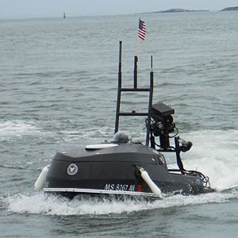
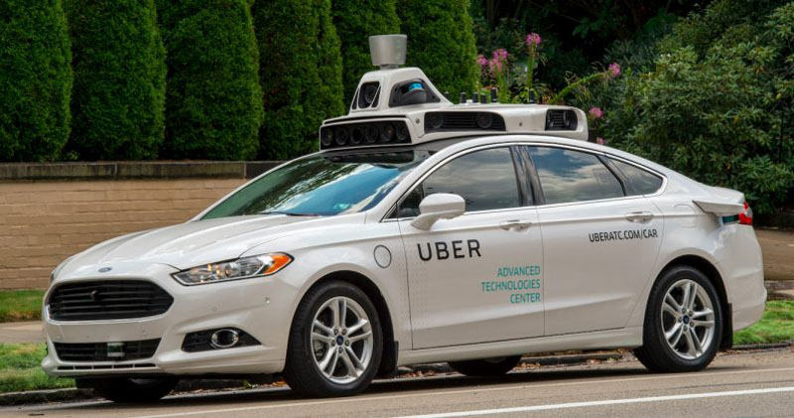
Autonomous Vehicles
Sigfusson, Lauren. “Autonomous Cars.” Discover Magazine, 2018.
Hambling, David. “The Navy's Terrorist Hunting Robot Jet Ski.”
Popular Mechanics, Popular Mechanics, 14 Nov. 2017.

Slide 3
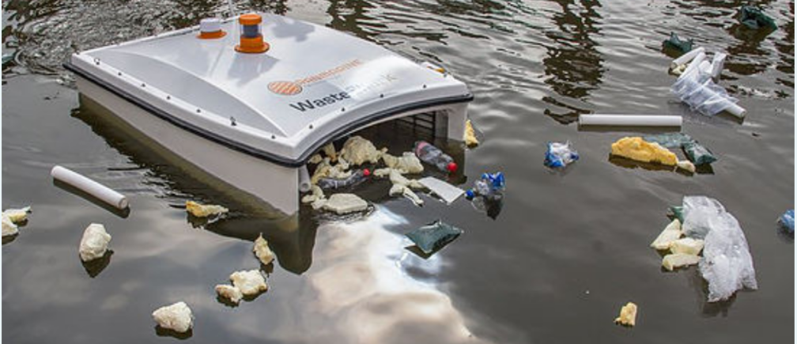
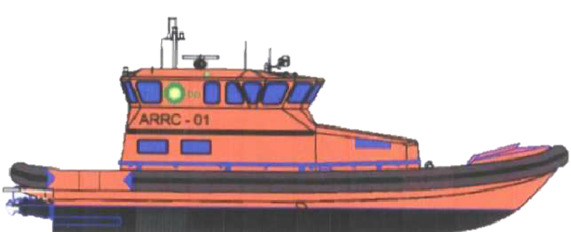
Applications of Autonomous Watercraft
Hunt, Kristin. “This Floating Drone Sucks up Trash.”
World Economic Forum, 29 Aug. 2018.
United Nations. “UNHCR Appalled at News of Refugee and
Migrant Deaths on Mediterranean Sea.” UNHCR,
United Nations, 19 Jan. 2019.
Quinn, S & Moy, S.s.J. & Piggott, Keith. (2006).
Combined Lifting Analysis and Load Test of a
Hook Foundation in a GRP Hull. Applied
Mechanics and Materials. 5-6. 101-106.

Slide 4
Python Simulation
$$\hat{d}$$
$$θ$$
Watercraft
Target Object
$$\vec{stepmax}$$
$$\vec{step}$$
|$\vec{step}|=\vec{stepmax}∙\hat{d}=|\vec{stepmax}|\cos{θ }$

Slide 5
Simulation Results and Discussion
Paths Taken Finding a Randomly Moving Target with No Bias
Paths Taken Finding a Randomly Moving Target with a Bias
Watercraft
Target Object
Distance in y-direction (m)
Distance in y-direction (m)
Watercraft
Target Object
Distance in x-direction (m)
Distance in x-direction (m)

Slide 6
Paths Taken Over 100 Runs (Randomly Moving Target with a Bias)
Watercraft
Target Object
Distance in y-direction (m)
Distance in x-direction (m)

Slide 9
Conclusions and Future Work
More simulations must be done
Linearly variable speed simulations
Machine learning
Experimental land and water based tests

Slide 10
Acknowledgments
Westover Honors College
Lynchburg College of Arts and Sciences
Thesis Committee
Dr. William Roach
Dr. Crystal Moorman
Dr. Nancy Cowden

Slide 11
Questions?

