Slide 1

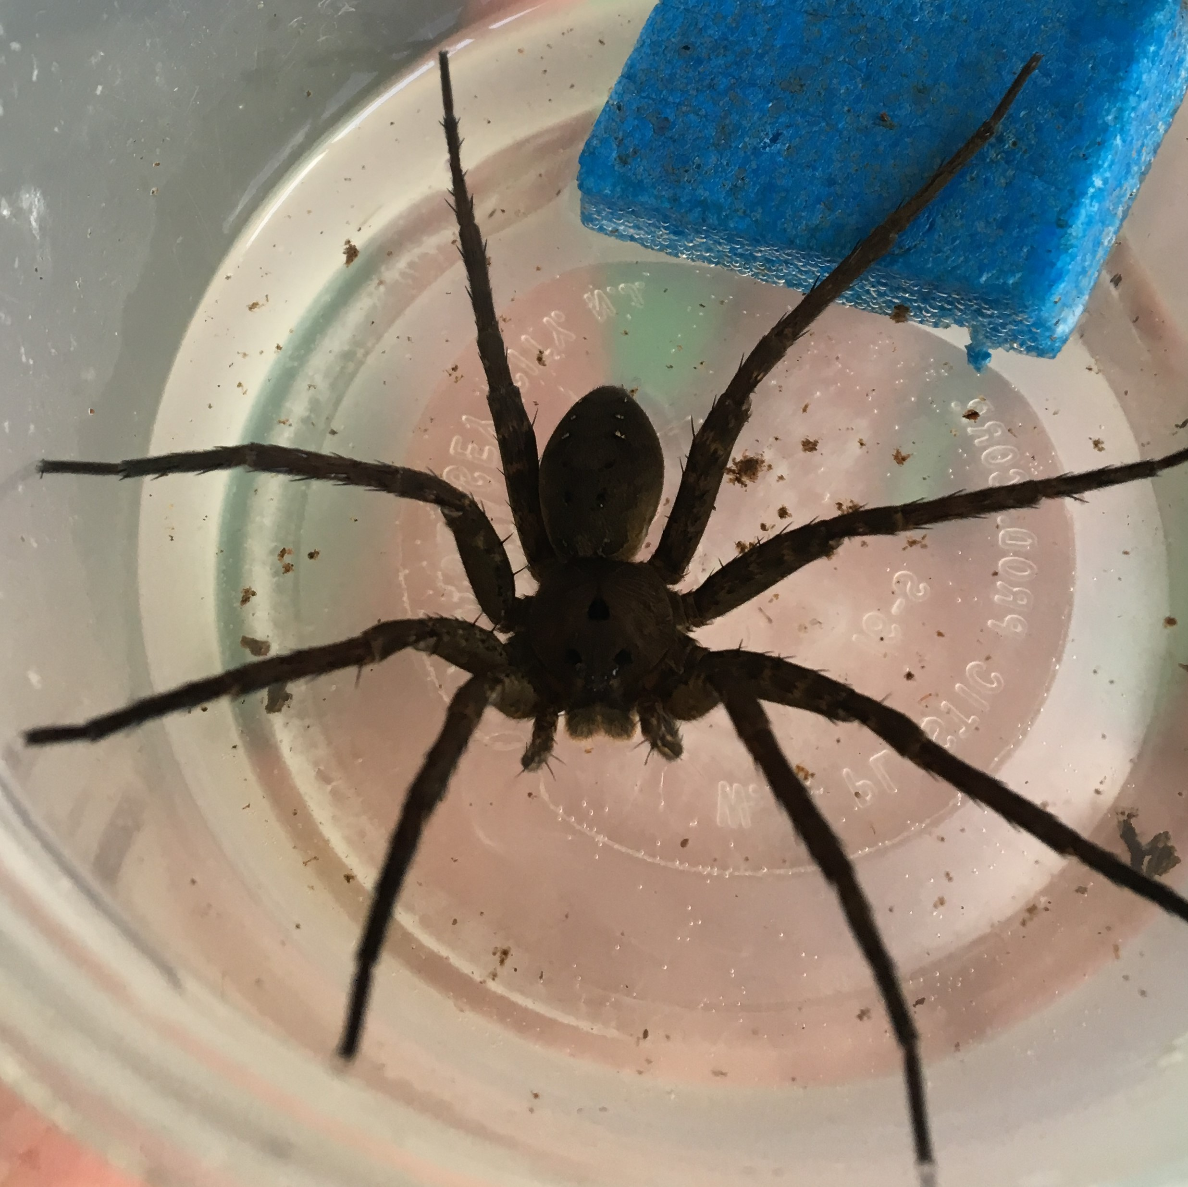
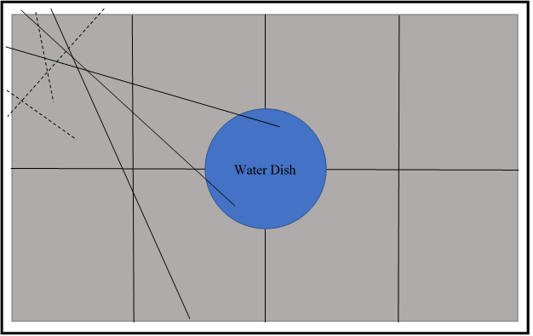
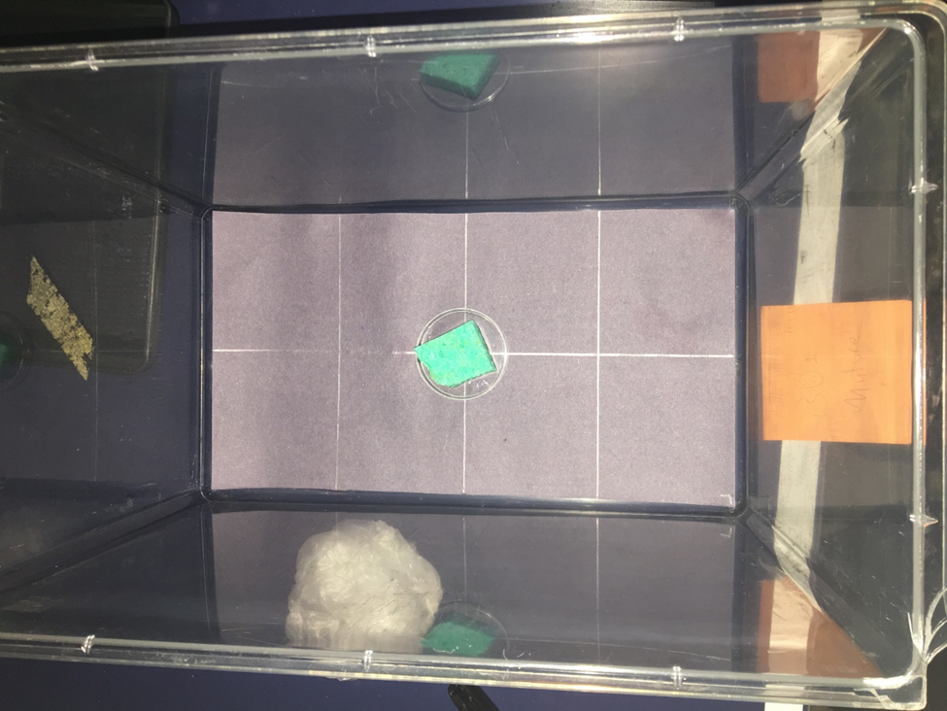
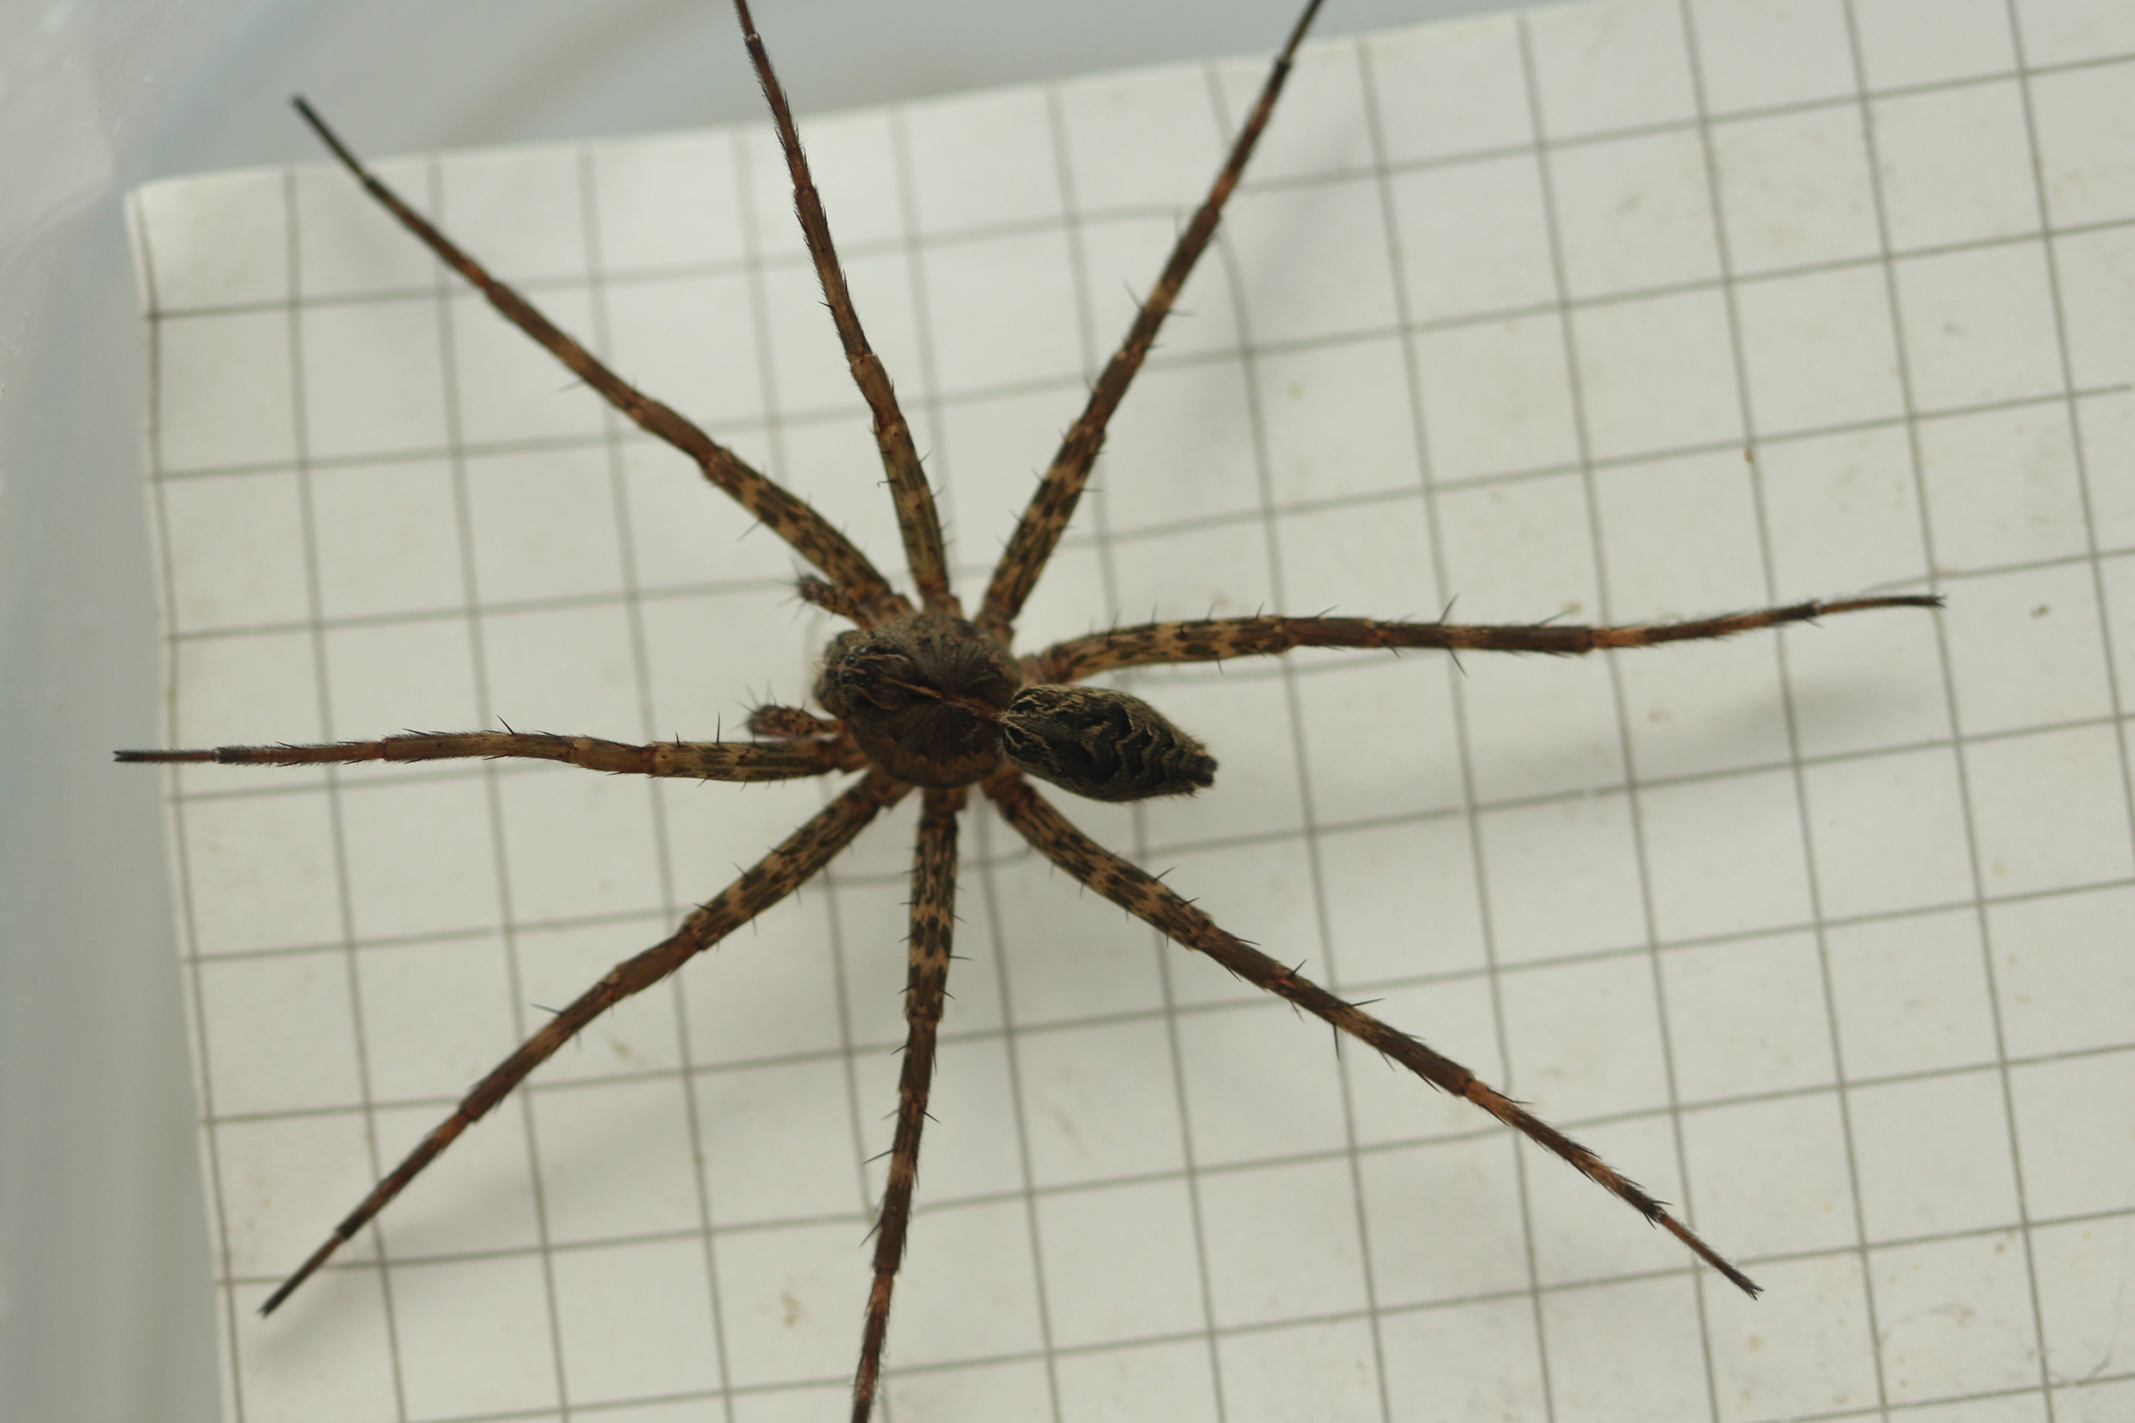

Age Status Effects on Female Silk Production and Male Courtship Response in Dolomedes scriptus
Joe Osborne & Dr. Benson
MAIE LAB
Department of Biology, School of Science, University of Lynchburg, Lynchburg, VA
Abstract
Discussion
Female Dolomedes scriptus, the striped fishing spider, serve as model organisms exhibiting pheromone production as a means of chemical signaling. Previous work has shown that male fishing spiders are responsive to female silk and preferentially court in the presence of silk from mature virgins. In our research we hypothesized that mature females produced larger quantities of silk than penultimate females in an attempt to elicit greater male mating response. Female spiders of both age statuses were kept for two days in a gridded tank. Sub-sampling of silk lines that crossed a random portion of the grid produced results signifying the variation of silk production between statuses. Mature female spiders produced more silk than penultimate females, suggesting that females facultatively use silk to enhance male search, thus potentially increasing their encounter rate with suitable males. Further analysis of male behavioral responses to deposited female silk fails to support the previous findings, but this may be due to experimental limitations.
.
Our results show there is a significant difference in silk production between penultimate and mature female D. scriptus. This indicates support for higher amounts of silk production in mature females correlating to the need for increased expression of some chemical factor present on silk that elicits courtship behavior.
Our silk production analysis results suggest there should be some detectable behavioral difference in males’ response to female silk of different statuses. Nonsignificant results produced in our behavioral analysis yield several conditions.
Slow moving behavior and pedipalp tracing were stronger indicators of chemo-exploration because they are more synonymous with search behavior and were more often observed in mature male D. scriptus.
Grooming did not occur in any trials until the male disturbed a silk line. This pattern could indicate male spiders engaged in grooming behaviors partly to interact with the silk and attempt to interpret communication.
Introduction
Reproductive economics drives the decision-making process in selecting potential mates in sexually reproducing species.
Physical limitations of specific species determines the mode of communication (i.e. auditory, visual, tactile, etc.) Female spiders signal their intent to reproduce through pheromones emitted during silk production. Males need to be able to receive the cue, interpret its message, and act on it.
        Pisauridae is the family of nursery web spiders containing the Dolomedes genus. Dolomedes represent semi-aquatic fishing spiders that live in the Nearctic region of North America. Their dragline silk is used for protection while hunting as well as facilitating the release of pheromones.
We hypothesized that mature females would produce increased amounts of silk compared to penultimate females to increase the probability in securing a mate by emitting the most pheromones.
Figure 1 (Left): Representation of a corner of the grid that depicts silk lines that were counted (solid) and silk lines that were not counted (dashed) during the 48-hour silk quantification trials. (Right) Aerial view of an actual tank and grid setup.
Results
Silk Quantification
Moving Forward…
Date of Silk Collection | Penultimate ID | Silk Lines Counted (per 7.62cm²) | Mature ID | Silk Lines Counted (per 7.62cm²)
3-Jul | 306 | 12 | 305 | 30
 | 208 | 9 | 302 | 32
5-Jul | 308 | 1 | 411 | 22
 | 410 | 12 | 418 | 0
7-Jul | 419 | 9 | 408 | 26
31-Jul | 205 | 8 | 313 | 24
 | 405 | 14 | 403 | 30
6-Aug |  |  | 104 | 17
 |  |  | 314 | 32
 |  |  | 402 | 31
 |  |  | 102 | 3
Table 1: Number of silk lines recorded for penultimate and mature females after each 48-hour trial was conducted.
We used a Student’s t-test to analyze the silk quantities displayed from each 48-hour trial. Silk quantities produced from seven penultimate females were compared to 11 mature females. Mean quantity of silk was 9.49 lines (St. dev. = 4.23) for penultimate spiders and 22.45 (St. dev. = 11.9) . Mature females produced significantly more silk lines than penultimate females during the 48-hour trials (t(df) = 16, P = 0.0103).
Future attempts to recreate this research might consider analyzing variance in silk production among females in the presence of a male spectator. Discovering a correlation in silk production with heightened male courtship might benefit from analyzing male behavior in the direct presence of females simultaneously depositing silk. From this, trends in locations of female silk depositions in respect to the male spectator could indicate communication of chemical signals. The position of the male spectator relative to both females could suggest preference for a specific status.
Objectives
To quantify silk produced between penultimate and mature female Dolomedes scriptus.
To observe any significant behavioral responses of male D. scriptus to females’ silk of both statuses.
Behavioral Analysis
Materials & Methods
Figure 2: Mean responses (milliseconds) of 5 mature males to female penultimate and mature silk for a) total time spent removing silk from legs/body, b) total time spent maneuvering with 1 leg a time, c) total time interacting and following silk with pedipalps, and d) sum of previous three behaviors. Error bars represent standard deviations about the mean.
Behaviors observed during interactions of the mature males with silk from one penultimate and one mature female were analyzed with a paired t-test. No significant results were produced from the available data.
67 Dolomedes scriptus subjects were collected from the Big Otter River at the Claytor Nature Study Center of the University of Lynchburg in Bedford, VA.
Plastic storage containers, each filled with about an inch of water and containing a floatable foam piece, were used to individually house each spider after documentation
Forty-eight-hour trials were conducted in which spiders individually roamed in 15.24cm by 30.48cm Pal Pens™. Black construction paper gridded into 8, 7.62cm² squares, was placed under the Pal Pen and allowed for easier measurement of silk production by eye.
JWatcher v. 1.0 was used to score and analyze videos of mature male D. scriptus responses to the presence of silk from penultimate and mature females. Each response video was made by recording mature males in 10-minute bouts, each to one random penultimate female’s silk and one mature female’s silk.
Additional photograph depicting a typical mature Dolomedes scriptus female.
Acknowledgements
Contact Info.
*Joe Osborne
E-mail: osborne_j@Lynchburg.edu
Kari Benson, Ph.D.
E-mail: benson@Lynchburg.edu

