Slide 1
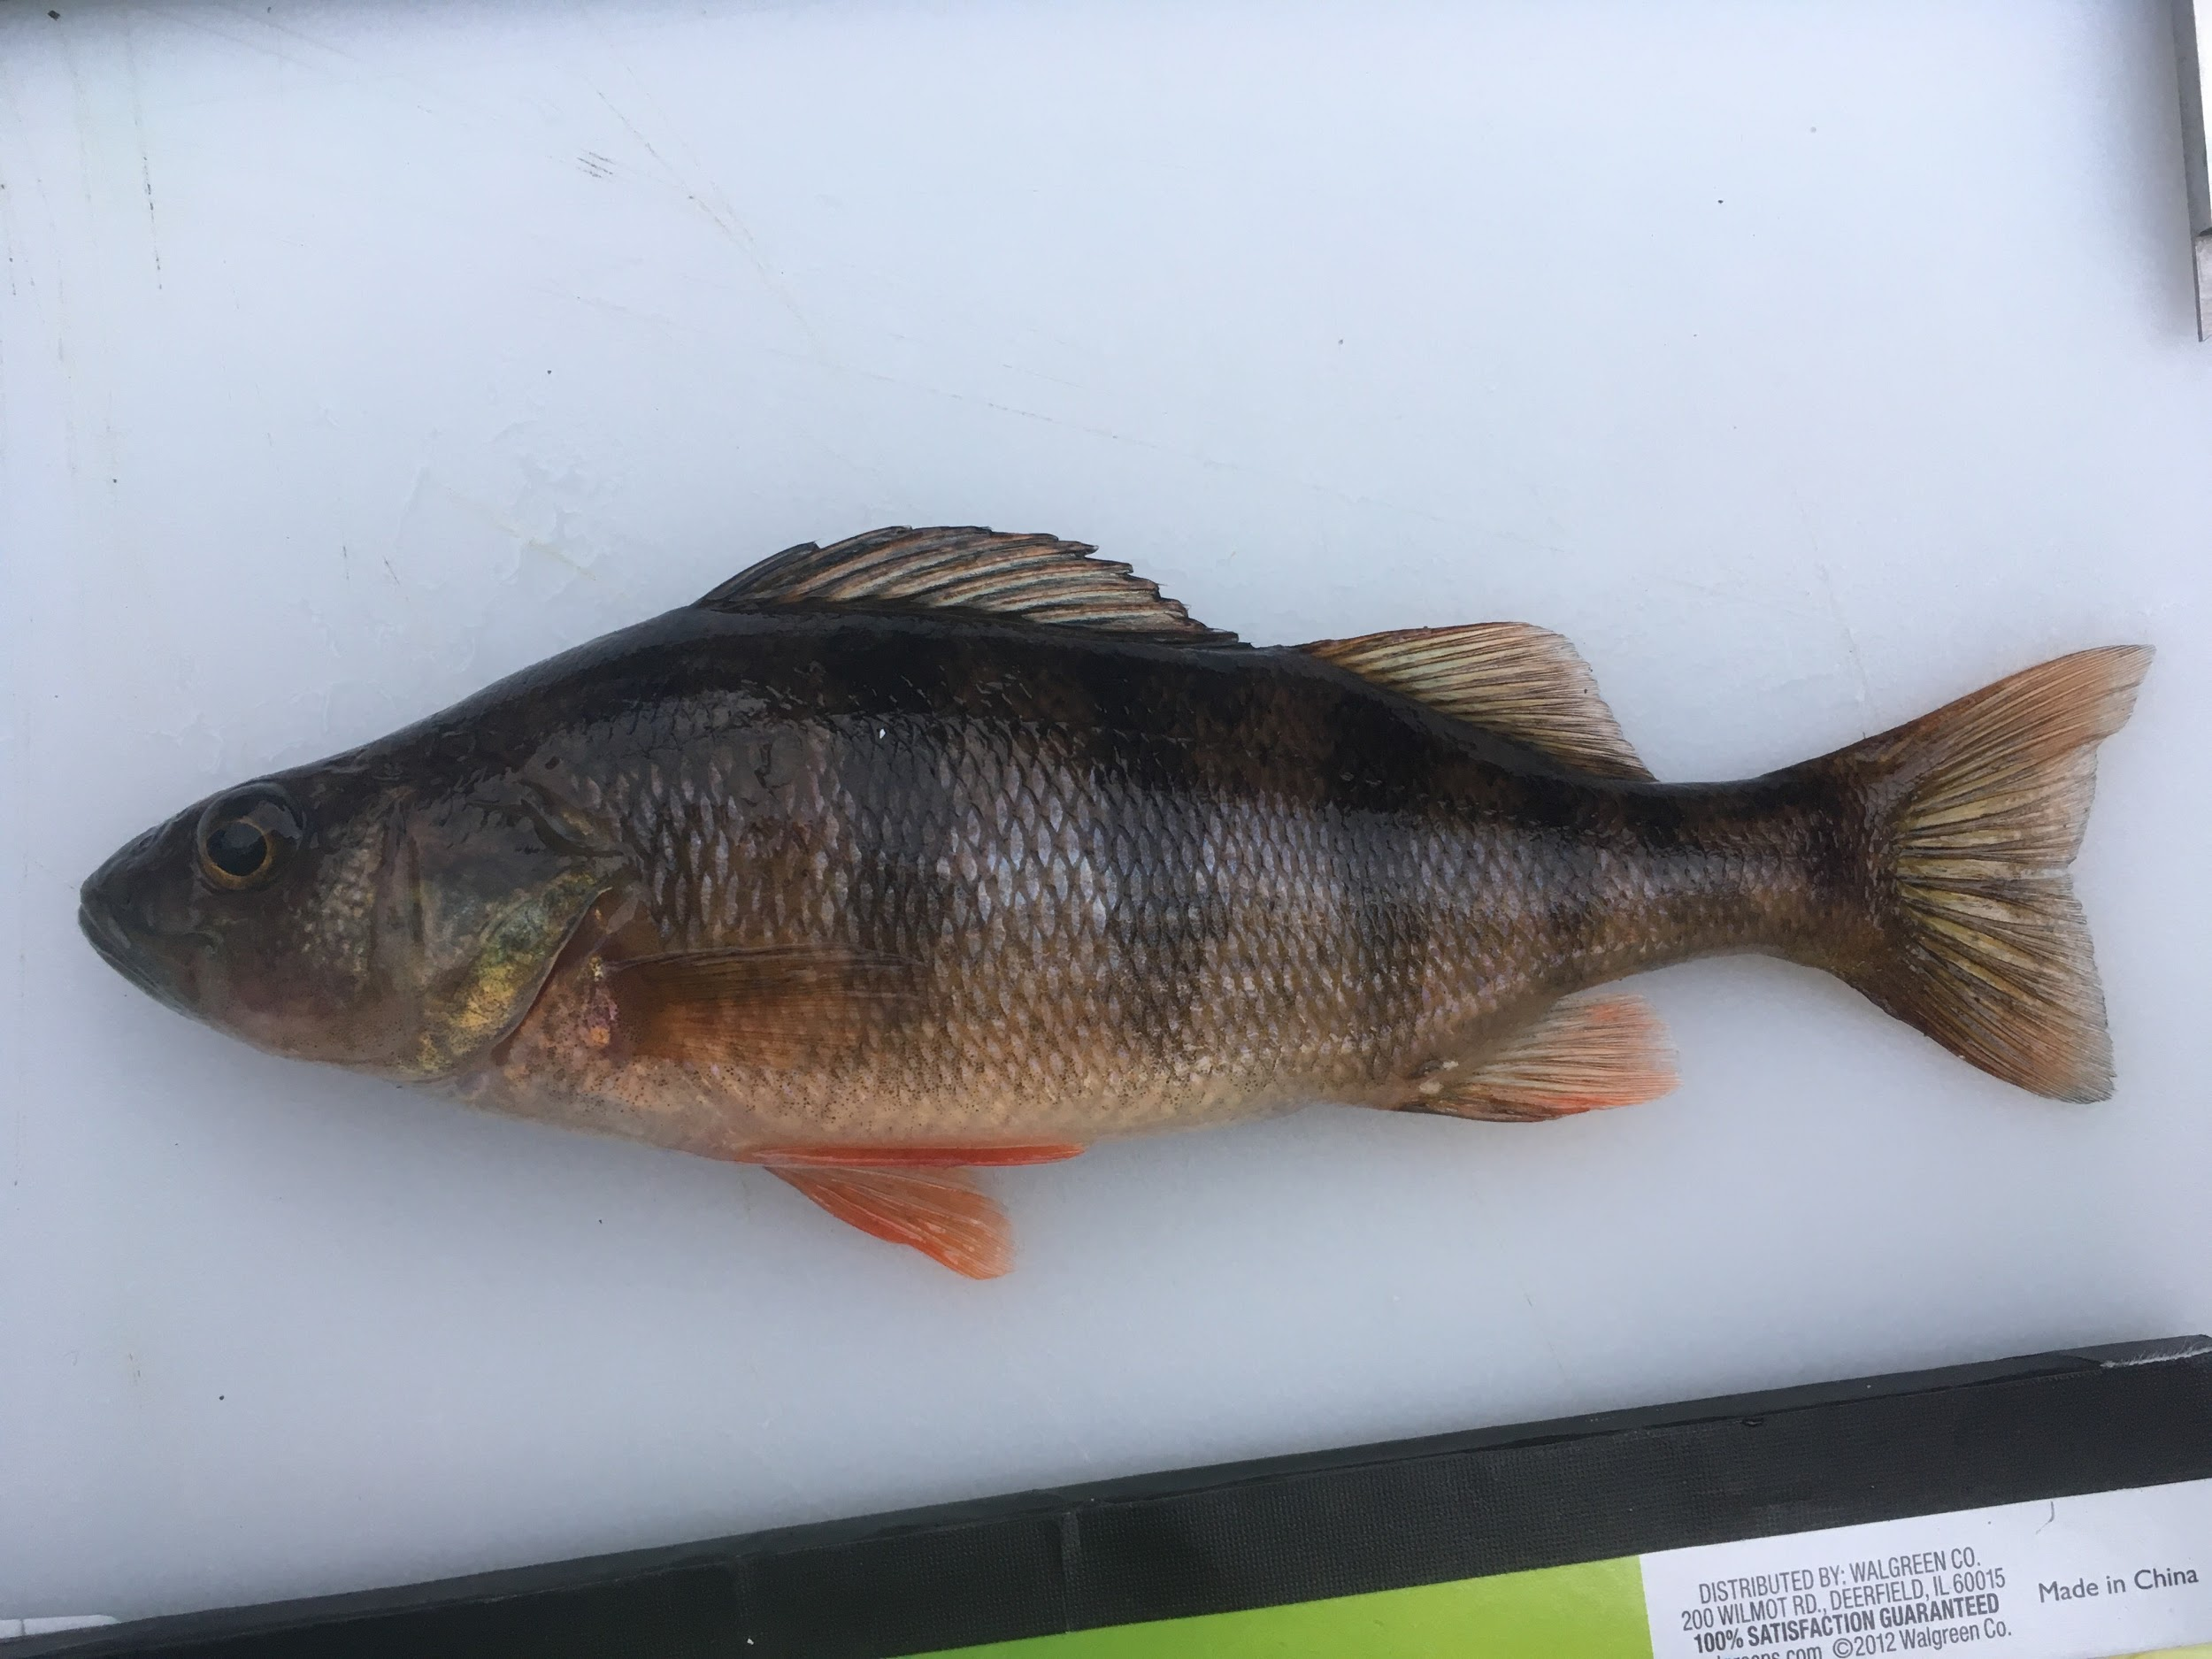
Mobilization of Calcium Across Mineralized Tissues in Yellow Perch, Perca flavescens
Taylor Bopp ‘19, Priscilla Gannicott PhD, & Takashi Maie PhD
Notes:
Hello, so as indicated by Dr. Crumpton, today I am going to present on the year and a half to two-year research project examining the difference in calcium concentrations in skin, scale, and vertebrae in two different Yellow Perch populations. One originating from a calcium rich environment and the other from a relatively calcium deprived environment.

Slide 2
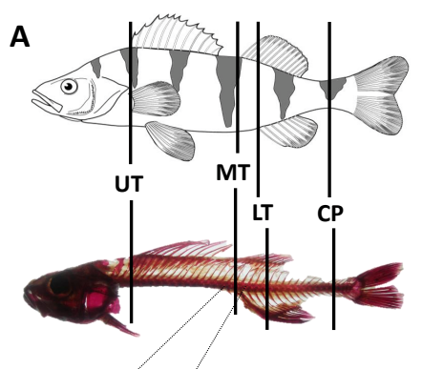
Introduction
Calcium function in bone modeling and remodeling
Higher teleost fish calcium homeostasis mechanisms⁴
Environmental calcium influx^{1,3,5,6}
Bone calcium reservoir²
Notes:
Introduce the different areas of the fish that will be examined (UT, MT, LT, and CP)
Can have a normal genotype with abnormal expression

Slide 3
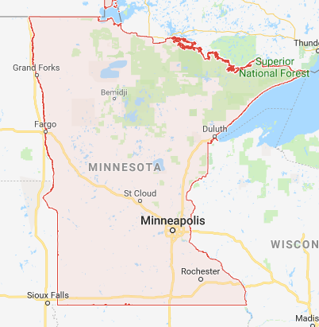
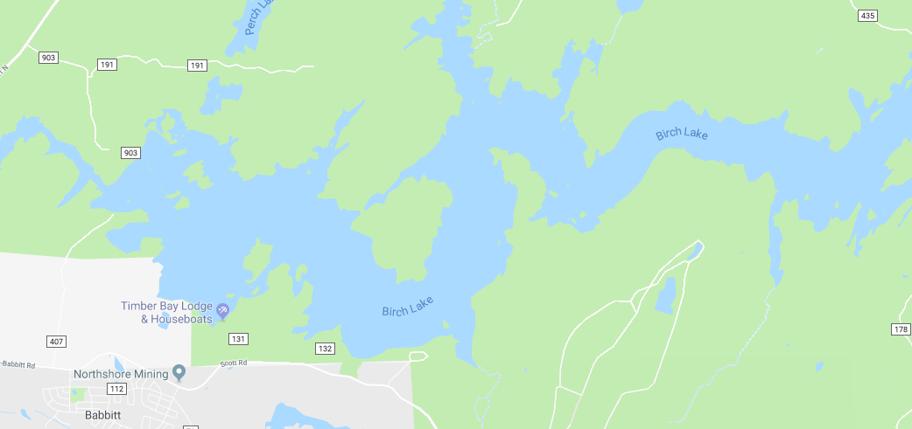
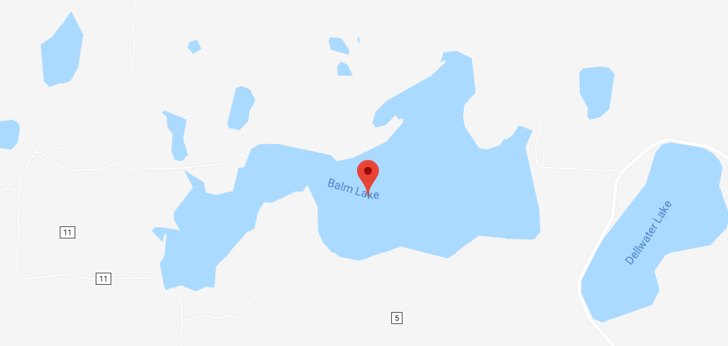
Study Cites
Google Maps:
Birch Lake: 85 ppm Ca²⁺
1 mile
Balm Lake: 250 ppm Ca²⁺
2000 ft.
Notes:
To begin the following research project,
Specimen were taken from either Birch Lake, Minnesota in the summer of 2017 (shown in the upper right-hand corner)
Or from Balm Lake, Minnesota (shown in the lower right-hand corner)
Both located in the northern part of the state with similar geographical characteristics
EXCEPT Birch Lake heavily influenced by a coal mine located on the southwest edge of the lake
The nearby mine and other factors therefore influenced the amount of calcium in the lake itself
Visibility differences

Slide 4
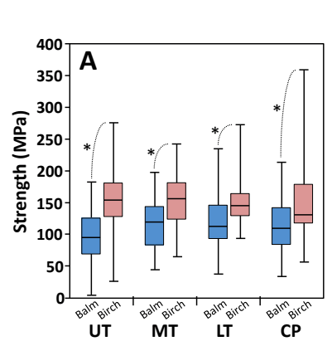
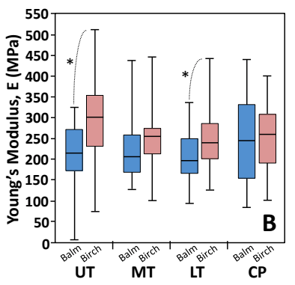
Functional Correlation Between Predator Escape and Mineral Properties
Notes:
Greater turning velocity and acceleration in Birch Lake fish
Young’s Modulus equation
Low calcium environment calcium levels should be low, but Doug’s shows opposite

Slide 5
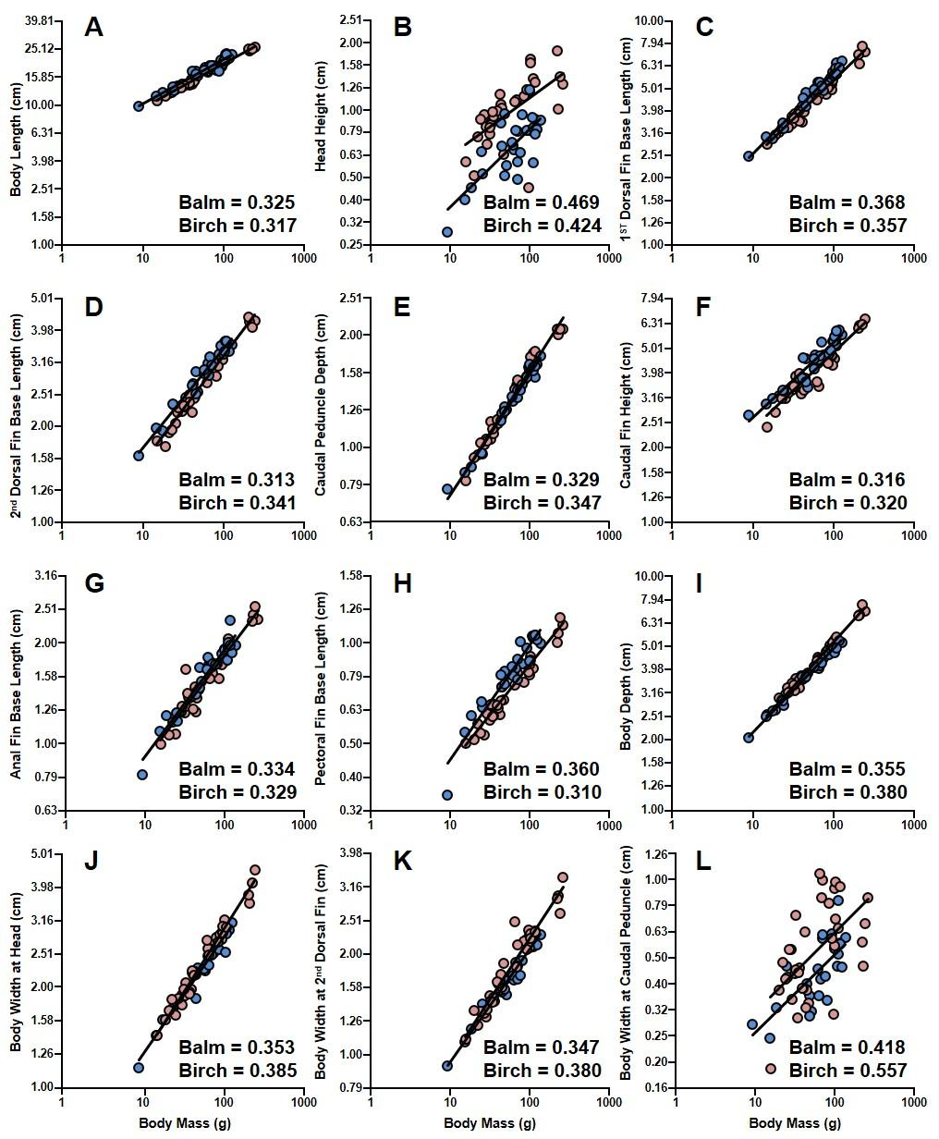
Correlation between ecology and functional performance
Lily Altenburg ‘19
Body length
Head height
1st dorsal fin base length
2nd dorsal fin base length
Caudal peduncle depth
Caudal fin height
Anal fin base length
Pectoral fin base length
Body depth
Body width at head
Body width at 2nd dorsal fin
Body width at caudal peduncle
Notes:
Really just looked at body shape
Two different tests in these diagrams: RMA
Was to look at the differences between Birch and Balm
Birch fish were shorter
Then to compare the two we used the Tsutakawa’s test
Senior Lilli Altenburg and Maie also examined the correlation between ecology and functional performance
Both examined variations in body morphology, such as body length, pectoral fin base length, and caudal fin height (as shown in this extensive list) and in the diagram to the right
Significant differences between morphology indicated Birch Lake (mining influenced) fish had shorter and deeper with wider caudal peduncle vertebrae
Wider caudal peduncle regions suggest that these morphological traits contribute to the organism’s ability to quickly escape predators
How Lilli’s research associated with Doug’s

Slide 6
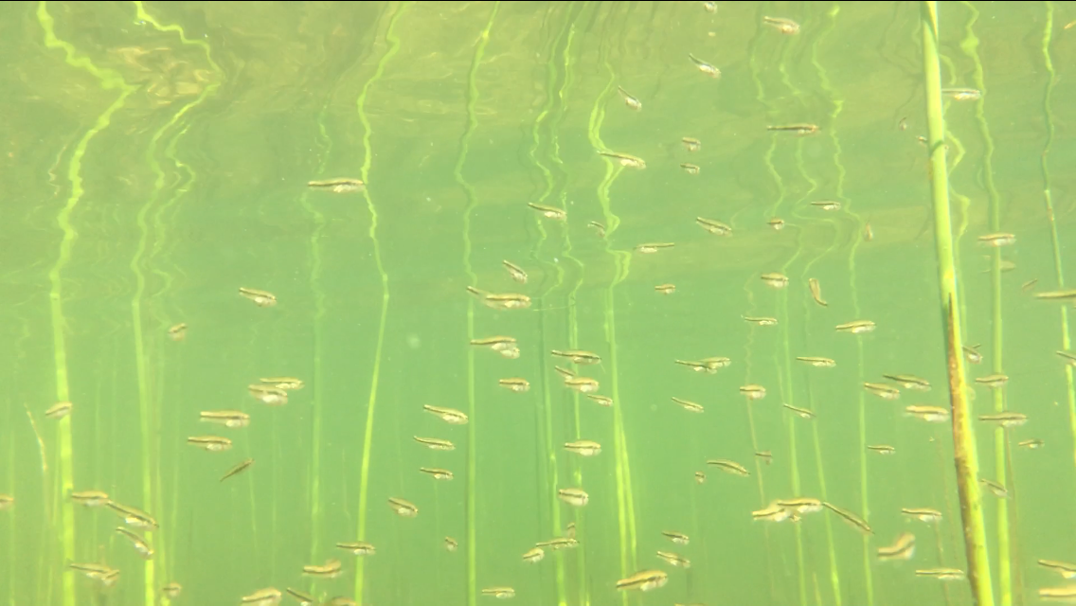
Hypothesis
We hypothesized the fish specimen from Birch Lake (mining-influenced, 85 ppm calcium) have a higher calcium concentration than those fish in Balm Lake (spring fed, 250 ppm calcium).
Balm Lake: 250 ppm Ca²⁺
Notes:
Rationalization will come from a combination of information from introduction, Dickerson, and Altenburg

Slide 7
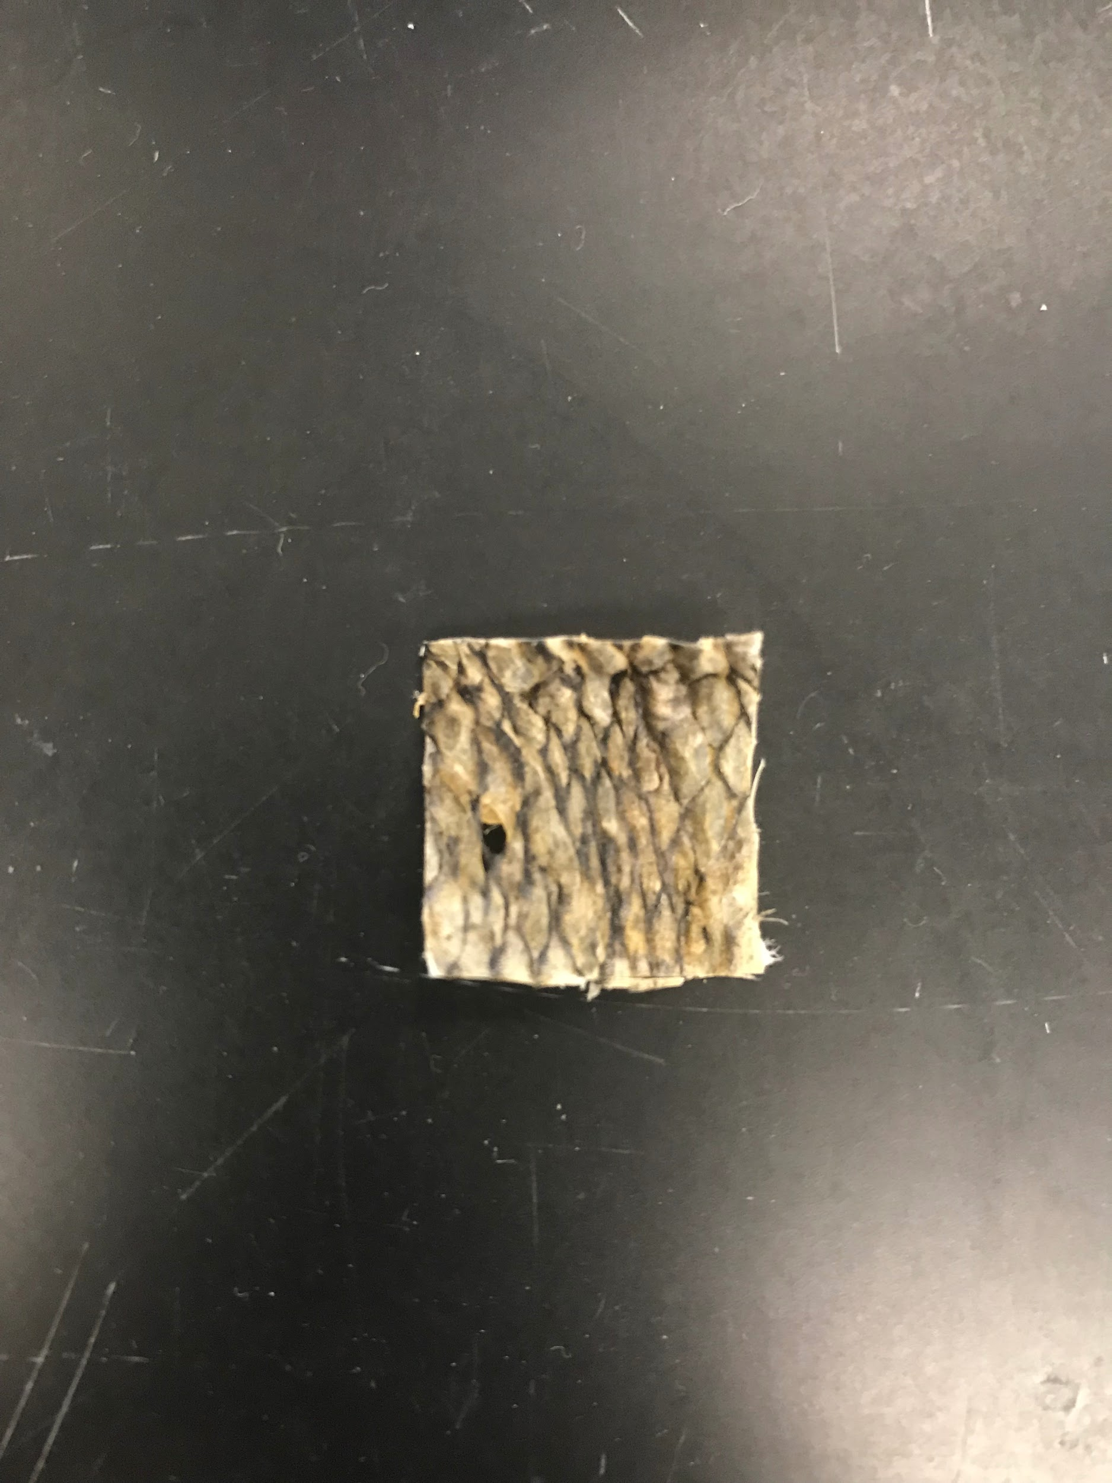
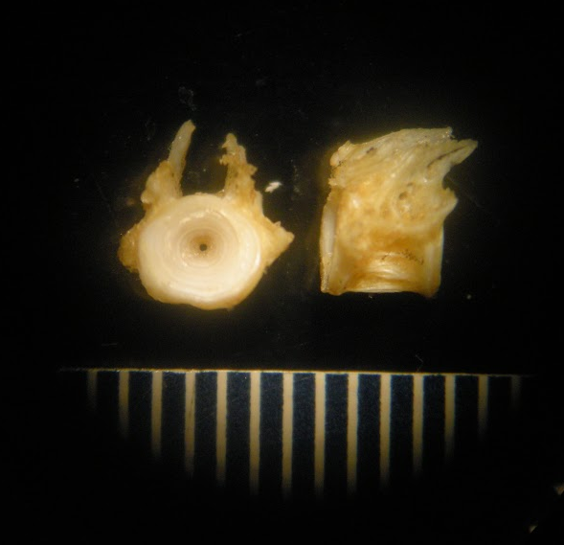
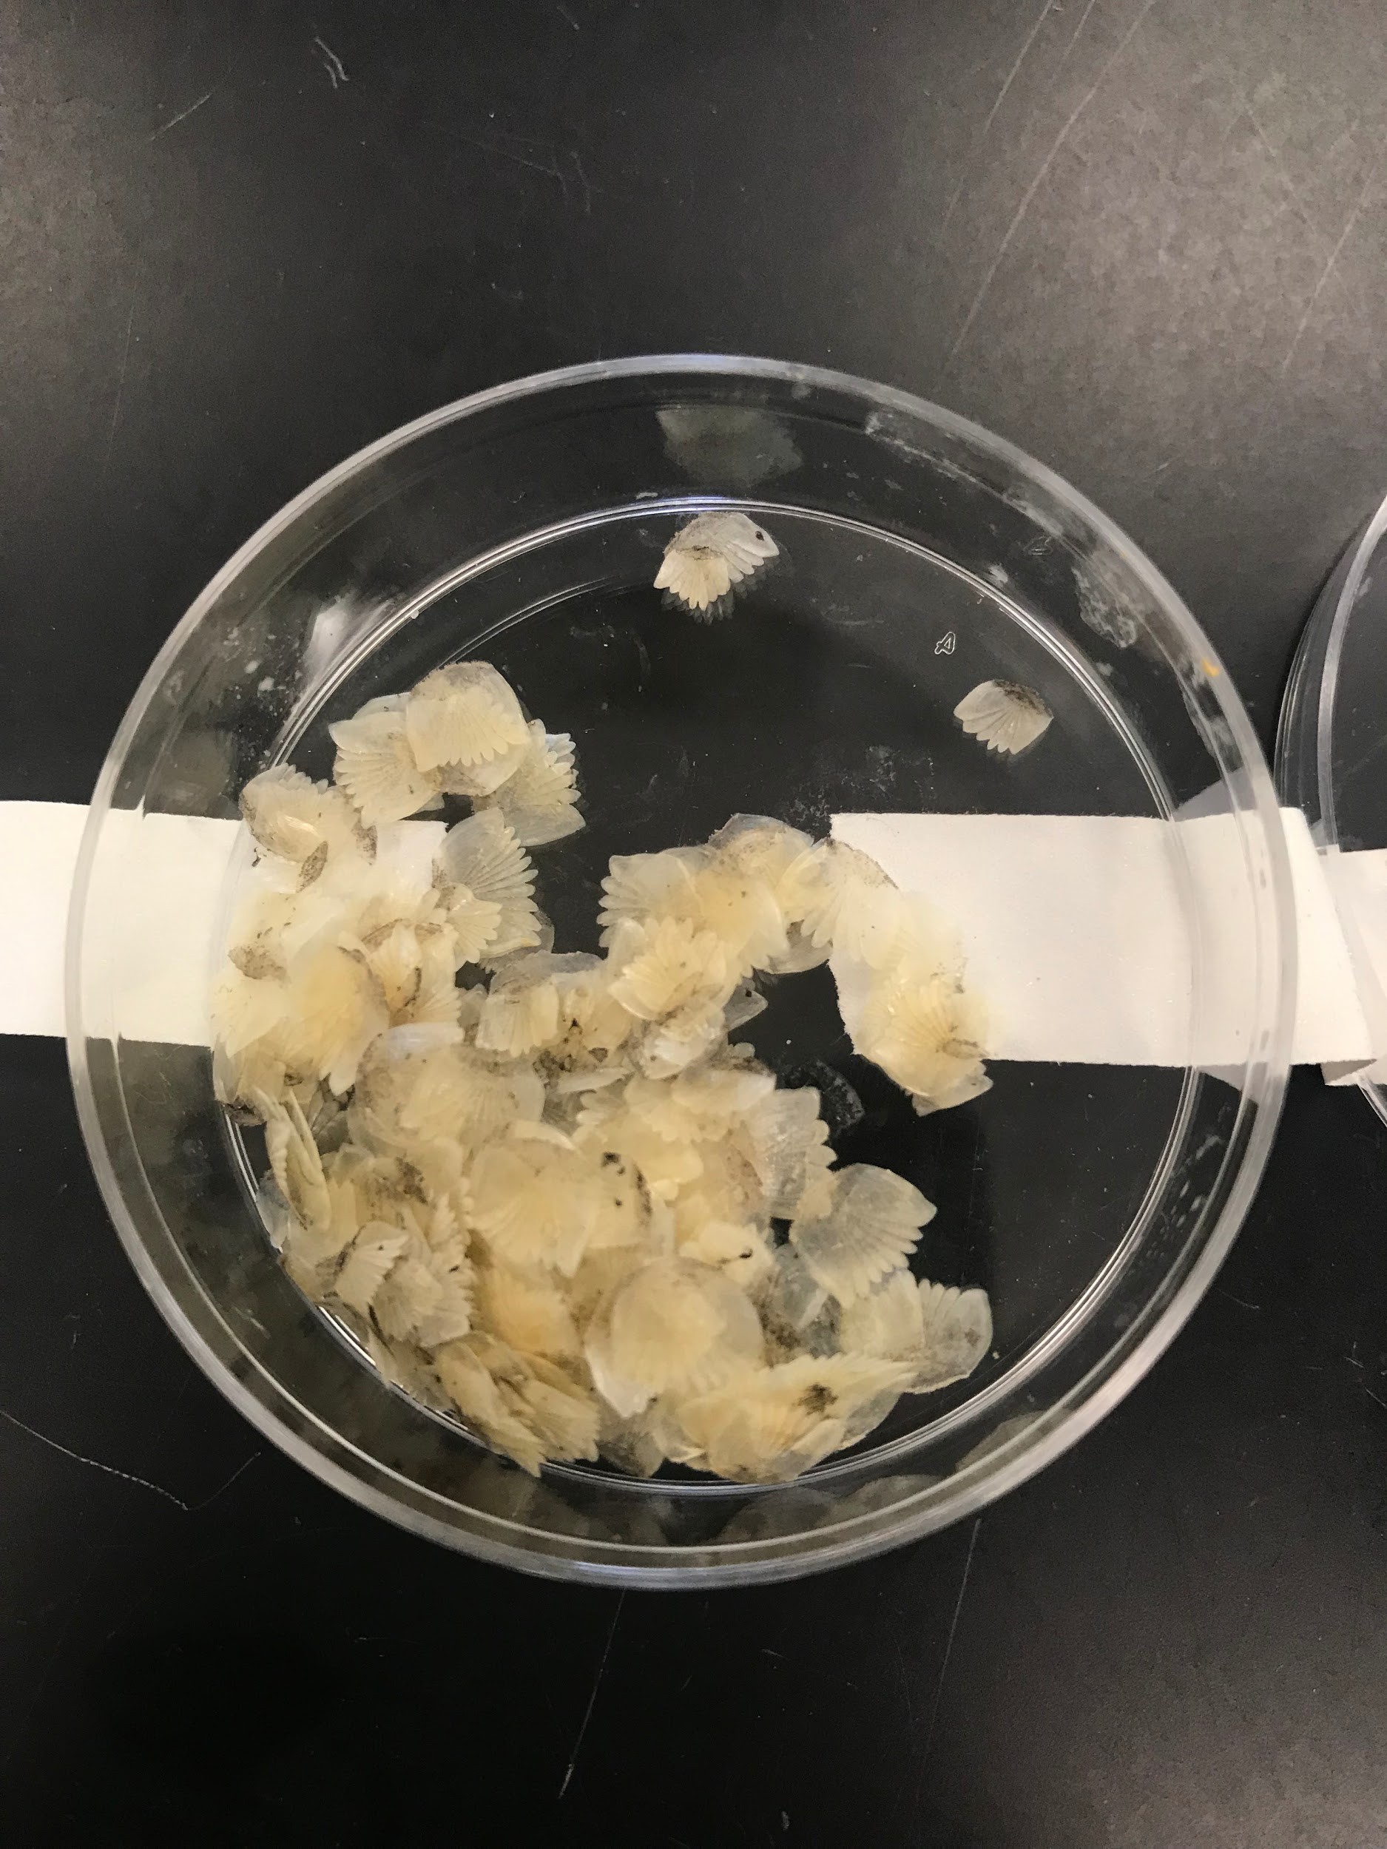
Sample Dissection
2 cm
2 cm
Notes:
In the fall of 2017, we began dissections, which ultimately took about two semesters for all 20 fish
We took three vertebrae from each of the desired locations (UT, MT, LT, CP), so 12 vertebrae from each fish for a total of 240 vertebrae
In addition, we took approximately 3-4 2 cm by 2 cm skin samples from each fish from random places on the fish (head, middle, lower end)
We also took as many scales as possible from each fish, just to have a little extra in addition to the 80 scales from each sample

Slide 8
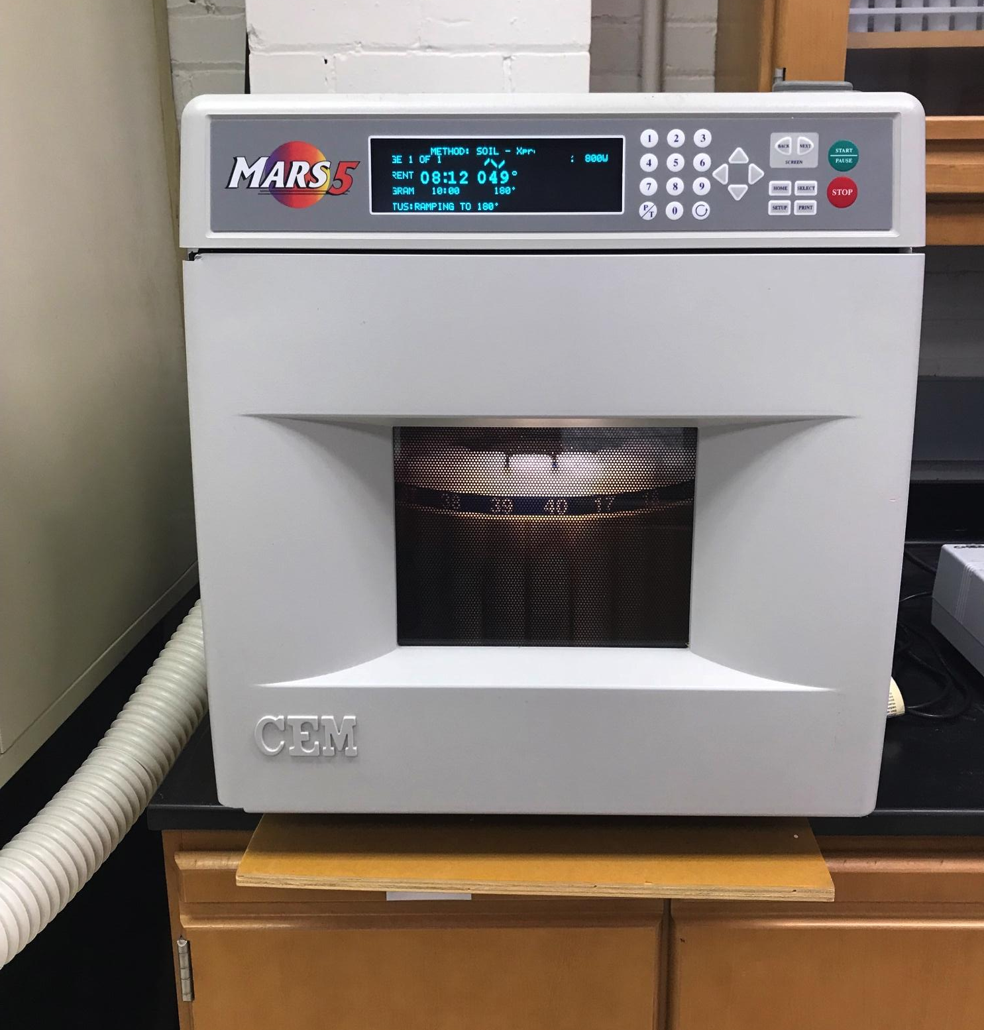
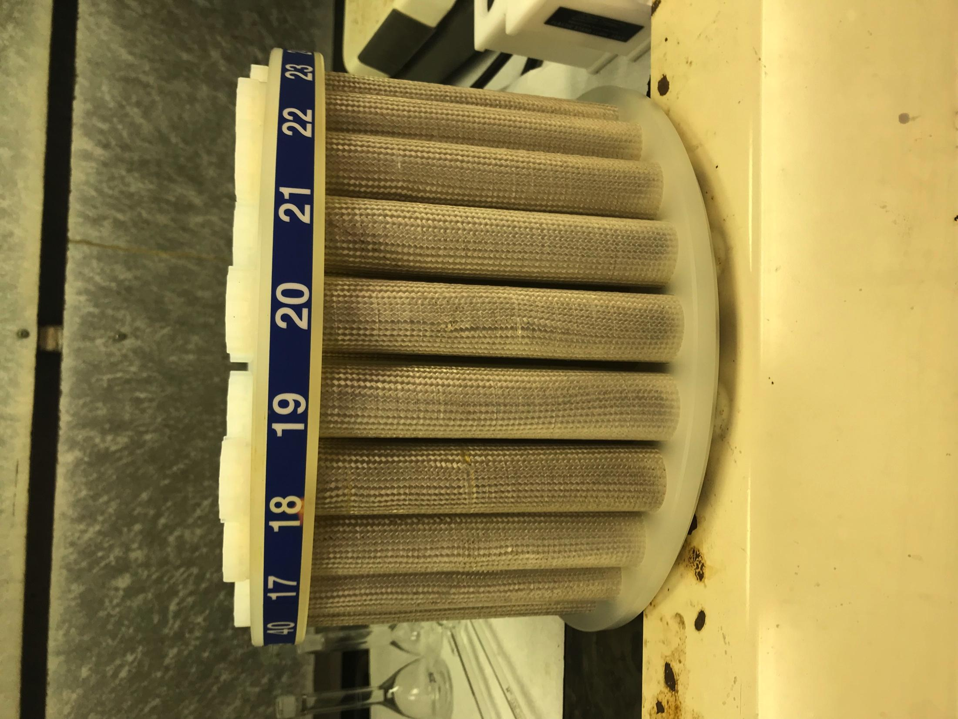
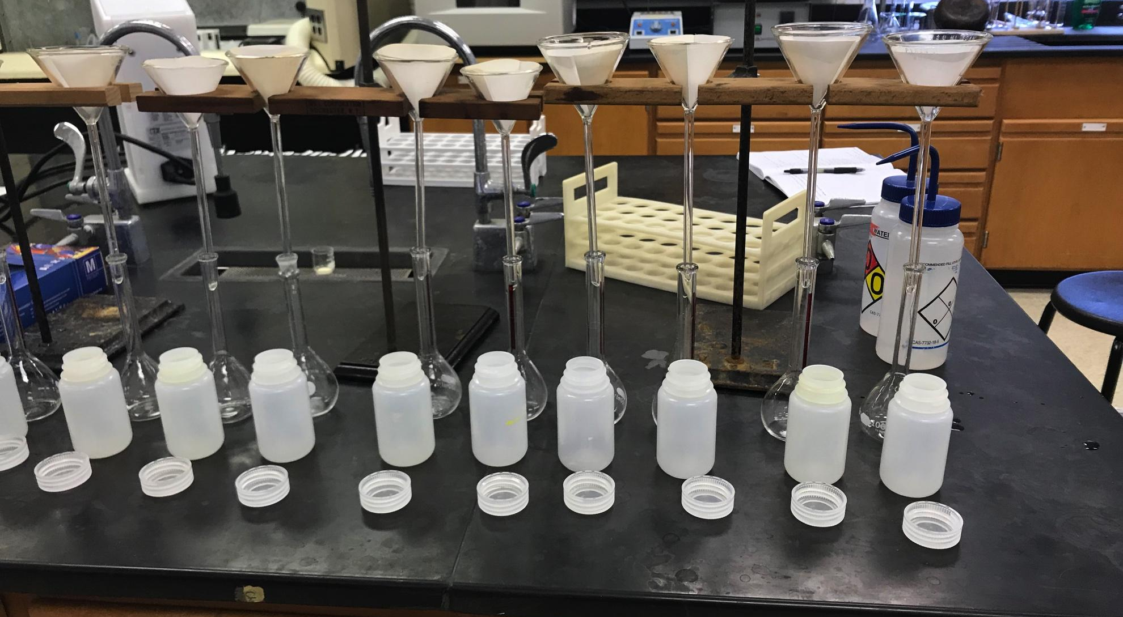
Sample Preparation
Nitric acid predigestion
MARS 5 microwave digestion
Notes:
After the physical dissection of samples, vertebrae samples were dried overnight in a general oven at 160 degree celsius to remove all remaining blood vessels, connective tissue, and nerves
Using an analytical scale, each samples’ weight was recorded prior to the predigestion
Samples were loaded into digestion vessels along with 10 mL of nitric acid trace metal grade the day before the microwave digestion unit was used
The MARS 5 microwave over at Randolph College was then used for further digestion of samples
The samples ran in the microwave for around 20 minutes
Afterwards, there was a brief cooling time before we filled the vessels with D.I. water about ¾ of the way full and filtered the contents through Grade A filter paper (as shown in the image) into 100 mL grade A volumetric flasks
The 100 mL volumetrics were then brought to volume (with D.I. water) and samples were stored in 125 mL Nalgene containers until analysis

Slide 9
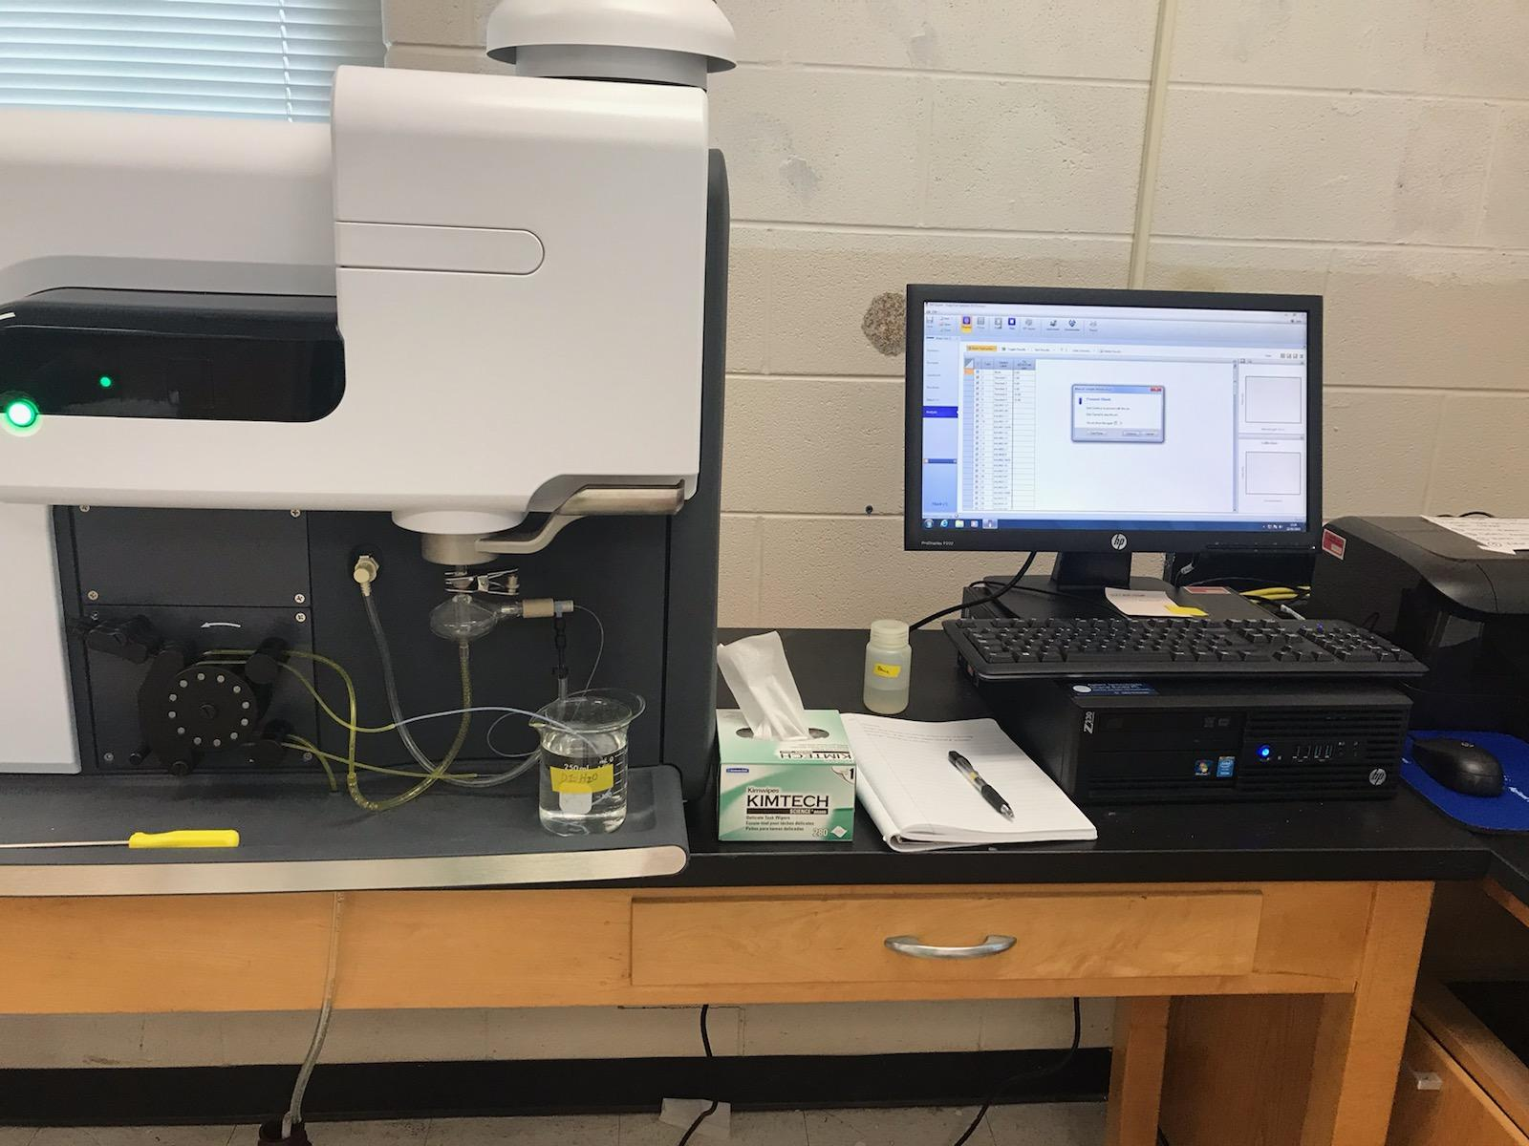
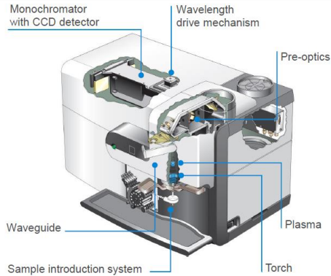
MP-AES Analysis
Dilution factors of 5, 10, 25, 50, and 100 fold
Calibration standards of 2, 4, 5, 10, 15 ppm Ca
Notes:
From there, further dilutions of samples were prepared before the MP-AES analysis
The MP AES (microwave plasma atomic emission spectrometer) here at Lynchburg essentially takes up sample through the capillary tubes located here (point to it on image)
It then uses a nebulizer to turn the sample into an aerosol gas
The gas then goes up through the instrument and is excited by the inductively coupled plasma torch, in which the emission produced by the sample is then measured
So using the MP-AES and the calibration standards of 2, 4, 5, 10, 15 mg/L of calcium all the samples were analyzed over a course of a week because I had to continue doing dilutions
Due to the small calcium window I had with the standards

Slide 10
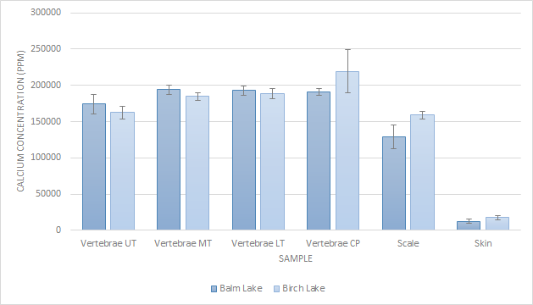
Results
Notes:
As you can see by this plot, all calcium concentrations of samples were around 15,000 to 20,000 ppm (or mg/L) of calcium
ANOVA statistical analysis was performed on results and there was found to be no statistical significance between lake specimen
CP of Birch fish has more calcium than UT (tail)
CP seems more mechanically stressed perhaps because of the greater use of the tail in Birch Lake fish

Slide 11
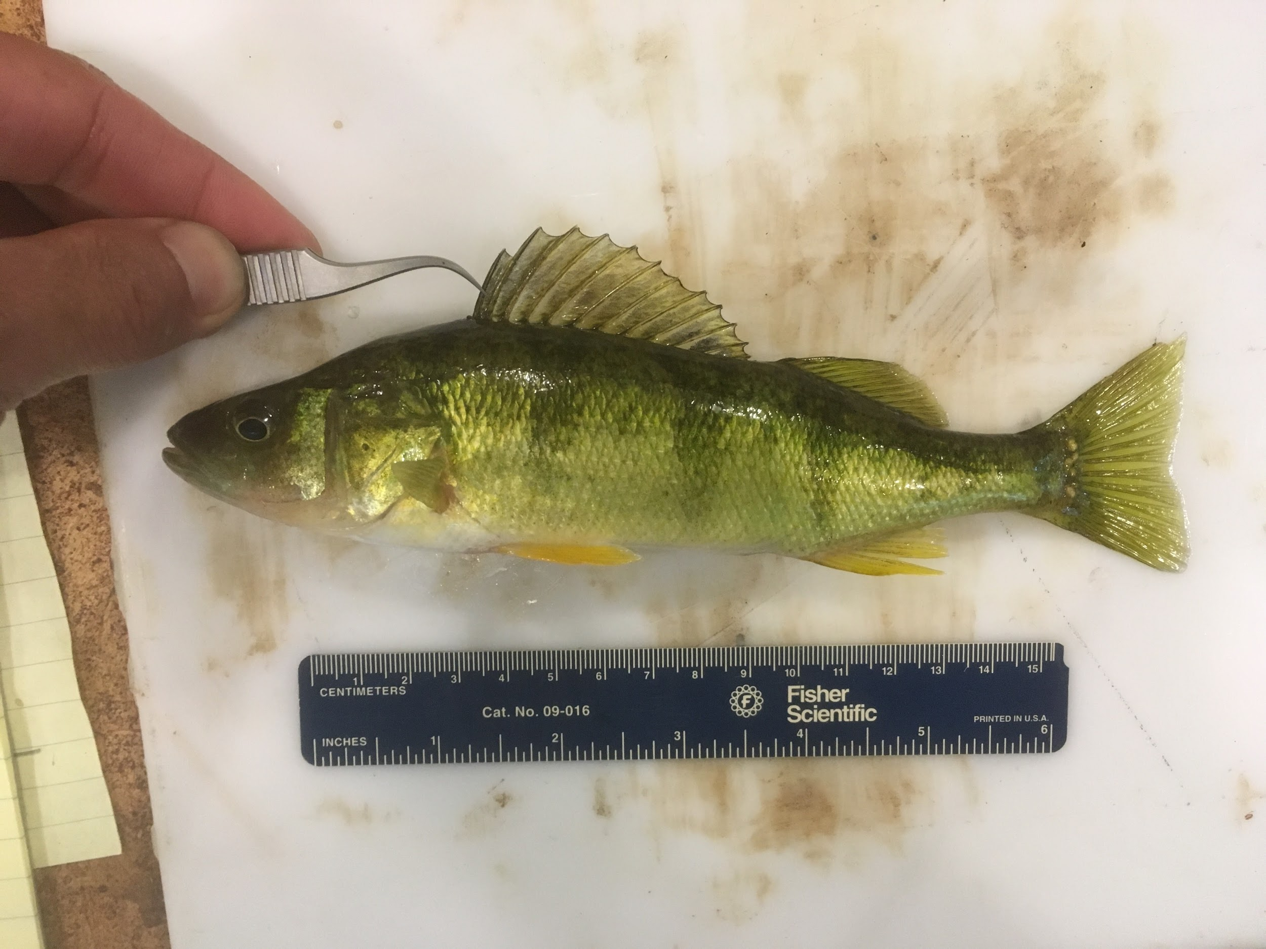
Discussion
Little difference between populations; reject hypothesis
Low Ca environment, but same levels
Going further:
Larger sample size
Genetic components
Blood samples
Standard Ca level in bones
Notes:
Something is driving calcium into bones
Bones serve as calcium reservoir in both populations

Slide 12
References
Flik, G., Fenwick, J. C., Kolar, Z., Mayer-Gostan, N., Bonga, W. (1985). Effects of low ambient calcium levels on whole-body Ca²⁺ flux rates and internal calcium pools in freshwater cichlid teleost, Oreochromis mossambicus. The Company of Biologists Limited. 120: 249-264.
Horton, J. M., Summers, A. P. (2009). The material properties of acellular bone in a teleost fish. Journal of Experimental Biology. 212: 1413-1420.
Mayer-Gostan, N., Bornancin, M., DeRenzis, G., Naon, R., Yee, J. A., Shew, R. L., Pang, P. K. (1983). Extraintestinal calcium uptake in the killifish, Fundulus heteroclitus. J Exp Zool. 227(3): 329-338.
McCormick, S. D., Hasegawa, S., Hirano, T. (1992). Calcium uptake in the skin of a freshwater teleost. Proc. Natl. Acad. Sci. 89: 3635-3638.
Milhaud, G., Rankin, J. C., Bolis, L., Benson, A. A. (1977). Calcitonin: Its hormonal action on the gill. Proc Natl Acad Sci. 74(10): 4693-4696.
Moss, M. L. (1961). The biology of acellular teleost bone. Annals New York Academy of Sciences. 109: 337-350.
Notes:
Thank people… Lilli, Dickerson

Slide 13
QUESTIONS?
Notes:
Image from: https://media.istockphoto.com/vectors/question-mark-sign-icon-help-speech-bubble-symbol-faq-sign-copy-files-vector-id914054164?k=6&m=914054164&s=612x612&w=0&h=mmkUO83i30gHdRPRJkEceie8bcDDIfUy4nZn0OscSAw=

