Slide 1
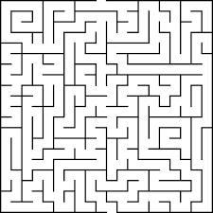
Procedural Generation in 3D and Virtual Reality
https://sydney.newcastle.edu.au/course/VRAR
Notes:
Remember to introduce yourself – your major – your topic – and why you chose to study this subject

Slide 2
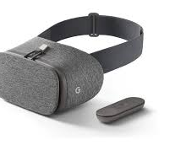
What is All of This?
Procedural Generation
A method of generating random numbers
Allows for differences every time the program is run
Virtual Reality
Works through a VR headset
Allows for immersion into an environment
Notes:
Introduce what Procedural Generation, Perlin Noise, and Virtual reality are.

Slide 3
What is the Purpose?
The purpose was to examine techniques of different types of generations, and virtual reality to develop a 3D maze and cave algorithm
Notes:
Why did we do this Project?

Slide 4
Problems
How do we handle the maze colliding with itself?
3D offers even more possible Collisions
How do we handle the objects that the player cannot see?
Pure Random Number Generation did not generate naturalistic structures
Code needed to be optimized to minimize VR sickness
Notes:
What did you have to overcome to make this project. The points of 3D, Collisions, VR, Controllers, And naturalistic generation

Slide 5
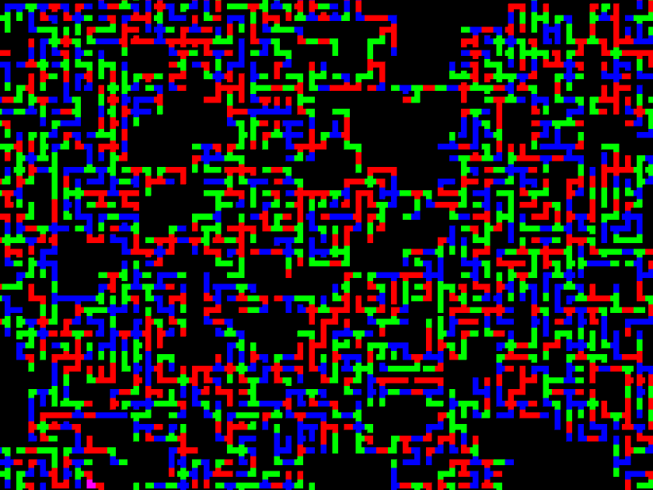
How It Was Done?
Start
Create 2D Maze Generator
3D
Convert the maze generation script to 3D
Halfway
Add multiple floor levels to the generation algorithm
Adding VR
Implement VR and controller support
Finishing
Optimize, Optimize, Optimize
Notes:
What did you do to reach the goal for the first semester. 2D, 3D, Controller Support, VR Support, Google Daydream.

Slide 6
How Does it Look?
Notes:
Take a break, It’s a video.

Slide 7
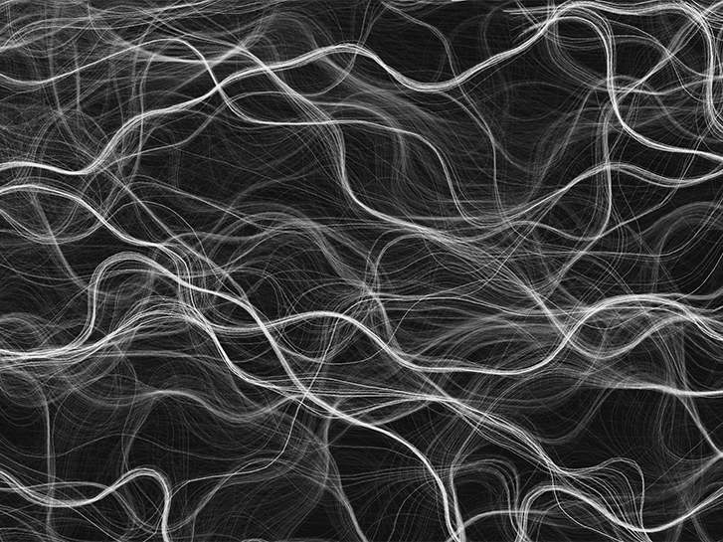
Naturalistic Generation
Perlin Noise
Noise that has a gradient
Allows for natural curves
Perlin Worms
An implementation of Perlin Noise
Allows for Tunnels or “Caves” to be formed
Notes:
What exactly is perlin noise/ perlin worms, and why did we need to use it.

Slide 8
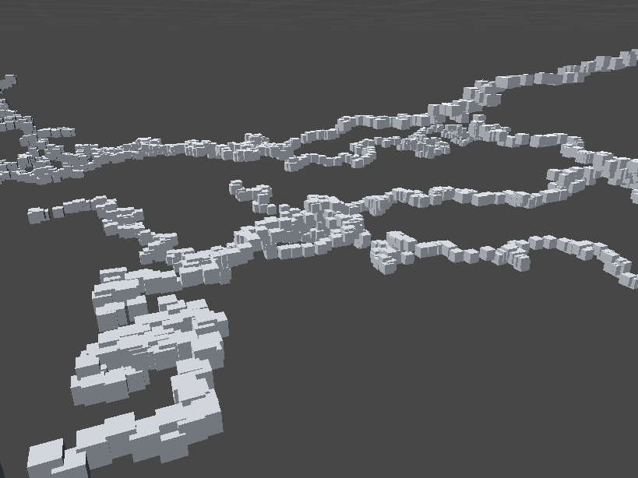
How It Was Done Again?
Finishing Beginning
Optimize
Start Noise Generation
Create a Perlin Noise Algorithm that is able to generate naturalistic caves
Finish Noise Generation
Implement Perlin Worms so that it generates with simple cubes
Meshes
Create Voxels so that meshes can be generated from the intersection of the cubes
Finishing For Real
Optimize, Optimize, Optimize
Notes:
Talk about how our algorithm works and briefly mention what voxels are and why I needed them.

Slide 9
How Does it Look?
Notes:
Thank goodness, another video. Take another break and stop bugging out. You only got one more slide.

Slide 10
Conclusion
Procedural Generation allows for the generation of our mazes and offers ways for the generations to generate as the player walks through them.
___________________
Perlin Noise allows for a naturalistic generation of tunnels. After optimizations, it can even run in VR with acceptable speed that do no induce sickness
Notes:
Don’t read the slide. Summarize what you wrote.

Slide 11
Questions?
Notes:
Stand up straight and take all the questions of amazement. You did it.

