Slide 1
Comparison of Head Impact Mechanisms and Type of Play for Women’s Lacrosse Over 4 Years
Jessica E. Riquelme, ATS
Debbie A. Bradney, DPE, ATC
Katherine M. Breedlove, PhD, ATC
Thomas G. Bowman, PhD, ATC

Slide 2
INTRODUCTION
Due to potential negative health consequences studying head impacts in sport is an important step to develop effective prevention strategies
Women’s Lacrosse participation numbers have doubled in the past ten years (Crisco 2010)
Minimal studies have examined head impacts in women’s lacrosse (Multiple Authors)
One study had women’s lacrosse at the 3rd highest concussion rate out of 8 collegiate women’s sports over a 16 year study (Hootman 2007)

Slide 3
INTRODUCTION
Yet athletes are only required to wear minimal protective equipment (Multiple Authors)
Mechanisms like stick slashing or intentional body contact are not permitted (Putukian 2014, Le 2018)
These mechanisms can change magnitude and frequency of head impact outcomes
Examination of type of play characteristics can determine what play occurred when there were impacts to the head

Slide 4
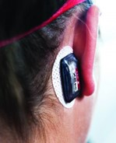
METHODS
Participants
29 NCAA Division III women’s lacrosse athletes
Data collection:
All participants wore xPatch sensors (Figure 1) which were applied every game and practice from 2015-2018
Sensors collected peak linear (g) and rotational (deg/sec2) accelerations of all head impacts
Date and time stamped video recordings were used to verify all head impacts
Figure 1. xPatch sensor

Slide 5
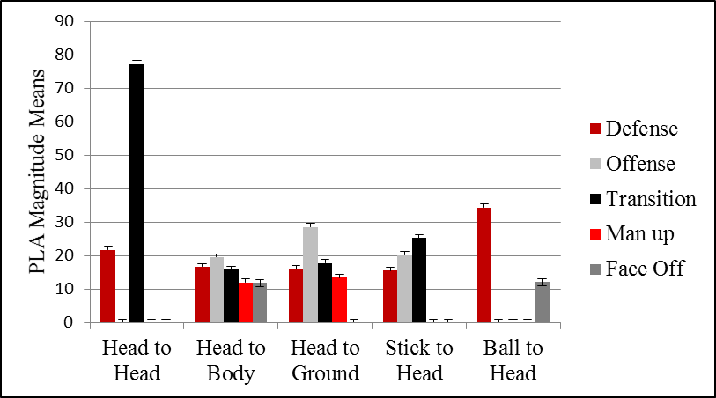
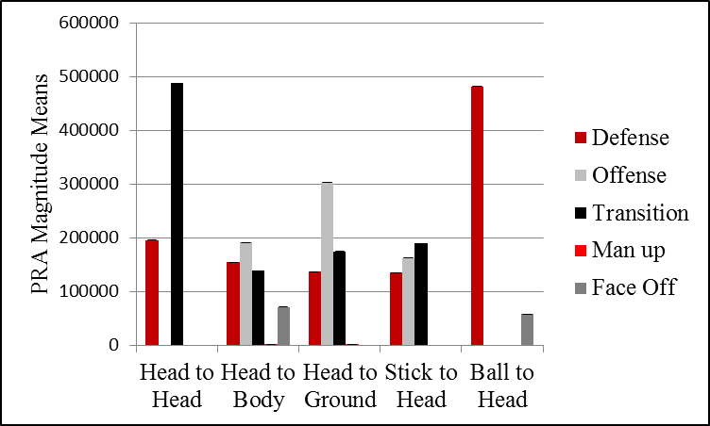
RESULTS
Figure 2. Standard deviation and means of head impact PLA magnitudes.
Figure 3. Standard deviation and means of head impact PRA magnitudes.

Slide 6
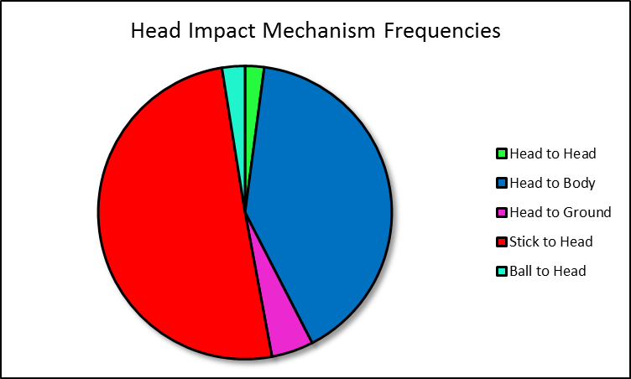
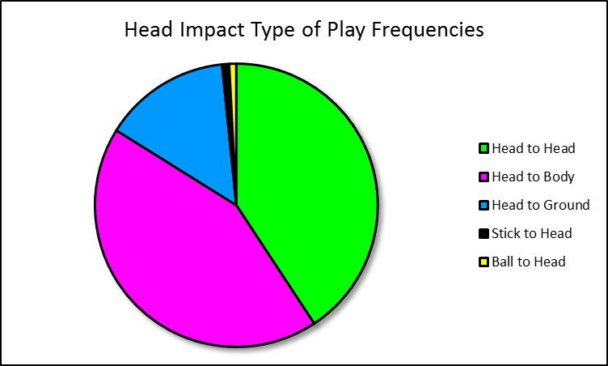
RESULTS
Figure 4. Pie chart of frequencies in head impact mechanism.
Figure 5. Pie chart of frequencies in head impact type of play.

Slide 7
DISCUSSION
The rules in women’s lacrosse only allows incidental player-player contact (Lincoln, 2007)
Yet it is highly ranked in concussion rates when compared to other women’s sports (Hootman, 2007)
Our research found two main contributing factors altering magnitude and frequency were mechanism and type of play

Slide 8
CONCLUSION
Sustaining head impacts by way of stick to head mechanism while playing defense is most probable
Stick to head contacts are illegal, yet occurred most often
Efforts to enforce the rules should be focused on

Slide 9
REFERENCES
Caswell SV, Lincoln AE, Almquist JL, Dunn RE, Hinton RY. Video incident analysis of head injuries in high school girls’ lacrosse. Am J Sport Med. 2012;40(4):756-762.
Putukian M, Lincoln AE, Crisco JJ. Sports-specific issues in men’s and women’s lacrosse. Curr Sports Med Rep. 2014;13(5):334-340.
Le RK, Saunders TD, Breedlove KM, Bradney DA, Lucas JM, Bowman TG. Differences in the mechanism of head impacts measured between men’s and women’s intercollegiate lacrosse athletes. Orthop J Sport Med. 2018;6(11):1-7.
Caswell SV, Lincoln AE, Stone H, Kelshaw P, Putukian M, Hepburn L, Higgins M, Cortes N. Characterizing verified head impacts in high school girls’ lacrosse. Am J Sport Med. 2017;45(14):3374-3381.
Hootman JM, Dick R, Agel J. Epidemiology of collegiate injuries for 15 sports: summary and recommendations for injury prevention initiatives. J Athl Train. 2007;42(2):331-319.
Crisco JJ, Fiore R, Beckwith JG, Chu JJ, Brolinson PG, Duma S, McAllister TW, Duhaime AC, Greenwald RM. Frequency and location of head impact exposures in individual collegiate football players. J Athl Train. 2010;45(6):549-559.
Clack JM, Hoshizaki TB. The ability of men’s lacrosse helmets to reduce the dynamic impact response for different striking techniques in women’s field lacrosse. Am J Sport Med. 2016;44(4):1047-1055.
Lincoln AE, Hinton RY, Almquist JL, Lager SL, Dick RW. Head, face, and eye injuries in scholastic and collegiate lacrosse. Am J Sport Med. 2007;35(2):207-215.

