Slide 1
An Anatomical and Functional Analysis of Digital Arteries
Katie Highsmith

Slide 2
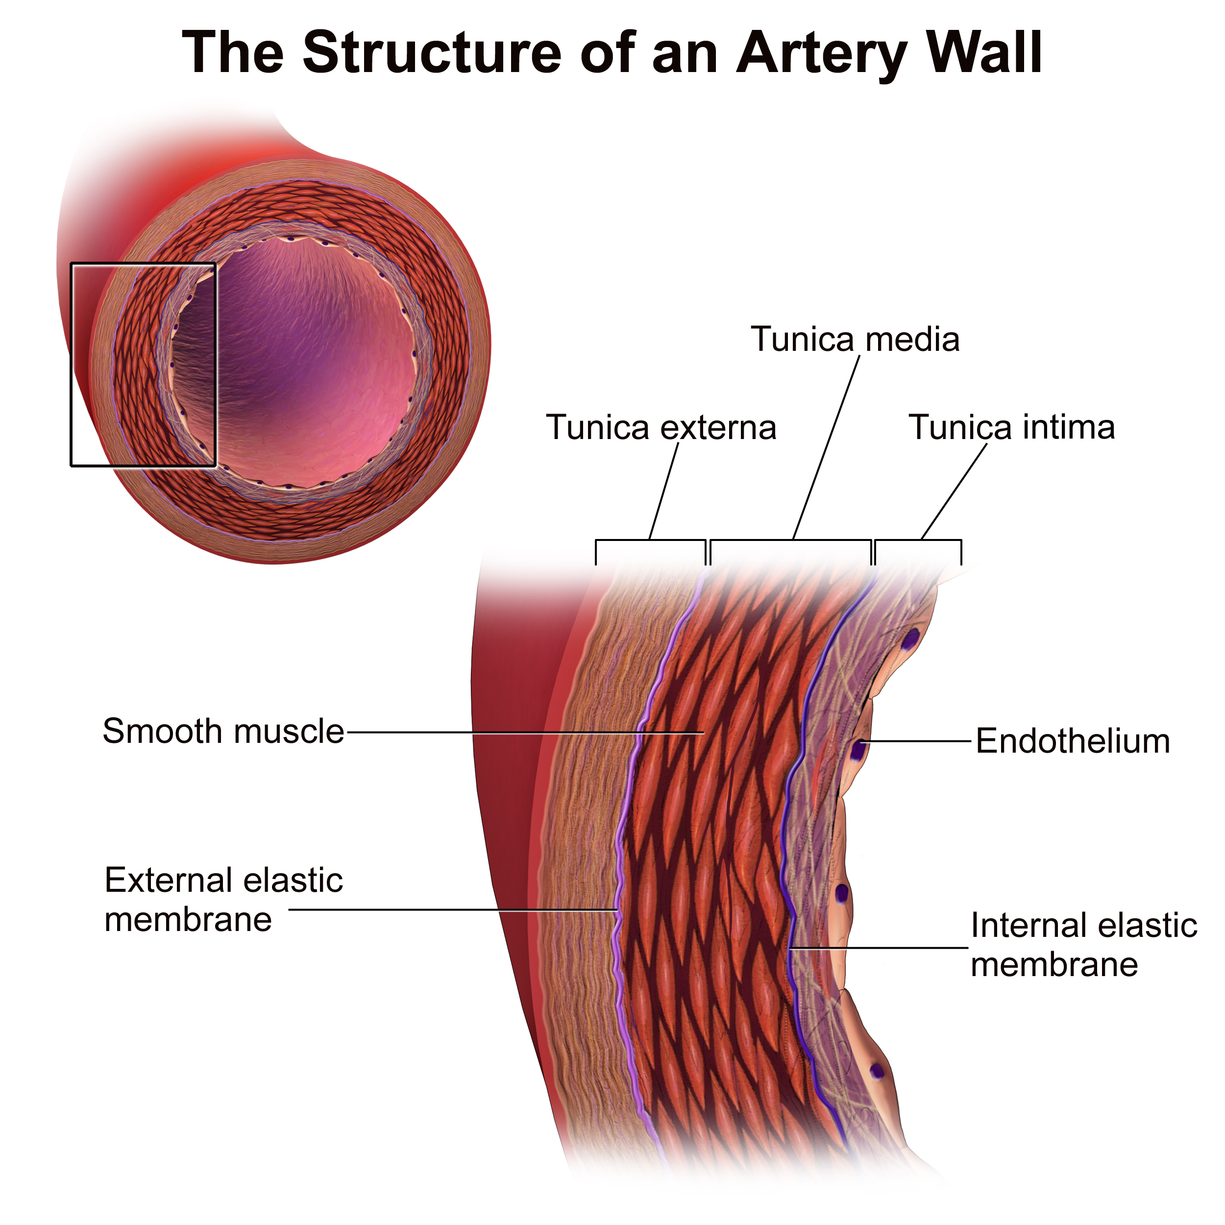
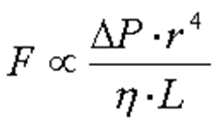
Arteries maintain blood flow and pressure through the cardiovascular system
The 𝛼 and 𝛽 adrenergic receptors on the smooth muscles cause vasoconstriction and vasodilation
Vasoconstriction
Decrease in diameter caused by smooth muscle contraction
Vasodilation
Increase in diameter of the blood vessel

Slide 3
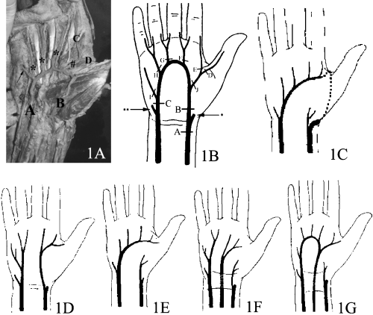
Superficial Palmar Arch Variation
47.5%
52.5%
0.04%
Fazan et al. 2004

Slide 4
Left Palmar View: Precise locations for collecting measurements (diameter and distance) are indicated.
* Digi. = Beginning of specific digital arteries
III
II
IV
* Digi. Base = On the superficial palmar arch where specific digits originate
V
3rd digi.
2nd digi.-3rd digi. Dist.
3rd digi. base
I
3rd digi.-5th digi. Dist.
2nd digi. base
5th digi. base
2nd digi.
5th digi.
Radial art.-3rd digi. Dist.
1st digi.-5th digi. Dist.
Ulnar art.-3rd digi. Dist.
1st digi. base
Ulnar art.-5th digi. Dist.
Radial art.-1st digi. Dist.
Ulnar art. base
Radial art. base

Slide 5
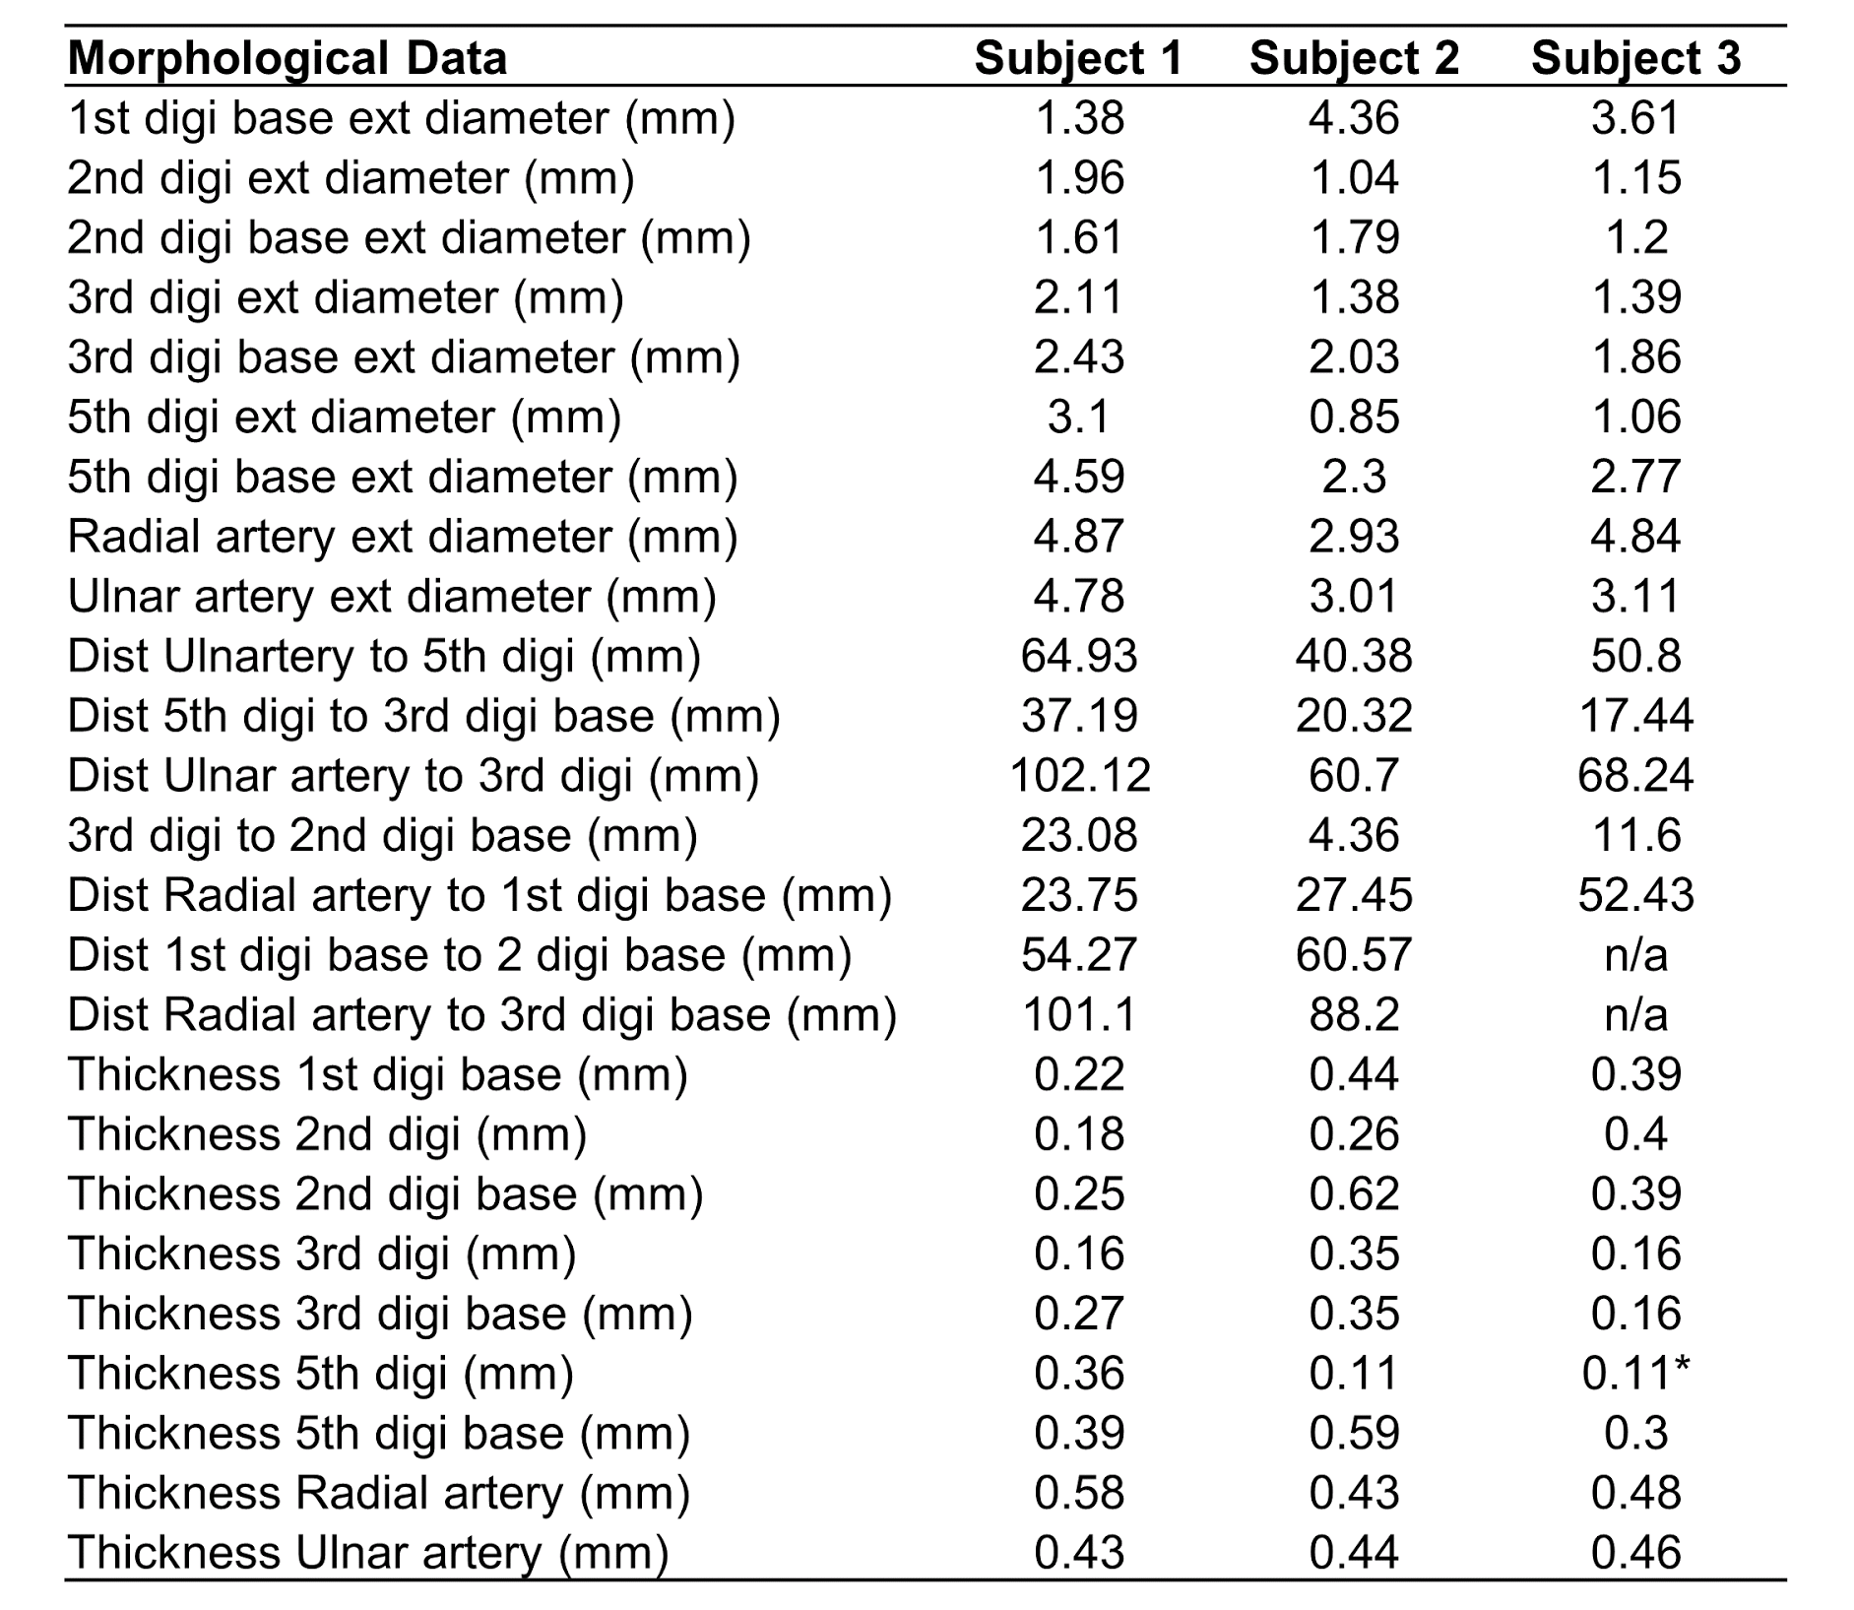
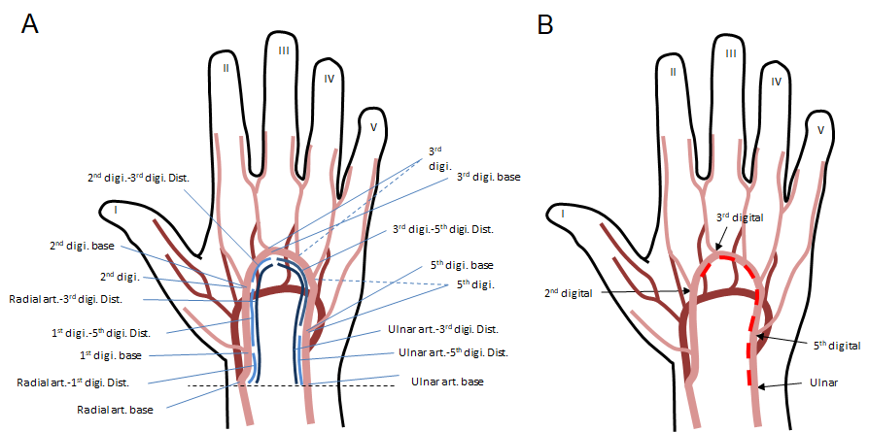
Methods

Slide 6
Flow Analysis
Blood flow changes as blood vessels change their diameters (via vasoconstriction and vasodilation).
Rate of Blood flow (Q): Poiseuille Equation
(Bernoulli’s theorem)
A simple flow model (a conical frustum model):
X
Y
Larger artery (e.g., ulnar art.) (fixed)
L
Digital artery (e.g., 3rd digi. art.)
(dilating & constricting)
π*ΔP*r⁴
Q =
8*η*L

Slide 7
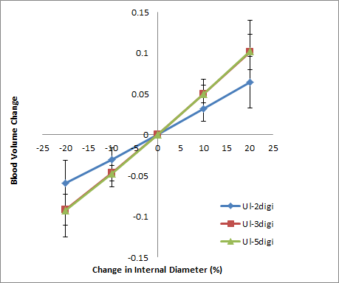
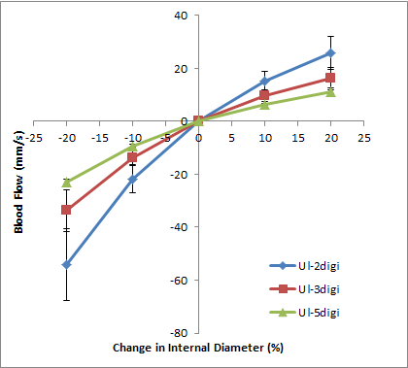
Results
Figure 1. The relationship of changes in blood volume and simulated changes in internal diameter (%) from the averages of
Figure 2. The relationship of blood flow (mm/s) to simulated changes in internal diameter (%) using the average of three individuals measurements of undilated/unconstricted superficial palmar arch points from the ulnar artery to the 2nd, 3rd, and 5th digits.

Slide 8
X
Y
Supports the relationships between flow and morphological and physiological variables
Highlights the importance of flow control in palmar arteries
Despite variation in palmar arch type there is still a consistent pattern in flow control
L
π*ΔP*r⁴
Q=
8*η*L

Slide 9
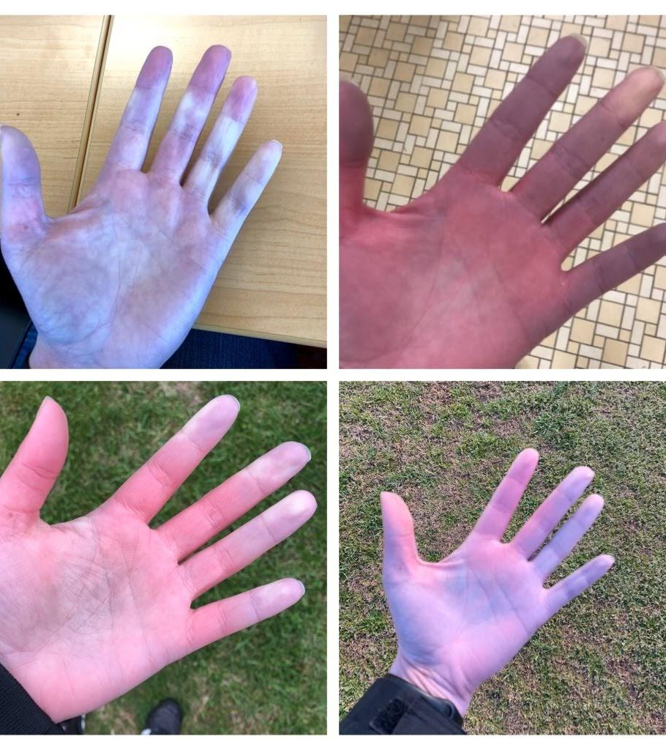
Implications for Future Study

Slide 10
Acknowledgements
Student Scholar Showcase for hosting this presentation.
Dr. Takashi Maie for his supervision and expertise.
Mrs. Leah Stevens for letting me dissect during her labs in session.
Individuals who donated their bodies to science and without whom we would not have been able to do this research.

