Slide 1
Differences In Resting Metabolic Rate Between Sex and Sport Type of D3 Athletes
Alissa Anderson

Slide 2
Introduction
Resting metabolic rate (RMR) assesses the amount of metabolic energy that the body needs to function while at rest. Commonly reported in calories per day.
RMR varies between individuals, largely based on variances in:
Daily caloric intake
Age
Sex
Hormones
Body composition (fat, muscle, bone, and water)

Slide 3
Background Literature
Athletes are more likely to have higher resting metabolic rates than non-athletes due to their endurance and resistance training creating high levels of lean mass and low levels of fat mass [1]
Males tend to have a higher amount of muscle mass than females, resulting in a higher RMR [2]
At rest, lean tissue metabolizes about 6 kcals/lb/day, fat tissue metabolizes about 2 kcals/lb/day [3]

Slide 4
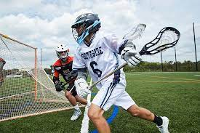
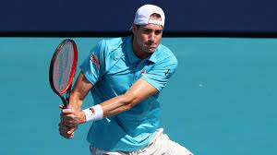
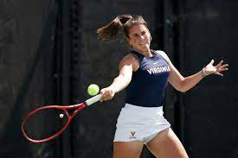
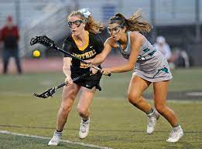
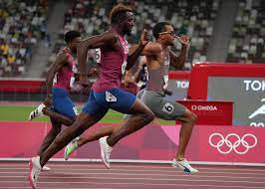
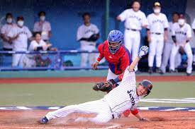
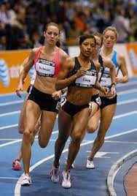
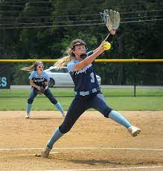
Purpose & Hypothesis
The purpose of this study is to characterize resting metabolic rate in Division 3 track, tennis, baseball, softball, and lacrosse sport athletes. In addition, to determine the effect of sex and sport type on resting metabolic rate.
I hypothesize that my research will show that there is a higher RMR among male field sports (lacrosse) than any other male athletes.

Slide 5
Methods: Subjects
This study examines the differences in resting metabolic rate between 8 different NCAA D3 sports teams at the University of Lynchburg: Men’s Lacrosse, Women’s Lacrosse, Men’s Tennis, Women’s Tennis, Women’s Track, Men’s Track, Baseball, and Softball.
A total of 32 subjects were recruited for this study, 4 from each team measured.
Inclusion Criteria:
Athletes were cleared for competition by training staff
Athletes did not report diagnosis of a cardiovascular or metabolic disorder
Active members of the team (training and competition)

Slide 6
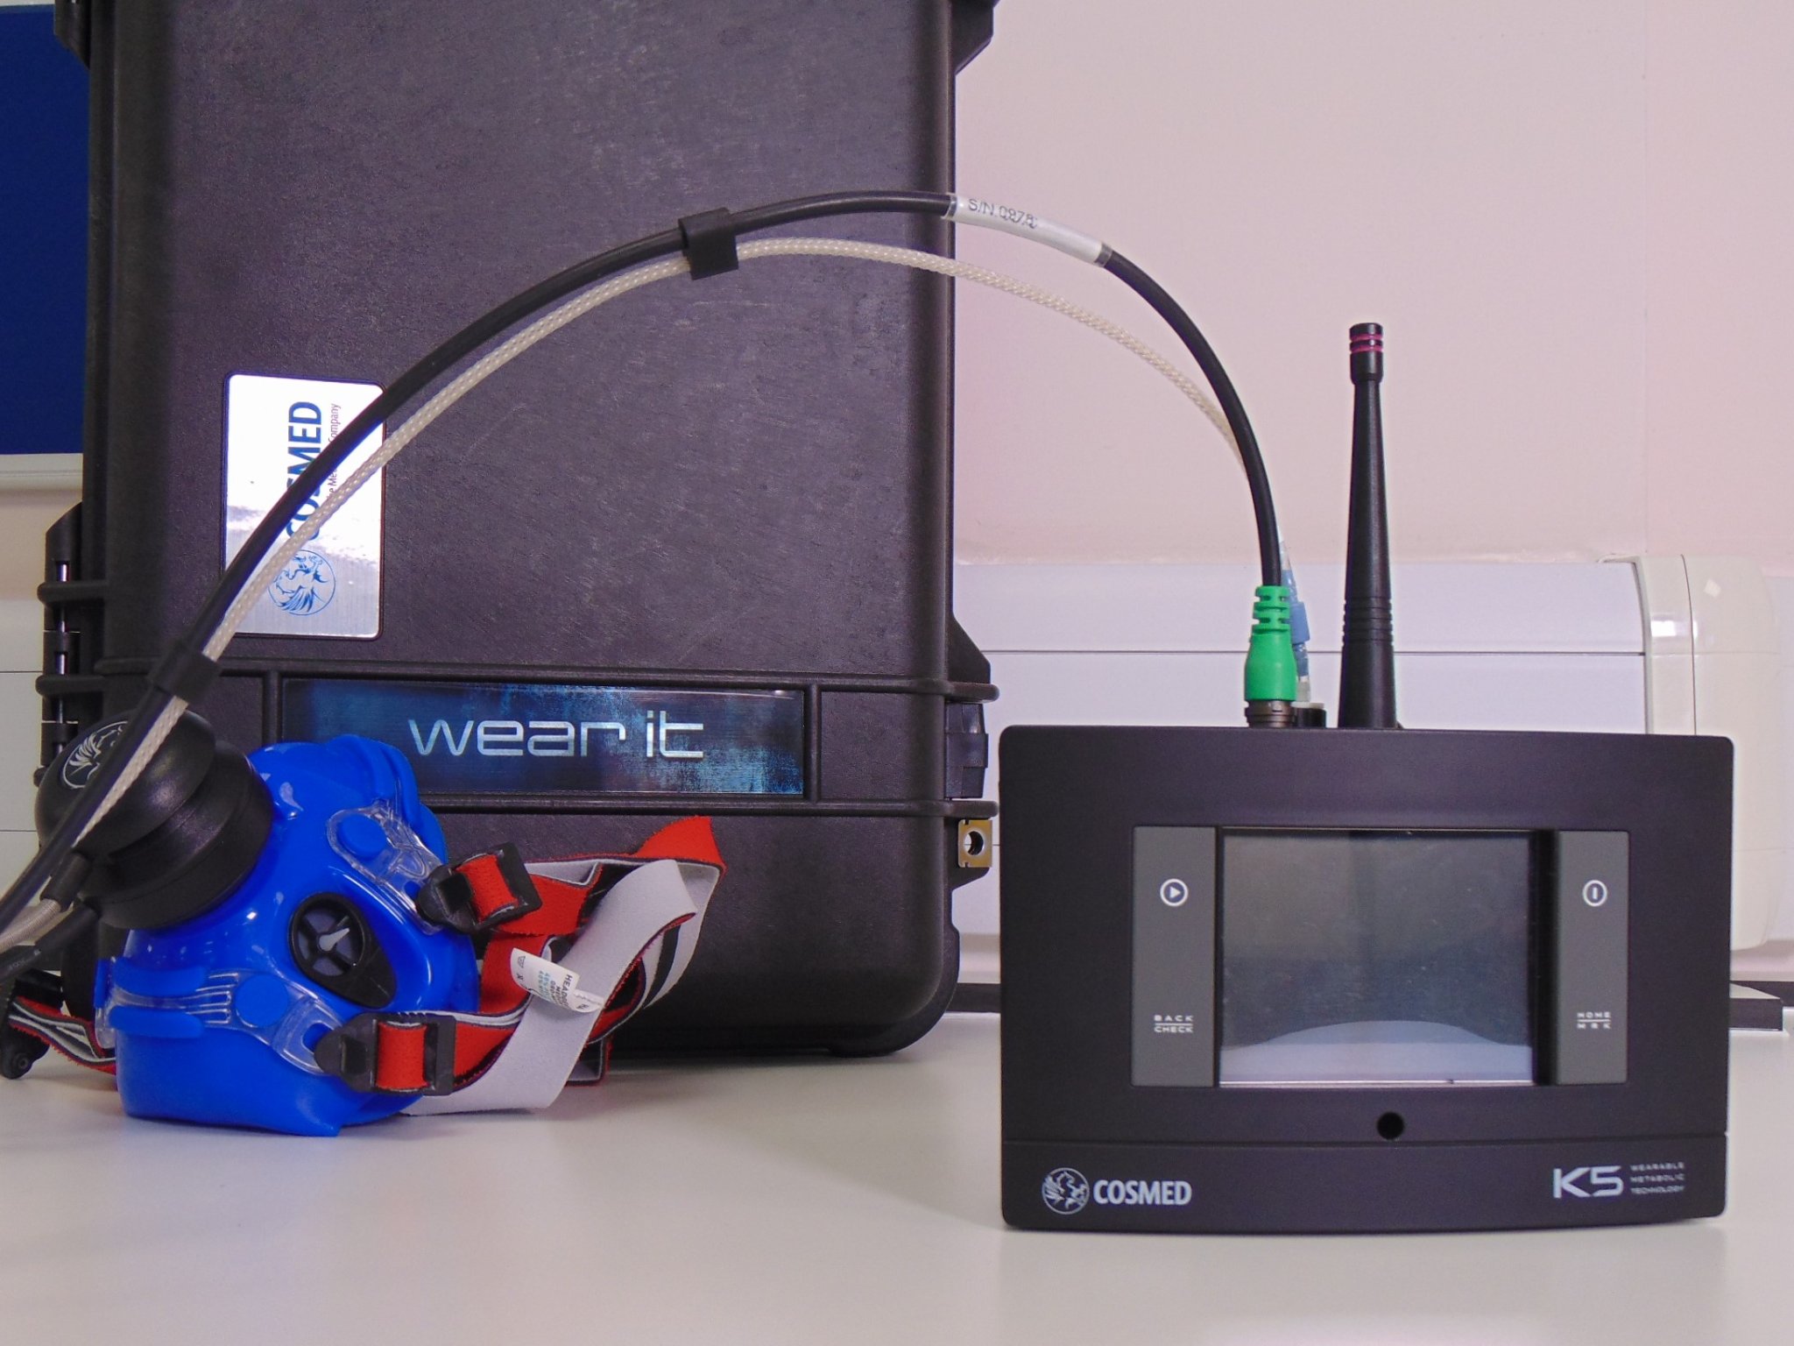
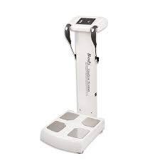
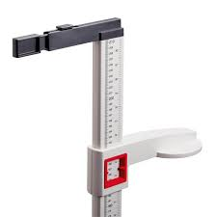
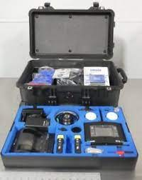
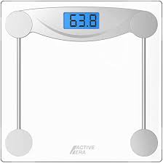
Methods: Instrumentation
Resting Metabolic Rate assessed with Cosmed K5 indirect calorimetry
Estimated daily caloric cost (calories per 24 hours)
Body composition with Bioelectrical Impedance Analysis (Tanita, BIA)
Total amount of fat mass and fat-free mass (bone, muscle)
Height and weight assessed via Stadiometer & Digital Scale

Slide 7
Methods: Testing Procedure
Informed Consent Process
Research was approved by the University of Lynchburg Institutional Review Board.
All subject were provided an informed consent and description on the experimental procedures.
Following signing the informed consent all subjects were provided instructions on visiting the laboratory for data collection
Overnight fast (no food past 8pm the evening before reporting to laboratory)
Instructed to sleep their usual duration.
No food or caffeine prior to reporting to laboratory.
All data collection was before 10am.

Slide 8
Data Collection Order of Operations
Data Collection Day for every participant.
Height and Weight assessed
Bioelectrical impedance analysis
5-minutes of laying down prior to resting metabolic rate test
Resting metabolic rate assessment
Subject left the study

Slide 9
Results
Table 1
Differences between Resting Metabolic Rates in male and female participants.
 | Avg RMR (kcals) | Avg Fat (kg) | Avg lean (kg)
Males n=16 | 2801±544 | 8±5.6 | 32.8±3.9
Females n=16 | 2127±319 | 12.7±6.7 | 22.8±5
P-value | P > 0.000 | P= 0.041 | P > 0.000
Independent Samples T-test, significance P > 0.05

Slide 10
Team RMR
Team | Avg Resting Metabolic Rate (kcals)
Men’s Track | 2439±165
Women’s Track | 2205±363
Men’s Tennis | 2883±429
Women’s Tennis | 1913±319
Baseball | 2776±637
Softball | 2038±250
Men’s Lacrosse | 3107±743
Women’s Lacrosse | 2354±257
Table 2
Differences in RMR across teams

Slide 11
TEAM RMR difference
Analysis of Variance and Tukey HSD to determine RMR differences between teams.
There was a significant difference in RMR between at least two groups (F=3.7, P=0.007)
Post Hoc Analysis Tukey HSD showed that average RMR from women’s tennis was significantly lower than that of men’s lacrosse (P=0.015)
Men’s Lacrosse avg. kcals/day: 3107±743, Women’s Tennis avg. kcals/day: 1913±319
Data also showed that average RMR from softball was significantly lower than that of men’s lacrosse (P=0.037)
Men’s Lacrosse avg. kcals/day: 3107±743, Softball avg. kcals/day: 2038±250

Slide 12
Team Fat and Lean KG table
Table 3
Differences in fat and lean mass across teams
Team | Avg Fat (kg) | Avg Lean (kg)
Men’s Track | 2.2±0.11 | 31.8±1.6
Women’s Track | 10.1±1.7 | 20.7±1.2
Men’s Tennis | 10.9±2.9 | 31.6±3.9
Women’s Tennis | 11.4±6.6 | 21.1±5.4
Baseball | 9.9±8.1 | 33.3±5.3
Softball | 10.1±7.9 | 21.5±1.2
Men’s Lacrosse | 8.8±5.1 | 34.7±4.6
Women’s Lacrosse | 19.1±6.6 | 27.9±7.01

Slide 13
Team Fat and Lean differences
There was a significant difference in fat mass (kg) between men’s track and women’s lacrosse (P=0.006)
Men’s Track avg. fat mass (kg): 2.2±0.11, Women’s Lacrosse avg. fat mass (kg): 19.1±6.6
There was no significant differences between lean mass (kg) between teams

Slide 14
RMR predictions
Step-wise linear regression was used to determine the strongest predictor of RMR in D3 athletes
Independent variables: fat mass (kg), lean mass (kg), sport, and sex
Dependent variable: Resting Metabolic Rate
R= 0.706, R²=0.498
Lean kg was the strongest predictor for RMR)

Slide 15
Discussion - Primary Outcomes
Men’s Lacrosse had the highest RMR across groups
Due to their mixture of endurance and resistance training, these participants had the highest amount of lean mass across groups
It was determined that independent of sex, lean mass is the most accurate predictor of resting metabolic rate

Slide 16
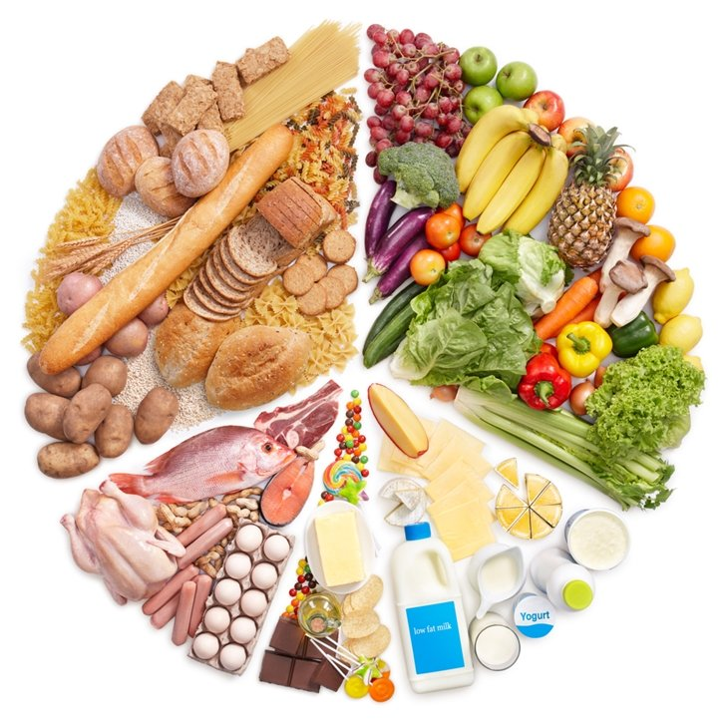
Practical Applications
Gaining more muscle mass and decreasing fat mass will result in a higher RMR
Lean mass metabolizes calories faster than fat mass

Slide 17
Discussion: Limitations
There were small sample sizes - which may limit the power of our analysis.
Training volume and loads were not assessed from each team, it is plausible variations may modify RMR.
Participants may not have followed the sleep and fasting recommendations from research team. (Self reported)

Slide 18
Differences In Resting Metabolic Rate Between Sex and Sport Type of D3 Athletes
Alissa Anderson
Department of Exercise Physiology

Slide 19
References
Jagim AR, Camic CL, Askow A, Luedke J, Erickson J, Kerksick CM, Jones MT, Oliver JM. Sex Differences in Resting Metabolic Rate Among Athletes. J Strength Cond Res. 2019 Nov;33(11):3008-3014. doi: 10.1519/JSC.0000000000002813. PMID: 30199450.
Pilis K, Stec K, Pilis A, Mroczek A, Michalski C, Pilis W. Body composition and nutrition of female athletes. Rocz Panstw Zakl Hig. 2019;70(3):243-251. doi: 10.32394/rpzh.2019.0074. PMID: 31515983.
Dionne I, Després JP, Bouchard C, Tremblay A. Gender difference in the effect of body composition on energy metabolism. Int J Obes Relat Metab Disord. 1999 Mar;23(3):312-9. doi: 10.1038/sj.ijo.0800820. PMID: 10193878.
Skrypnik D, Bogdański P, Mądry E, Karolkiewicz J, Ratajczak M, Kryściak J, Pupek-Musialik D, Walkowiak J. Effects of Endurance and Endurance Strength Training on Body Composition and Physical Capacity in Women with Abdominal Obesity. Obes Facts. 2015;8(3):175-87. doi: 10.1159/000431002. Epub 2015 May 8. PMID: 25968470; PMCID: PMC5652894.
Molé PA. Impact of energy intake and exercise on resting metabolic rate. Sports Med. 1990 Aug;10(2):72-87. doi: 10.2165/00007256-199010020-00002. PMID: 2204100.

