Slide 1
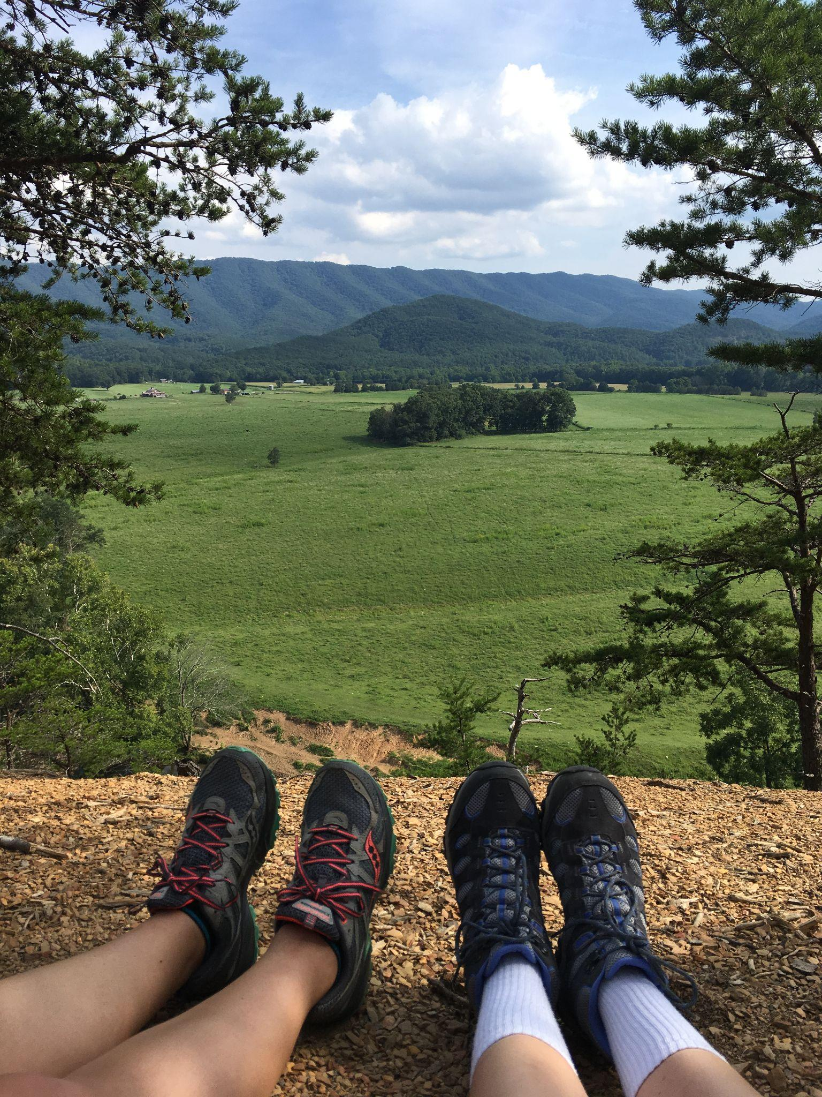
Mapping the Impact of A Trailway System on the Amount of Trash Present Within Two Watersheds of Lynchburg City, VA
Lillian Smith
Lillian Smith
Senior Honors Project

Slide 2
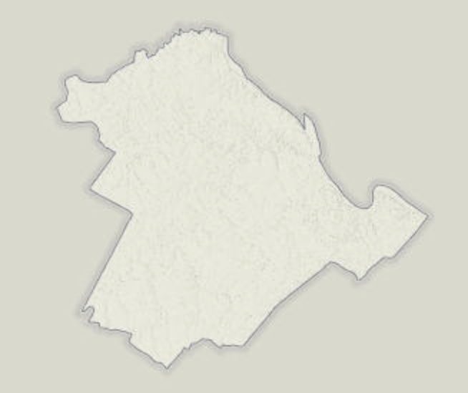
Purpose
To aid City of Lynchburg officials in the
Tyreanna & Pleasant Valley Neighborhood Plan

Slide 3
<15% of studies
01
Background
98.5% of pedestrians
01
Refer to freshwater systems
Contribute to litter at recreational areas

Slide 4
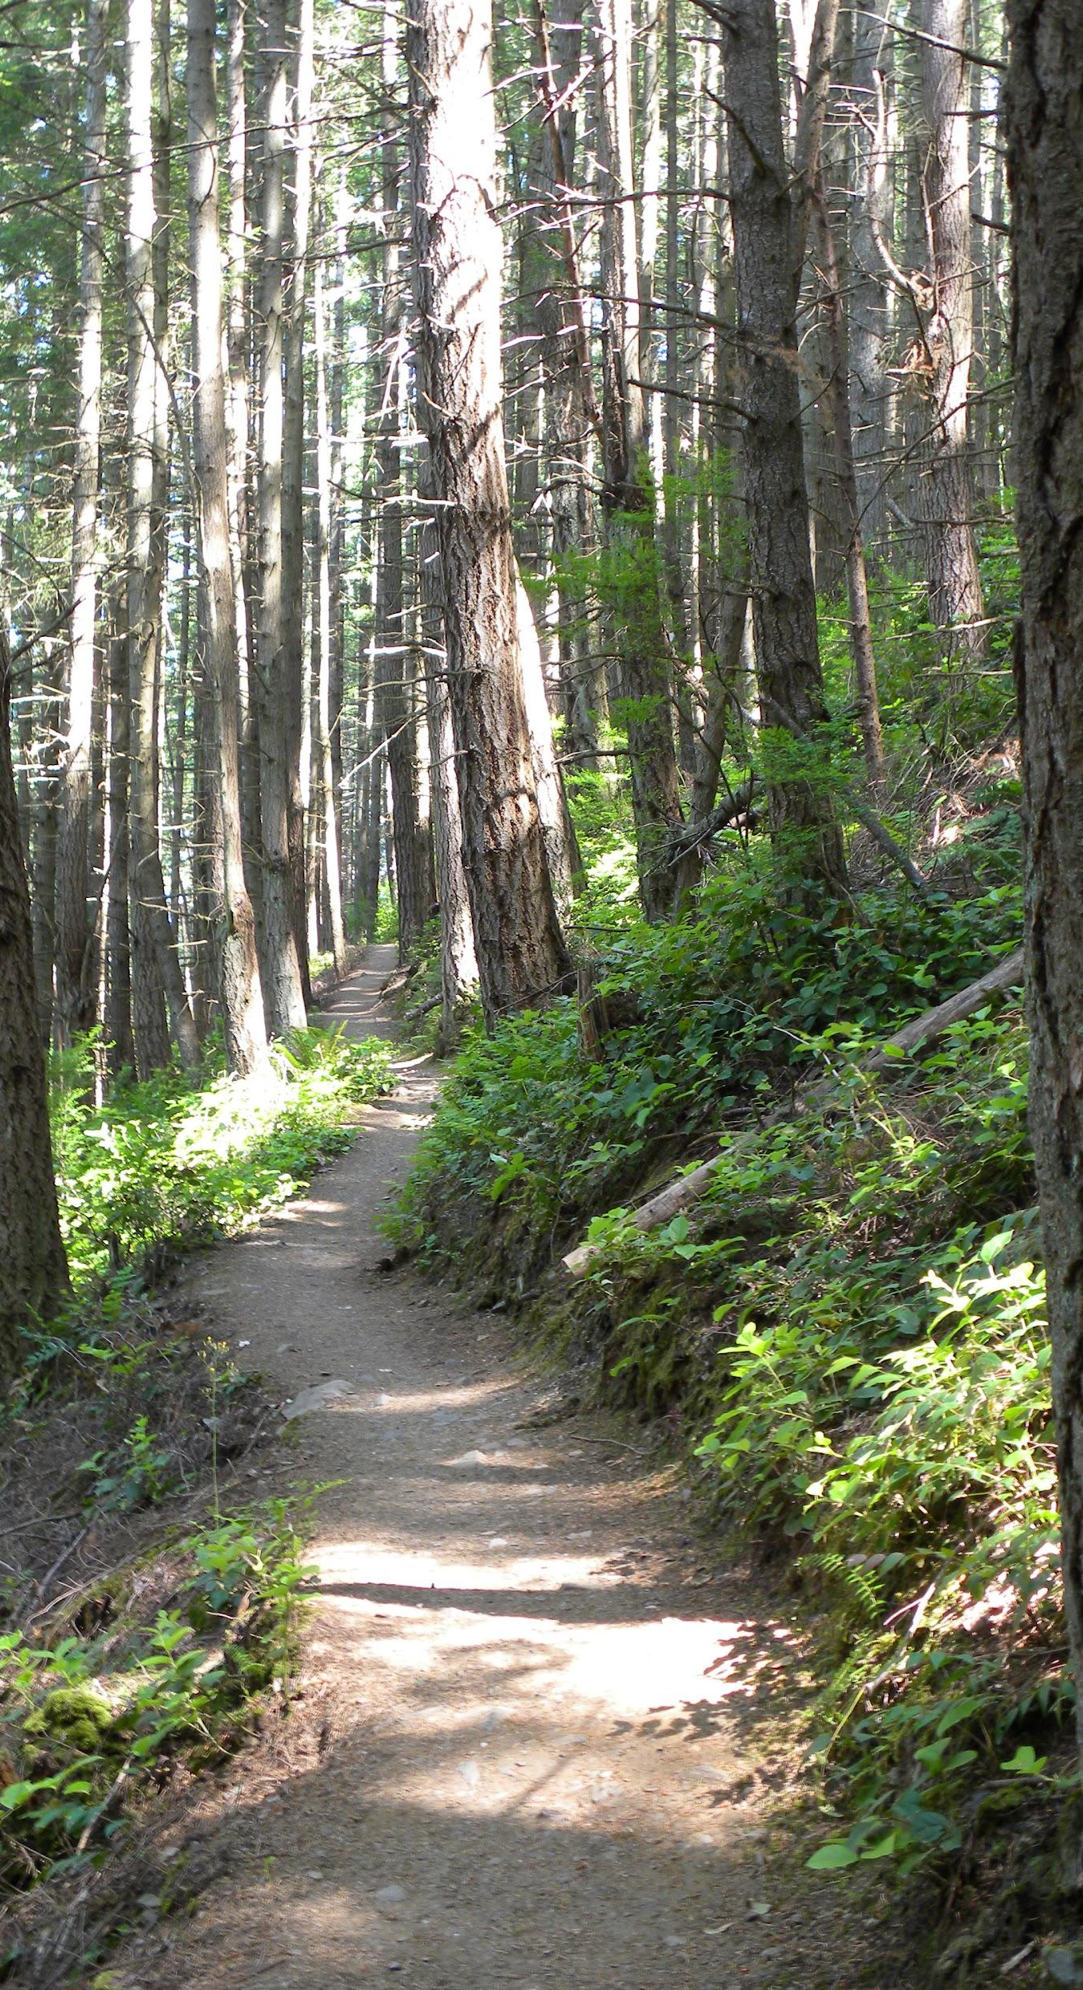
Research Question
This study examines whether the presence of an established recreational trail system limits trash accumulation in the entirety of a watershed

Slide 5
02
Methods
2.1 Study sites
2.2 GIS summaries
2.3 Site data collection

Slide 6
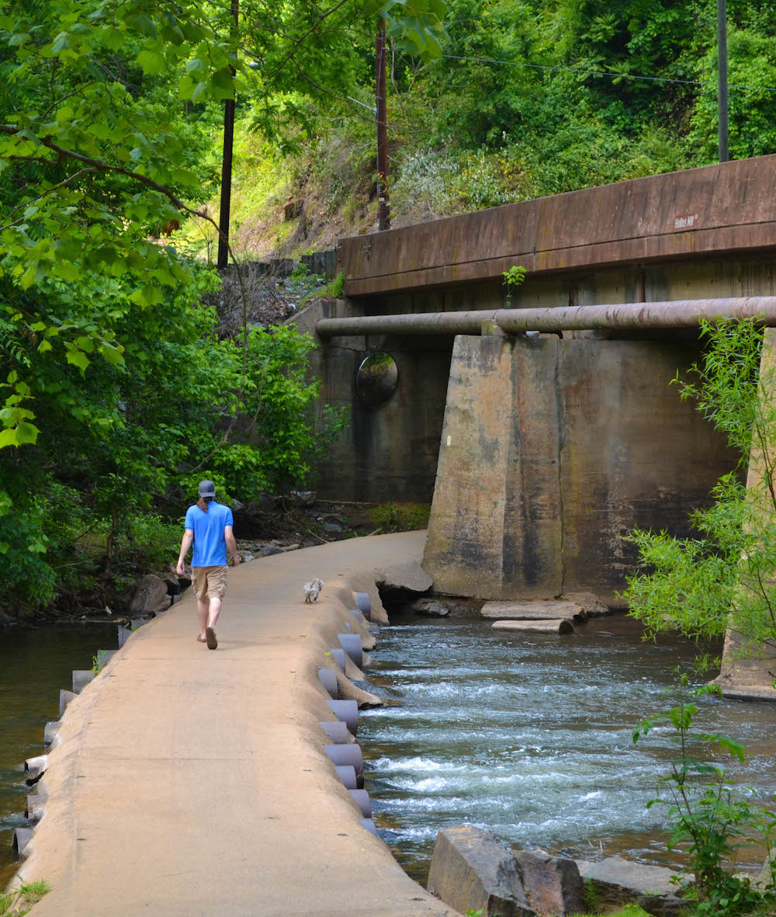
2.1 Study areas
Blackwater Creek
31.801 (Sq. Mi.)
Serves around 50,750 people
Fishing Creek
6.832 (Sq. Mi.)
Serves around 11,000 people

Slide 7
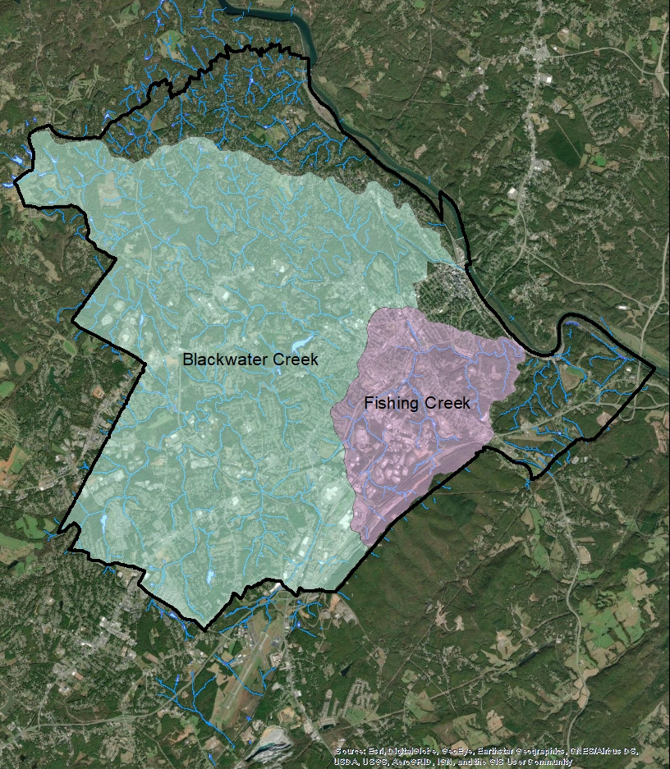
2.2 GIS summaries
Created an outline of each watershed
Distinguished zoning, parks, recreation access points, streams, contour lines, and other factors contributing to watershed description

Slide 8
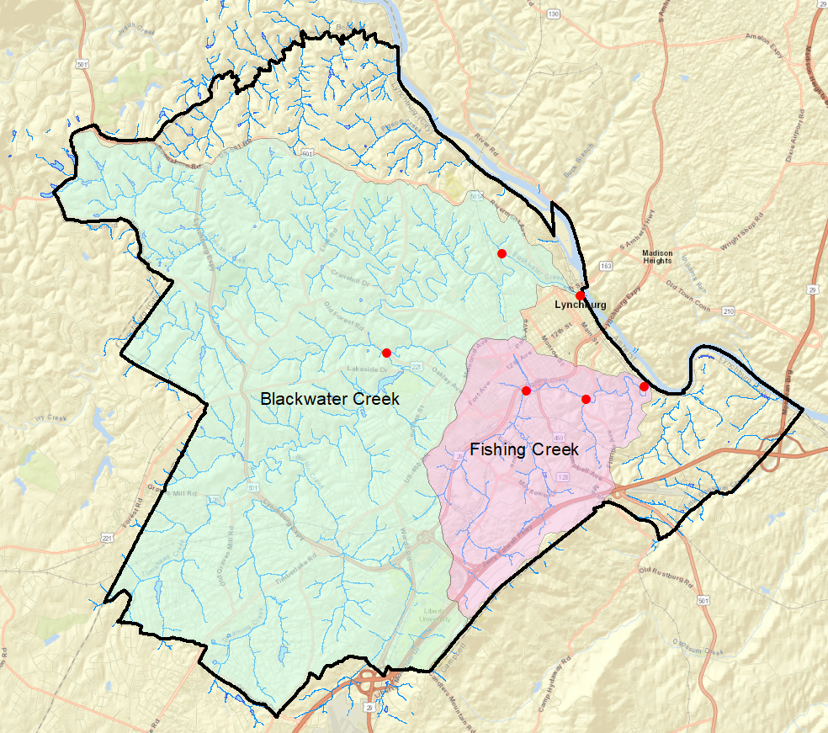
2.3 Site data collection
Blackwater Creek: 3/2/22
Fishing Creek: 12/20/21
Manual collection at 3 sites
Distance of 100 yards
45 to 60 minutes at each site

Slide 9
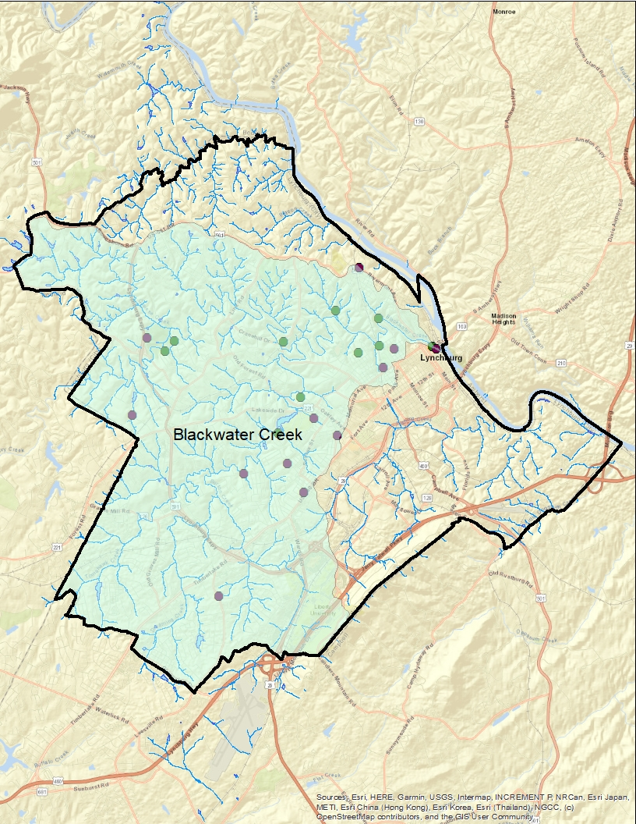
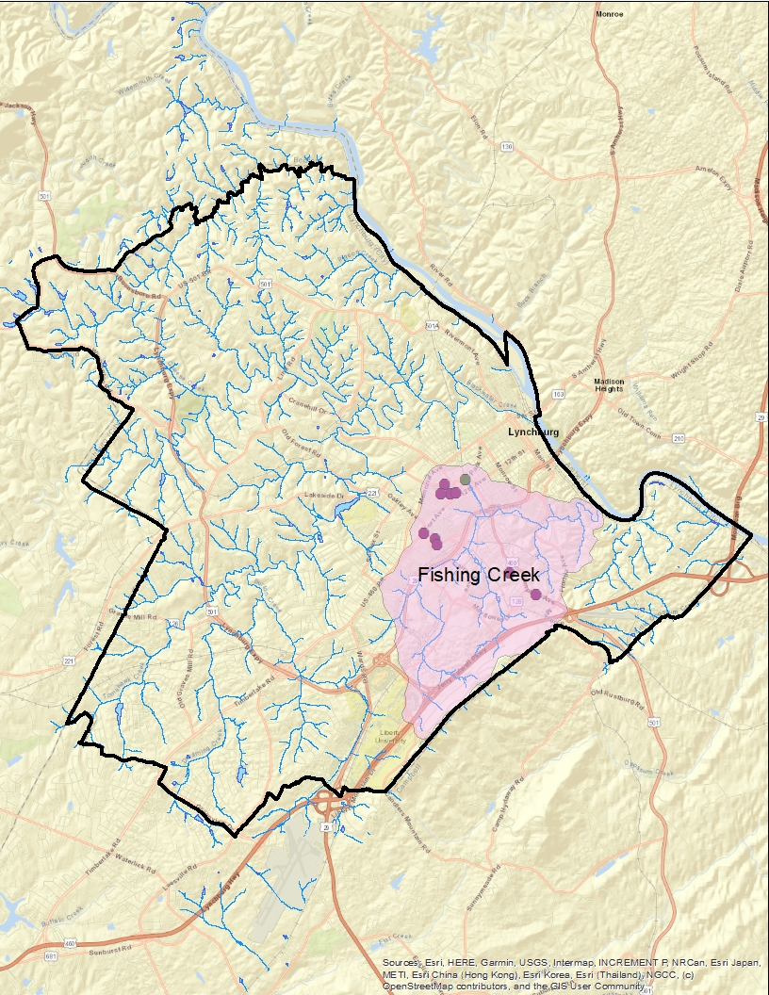
03 GIS Results
: Playgrounds
: Official trail access points

Slide 10
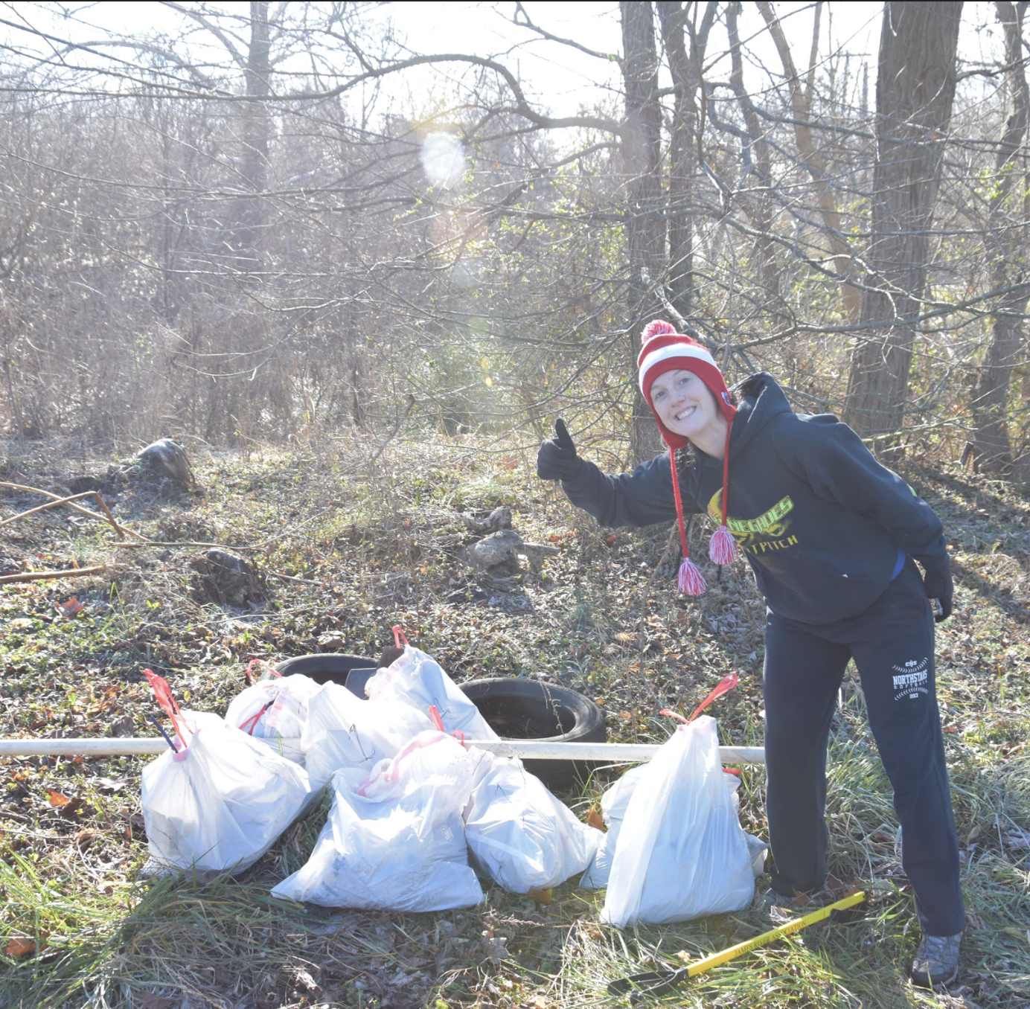
03
Results
Blackwater Creek
Fishing Creek
14 bags of debris
Beer cans, snack wrappers, large items (tires, cones)
24 bags of debris
Cans, bottles, snack wrappers, large items (tires, cushions)

Slide 11
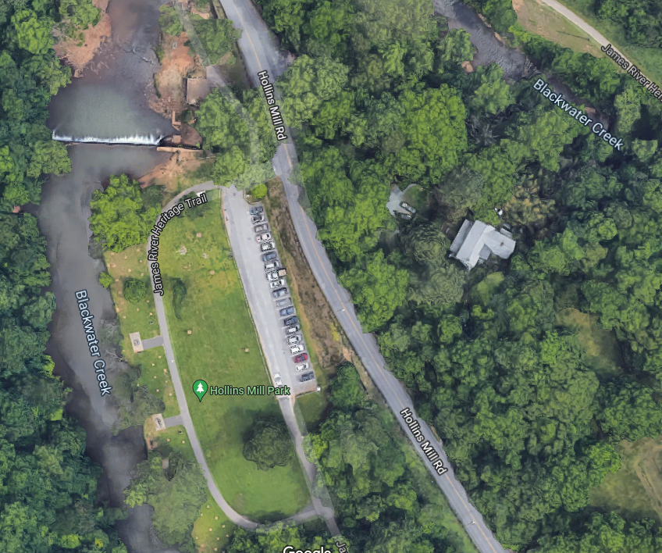
Least amount of trash found at Hollins Mill

Slide 12
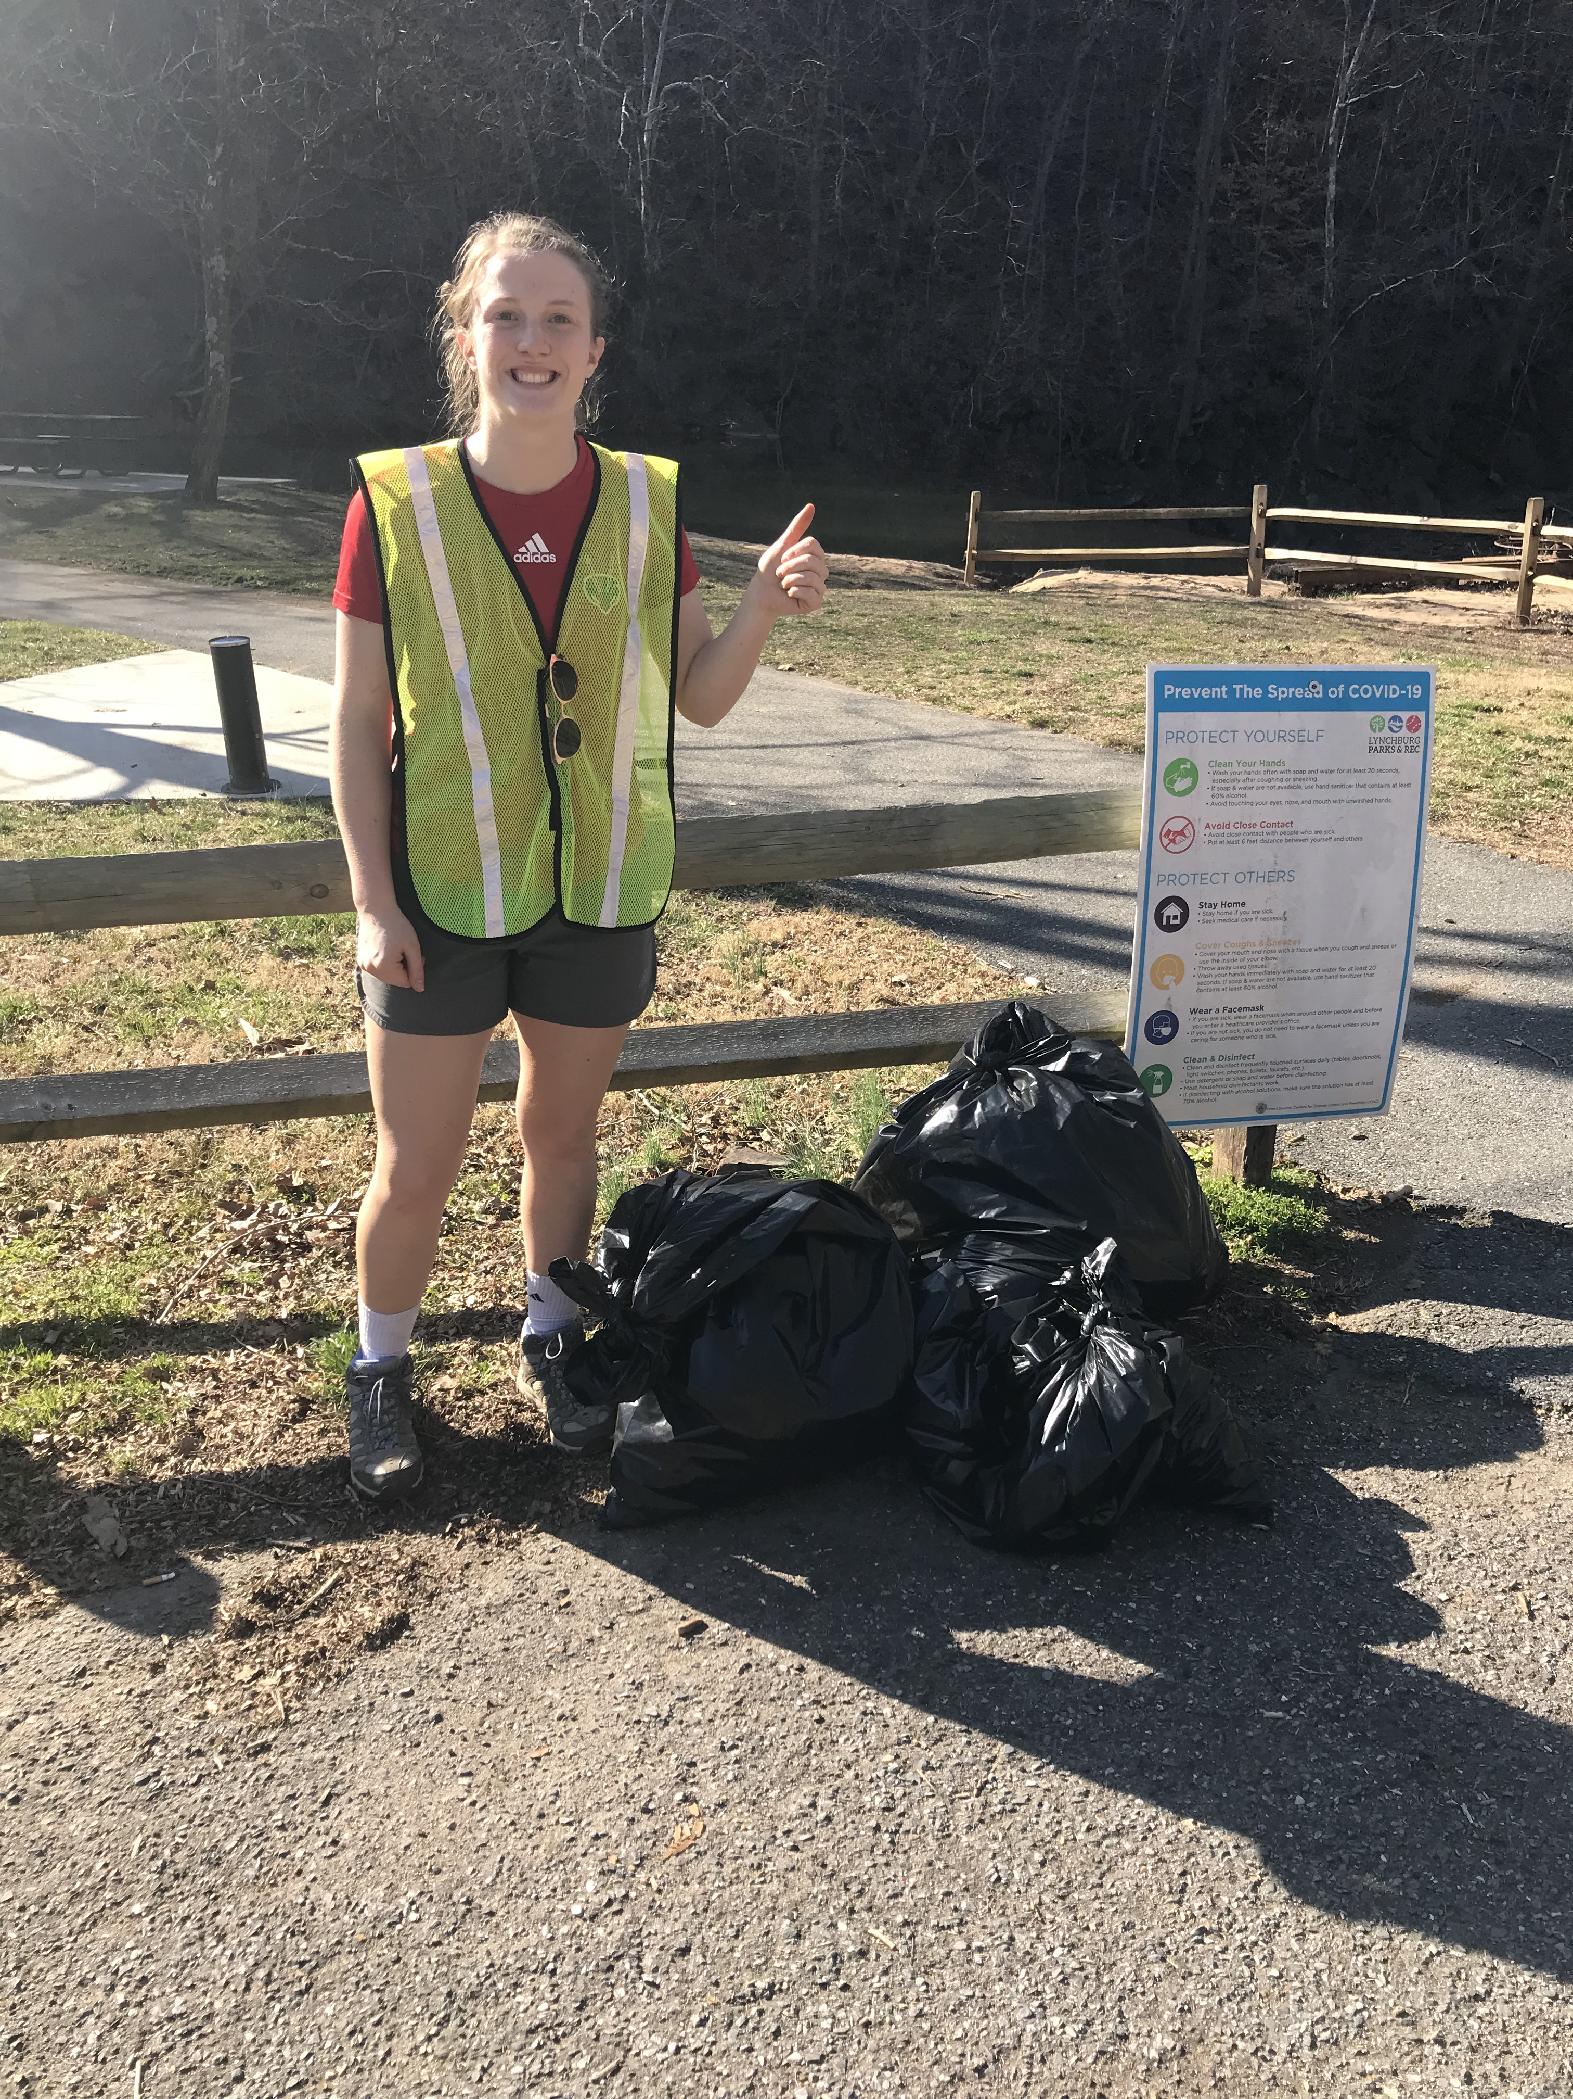
04
Future Studies
Additional Research
Increase study sites within both watersheds
Categorize the debris collected

Slide 13
New Trail Locations

Slide 14
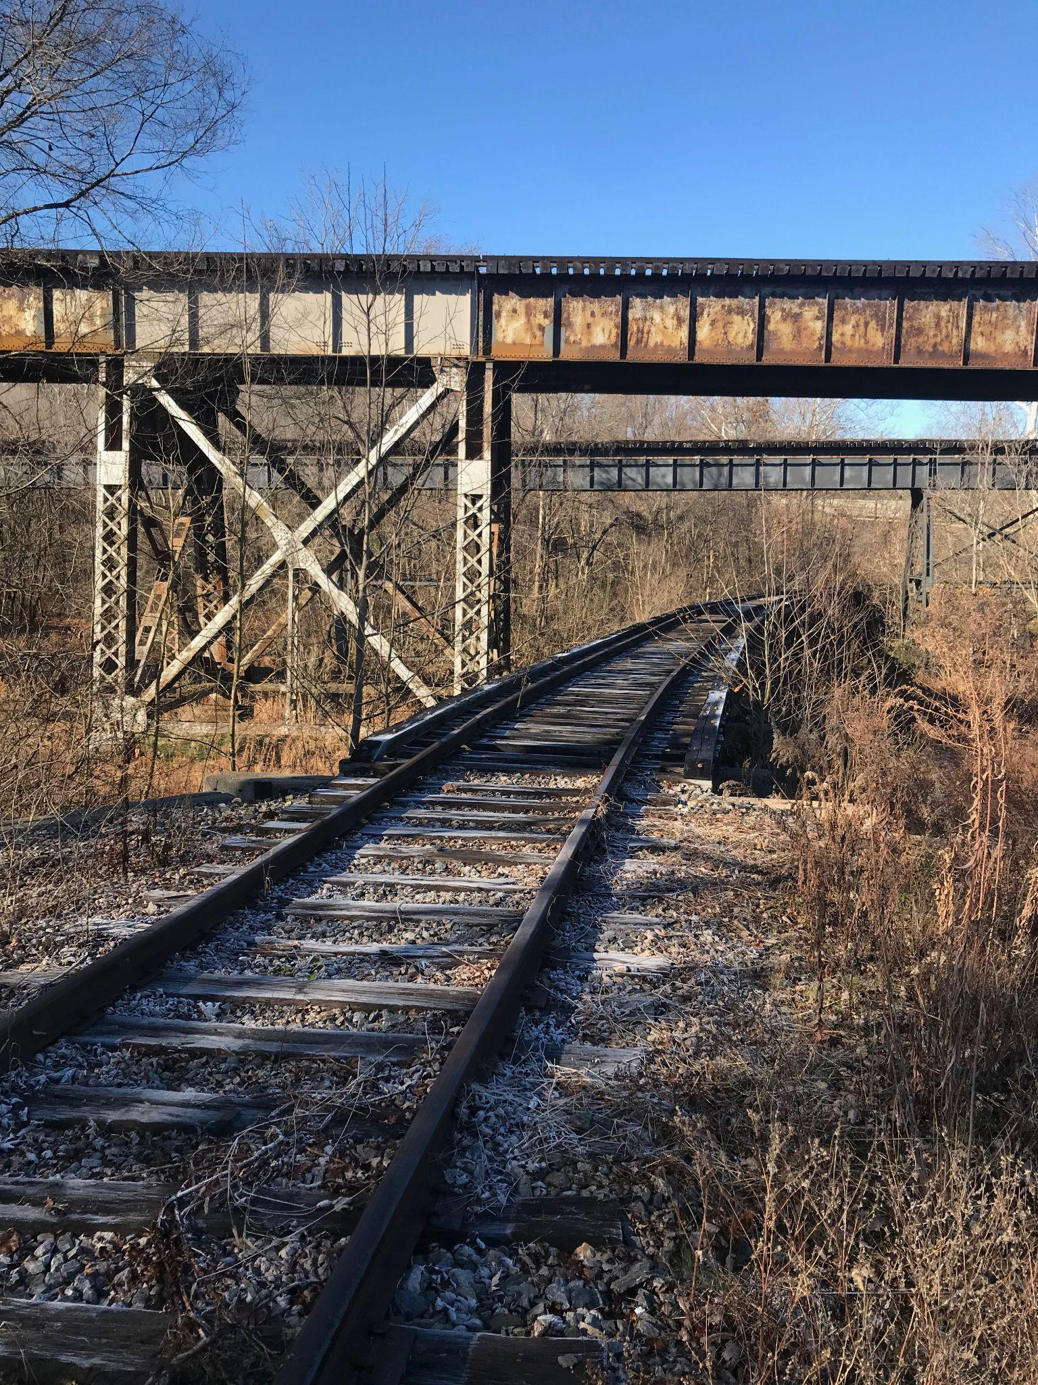
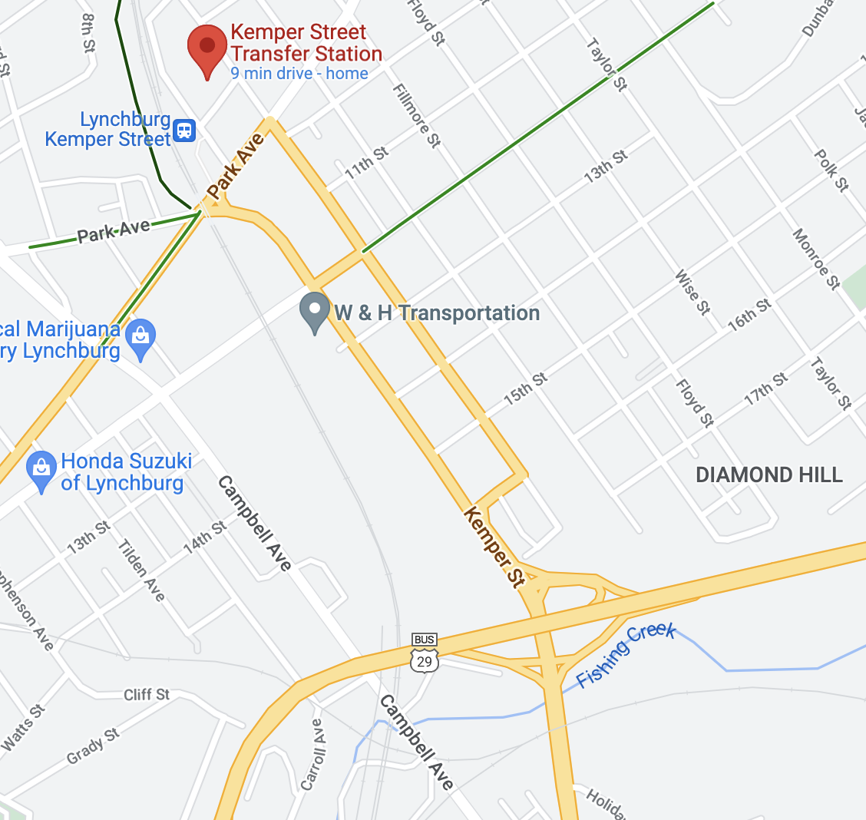
Unused Railroads
BWC Connection

Slide 15
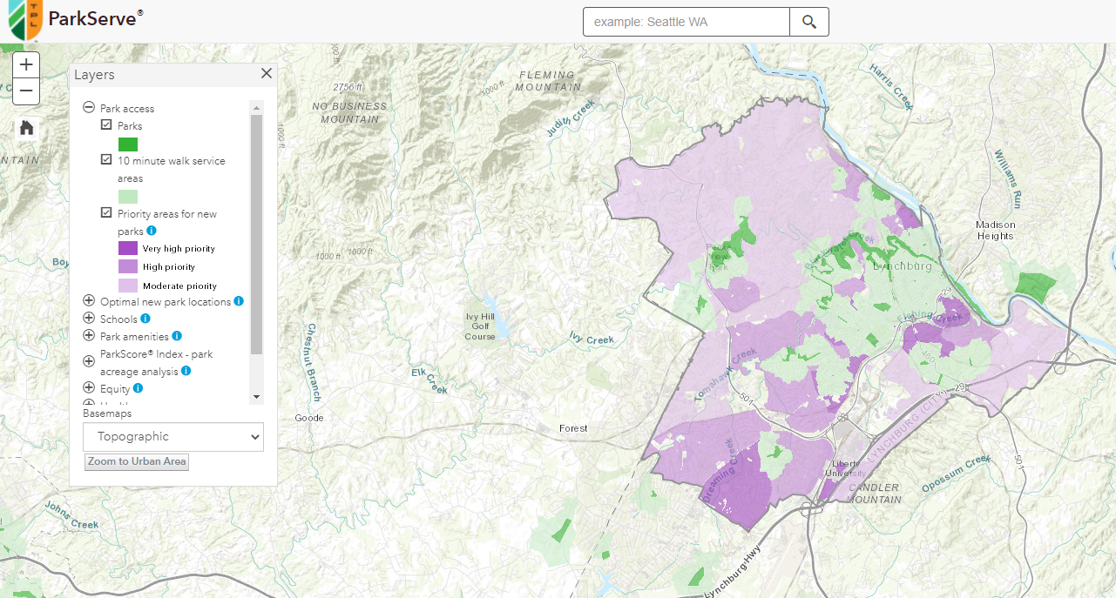

Slide 16
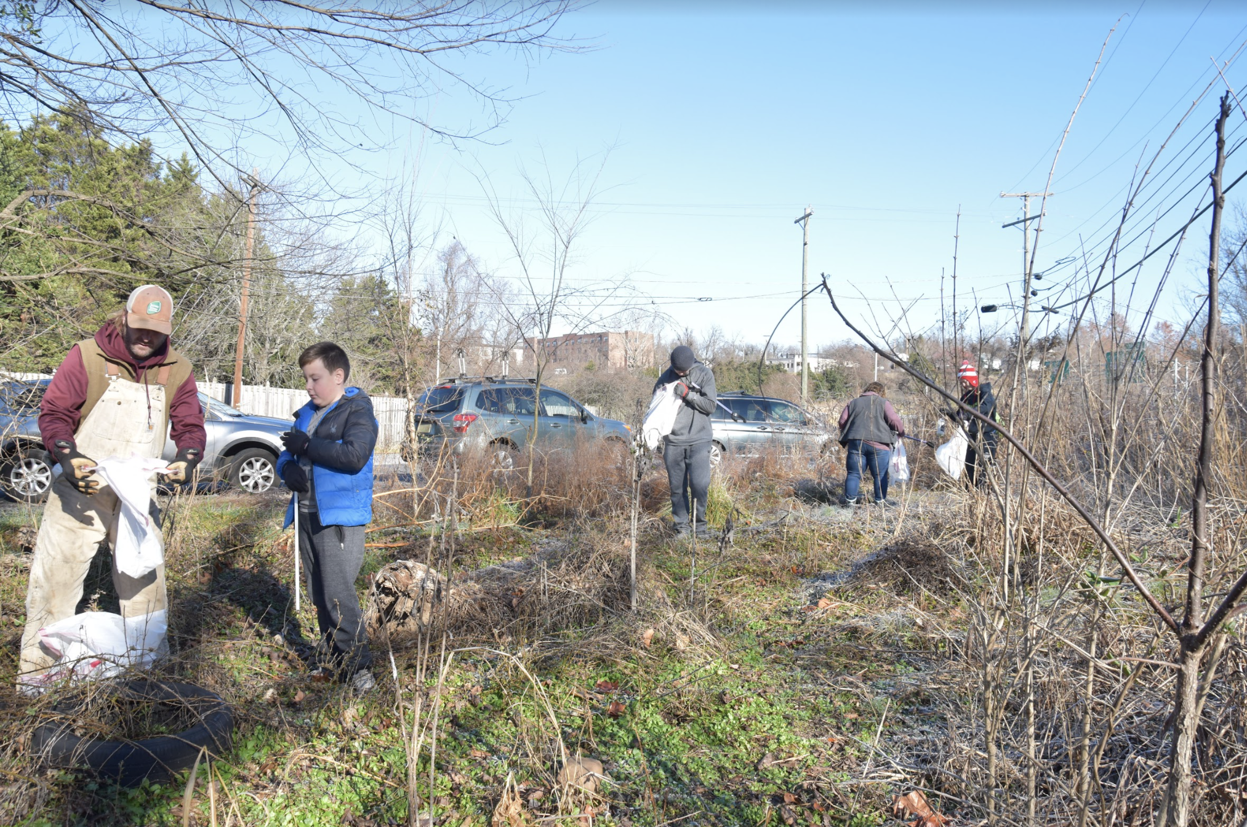
Thanks!
Do you have any questions?
smith_le@lynchburg.edu

