Slide 1
Prevention and Detection of Post-Intensive Care Syndrome in COVID-19 Patients
Presented by: Bethany Melega
University of Lynchburg
Nursing Major
Class of 2022
Student Scholar Showcase
April 6, 2022

Slide 2
What is the Problem?
COVID-19 increased the number of critically ill patients seen in hospitals
Patients cared for in Intensive Care Units (ICUs) have the potential to develop a condition known as Post-Intensive Care Syndrome (PICS)
Patients with COVID-19 often have multiple risk factors for the development of PICS

Slide 3
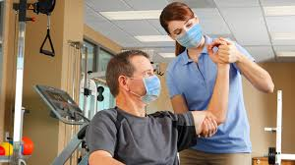
What is Post- Intensive Care Syndrome (PICS)?
“A new or worsening impairment in physical (ICU-acquired neuromuscular weakness), cognitive (thinking and judgment), or mental health status arising after critical illness and persisting beyond discharge from the acute care setting” (Rawal, et al., 2017).

Slide 4
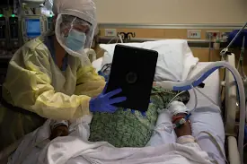
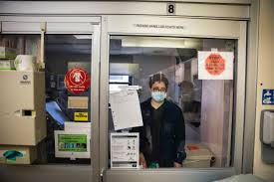
Risk Factors that COVID-19 Patients Experience:
Isolation Precautions
Communication Barriers
Personal Protective Equipment (PPE)
Lack of Visitation
Complications that arise during hospitalization

Slide 5
Recommendations to Help Decrease Instances of PICS While Hospitalized
Effective teaching and Active Listening
Communication Tool “TAGEET”
Tune in
Approach and introduce
Ground-self
Engage and respond
End encounter
Tune out
(McCarthy & Trace, 2021)

Slide 6
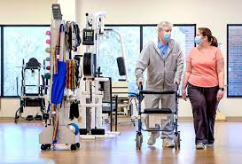
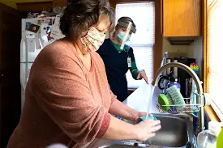
Recommendations to Help Detect Instances of PICS After Discharge
Follow up with Primary Care Provider, Outpatient Physical Therapy, Outpatient Occupational Therapy and Home Health (if applicable)
GAD-7
PCL-2
PHQ-9
Provide Educational Materials to Patient and Family
Ensure all employees of health networks who provide patient care are aware of the signs and symptoms of PICS

Slide 7
Questions???

Slide 8
References
Boopathi, S., Poma, A. B., & Kolandaivel, P. (2021). Novel 2019 coronavirus structure,
mechanism of action, antiviral drug promises and rule out against its treatment. Journal of biomolecular structure & dynamics, 39(9), 3409–3418. https://doi.org/10.1080/07391102.2020.1758788
Centers for Disease Control (CDC), (2022). Symptoms of COVID-19, Centers for Disease
Control and Prevention: COVID-19, Retrieved from: https://www.cdc.gov/coronavirus/2019-ncov/symptoms-testing/symptoms.html
Chang, Elhusseiny, K. M., Yeh, Y.-C., & Sun, W.-Z. (2021). COVID-19 ICU and mechanical
ventilation patient characteristics and outcomes-A systematic review and meta-analysis. PloS One, 16(2), e0246318–e0246318. https://doi.org/10.1371/journal.pone.0246318
Fauci, A. S., Lane, H. C., & Redfield, R. R. (2020). Covid-19 — navigating the uncharted. N
Engl J Med, 382(13), 1268-1269. doi:10.1056/NEJMe2002387

Slide 9
McCarthy, O’Donovan, M., & Trace, A. (2021). A new therapeutic communication model
“TAGEET” to help nurses engage therapeutically with patients suspected of or confirmed with COVID-19. Journal of Clinical Nursing, 30(7-8), 1184–1191. https://doi.org/10.1111/jocn.15609
“Mental health outcomes after hospitalization with or without COVID-19,” General Hospital Psychiatry. DOI: 10.1016/j.genhosppsych.2021.07.004
Moss S.J., Stelfox H.T., Krewulak K.D., Impact of restricted visitation policies in hospitals
on patients, family members and healthcare providers during the COVID-19 pandemic: a scoping review protocol. BMJ Open 2021;11:e048227. doi: 10.1136/bmjopen-2020-048227
Rawal, Yadav, S., & Kumar, R. (2017). Post-intensive care syndrome: An overview. Journal of
Translational Internal Medicine, 5(2), 90–92. https://doi.org/10.1515/jtim-2016-0016
Shwe, Sharma, A. A., & Lee, P. K. (2021). Personal Protective Equipment: Attitudes and
Behaviors Among Nurses at a Single University Medical Center. Curēus (Palo Alto, CA), 13(12), e20265–e20265. https://doi.org/10.7759/cureus.20265
Simpson, Milnes, S., & Steinfort, D. (2020). Don’t forget shared decision-making in the
COVID-19 crisis. Internal Medicine Journal, 50(6), 761–763. https://doi.org/10.1111/imj.14862
Smith, Lee, A. C. W., Smith, J. M., Thiele, A., Zeleznik, H., & Ohtake, P. J. (2021).
COVID-19 and Post-intensive Care Syndrome: Community-Based Care for ICU Survivors. Home Health Care Management & Practice, 33(2), 117–124. https://doi.org/10.1177/1084822320974956

Slide 10
Strandås, & Bondas, T. (2018). The nurse–patient relationship as a story of health enhancement
in community care: A meta-ethnography. Journal of Advanced Nursing, 74(1), 11–22. https://doi.org/10.1111/jan.13389
Tran, Bell, C., Stall, N., Tomlinson, G., McGeer, A., Morris, A., Gardam, M., & Abrams,
H. B. (2016). The Effect of Hospital Isolation Precautions on Patient Outcomes and Cost of Care: A Multi-Site, Retrospective, Propensity Score-Matched Cohort Study. Journal of General Internal Medicine : JGIM, 32(3), 262–268. https://doi.org/10.1007/s11606-016-3862-4
Trotta, Rao, A. D., McHugh, M. D., Yoho, M., & Cunningham, R. S. (2020). Moving beyond
the measure: Understanding patients’ experiences of communication with nurses. Research in Nursing & Health, 43(6), 568–578. https://doi.org/10.1002/nur.22087

