Slide 1
The Effect of Ethanolic Echinacea purpurea Root Extracts on the Production of Pro-Inflammatory Mediators in RAW 264.7 Murine Macrophages
Trey Nguyen
Supervised by David Freier, PhD
Department of Biomedical Sciences
University of Lynchburg

Slide 2
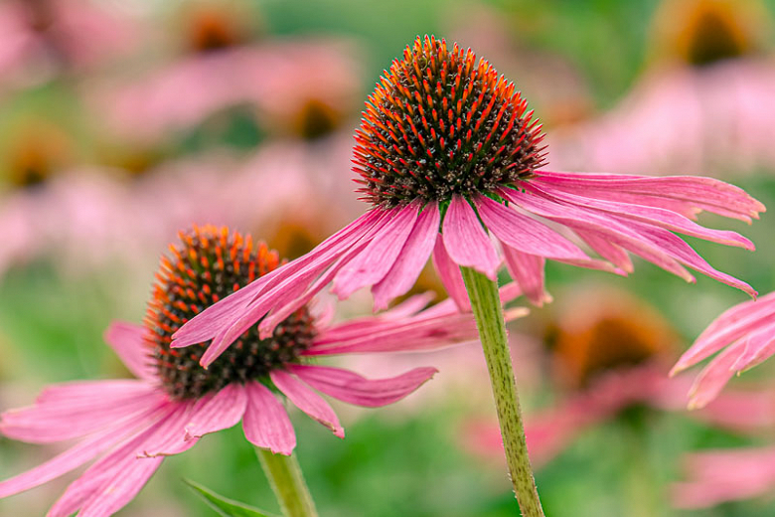
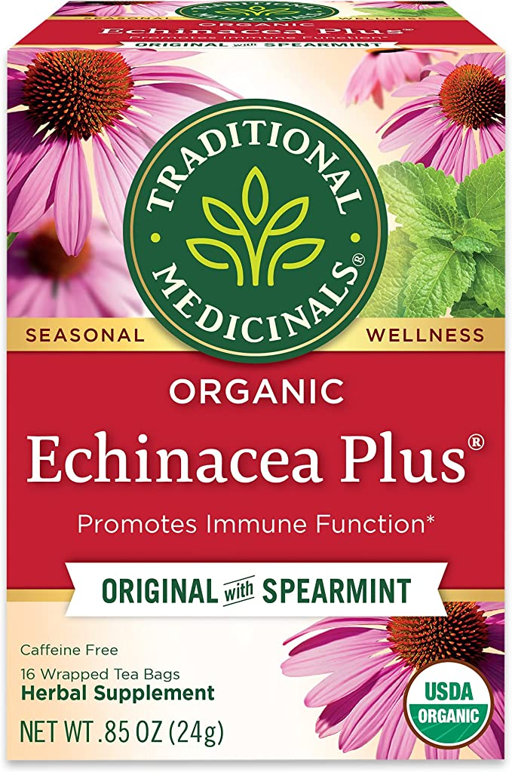
What is Echinacea purpurea?
Used in herbal medicine (tea, tablets, and capsules)
Commonly known as purple coneflower
“Promotes the immune system”

Slide 3
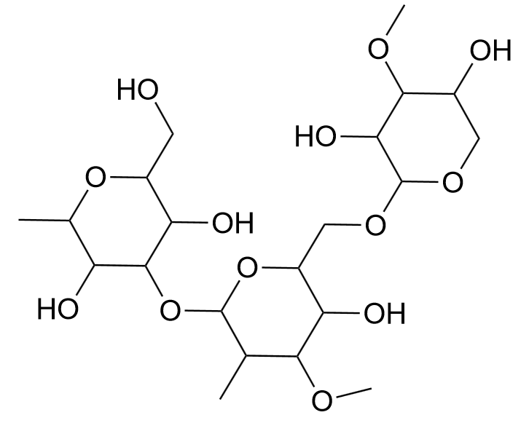
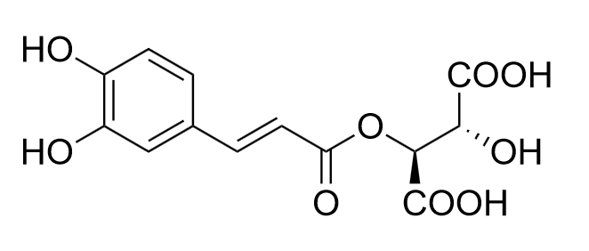
The Chemical Complexity of E. purpurea
Polysaccharides:
- Arabinogalactan
Caffeic Acid Derivatives:
Chlorogenic Acid
Chicoric Acid
Caftaric Acid
Alkamides
Glycoproteins

Slide 4
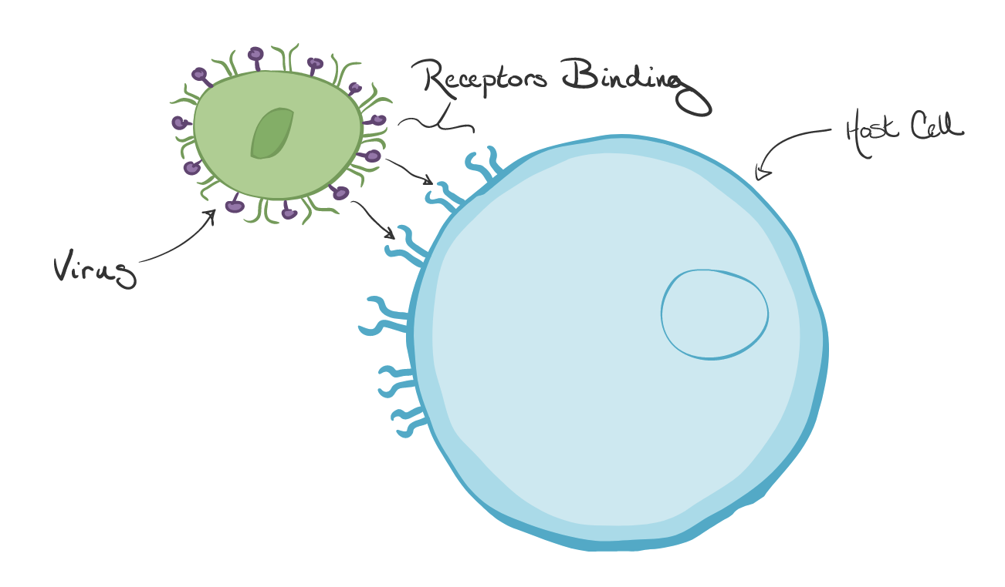
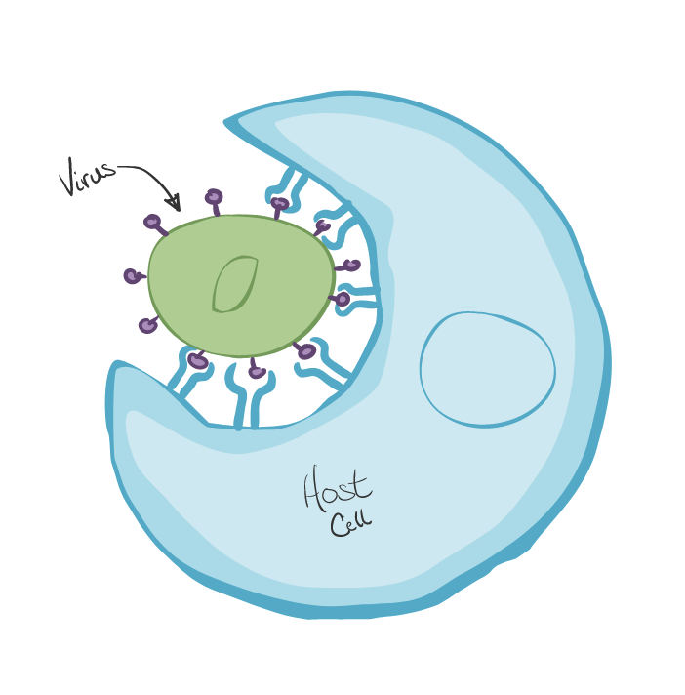
What is a Macrophage?
Specialized cells of the immune system
Pathogen recognition abilities:
- Stimulation by lipopolysaccharide (LPS)
Process of phagocytosis

Slide 5
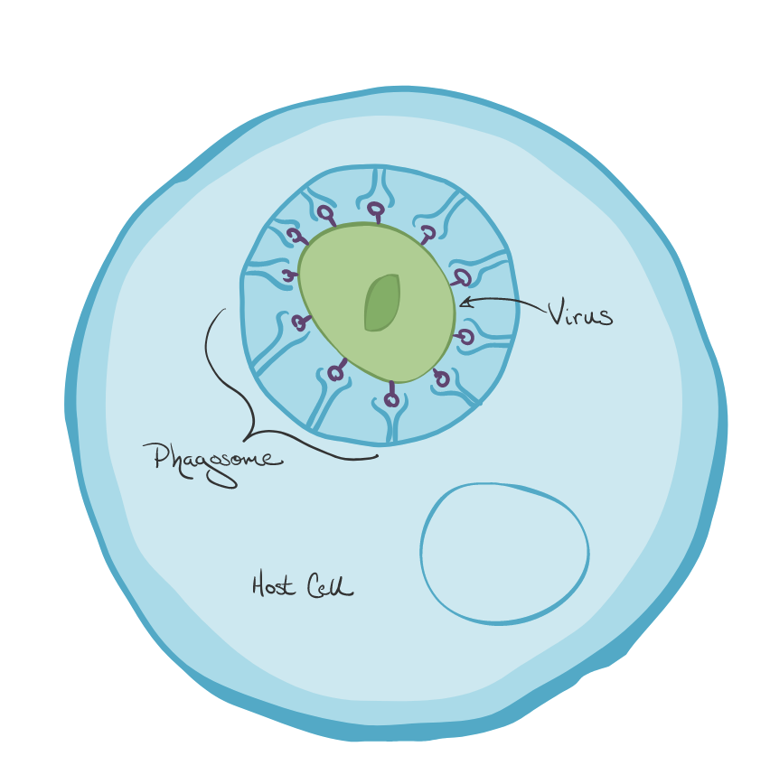
The Inflammatory Response
Production of nitric oxide (NO)
What is the importance of nitric oxide?
L- Arginine
Nitric Oxide
Nitrite
Inducible Nitric Oxide Synthase (iNOS)

Slide 6
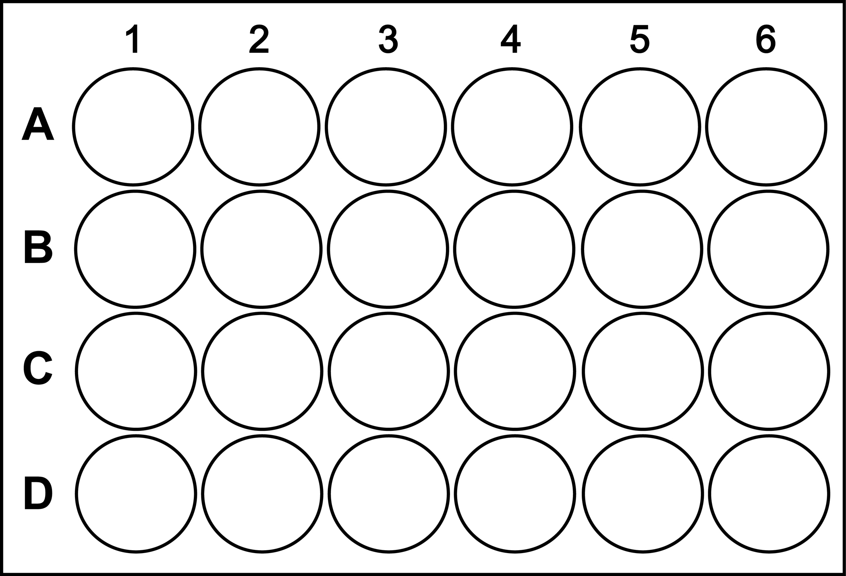
Treatment Groups #1
0 ng/mL LPS
0.15% Ethanol Control
100 ng/mL LPS
0.75% Ethanol Control
0.15% 75:25 Ech. Extract
1.5% Ethanol Control
0.75% 75:25 Ech. Extract
0.15% 75:25 Ech. Extract Only
1.5% 75:25 Ech. Extract
0.75% 75:25 Ech. Extract Only
1.5% 75:25 Ech. Extract Only

Slide 7
*

Slide 8
Treatment Groups #2
0 ng/mL LPS
0.15% Ethanol Control
100 ng/mL LPS
0.75% Ethanol Control
0.15% 75:25 Ech. Extract (Old)
1.5% Ethanol Control
0.75% 75:25 Ech. Extract (Old)
0.15% 75:25 Ech. Extract (New)
1.5% 75:25 Ech. Extract (Old)
0.75% 75:25 Ech. Extract (New)
1.5% 75:25 Ech. Extract (New)

Slide 9
*

Slide 10
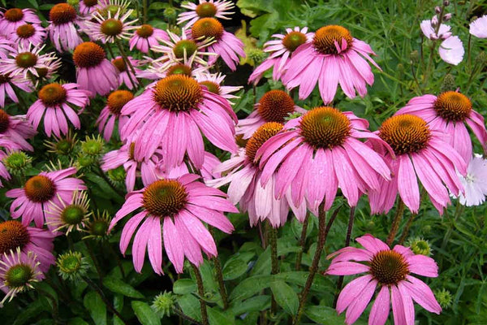
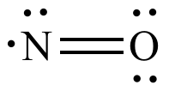
What does the data suggest?
Concentration of Echinacea purpurea
Production of Nitric Oxide
Anti-Inflammatory Response

Slide 11
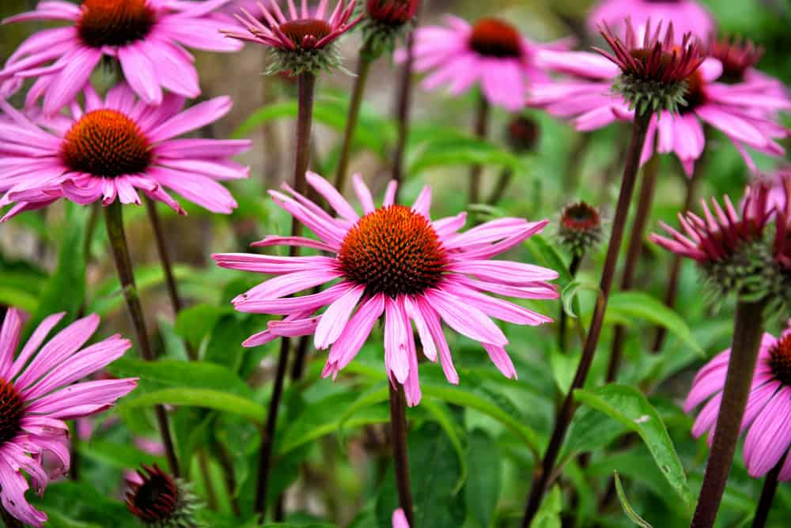
What’s next?
Identify the chemical composition of Echinacea purpurea root extract
Determine the concentration of specific compounds present within the extract sample
Comparison to aerial components of Echinacea purpurea

Slide 12
Acknowledgements
University of Lynchburg
Department of Biomedical Sciences
Dr. David Freier

