Slide 1
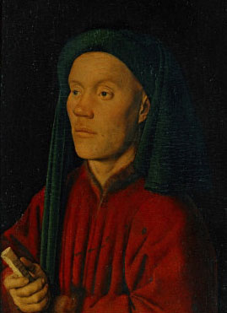
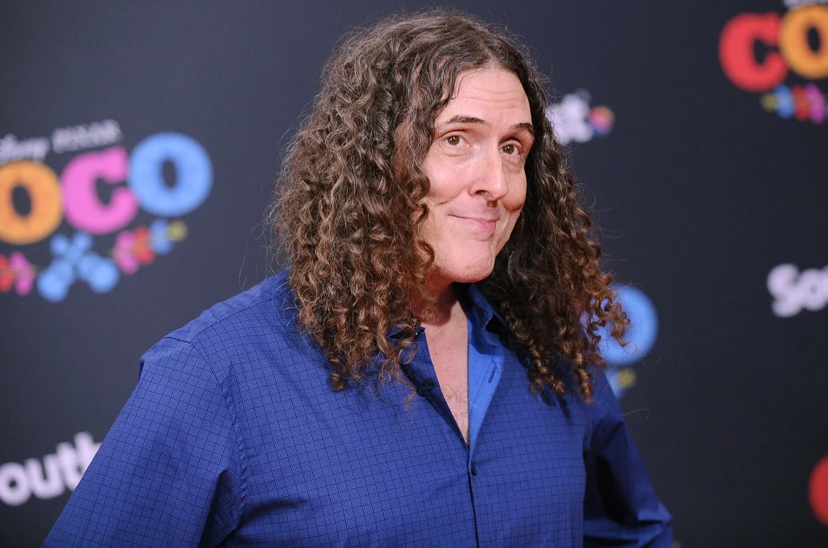
L’homme Armé: The Tradition of Contrafactum
Lauren Moseley
Notes:
Remember to introduce yourself – your major – your topic – and why you chose to study this subject
You can make it pretty Lauren
Pictures:
DuFay: https://www.singers.com/bio/4119
Weird Al: https://www.billboard.com/music/rock/weird-al-yankovic-michael-jackson-parodies-8517896/

Slide 2
Introduction of Topic
Contrafactum (Falck & Picker 2001)
From the Latin word “Contrafacere” meaning to imitate
New poems to older melodies
More specific: sacred text to secular melodies
A vocal piece where the text has been replaced (Lingas, 2011).
L’homme Armé (The armed man)
Famous secular text often used in contrafactum
Guillaume Dufay (c. 1397-1474) (Wright & Simms, 2010)
Missa L’homme Armé (late 1450s)
Most circulated English Mass in the 15th century (Planchart, 2003).
Notes:
Generic Information, bullets from the introduction, have sources!!!!
Source doesn’t have to be the actual size font and now you don’t have to say the sources
Bulleted Statements
Paintings Strip: https://earlymusicmuse.com/l-homme-arme/

Slide 3
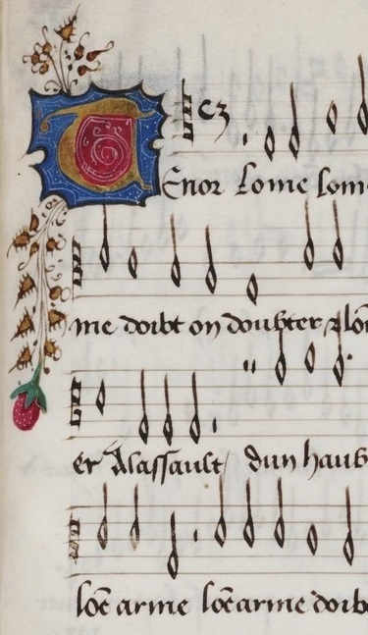
Purpose
With the intent of improving music performance, the purpose of this research was to investigate L’homme Armé and Contrafactum and their usage today.
Notes:
LEAVE TEXT, JUST ADD PURPOSE
L’homme Arme: https://en.wikipedia.org/wiki/L%27homme_arm%C3%A9

Slide 4
Problems
Examine
Examine contrafactum and L’homme Armé in medieval and renaissance music;
Explore
Explore the use of contrafactum today; and
Arrange
Arrange a piece of music that combines a sacred and modern secular song.
Notes:
ADD PROBLEMS

Slide 5
Literature Review
Sargent J. (2011). Morales, Josquin and the “l’homme armé” tradition. Early Music History, 30, 177. https://doi.org/10.1017/S0261127911000040
This source provided information on the L’homme Arme Tradition, the history of L’homme Armé, and monumental composers and their works involving the chanson.
Wright C. & Simms B. (2010). Music in western civilization. Upper Saddle River: NJ: Schirmer Cengage Learning.
This source provided a wide range of information on most time periods of music which included the usage of L’homme Armé.
Moll, K. N. (2017). Streaming music into renaissance studies: The case of l’homme armé. Exploration in Renaissance Culture, 43, 109. https://doi.org/10.1163/23526963-04302001
This source provided a deeper dive into the political and historical implications of L’homme Arme along with details on the original chanson.
Notes:
ALL INFO ON ONE SLIDE (have source in APA format, one bullet point “I liked this because___”

Slide 6
Methodology
Design:
Texts, Scholarly journals, musical scores: understand musical characteristics and the use of contrafactum and L’homme armé along with historical accounts.
Instrumentation:
review of reputable texts, journals, and scores: information about composers and compositions, developments in technique.
Analysis:
Scholarly sources to define and investigate the history of L’homme armé and contrafactum
Arranged a piece of music
Public Presentation: Student Scholar Showcase, April 6th 2022
Notes:
ONE SLIDE, NOT TOO MANY WORDS

Slide 7
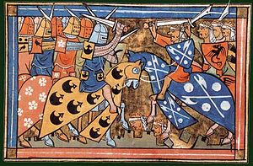
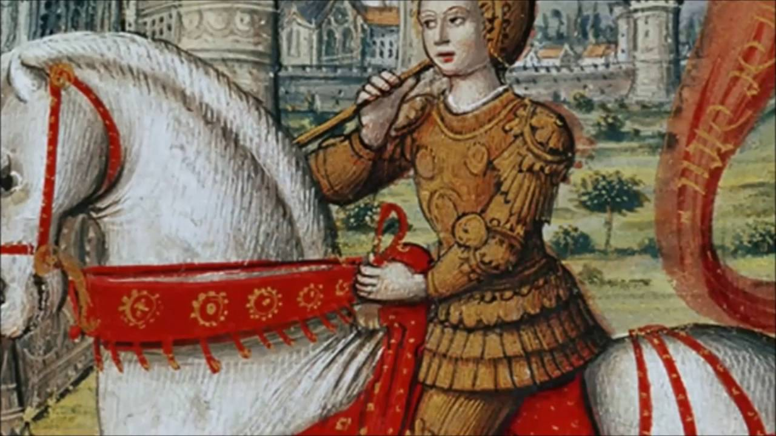
Problem One To examine contrafactum and L’homme armé in medieval and renaissance music.
Contrafactum in the late medieval and early renaissance eras
The reason many early secular songs survive (Lingas, 2011)
Contrafactum: the new poems to already existing melodies. (Falck & Pickler, 2001)
In the 12th and 13th centuries composers utilized contrafactum with sequences and hymn melodies to edit the text.
L’homme Armé
L’homme Armé originated as an unwritten song (Fallows, 2001).
Many changes made in different masses.
Existed due to the crusades. (Wright & Simms, 2010).
Impact of the fall of Constantinople and the militant spirit that followed in the Holy Roman Empire
Leaders rallied troops for a form of battle with L’homme Arme. (Fallows, 2oo1)
Notes:
Add speaking points, one slide preferable, don’t go over 2
Crusades: https://en.wikipedia.org/wiki/Crusades

Slide 8
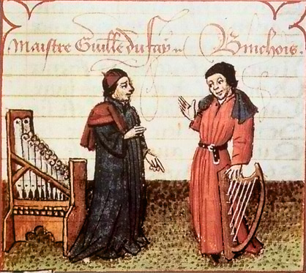
Problem One To examine contrafactum and L’homme arme in medieval and renaissance music.
Guillaume Dufay
Missa L’homme Armé,
Marked the beginning a long tradition of retrograde motion
Symbolic of the journey of Jesus from heaven to earth and back to heaven
Lived in a time of religious turmoil
Crusades and the tension between the Holy Roman Empire and the Ottoman-Turks.
Spent most of his life in the church and worked as multiple positions which included chorister, subdeacon, and canon. (Planchant, 2001).
Frequented the musical chapel of the dukes of Burgundy, the later home of many Armed Man Masses. (Wright & Simms, 2010).
Notes:
Add speaking points, one slide preferable, don’t go over 2
Crusades: https://en.wikipedia.org/wiki/Crusades
Burgundy School: https://en.wikipedia.org/wiki/Burgundian_School

Slide 9
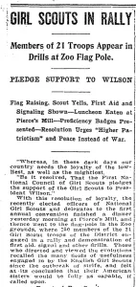
Problem Two To explore the use of Contrafactum in the 20th and 21st centuries
Parody & Contrafactum
Parody: a work where a composer replaced an old text with a new text (Randel, 2003).
Middle Ages and Renaissance, composers referred to this type of work as contrafactum.
Used parodies the same way and for the same purposes as Medieval and Renaissance composers
War.
Political purposes behind many L’homme Armé
Cantus firmus masses (Moll, 2017).
L’homme Armé
To raise support for the Order of the Golden Fleece and a new crusade.
US government reworded common songs to represent patriotism and wartime contributions (Lawson, 2017).
Girl Scouts such as sewing bandages and working with the junior red cross encouraged through re-worded the song “Yankee Doodle” during World War I.
Notes:
Order of the golden fleece: https://en.wikipedia.org/wiki/Order_of_the_Golden_Fleece
Girl Scouts: https://gshistory.com/tag/world-war-i/
Weird Al: https://en.wikipedia.org/wiki/Mandatory_Fun

Slide 10
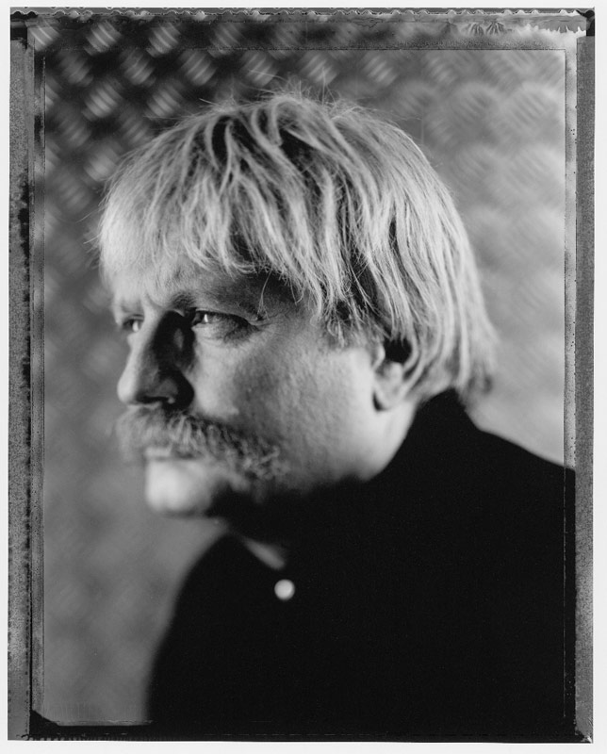
Problem Two To explore the use of Contrafactum in the 20th and 21st centuries
Sir Karl Jenkins’ (b. 1944) The Armed Man: A Mass for Peace (Wilson, 2004)
Modern application of L’homme Armé
Incorporated music from many cultures, sacred and secular
Moslem Call to Prayer,
A Kyrie that pays homage to Palestrina’s mass setting of L’homme Armé
A plainsong with the word of psalms
A musical adaption of a poem about the horrors of the bombing of Hiroshima.
Alfred Matthew Yankovic (b. 1959), better known as Weird Al Yankovic,
arranged numerous parodies from popular songs
won 3 Grammy Awards in his career as of 2014.

Slide 11
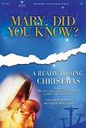
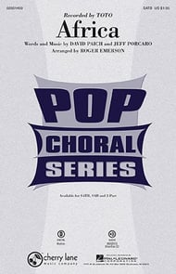
Problem Three Arrange a piece of music that combines a sacred and a modern secular song
Mary Did You Know and Africa
Both well known
Notable Materials
Choral arrangement of Africa arr. Roger Emmerson
Noteflight.com
Notable edits
Melody moved up an octave
Acapella portions of the music added to the accompaniment
Rhythms edited to allow Mary did You Know to make sense
Notes:
REMEMBER TO ADD AT LEAST ONE CITATION
Noteflight: https://twitter.com/noteflight
Africa: https://www.jwpepper.com/Africa/10091391.item#.YkfeXjUpC00

Slide 12
Performance: Mary Did You Know? By Toto
How is it Contrafactum?
Text of a secular song replaced with that of a sacred song
The Modern Parody
Other Examples in Social Media
The “Berries and Cream” audios
“Apple Bottom Jeans” by the Beach Boys
“These songs shouldn’t go together!”
Notes:
Put song here, add information about songs

Slide 13
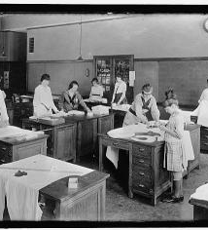
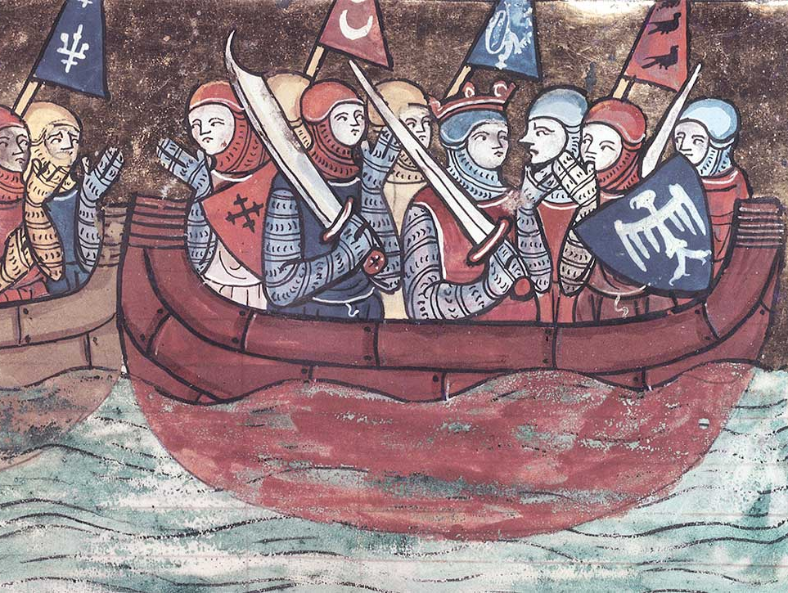
Conclusions
Contrafactum existed in multiple forms throughout history, from the beginnings of L’homme Armé
To the use of parody in modern pop culture.
Composers used both versions of contrafactum to address serious issues and for humorous purposes.
Notes:
Crusades: https://www.historytoday.com/archive/feature/crusades-complete-history
Girl Scouts: https://www.womenshistory.org/resources/general/girls-volunteer-groups-during-world-war-I
Parody: https://weirdal.fandom.com/wiki/Tacky

Slide 14
Implications for Music Pedagogy
When teaching composition or trying to get students into composition, contrafactum and parody may be a beneficial place to start. Allowing the students to engage in music they enjoy, to create something new likely will grant the student a lifelong appreciation of music and composition
The use of contrafactum in the classroom extends beyond the music classroom. The creation of parody compositions for other topics allows the student to engage more with the topic and provides them with a different way to remember the information.
Notes:
Because I studied this, now what can I do?
An understanding of modern musical parodies
The ability to pick out Contrafactum
The knowledge of church music and the use of music/text to add an alternate meaning/agenda
Calculus Rhapsody: https://www.youtube.com/watch?v=uqwC41RDPyg&list=PLq6rIsDXDOqvcNUEJZRbnFg6hgqrYebJG&index=5

Slide 15
Future Studies
Similarities between the use of musical parody and Greek comedy
Notes:
Because I studied this now, where can I go with this information

Slide 16
Bibliography
Bonds, Mark E. A history of music in western culture. Upper Saddle River, NJ: Pearson Education, Incorporated, 2006.
Burkholder, Peter. A History of Western Music. United States: W.W. Norton & Company Incorporated, 2006.
Fibich, Zdeněk ." In The Oxford Dictionary of Music, 2nd ed. rev., edited by Michael Kennedy. Oxford Music Online, http://www.oxfordmusiconline.com/subscriber/article/opr/t237/e3711 (accessed March 22, 2009).
Randel, Don Michael, ed. The Harvard Biographical Dictionary of Music. London: The Belknap Press of Harvard University Press, 1996.
Samson, Jim. “Romanticism.” In Groves Music Online. http://www.grovemusic.com/shared/views/article.html?from=search&session_search_id=521018996&hitnum=188&section=music.23751.1 (accessed March 21, 2009).
Slonimsky, Nicholas. Baker’s Biographical Dictionary of Musicians. New York: Schirmer Books, 1992.
Smaczny, Jan. “Fibich, Zdenĕk.” In The Oxford Companion to Music.http://www.oxfordmusiconline.com.academic-1.lynchburg.edu:2048/subscriber/article/opr/t114/e2498?q=fibich&search=quick&pos=2&_start=1#firsthit (accessed March 21, 2009).
Temperley, Nicholas. "nationalism." In The Oxford Companion to Music, edited by Alison Latham. Oxford Music Online, http://www.oxfordmusiconline.com/subscriber/article/opr/t114/e4676 (accessed March 22, 2009).
Ed. Thompson, Oscar. The International Cyclopedia of Music and Musicians. 1985. New York: Dodd, Mead & Company.
Tyrrell, John and Mabary, Judith A. “Fibich, Zdenĕk”. Grove Music Online.http://www.oxfordmusiconline.com.academic-1.lynchburg.edu:2048/subscriber/article/grove/music/09590?q=fibich&search=quick&pos=1&_start=1#firsthit (accessed March 21, 2009).
Warrack, John. "Romanticism." In The Oxford Companion to Music, edited by Alison Latham. Oxford Music Online, http://www.oxfordmusiconline.com/subscriber/article/opr/t114/e5729 (accessed March 22, 2009).
Notes:
“The # sources ranged from text book to _________”

Slide 17
Who Receives Thanks
Dr. Cynthia B. Ramsey for guidance through this project
Monica for putting up with a constant stream of tik toks which were examples of contrafactum
Mom & Dad for supporting my venture into music in the first place
Seymoné for being my project topic buddy

Slide 18
Questions?
Notes:
Remember to introduce yourself – your major – your topic – and why you chose to study this subject
You can make it pretty Lauren
Pictures:
DuFay: https://www.singers.com/bio/4119
Weird Al: https://www.billboard.com/music/rock/weird-al-yankovic-michael-jackson-parodies-8517896/

