Slide 1
The Mind and Crime: Criminal Victimization, Age, and Psychological Well-being
Alana Compton

Slide 2
Past Research - Victimization and Mental Health
Victimization associated with:
Depression and suicidal ideation (Boudreaux et al., 1998; Kilian et al., 2021)
Anxiety (Kilian et al., 2021)
PTSD (Dunn et al., 2017)
Disordered eating (Claydon et al., 2022; Lie et al., 2021)

Slide 3
Past Research - Victimization and Mental Health
Sexual assault and rape → highest levels of:
Depression (Boudreaux et al., 1998)
Anxiety (Gidyez & Koss, 1989; Short et al., 2020)
PTSD (McCutcheon et al., 2010; Short et al., 2020)
Disordered eating (Claydon et al., 2022; Harned, 2000)

Slide 4
Past Research - Trauma and Age
Children: more at risk for adverse impacts
Physical impacts (Dye, 2018; Seon at al., 2018; Vallières et al., 2022)
Chronic illnesses
Poor sleep
Physical disabilities and obesity
Neurological impacts (Dye, 2018; Enlow et al., 2021; Negriff et al., 2022)
Disrupts and worsens cognitive development
Change reactions to hormones (i.e., stress)
Notes:
Past research has shown that those who experience trauma at a younger age are more likely to experience adverse impacts in all areas of life compared to those who experienced trauma at an older age
Traumatized children are more likely to have overall poorer physical health including, chronic illnesses, poor sleep, physical disabilities, and obesity
Traumatized children are also more likely to have disrupted cognitive development which can affect their cognitive, emotional, and social competencies negatively. It also can alter how the brain reacts to hormonal stimuli, such as increasing risk-taking behavior or stress

Slide 5
Past Research - Trauma and Age
Social impacts (APA, n.d.; Seon et al., 2021; Yule et al., 2019)
Academic difficulties
Weaker interpersonal skills
Aggression, antisocial behavior, and delinquency
Psychological impacts (APA, n.d.; Dye, 2018; McCutcheon et al., 2010; Seon et al., 2021; Vallières et al, 2022; Yule et al., 2019)
Excessive alcohol and drug use
Depression, anxiety, PTSD, eating disorders
Suicidal ideation and attempts
Other psychopathologies (i.e., ADHD, bipolar disorder, etc.)
Notes:
Traumatized children are more likely to be impacted socially, including having difficulties with their academics at school. They are also more likely to have weaker interpersonal skills, which can lead to increased aggression, antisocial behavior, and delinquency
There are also psychological impacts for traumatized children. Studies have shown that early trauma can lead to excessive alcohol and drug use, and it has also been linked to higher levels of depression, anxiety, PTSD, and eating disorders. Traumatized children are also more likely to have suicidal ideation, and they make more suicide attempts. There are also links to other psychopathologies, including ADHD, bipolar disorder, and attachment, personality, conduct, and psychotic disorders

Slide 6
Goals
Past research limitations
Little data on crimes other than sexual assault/rape
Only look at one psychological disorder
Focus on trauma, not victimization
No emphasis on adolescents
Goal of the study: address these limitations from previous research
Look at multiple crimes and psychopathologies
Examine victimization specifically
Include multiple age groups

Slide 7
Purpose and Research Question
Purpose: to examine the relationship between crime victimization, age, and mental health
Does victimization status and age at the time of victimization influence an individual’s psychological well-being?

Slide 8
Hypothesis 1
Those who experienced a sexual assault or rape victimization will have the lowest levels of psychological well-being in all areas studied than those who experienced a different type of crime victimization or those who have not experienced any type of crime.

Slide 9
Hypothesis 2
Those whose victimization occurred during childhood will have the lowest levels of psychological well-being in all areas studied compared to those whose victimization occurred during adolescence or adulthood.

Slide 10
Method - Participants
93 participants
Age Range: 18-64
Average age: 21.66
Notes:
There were 93 participants in this study made up of undergraduate and graduate students, as well as faculty and staff

Slide 11
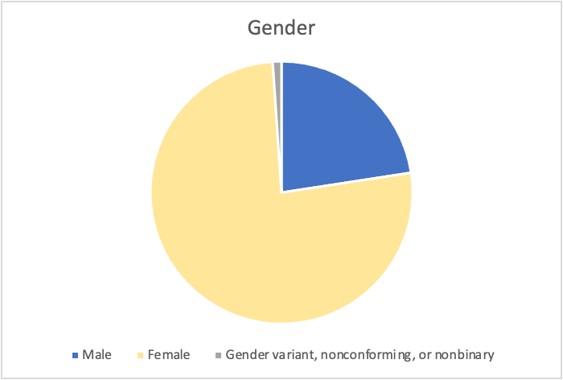
Method - Participants

Slide 12
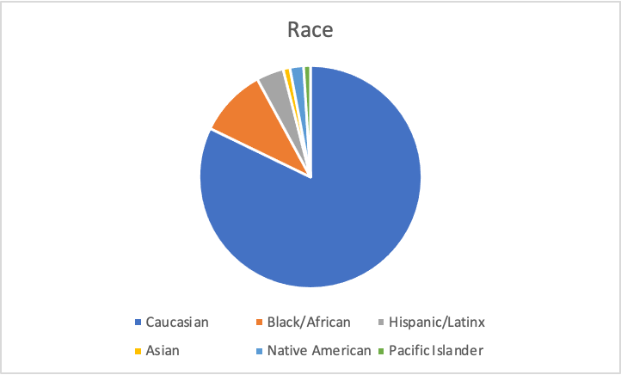
Method - Participants

Slide 13
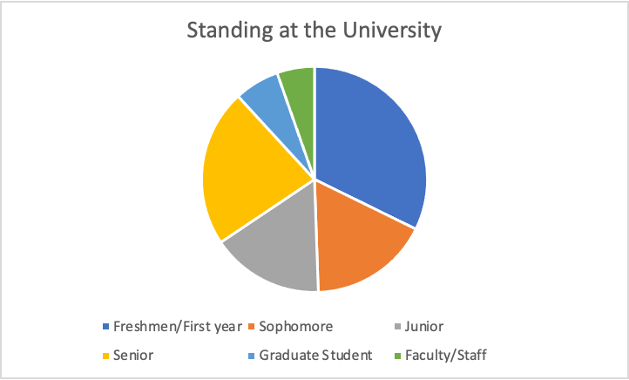
Method - Participants

Slide 14
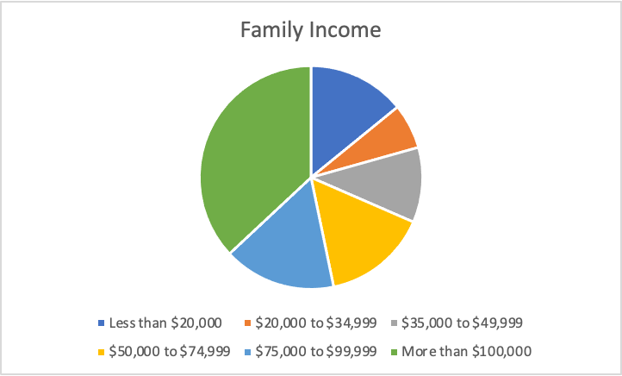
Method - Participants

Slide 15
Method - Measures
Victimization status
Reported victimization experience
Sexual assault/rape: 44.1%
Other crime: 16.1%
Burglary, robbery, interpersonal/domestic violence, and physical assault
Nonvictim: 39.8%
Notes:
Victimization status was measured by asking participants to report their victimization experience for 5 crimes, and they were placed into groups based on their answers

Slide 16
Method - Measures
Age at the time of victimization
Reported age when victimization was experienced
Child (0-9): 42.6%
Adolescent (10-18): 40.7%
Adult (18+): 16.7%
Notes:
Age at the time of victimization was measured by asking participants to report how old they were when they experienced their victimization, and they were placed into groups based on their answers. If participants provided multiple ages, they were placed in the group that corresponded with the youngest age they provided

Slide 17
Method - Measures
Depression and suicidal ideation
Patient Health Questionnaire (Kroenke et al., 2001)
Measuring symptoms of depression and suicidal ideation
“Little interest or pleasure in doing things”
“Feeling tired or having little energy”
Likert Scale: 0 (not at all) to 3 (nearly every day)
Internal consistency: α= .89

Slide 18
Method - Measures
Anxiety
Beck Anxiety Inventory (Beck et al., 1988)
Measuring severity of symptoms of anxiety
“Numbness or tingling”
“Fear of worst happening”
Likert Scale: 0 (not at all) to 3 (severely - it bothering me a lot)
Internal consistency: α= .95

Slide 19
Method - Measures
PTSD
Posttraumatic Stress Disorder Checklist for the DSM-5 (Blevins et al., 2015)
Measuring severity of symptoms of PTSD
“Feeling jumpy or easily startled”
“Feeling distant or cut off from other people”
Likert Scale: 0 (not at all) to 4 (extremely)
Internal consistency: α= .96

Slide 20
Method - Measures
Eating disorders
Eating Attitudes Test (Garner et al., 1982)
Measuring symptoms of disordered eating
“I am terrified of being overweight”
“I take longer than others to eat my meals”
Likert Scale: 0 (never) to 5 (always)
Internal consistency: α= .90

Slide 21
Method - Procedure
Recruited via email
Required to be 18
Selected to agree with informed consent
Demographic information
Victimization status and age
Depression and suicidal ideation scale
Anxiety scale
PTSD scale
Eating disorders scale
Notes:
At the end, if applicable, students were sent to another form to receive class credit for participation

Slide 22
Results - Victimization Status
Depression and suicidal ideation
Multivariate ANOVA: no significant difference
H1 not supported
F(2, 90)= 1.59, p= .211, η² = .03
Notes:
There were no significant differences found for victimization status for depression and suicidal ideation between any of the groups

Slide 23
Results - Victimization Status
Anxiety
Multivariate ANOVA: significant difference
H1 partially supported
F(2, 90)= 4.04, p= .021, η² = .08
Notes:
There was significant difference found between the sexual assault/rape group and the nonvictim group for anxiety

Slide 24
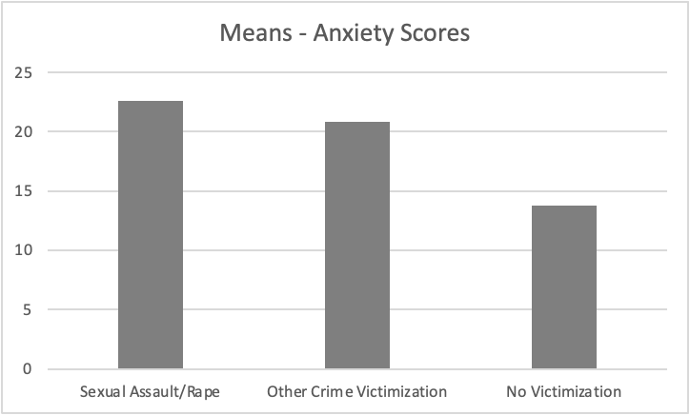

Slide 25
Results - Victimization Status
PTSD
Multivariate ANOVA: significant difference
H1 partially supported
F(2, 90)= 8.24, p< .001, η² = .16
Notes:
There was significant difference found between the sexual assault/rape group and the nonvictim group for PTSD. There was also a significant difference found between the other crime victimization group and the nonvictim group for PTSD

Slide 26
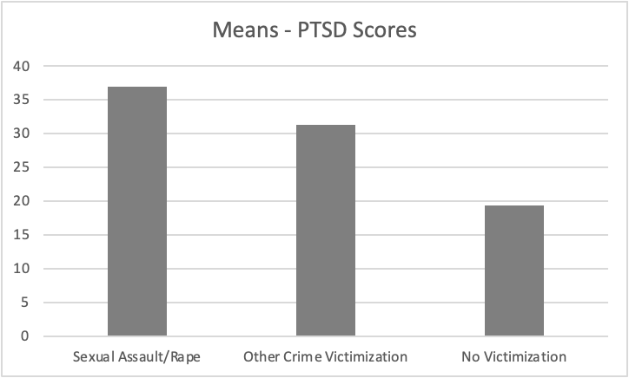

Slide 27
Results - Victimization Status
Eating disorders
Multivariate ANOVA: no significant difference
H1 not supported
F(2, 90) = .12, p= .884, η² = .003
Notes:
There were no significant differences found for victimization status for eating disorders between any of the groups

Slide 28
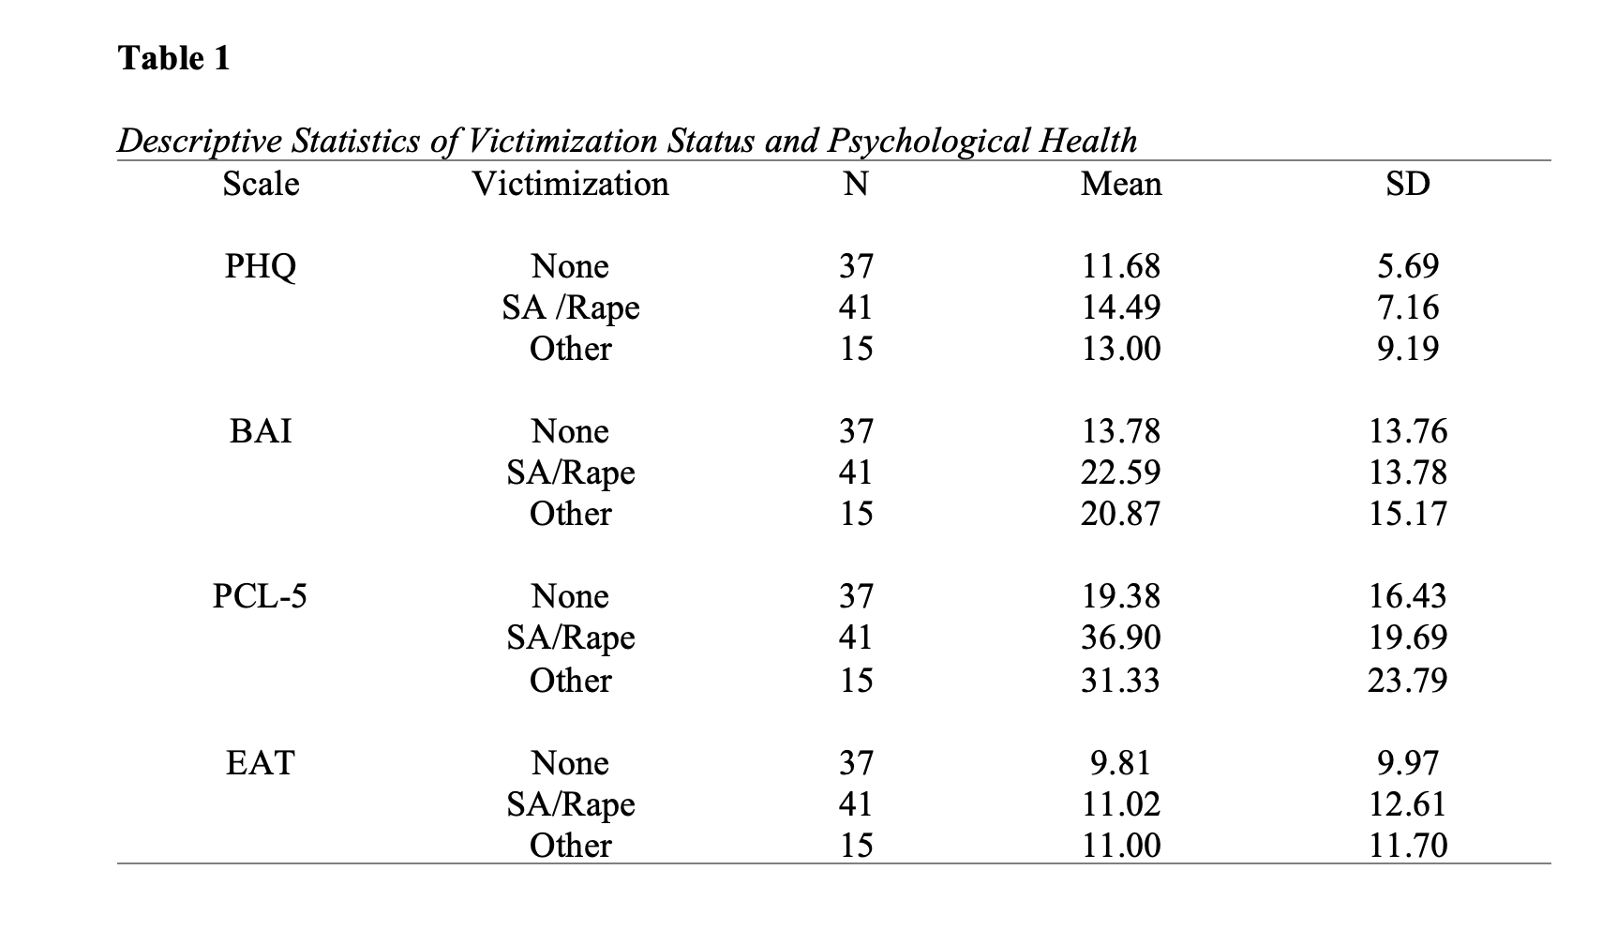

Slide 29
Results - Age at the time of Victimization
One Way ANOVA: no significant differences
Depression and SI: F(2, 51)= 2.56, p= .087, η² = .09
Anxiety: F(2, 51)= 1.98, p= .148, η² = .07
PTSD: F(2, 51)= 1.34, p= .271, η² = .05
Eating disorders: F(2, 51)= .753, p= .476, η² = .03
H2 not supported
Notes:
There were no significant differences found for age for any of the areas of psychological well-being that were studied between any of the groups, meaning that age was not a significant factor in the scores of those who had been victimized

Slide 30
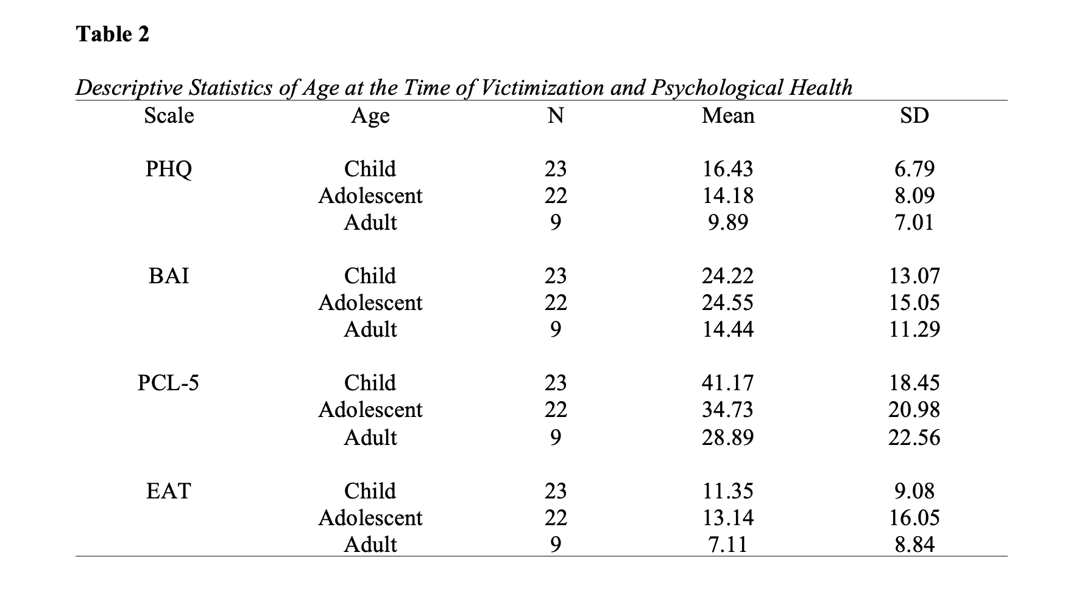

Slide 31
Discussion
H1: partially supported
Sexual assault/rape vs. nonvictims in anxiety and PTSD
Other crime vs. nonvictims in PTSD
H2: not supported
All age groups had similar levels of psychological well-being
Notes:
The first hypothesis was partially supported. Those who had experienced a sexual assault or rape had higher scores on both the anxiety and PTSD scales than nonvictims, and those who experienced a different crime victimization had higher scores on the PTSD scale than nonvictims. The scores between the SA/rape group and the other crime victimization group were similar for psychological well-being, and depression/suicidal ideation and eating disorder scores were similar regardless of victimization status
The 2nd hypothesis was not supported by the results. There were similar scores for psychological well-being across all the age groups

Slide 32
Discussion
Victimization status
Nature of sexual assault/rape
Nature of crime in general
“Shadows of sexual assault” (Ferraro, 1996; Hilinksi, 2009)
Types of disorders

Slide 33
Discussion
Age at the time of victimization
Plasticity of the brain
Neural development
Ability to cope
Memory
Forming
Trauma-induced amnesia

Slide 34
Discussion - Limitations
Participants studied
Convenience sample
Cannot be generalized
Correlational results
No causation
Third-variable problem
Possible other factors

Slide 35
Discussion - Future Research
Individual comparison of crimes
Controlling for confounding variables
Reporting crime
Seeking counseling
Examining victimized children
Measuring psychological well-being while they are still children, not as adults

Slide 36
Discussion - Implications and Applications
Influence of victimization on mental health
Sufficiency
Stress vs. mood disorders
Educating criminal justice agencies
Special training for counselors
Victims
Age

Slide 37
Acknowledgements
Thank you to Dr. Marciano, Dr. Cylke, and Dr. Kicklighter for endless support throughout the past year as I have worked on and completed this project!

Slide 38
Questions?

