Slide 1
University of Lynchburg
Evaluation of Concussion Assesment Tools for Collegiate Athletes
Jacqueline Villanueva Arevalo
Health Promotion

Slide 2
Research Question
What is the most effective diagnostic concussion assessment tool for collegiate athletes to reduce concussion misdiagnosis and vestibular ocular-motor complications?

Slide 3
Background
Due to the increase in sports-related concussions in the United States, there is a rising concern about concussion assessments in collegiate athletes concerning long-term vestibular and ocular motor dysfunction and post-concussion syndrome.
1.8-3.8 million sport-related concussions occur annually

Slide 4
Central Connections
brain stem
cerebellum
central cortex
visual systems
postural muscles
Peripheral
sensory organs
The Vestibular System
Vestibulo-ocular System Function:
visual stability during head movements
Vestibulo-spinal System Function:
postural control

Slide 5
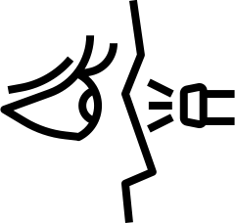
smooth pursuits
horizontal saccades
near point convergence
distance horizontal vestibular ocularmotor reflexes (VOR)
distance vertical VOR
visual motion sensitivity
Vestibular Oculomotor Screening (VOMS)
Notes:
How: Physical Assessment symptoms scale 0-10
headache
dizziness
nausea
fogginess

Slide 6
saccadic eye movements
oculomotor visual performance
The King Devick Test (KD)
Notes:
How: Physical Assessment Speed of rapid number reading
processing
speed
visual tracking

Slide 7
baseline symptom self-report
neurological screening
cognitive screening
delay recall
balance examination
Sport Concussion Assessment Tool 5 (SCAT-5)
Notes:
How: Self Reported
On and off field assessment

Slide 8
Methods
Exclusion Criteria
full text unavailable
did not include college athletes
VOMS, King Devick, or SCAT 5 assessments
not a sport-related concussion
athletes under 18 years of age
not peer-reviewed
Published before 2018
Knested Knowledge Software
PubMed
Europe PubMed Central
Clinical Trials.gov
Key Terms
Combination of "King Devick," "Concussion," "Athletes," "Vestibular and Oculomotor Reflexes," and "SCAT 5"

Slide 9
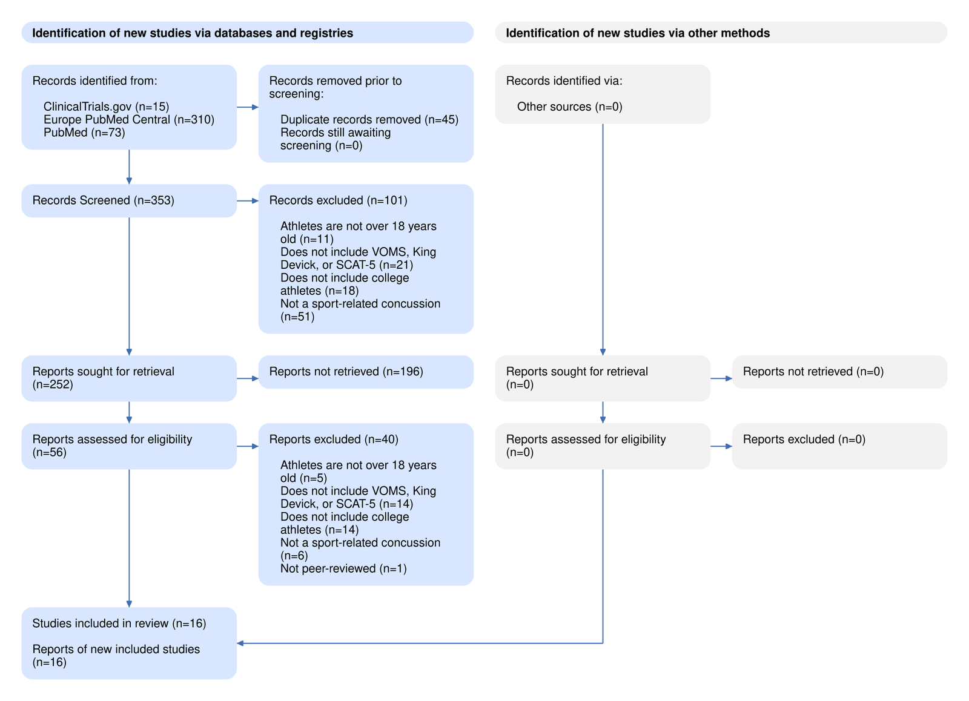
Results:
PRISMA

Slide 10
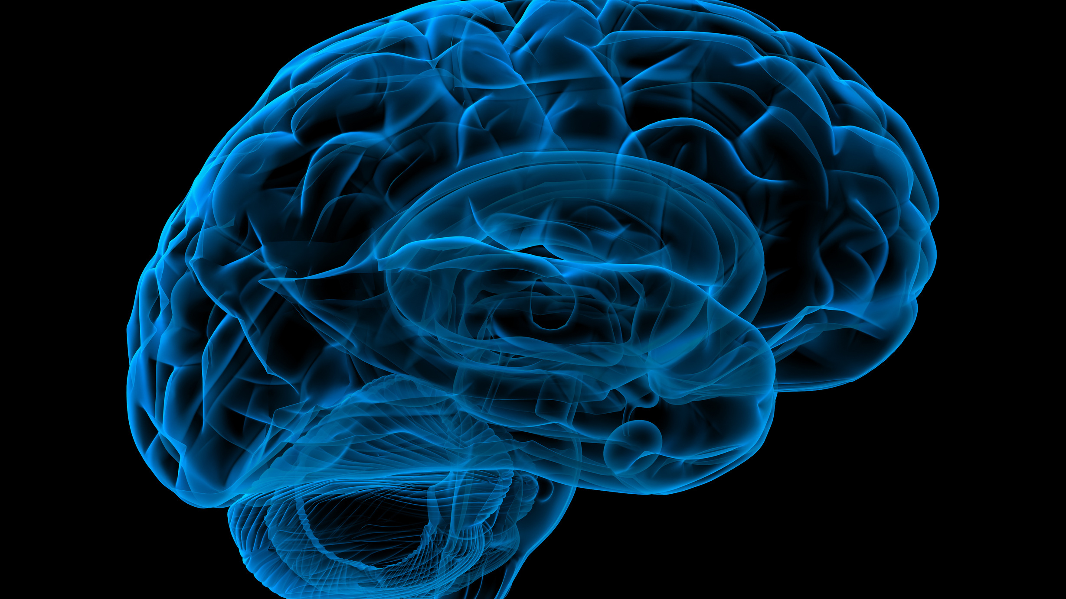
Conclusion:
VOMS
Concussion Assessment Tools
King Devick
SCAT-5
Notes:
The King Devick, Screening Concussion Assessment Tool (SCAT-5), and the Vestibular Ocular-Motor Screening Tool (VOMS) should not be used independently. Concussion assessment tools like the SCAT-5 and King Devick should be used in conjunction with the VOMS to limit the probability of misdiagnosing concussion and failure to identify vestibular ocular-motor dysfunction.

Slide 11
Questions?
Thank You!
Dr. Rebekkah McLellan
Jacqueline Villanueva Arevalo
University of Lynchburg

