Slide 1
Recognizing Traps and Frightening Wolves:
Foxes and Lions as a Representative of Machiavellian Political Ideology in Shakespeare’s Comedies
Grace Audrey Powell

Slide 2
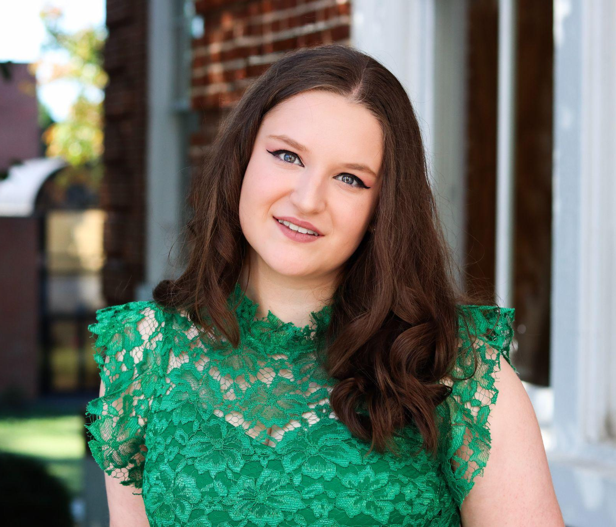
Introduction
Grace A. Powell
English Major | History & Theatre Minors
Committee:
Robin Bates, PhD (Thesis Director)
Beth Savage, PhD (Westover Representative)
Chidsey Dickson, PhD
Why this project?
- Shakespeare II – Comedies (w/ Dr. Bates)
- Animalistic Symbolism

Slide 3
table of contents
01.
02.
03.
04.
05.
06.
Background
Methodology
Literature
Review
Results
Discussion
Acknowledgements

Slide 4
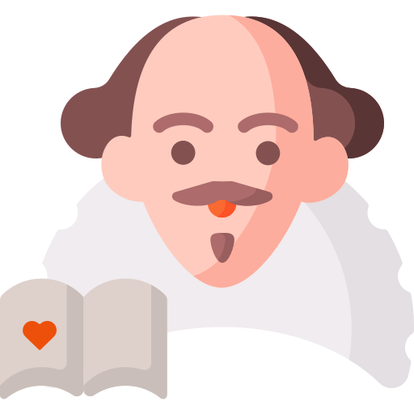
Background
Saturnalian Pattern
Chaos : Leadership and Familial Dynamics
Anarchical, archaic, or extremist
English & Italian Relations
Machiavelli’s Brutal Prince
(Lion and Fox)

Slide 5
—Niccolò Machiavelli
The Prince
“[A leader] must be a fox in order to recognize traps, and a lion to frighten off wolves.”

Slide 6
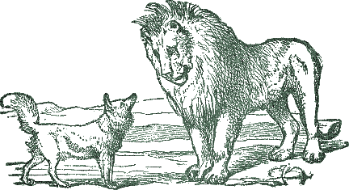
Research Question
What is the historical significance of Niccolò Machiavelli’s The Prince on William Shakespeare’s Comedies, and how is this political ideology reflected in the literary appearance of
lions and foxes?

Slide 7
Methodology
Keywords
Lion
Mane
Fox
Vulpine
Vulpes
Reynard
Initial
Reading
Historical Connections

Slide 8
Literature
Review

Slide 9
Beastly Symbolism
Popularity of folktales and fables with animal characters throughout Europe
Early Fox Symbolism (Chadwick 72-74)
Aesop’s Fables: “The Hare and the Tortoise,” “The Wolf in Sheep’s Clothing,” “Belling the Cat,” and “The Fox and the Crow”
Renard/Reynard the Fox – series of anthropomorphic tales
Early Lion Symbolism (Harris 188-207)
Four Categories: Threatening, Christian, Noble, or Sinful
Shakespeare and Animal Studies (Raber 295)
Used to symbolize power struggles or rightful nobility
Machiavelli’s Natural Politics (Marshal et al. 20)
Leonine force: roar has friend- and enemy-coded meanings
Vulpine fraud: especially Machiavellian; gratification earned from interpersonal interactions rather than personal social gain
Notes:
Nigel Harris closely examines its portrayal in medieval Western Europe, laying out four different categories in which the appearance of or comparison to a lion would fall into: Threatening, in that they are dangerous, bloodthirsty, and foretelling of disaster; Christian, in that they are often connected to either Christ or the Devil directly; Noble, in that they are related to chivalry, kings, and high placement in the social order; or Sinful, in that they are traited with siding with the Devil and even representing the sin of pride in Dante’s Inferno (188-207)

Slide 10
Political Europe
16th-17th Century: Italy and England are not friends
Machiavellianism (Barlow 636)
Borrowed symbols from Cicero; originally used to exemplify how “the methods of the beasts are foreign to humanity”
“The ends justify the means” – seen as brutal, severe Italianism
Machiavellian Hero (Cro 57, 60-61; Keefton 312-333)
Dramatic portrayals of historical figures – Machiavelli with Cesare Borgia, Sir Thomas More and Shakespeare with Richard III
English: Against radical or extreme leadership changes; exaggerate deformities to highlight immorality
Italian: Justified deceit when it provides for stronger state
Notes:
With the Renaissance marking a transformation and revival of ideas, art, literature, and the like, the two most prominent nations of the time – Italy and England – served as major focal points for European development. However, amidst power struggles between church and state and England’s eventual split from the Catholic Church under Henry VIII’s rule, it is not all that unexpected that the relationship between Italy and England was quite a strained one. Therefore, it should be equally unexpected that much of the literature of the era displays an animosity between Italy and England; in fact, much of Shakespeare’s writing was geared towards criticizing and tearing down the works of Italians like Francesco Petrarca and Niccolò Machiavelli. This is also why many of Shakespeare’s plays are centered in Italian cities like Verona, Venice, and Florence, in which power struggles and clashing families are often at the forefront of the conflict and therefore serve as political commentary.

Slide 11
Shakespeare’s Political Understanding
Political Representation in Dramatic Literature
Inaccurate depictions of historical figures; used as a space for Englishmen to discuss political thought (Keefton 225-247)
Landscape of Shakespeare’s England
Tudor/Elizabethan & Jacobean Eras: Modern vs. Archaic, seen in Midsummer Night’s Dream (Tennenhouse 109-128)
Often uses English monarchy as the best government; ultimate goal of unification and purification (Jaffa 113-138)
Power Struggles: Inconstant, seductive, abusive, and immoral power; difficult to balance perfectly (Whitney & Packer 23-54)
Notes:
Tennenhouse, for instance, uses A Midsummer Night’s Dream as an example of a romantic comedy that shows this, discussing how the law at the beginning of the play is archaic and primarily serves Hermia’s father, Egeus, who wants an arranged marriage for his daughter instead of allowing her to marry for love. As Tennenhouse proves, the only comedic resolutions can come from independence from the law or generosity/change of heart from the father.
Jaffa – In King Lear, we are presented with a leader who is commanding and has a legacy in the unification of Britain. However, in his old age, he is tasked with the issue of his succession and the transference of power.

Slide 12
Linking Machiavelli to Shakespeare
The Anti-Machiavel
Richard III – Downfall of the Machiavellian Hero (Keefton 312-333)
Same characteristics of a Machiavel but used for “some common good rather than material self-interest” (Ringwood 40)
Ex: Brutus in Julius Caesar (Whitney & Packer 164-184)
Machiavellian Beasts
Lions: “symbol of kingship and absolute power” (Percec & Şerban 177)
Brutus – strength and slyness (Whitney & Packer 164-184)

Slide 13
Research
Results

Slide 14
Findings
Lions | Foxes
All's Well That Ends Well – Helena (1.1. 80) All's Well That Ends Well – Helena (3.2. 1509) As You Like It – Oliver and Rosalind (4.3) As You Like It – Rosalind (5.2. 2269) Love's Labour Lost – Boyet (4.1. 1034) Love's Labour's Lost – Costard (5.2. 2515) Love's Labour's Lost – Biron (5.2. 2565) Measure for Measure – Vincentio (1.3. 309) Measure for Measure – Lucio (1.4. 403) Merchant of Venice – Prince of Morocco (2.1. 537) Merchant of Venice – Jessica (5.1. 2450) Midsummer Night's Dream – Quince, Snug, Bottom(1.2.) Midsummer Night's Dream – Oberon(2.1. 550) Midsummer Night's Dream – Snout, Bottom (3.1.) Midsummer Night's Dream – Bottom (4.2. 1815) Midsummer Night's Dream – Quince(5.1. 1970) Midsummer Night's Dream – Theseus, Demetrius – 5.1. 1996 Midsummer Night's Dream – Theseus (to Hippolyta) (5.1. 2059) Midsummer Night's Dream – Snug [as Lion] (5.1. 2063) Midsummer Night's Dream – Lysander (5.1. 2073) Midsummer Night's Dream – Bottom [as Pyramus] (5.1. 2133) Midsummer Night's Dream – Puck(5.1. 2220) Much Ado About Nothing – Messenger (1.1. 11) Taming of the Shrew – Petruchio (1.2. 748) The Tempest – Sebastian, Antonio(2.1. 1057) Twelfth Night – Olivia (3.1. 1363) Two Gentlemen of Verona – Speed (2.1. 416) Two Gentlemen of Verona – Silvia (5.4. 2182) | All's Well That Ends Well – Lafeu (2.1. 670) All's Well That Ends Well – First Lord (3.6. 1826) Love’s Labour’s Lost – Don Adriano de Armado, Moth (3.1. 843) Measure for Measure – Pompey (3.2. 1518) Measure for Measure – Vincentio (5.1. 2713) Merry Wives of Windsor – Ford (3.3. 1548) Midsummer Night's Dream – Lysander, Demetrius, Theseus (5.1. 2073) Much Ado About Nothing – Claudio (2.3. 856) Taming of the Shrew – Gremio (2.1. 1252) Twelfth Night – Feste (1.5. 367) Twelfth Night – Fabian (2.5. 1147) Two Gentlemen of Verona – Julia (4.4. 1929)
Lions: 28
Some physical, some metaphorical
Foxes: 12
All metaphorical
Duology of Symbols – Midsummer Night’s Dream
“This lion is a very fox for his valour.” – Lysander, 5.1. 2173

Slide 15
Discussion

Slide 16
Lions
Positives: Courage, Bravery, and Power
Negatives: Poor Leadership and Chaos
Presence often indicates a power struggle
Physical Appearances
As You Like It
Tempest
Midsummer Night’s Dream
Notes:
Often points out a power struggle, even though it may not even try to rectify it
The lion is not there to fix, the lion is there to point – figurehead
As You Like It: Oliver and Orlando – brothers at odds, Oliver is duke and turns his brother away but Orlando saves him from a lioness attack, ultimately ending the familial and political struggle between them
Tempest: Stephano and Trinculo – faking a lion attack as a pretext for having swords drawn to assassinate king
Midsummer Night’s Dream: Lion (played by Snug in Mechanics Play); mocked, satirical, unbefitting of ‘lion’ symbol, but performed in front of Duke Theseus after his wedding to Hippolyta (Queen of the Amazons) because of a treaty to end a war; also proceeding the fight between Oberon and Titania

Slide 17
Foxes
Negatives: Cunning, Trickery, Dishonest
Heavily connected to and reliant upon Machiavellianism
Physical Appearances: None
Traited with sleazy, disloyal cowards
Taming of the Shrew
“An old Italian fox is not so kind, my boy.” – Gremio (2.1. 1252)
Notes:
All's Well That Ends Well: Parolles is a fox; The French Lords all believe that Parolles is a boastful and disloyal coward and wish to expose this to Bertram, who believes him to be a friend.
Two Gentlemen of Verona: Julia calls herself “A fox to be the shepherd of thy lambs” – had once been Proteus' lover, but upon arriving in the court of the Duke of Milan disguised as a man, she found that he is now attempting to court Valentine's lover, Silvia. Proteus speaks to the disguised Julia not knowing her real identity and asks 'him' to deliver a ring and letter to Silvia that tells his intentions.

Slide 18
Machiavellianism
in Shakespeare
Machiavelli: Lion AND Fox
Shakespeare: Maybe Lion, NO Fox
Splits them in leadership values
Reaffirms anti-Machiavellianism
Midsummer Night’s Dream
“This lion is a very fox for his valour.”
– Lysander, 5.1. 2173
Antithesis of one another; lions are strong, foxes are sneaky cowards

Slide 19
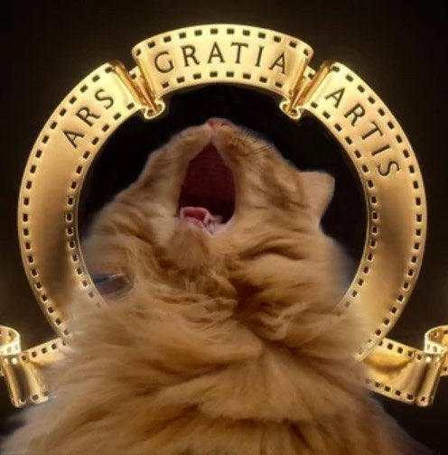
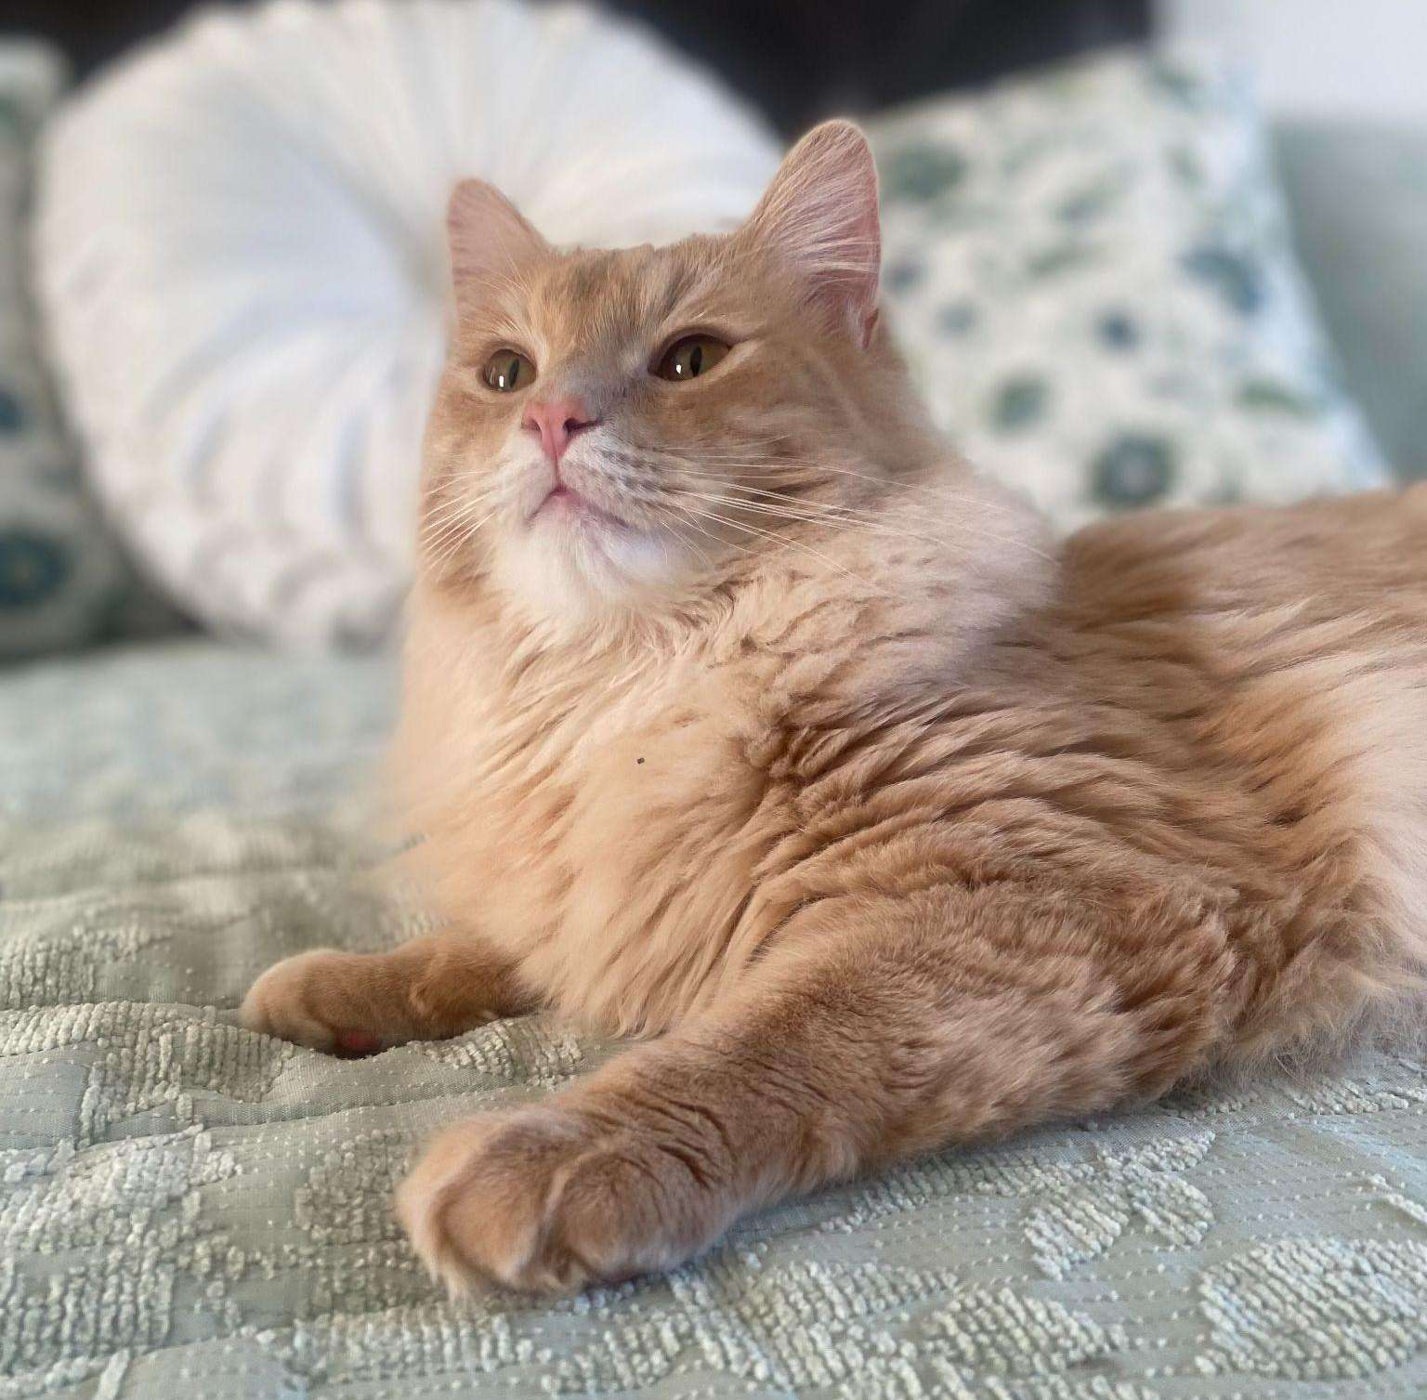
Acknowledgements
Committee:
Robin Bates, PhD (Thesis Director)
Beth Savage, PhD (Westover Representative)
Chidsey Dickson, PhD
Faculty:
University of Lynchburg’s English Department
Family:
Kelli and Steven Powell (Parents)
Devin and Walker (Decent Brothers)
Friends:
Ally, Rylee, Bex, Luthi, Gillian, and the SJB Family
Pets:
Sapphire, Onyx, Apollo (Baby Lion), and Hugo (Baby Fox)

Slide 20
Works Cited
Barlow, J. J. “The Fox and the Lion: Machiavelli Replies to Cicero.” History of Political Thought, vol. 20, no. 4, 1999, pp. 627–45. JSTOR, http://www.jstor.org/stable/26219664. Accessed 5 May 2023.
Chadwick, Joan V. “The Fox: A Medieval View, and Its Legacy in Modern Children's Literature.” Between the Species, vol. 10, 1993, pp. 71-75.
Cro, Stelio. “The Lion and the Fox: An Unholy Animal Kingdom.” Moreana, vol. 49, no. 189, 2012, pp. 55-70. ProQuest, https://lynchburg.idm.oclc.org/login?url=https://www.proquest.com/scholarly-journals/lion-fox-unholy-animal-kingdom/docview/1477572773/se-2.
Jaffa, Harry V. “The Limits of Politics: King Lear, Act I, scene i.” Shakespeare’s Politics. Basic Books, Inc., 1964, pp. 113-138.
Harris, Nigel. “The Lion in Medieval Western Europe: Toward an Interpretive History.” Traditio, vol. 76, 2021, pp. 185–213. DOI:10.1017/tdo.2021.5.
Keefton, George W. “Richard III: The Machiavellian Hero.” Shakespeare’s Legal and Political Background. Barnes & Noble, Inc., 1967, pp. 312-333.
—. “Shakespeare and the Political Thought of the Sixteenth Century.” Shakespeare’s Legal and Political Background. Barnes & Noble, Inc., 1967, pp. 225-247.
Machiavelli, Niccolò. “The Prince.” Three Renaissance classics: Machiavelli’s “The Prince”; More’s “Utopia”; and Castiglione's “The Courtier.” Scribner, 1953, pp. 65-68.
Marshall, Alasdair, et al. “The lion and fox animal spirits of Machiavelli and Pareto: A framework for studying organisational micro-politics.” Revue européenne des sciences sociales, vol. 58-1, no. 1, 2020, pp. 13-40.

Slide 21
Works Cited
Percec, Dana, and Şerban, Andreea. “Lions and She-Wolves: Kingship, Queenship and the Legitimacy of Power in Shakespeare’s Historical Plays.” Studia Universitatis Babes-Bolyai - Philologia, 2022, pp. 169–189. DOI:10.24193/subbphilo.2022.2.10
Raber, Karen. “Shakespeare and Animal Studies.” Literature Compass, vol. 12, no. 6, University of Mississippi, 2015, pp. 286-298, https://doi.org/10.1111/lic3.12235.
Ringwood, Frances. “Shakespeare's Mavericks and the Machiavellian Moment.” Shakespeare in Southern Africa, vol. 32, 2019, pp. 38-48. Gale Academic OneFile, http://dx.doi.org/10.4314/sisa.v32i1.5. Accessed 9 October 2023.
Tennenhouse, Leonard. “Strategies of State and political plays: A Midsummer Night’s Dream, Henry IV, Henry V, Henry VIII.” Political Shakespeare: Essays in Cultural Materialism, edited by Jonathan Dollimore & Alan Sinfield, 2nd ed., Manchester University Press, 1994, pp. 109-128.
Whitney, John O., and Packer, Tina. “Lend Me Your Ears.” Power Plays: Shakespeare’s Lessons in Leadership and Management. Simon & Schuster, 2000, pp.164-184.

Slide 22
Questions?

