Slide 1



Ain’t Gonna Let NOBODY Turn Me ’Round: My Story of the Making of Martin Luther King Day.
Author: Kathlyn J. Kirkwood
Illustrated by: Steffi Walthall
Presented by :Tristin Lucas

Slide 2
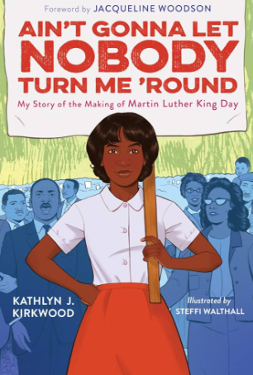
Book Talk
This book is a memoir about what is means to be an everyday activist and foot soldier for racial justice.
“This book is the perfect example of how history can help inform the present.”

Slide 3




NCSS Themes
VA SOL Standards
3.1 The student will demonstrate skills for historical thinking, geographical analysis, economic decision making, and responsible citizenship
3.11 The student will explain the responsibilities of a good citizen, with emphasis on
a) respecting and protecting the rights and property of others;
Time ,continuity and change
Individuals,groups,and institution
Civic ideas and practices

Slide 4
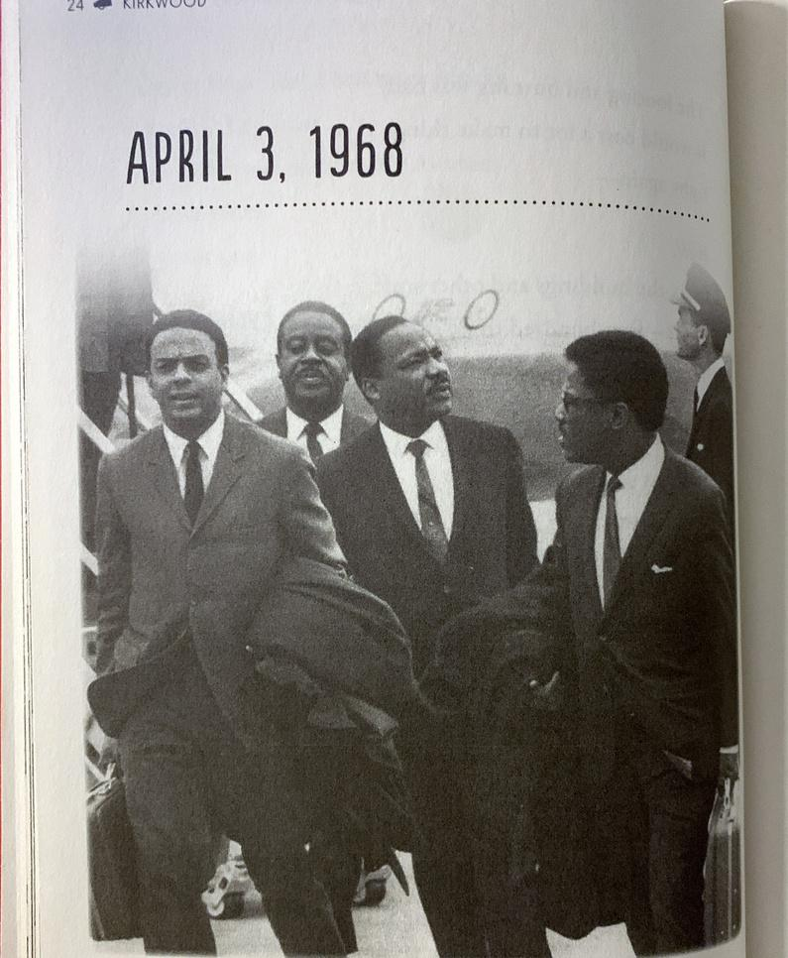
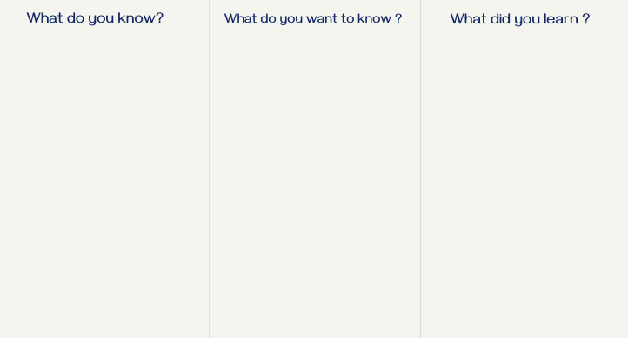

Lesson Ideas
Primary source analysis: See,Think ,Wonder
  Forces students to use their critical thinking skills to determine what the image is portraying
Research Activity :
  Have students work on a “KWL” worksheet
  This gives them the opportunity to research Martin Luther King jr before they read the book ( builds background knowledge)

